Slide 1
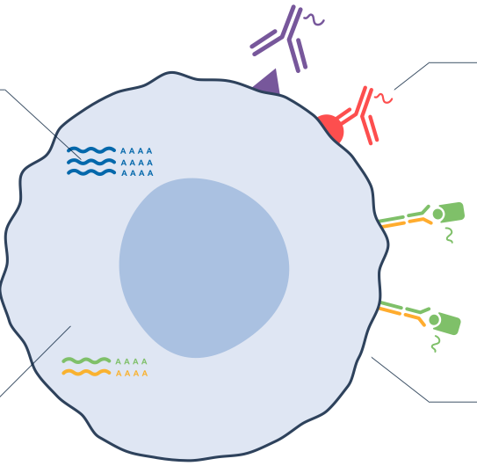
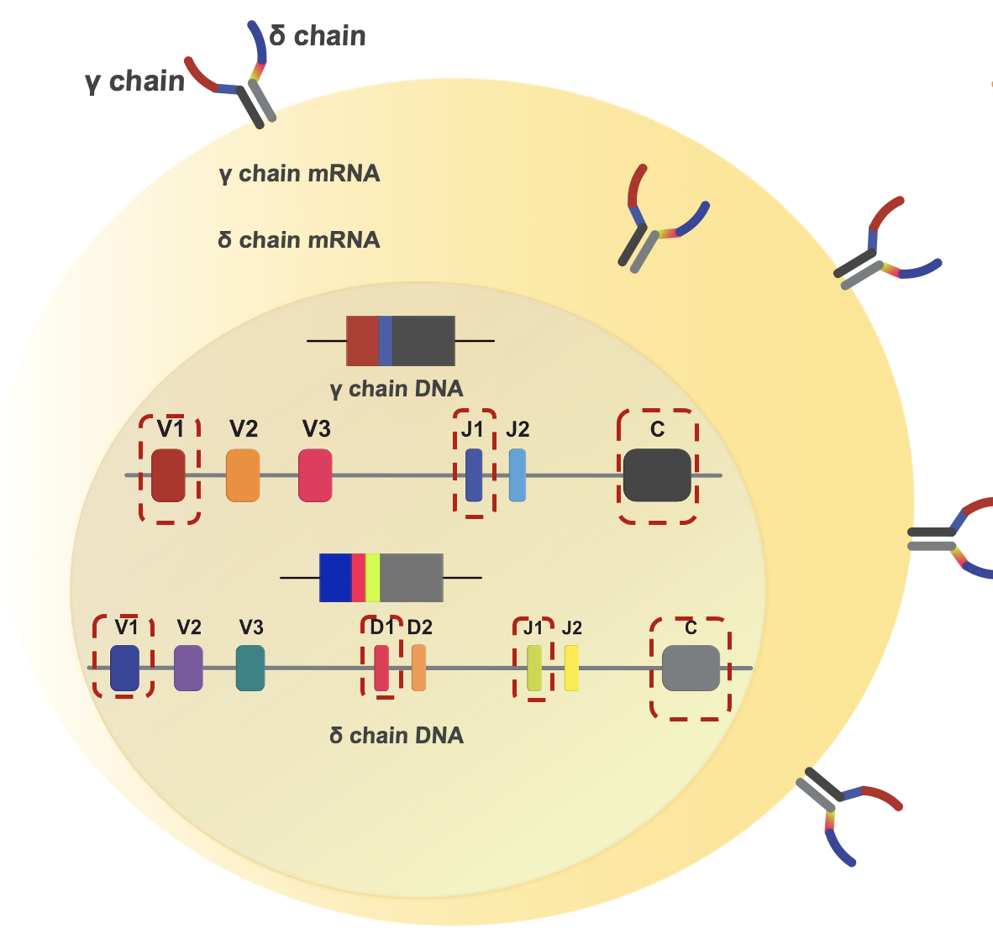
Objective:
Utilize a single-cell multi-omics approach to dissect the regulatory role of SLAM/SAP signaling on the development of specific innate-like γδ TCR clonotypes
Gene Expression (GEX)
Cell Surface Protein (CSP) Expression
TCR VDJ

Slide 2
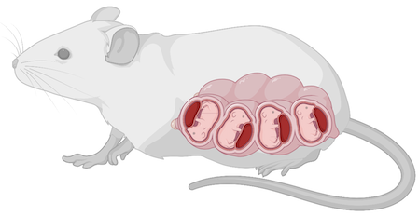



Experimental Design
B6
SAP KO
Thymus-1
Thymus-2
Thymus-3
Thymus-4
Thymus-1
Thymus-2
Thymus-3
Thymus-4
B6-1
B6-2
B6-3
B6-4
SAP-1
SAP-2
SAP-3
SAP-4

Slide 3
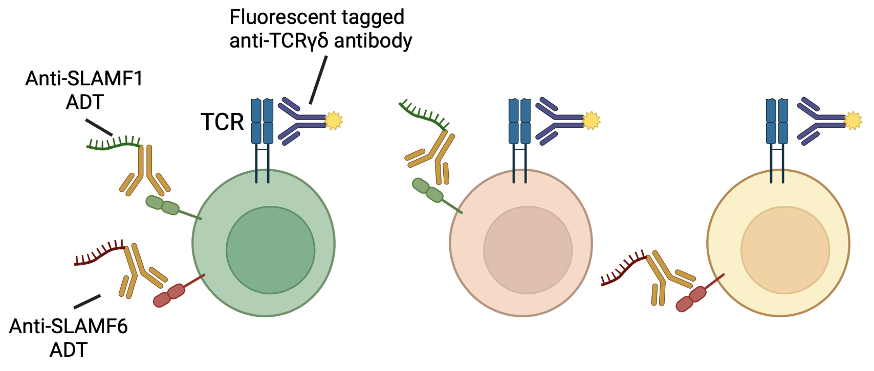
Experimental Design continued….
B6-1
B6-2
B6-3
B6-4
SAP-1
SAP-2
SAP-3
SAP-4
Staining all the cells with fluorescent tagged antibodies for FACS sorting of γδ T cells
+
Staining all the cells with Antibody Derived Tags (ADT), which are a specific type of antibody oligonucleotide conjugates (Totalseq-C, Biolegend) targeting cell surface protein expression of selected markers.

Slide 4


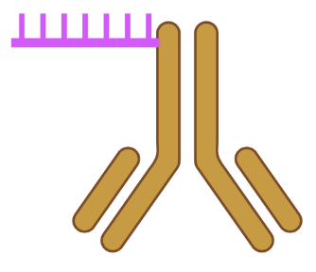
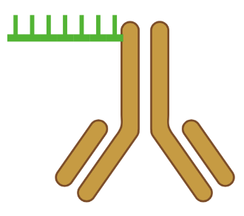



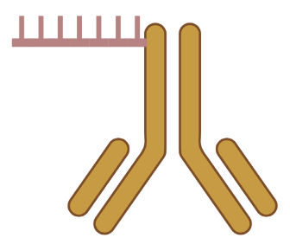
Experimental Design continued….
B6-1
B6-2
B6-3
B6-4
SAP-1
SAP-2
SAP-3
SAP-4
Staining cells from each sample separately with unique Hash Tag Oligonucleotide (HTO), which are a specific type of antibody oligonucleotide conjugates (Totalseq-C, Biolegend) targeting common cell surface markers such as CD45 and MHC class I.
Hashtag-1
Hashtag-2
Hashtag-3
Hashtag-4
Hashtag-5
Hashtag-6
Hashtag-7
Hashtag-8

Slide 5
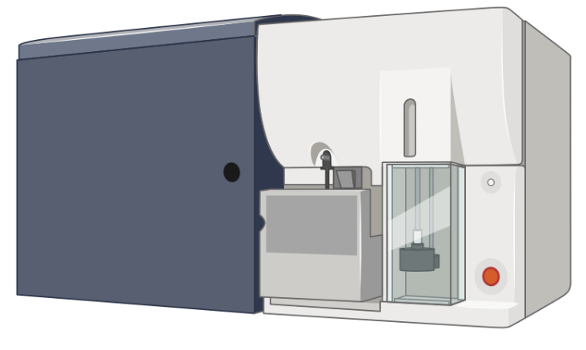
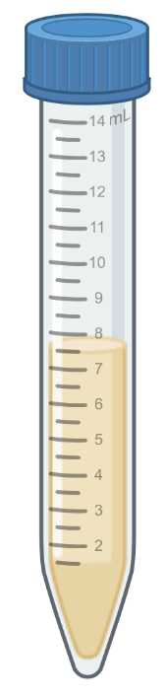
Experimental Design continued….
Hashtag-1
Hashtag-2
Hashtag-3
Hashtag-4
Hashtag-5
Hashtag-6
Hashtag-7
Hashtag-8
FACS of Live CD45⁺ CD11b⁻CD11c⁻CD19⁻TCRβ⁻ γδTCR⁺ cells
(Sort equal number of cells from each of the B6 samples into one B6 collection tube and sort equal number of cells from each of the SAP KO samples into one SAP KO collection tube)
B6
Collection
Tube
SAP KO
Collection
Tube

Slide 6
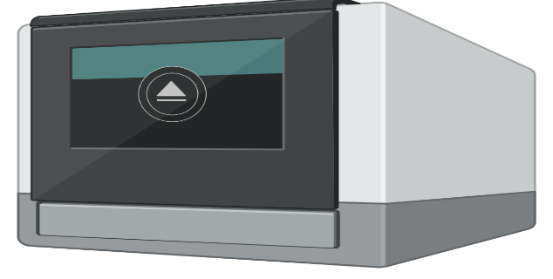
Experimental Design continued….
B6
Collection
Tube
SAP KO
Collection
Tube
Spin at 400 rcf for 10 mins (4⁰C)
Combine all the cells into one 1.5ml microcentrifuge tube
Resuspend and Count
Adjust concentration (if needed) and proceed to library preparation following 10X genomics kit protocols
As we are interested in single cell immune profiling, we need to use the Chromium Next GEM Single Cell 5' Reagent Kits (v1.1 or v2)

Slide 7
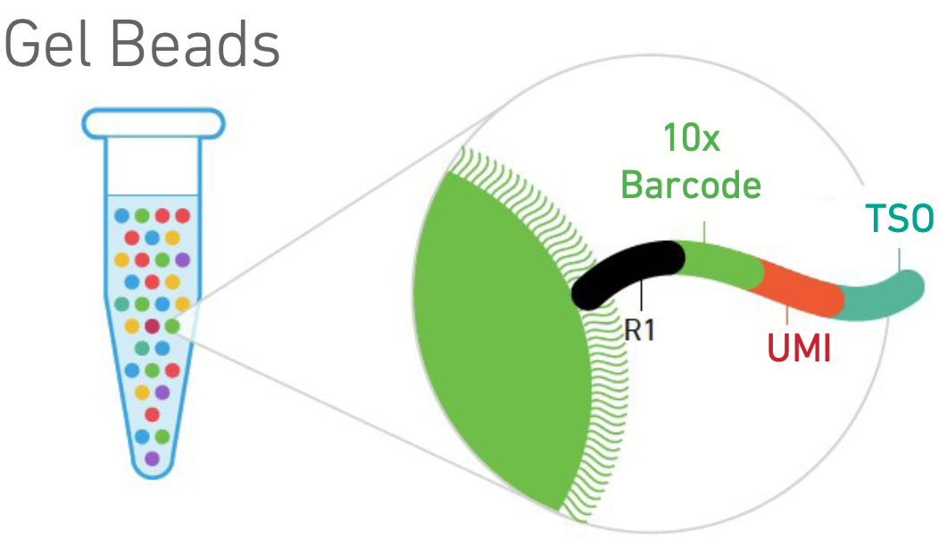
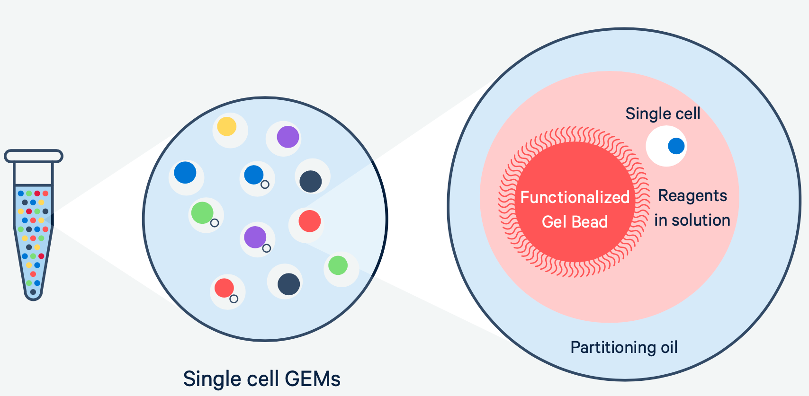
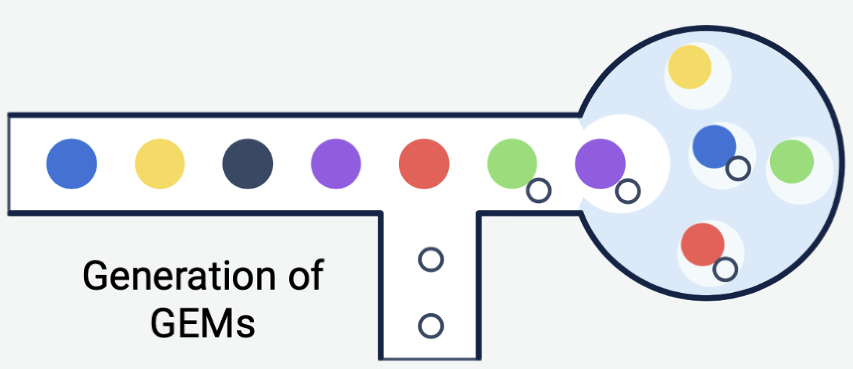
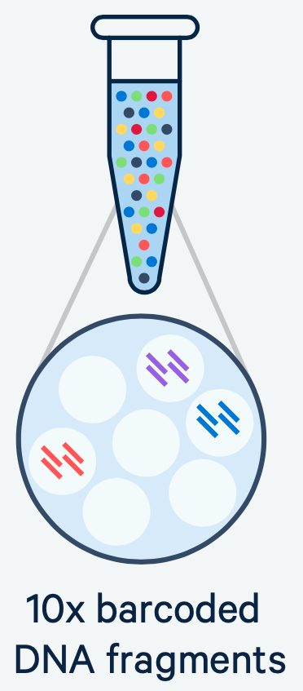
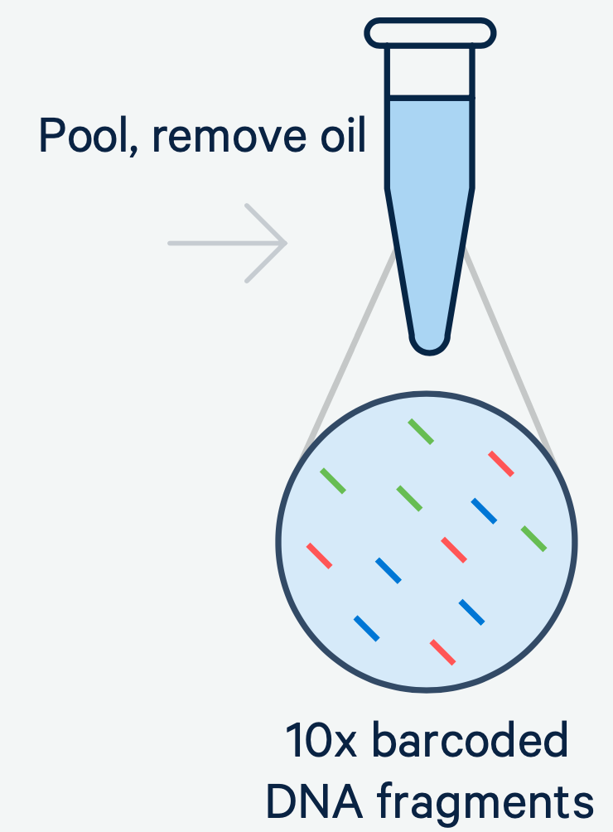
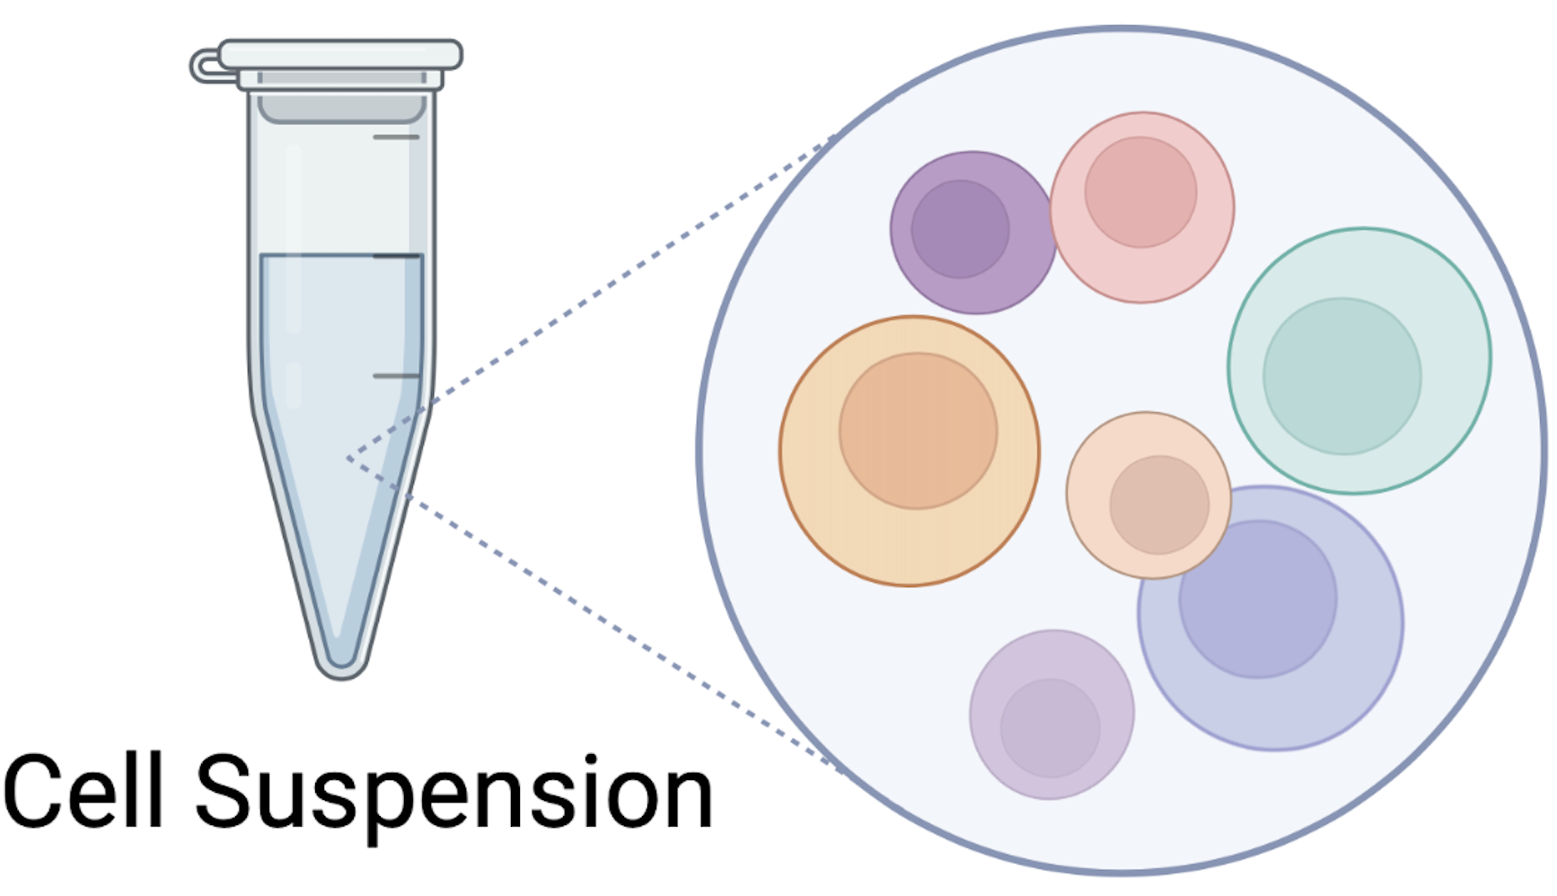
How it works: From cells to sequencing-ready libraries

Slide 8
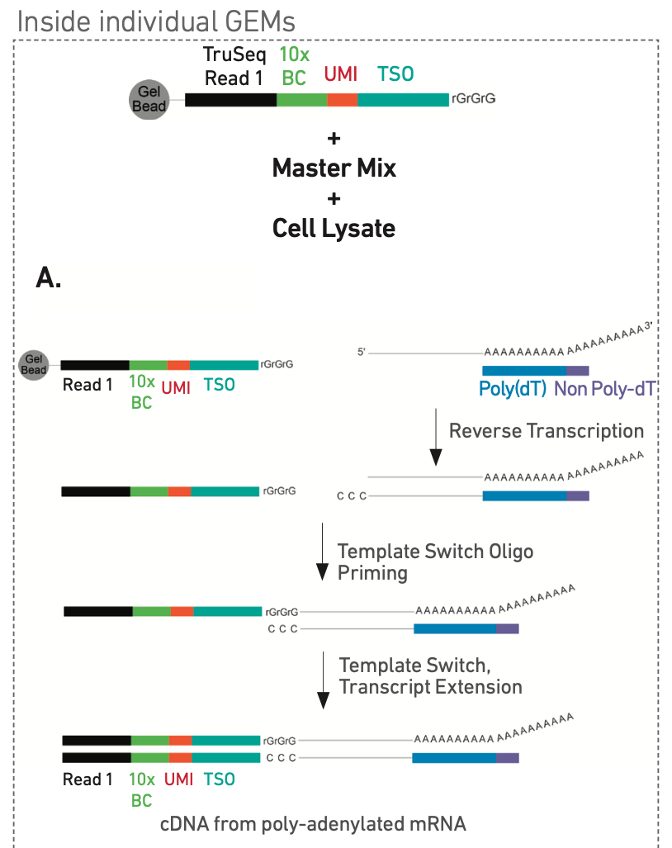
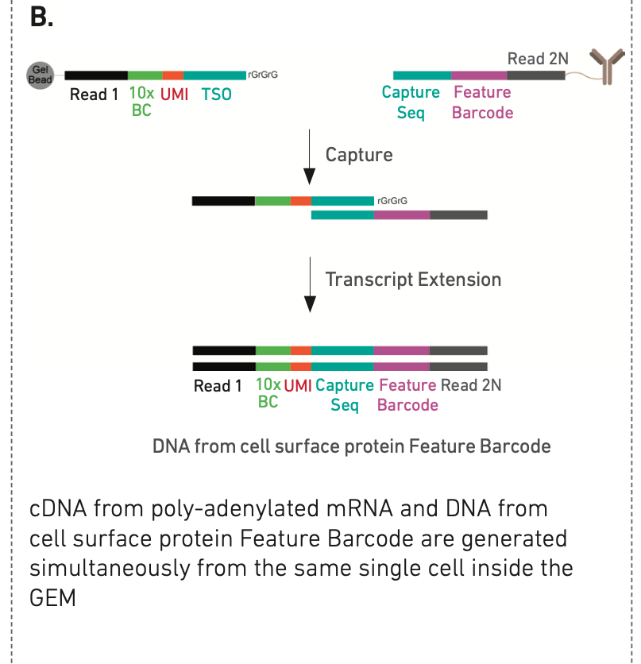
Step 1: GEM Generation and Barcoding
CSP
GEX and VDJ

Slide 9
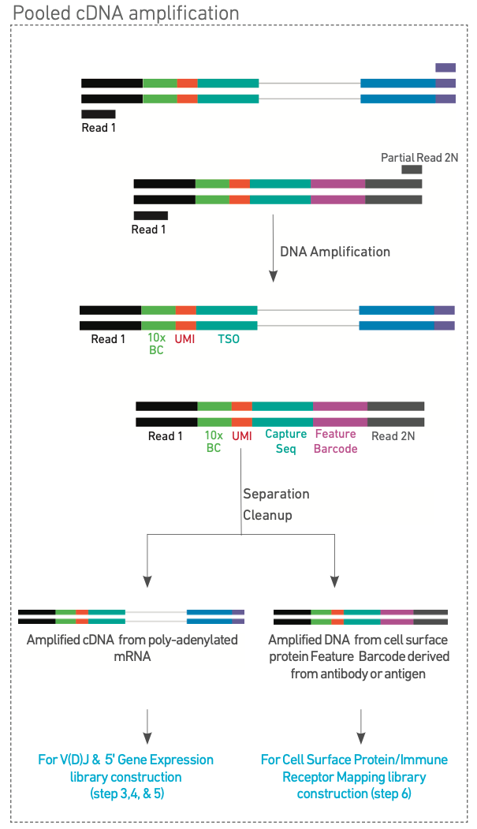
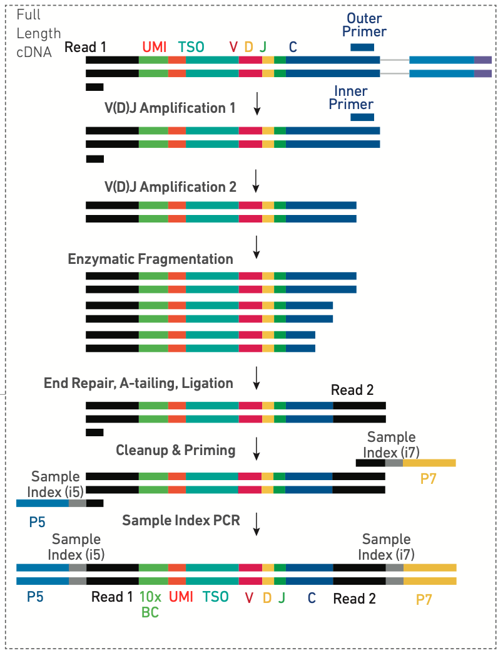
Step 2:Pooled cDNA amplification
Step 3: VDJ enrichment and Library Construction
GEX
CSP

Slide 10
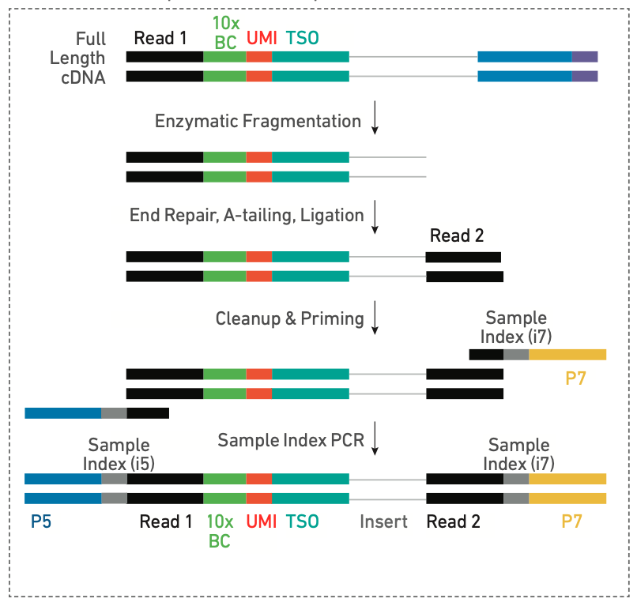
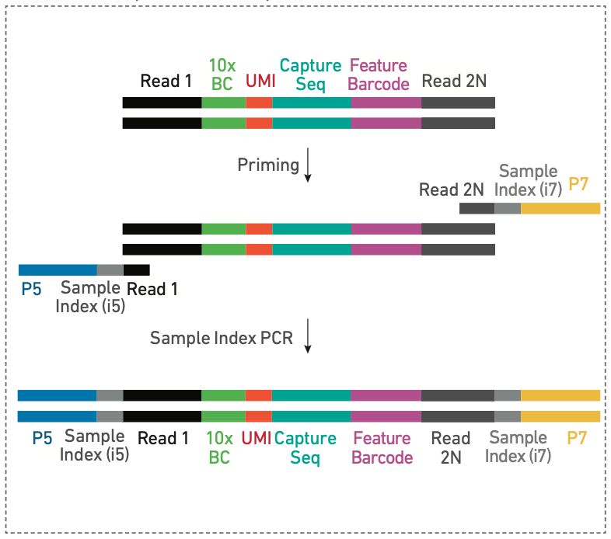
Step 4: 5ʹ Gene Expression (GEX) Library Construction
Step 5: 5ʹ Cell Surface Protein (CSP) Library Construction

Slide 11
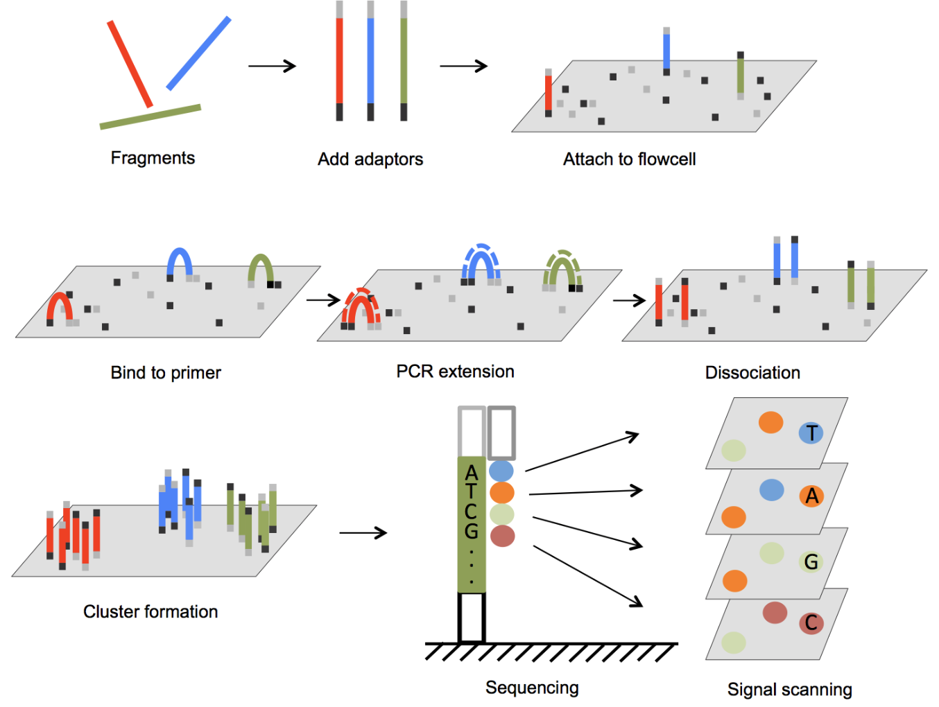
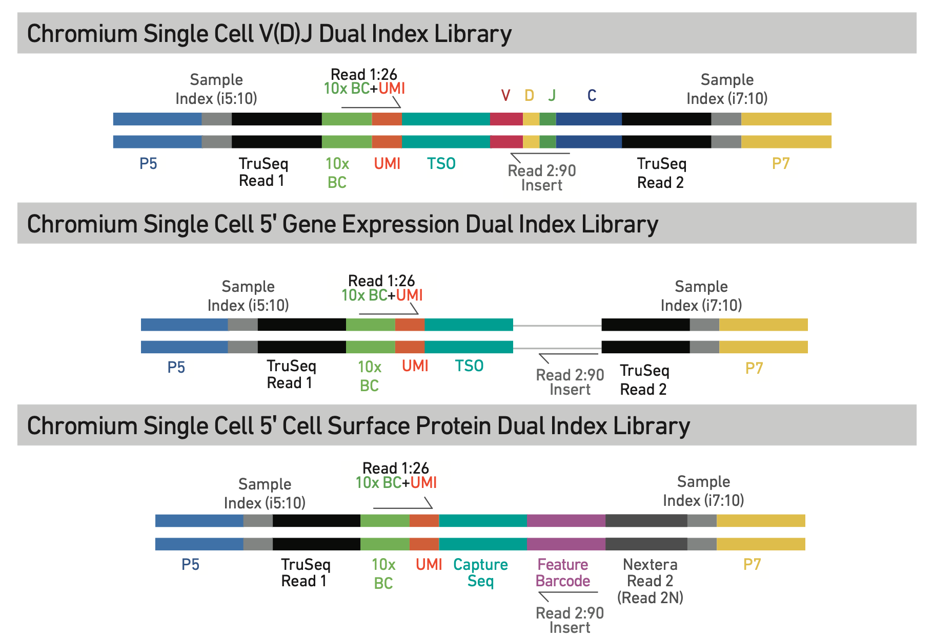
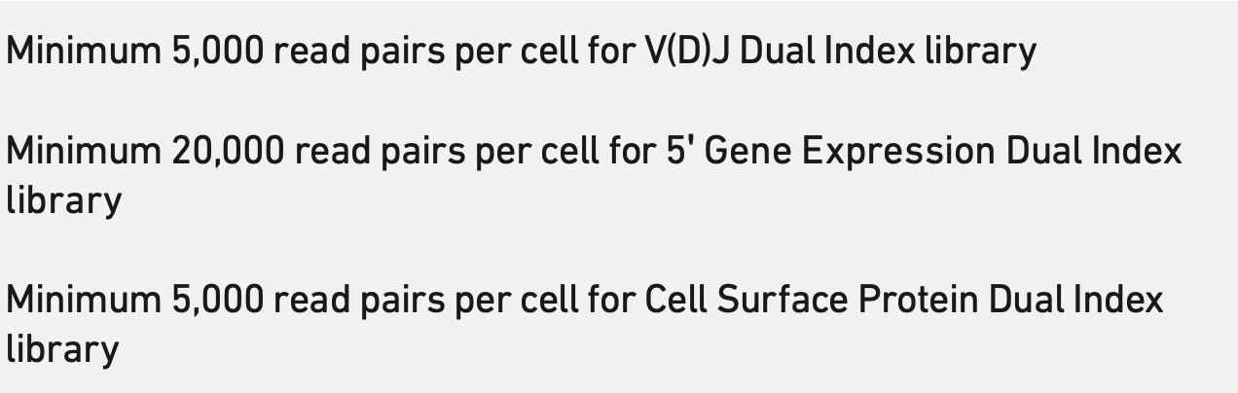
Step 6: Sequencing
Sequencing Depth

