Slide 1
Chapter 22: Object-Based Databases

Slide 2
Chapter 22: Object-Based Databases
Object-Relational Data Models
Complex Data Types and Object Orientation
Structured Data Types and Inheritance in SQL
Table Inheritance
Array and Multiset Types in SQL
Object Identity and Reference Types in SQL
Implementing O-R Features
Persistent Programming Languages
Comparison of Object-Oriented and Object-Relational Databases

Slide 3
Object-Relational Data Models
Advanced Database Applications need Complex Data Types
Two approaches:
  Object-Oriented Databases
  Object-Relational Databases
Object-Relational Data Model:
  Extend the relational data model by including object orientation and constructs to deal with added data types.
Allow attributes of tuples to have complex types, including non-atomic values such as nested relations.
Preserve relational foundations, in particular the declarative access to data, while extending modeling power.
Upward compatibility with existing relational languages.

Slide 4
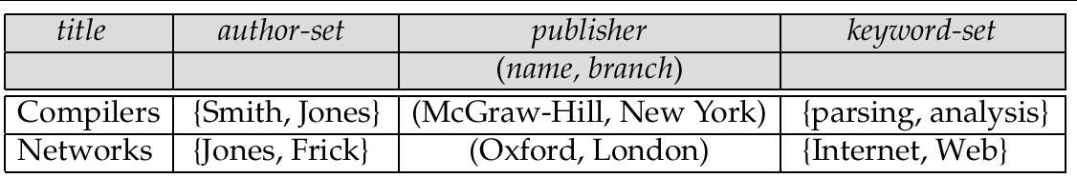
Example of a Nested Relation
Example: library information system
Each book has
  title,
  a set of authors,
  Publisher, and
  a set of keywords
Non-1NF relation books

Slide 5
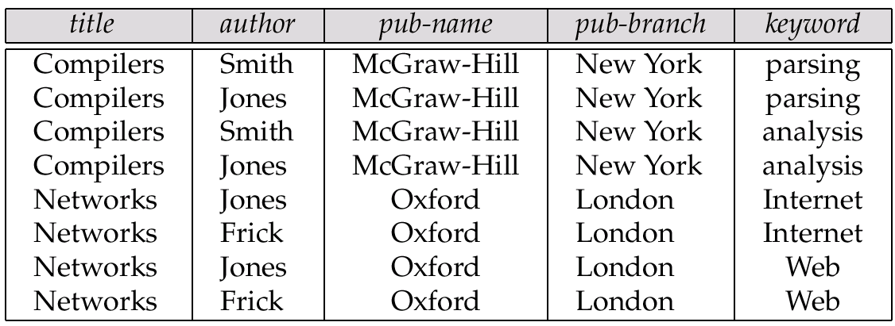
1NF Version of Nested Relation
1NF version of books
flat-books

Slide 6
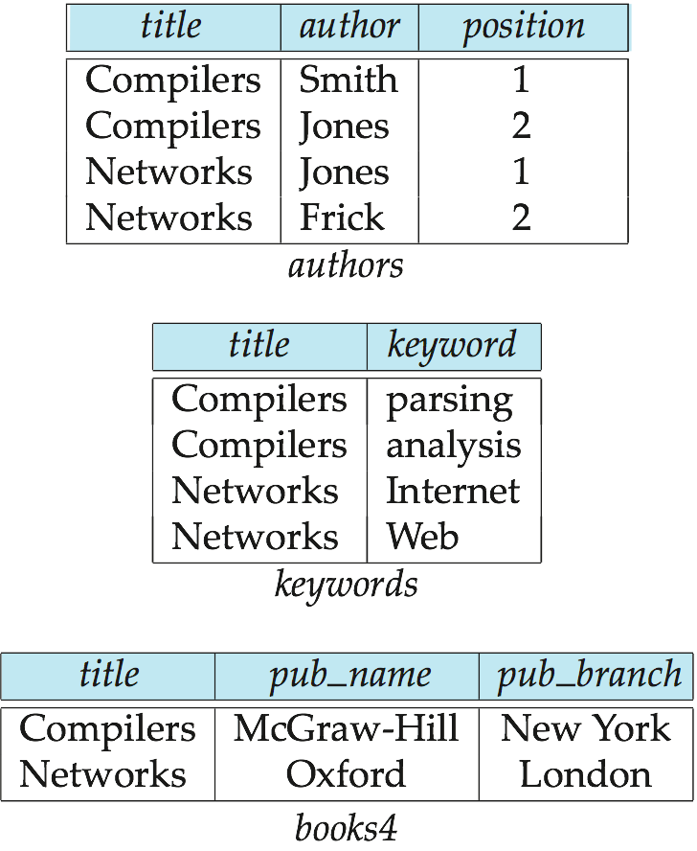
4NF Decomposition of Nested Relation
Remove awkwardness of flat-books by assuming that the following multivalued dependencies hold:
  title author
  title keyword
  title pub-name, pub-branch
Decompose flat-doc into 4NF using the schemas:
  (title, author )
  (title, keyword )
  (title, pub-name, pub-branch )

Slide 7
Array and Multiset Types in SQL
Example of array and multiset declaration:
create type Publisher as
(name varchar(20),
branch varchar(20))
create type Book as
(title varchar(20),
author-array varchar(20) array [10],
pub-date date,
publisher Publisher,
keyword-set varchar(20) multiset )
create table books of Book
Similar to the nested relation books, but with array of authors
instead of set

Slide 8
End of Chapter 22

