Slide 1
Ch.23 Testing Conventional Applications

Slide 2
Testability
Operability—it operates cleanly
Observability—the results of each test case are readily observed
Controllability—the degree to which testing can be automated and optimized
Decomposability—testing can be targeted
Simplicity—reduce complex architecture and logic to simplify tests
Stability—few changes are requested during testing
Understandability—of the design

Slide 3
What is a “Good” Test?
    A good test has a high probability of finding an error
    A good test is not redundant.
    A good test should be “best of breed”
    A good test should be neither too simple nor too complex

Slide 4
Internal and External Views
Any engineered product (and most other things) can be tested in one of two ways:
  Knowing the specified function that a product has been designed to perform, tests can be conducted that demonstrate each function is fully operational while at the same time searching for errors in each function;
  Knowing the internal workings of a product, tests can be conducted to ensure that "all gears mesh," that is, internal operations are performed according to specifications and all internal components have been adequately exercised.

Slide 5
Test Case Design
"Bugs lurk in corners
and congregate at
boundaries ..."
Boris Beizer
OBJECTIVE
to uncover errors
CRITERIA
in a complete manner
CONSTRAINT
with a minimum of effort and time

Slide 6
Exhaustive Testing
loop < 20 X
14
There are 10 possible paths! If we execute one
test per millisecond, it would take 3,170 years to
test this program!!

Slide 7
Selective Testing
Selected path
loop < 20 X

Slide 8
Software Testing
white-box
methods
black-box
methods
Methods
Strategies

Slide 9

White-Box Testing
... our goal is to ensure that all
statements and conditions have
been executed at least once ...

Slide 10
Why Cover?
    logic errors and incorrect assumptions are inversely proportional to a path's execution probability
    we often believe that a path is not likely to be executed; in fact, reality is often counter intuitive
    typographical errors are random; it's likely that untested paths will contain some

Slide 11
Basis Path Testing
First, we compute the cyclomatic
complexity:
or
number of enclosed areas + 1
In this case, V(G) = 4

Slide 12
Cyclomatic Complexity
A number of industry studies have indicated
that the higher V(G), the higher the probability
or errors.
modules
V(G)
modules in this range are
more error prone

Slide 13
Basis Path Testing
1
Next, we derive the
independent paths:
2
Since V(G) = 4,
there are four paths
3
Path 1: 1,2,3,6,7,8
4
Path 2: 1,2,3,5,7,8
5
6
Path 3: 1,2,4,7,8
Path 4: 1,2,4,7,2,4,...7,8
Finally, we derive test
7
cases to exercise these
paths.
8

Slide 14
Basis Path Testing Notes
you don't need a flow chart,
but the picture will help when
you trace program paths
count each simple logical test,
compound tests count as 2 or
more
basis path testing should be
applied to critical modules

Slide 15
Deriving Test Cases
Summarizing:
  Using the design or code as a foundation, draw a corresponding flow graph.
  Determine the cyclomatic complexity of the resultant flow graph.
  Determine a basis set of linearly independent paths.
  Prepare test cases that will force execution of each path in the basis set.

Slide 16
Graph Matrices
A graph matrix is a square matrix whose size (i.e., number of rows and columns) is equal to the number of nodes on a flow graph
Each row and column corresponds to an identified node, and matrix entries correspond to connections (an edge) between nodes.
By adding a link weight to each matrix entry, the graph matrix can become a powerful tool for evaluating program control structure during testing

Slide 17
Control Structure Testing
    Condition testing — a test case design method that exercises the logical conditions contained in a program module
    Data flow testing — selects test paths of a program according to the locations of definitions and uses of variables in the program

Slide 18
Data Flow Testing
The data flow testing method [Fra93] selects test paths of a program according to the locations of definitions and uses of variables in the program.
  Assume that each statement in a program is assigned a unique statement number and that each function does not modify its parameters or global variables. For a statement with S as its statement number
        DEF(S) = {X | statement S contains a definition of X}
        USE(S) = {X | statement S contains a use of X}
  A definition-use (DU) chain of variable X is of the form [X, S, S'], where S and S' are statement numbers, X is in DEF(S) and USE(S'), and the definition of X in statement S is live at statement S'

Slide 19
Loop Testing
Simple
loop
Nested
Loops
Concatenated
Loops
Unstructured
Loops

Slide 20
Loop Testing: Simple Loops
Nested Loops
  Start at the innermost loop. Set all outer loops to their minimum iteration parameter values.
  Test the min+1, typical, max-1 and max for the innermost loop, while holding the outer loops at their minimum values.
  Move out one loop and set it up as in step 2, holding all other loops at typical values. Continue this step until the outermost loop has been tested.
  Concatenated Loops
  If the loops are independent of one another
  then treat each as a simple loop
  else* treat as nested loops
  endif*
  for example, the final loop counter value of loop 1 is used to initialize loop 2.

Slide 21
Loop Testing: Nested Loops
Minimum conditions—Simple Loops
  1. skip the loop entirely
  2. only one pass through the loop
  3. two passes through the loop
  4. m passes through the loop m < n
  5. (n-1), n, and (n+1) passes through
  where n is the maximum number of allowable passes

Slide 22
Black-Box Testing
requirements
output
input
events

Slide 23
Black-Box Testing
How is functional validity tested?
How is system behavior and performance tested?
What classes of input will make good test cases?
Is the system particularly sensitive to certain input values?
How are the boundaries of a data class isolated?
What data rates and data volume can the system tolerate?
What effect will specific combinations of data have on system operation?

Slide 24
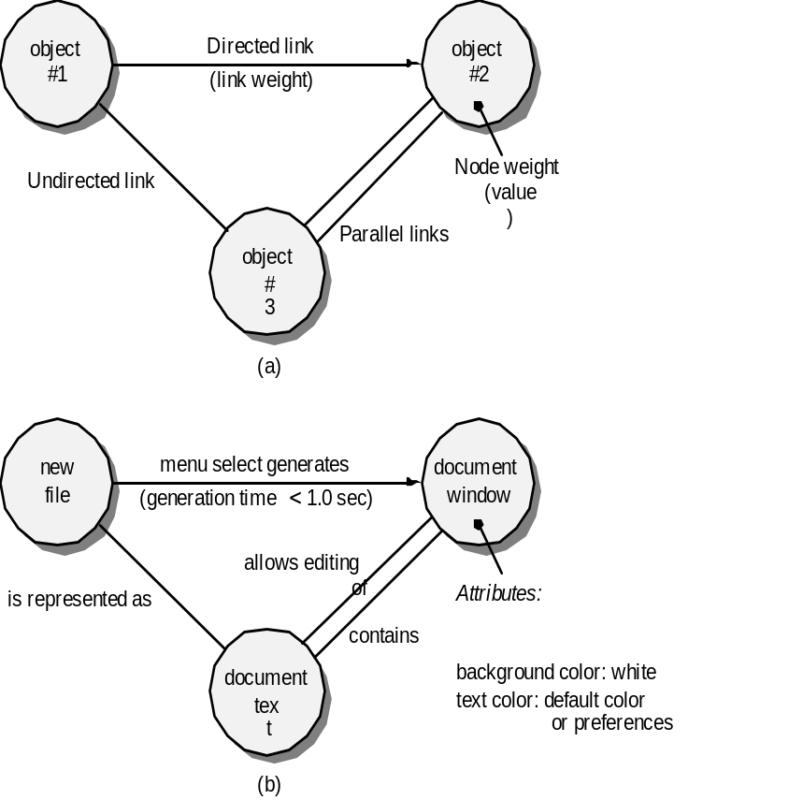
Graph-Based Methods
To understand the objects that are modeled in software and the relationships that connect these objects
In this context, we consider the term “objects” in the broadest possible context. It encompasses data objects, traditional components (modules), and object-oriented elements of computer software.

Slide 25
Equivalence Partitioning
user
queries
output
formats
FK
input
mouse
picks
data
prompts

Slide 26
Sample Equivalence Classes
Valid data
user supplied commands
responses to system prompts
file names
computational data
physical parameters
bounding values
initiation values
output data formatting
responses to error messages
graphical data (e.g., mouse picks)
Invalid data
data outside bounds of the program
physically impossible data
proper value supplied in wrong place

Slide 27
Boundary Value Analysis
user
queries
output
formats
FK
input
mouse
picks
data
prompts
output
domain
input domain

Slide 28
Comparison Testing
Used only in situations in which the reliability of software is absolutely critical (e.g., human-rated systems)
  Separate software engineering teams develop independent versions of an application using the same specification
  Each version can be tested with the same test data to ensure that all provide identical output
  Then all versions are executed in parallel with real-time comparison of results to ensure consistency

Slide 29
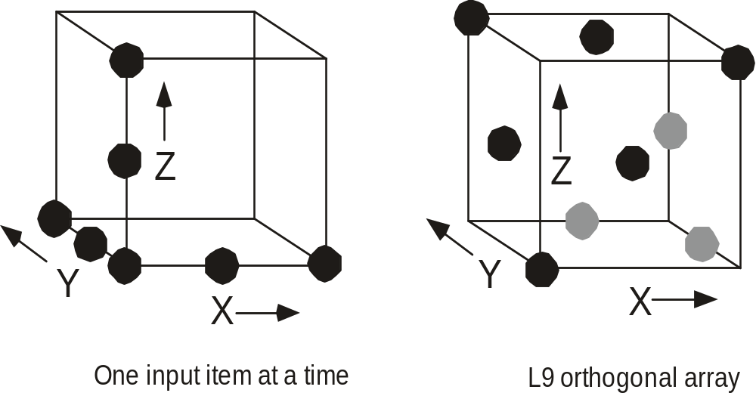
Orthogonal Array Testing
Used when the number of input parameters is small and the values that each of the parameters may take are clearly bounded

Slide 30
Model-Based Testing
Analyze an existing behavioral model for the software or create one.
  Recall that a behavioral model indicates how software will respond to external events or stimuli.
Traverse the behavioral model and specify the inputs that will force the software to make the transition from state to state.
  The inputs will trigger events that will cause the transition to occur.
Review the behavioral model and note the expected outputs as the software makes the transition from state to state.
Execute the test cases.
Compare actual and expected results and take corrective action as required.

Slide 31
Software Testing Patterns
Testing patterns are described in much the same way as design patterns (Chapter 12).
Example:
  Pattern name: ScenarioTesting
  Abstract: Once unit and integration tests have been conducted, there is a need to determine whether the software will perform in a manner that satisfies users. The ScenarioTesting pattern describes a technique for exercising the software from the user’s point of view. A failure at this level indicates that the software has failed to meet a user visible requirement. [Kan01]

