Slide 1
Breast Cancer Classification
Team Name: Prophet
Team Members: Boyu Lu, Shihui Chen, Meng Zhou

Slide 2
Background
Depend on digital Biomedical Photography Analysis----Histopathological images
Classify images between Benign, Benign without call back and Malignant
Convolutional Neural Network

Slide 3
Data Pre-process
Data Source
Clean Data
❏ 2620 mammography images
❏ Normal, benign and malignant cases
❏ Verified information tables
❏ Select useful data
❏ Drop missing data
Data
Split Data
Process Image
❏ Training data : 80%
❏ Validation data: 20%
❏ Rotate the images — avoid overfitting
❏ Resize the images
❏ Label the images
https://wiki.cancerimagingarchive.net/display/Public/CBIS-DDSM

Slide 4
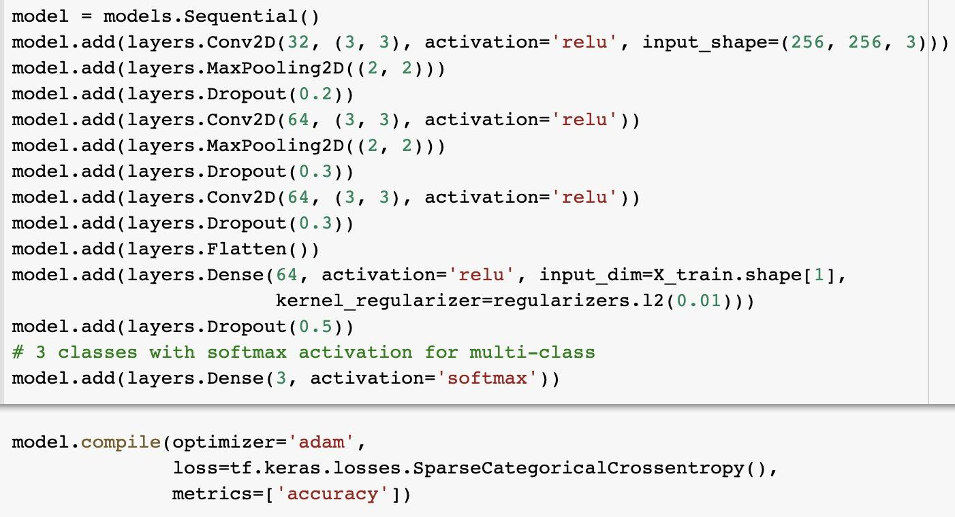
Model & Core Algorithm
❏ Model : Convolutional Neural Network
Automatically detecting the important features without any human supervision
❏ Core Algorithm :
Create the convolutional base
Add Dense layers on top
Compile and train model
Evaluate the model

Slide 5
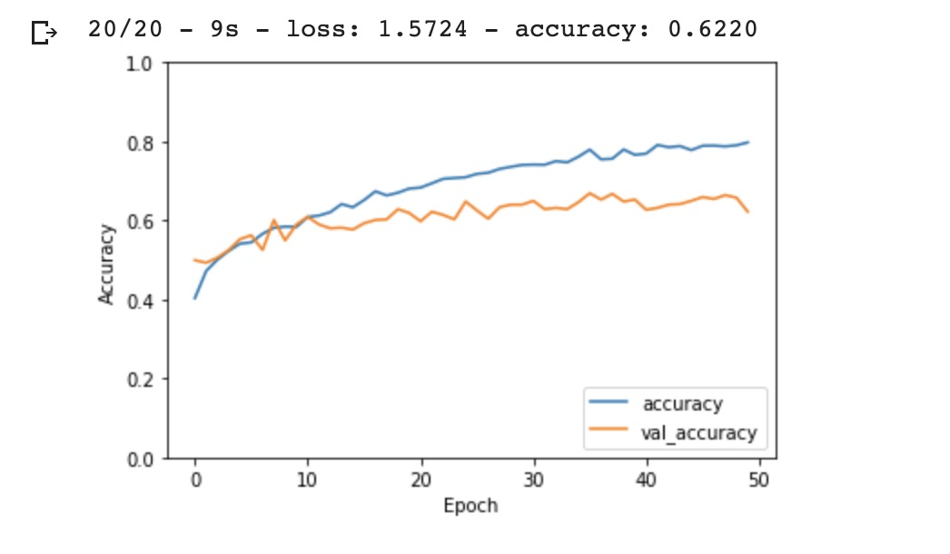
Result Analysis
❏
❏
❏ Training Accuracy: 79.74%
❏ Validation Accuracy: 62.20%
❏ Test Accuracy: 54.14%

Slide 6
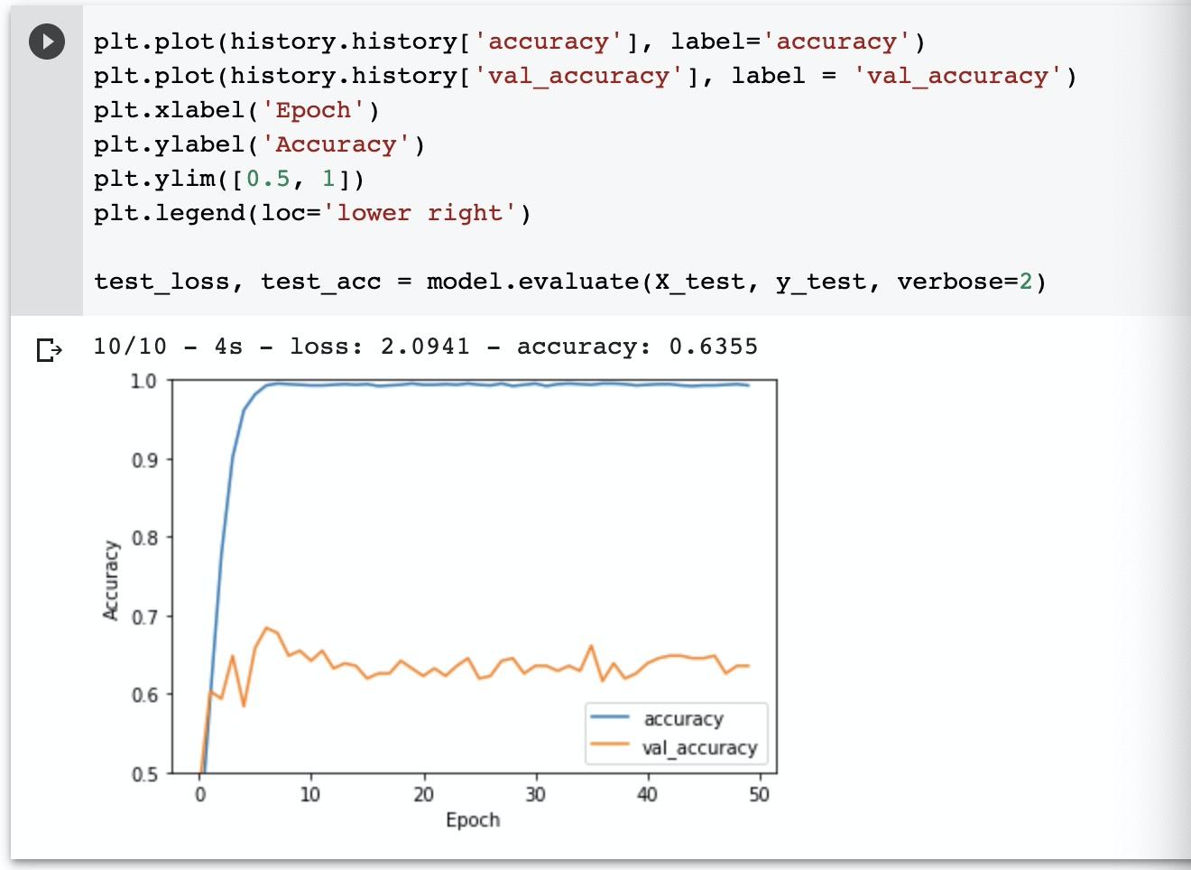
Former Model Analysis 1
Problem: Overfitting
Solution:
❏ Expand data volume
Rotate original images
❏ Add regularization
❏ Dropout features

Slide 7
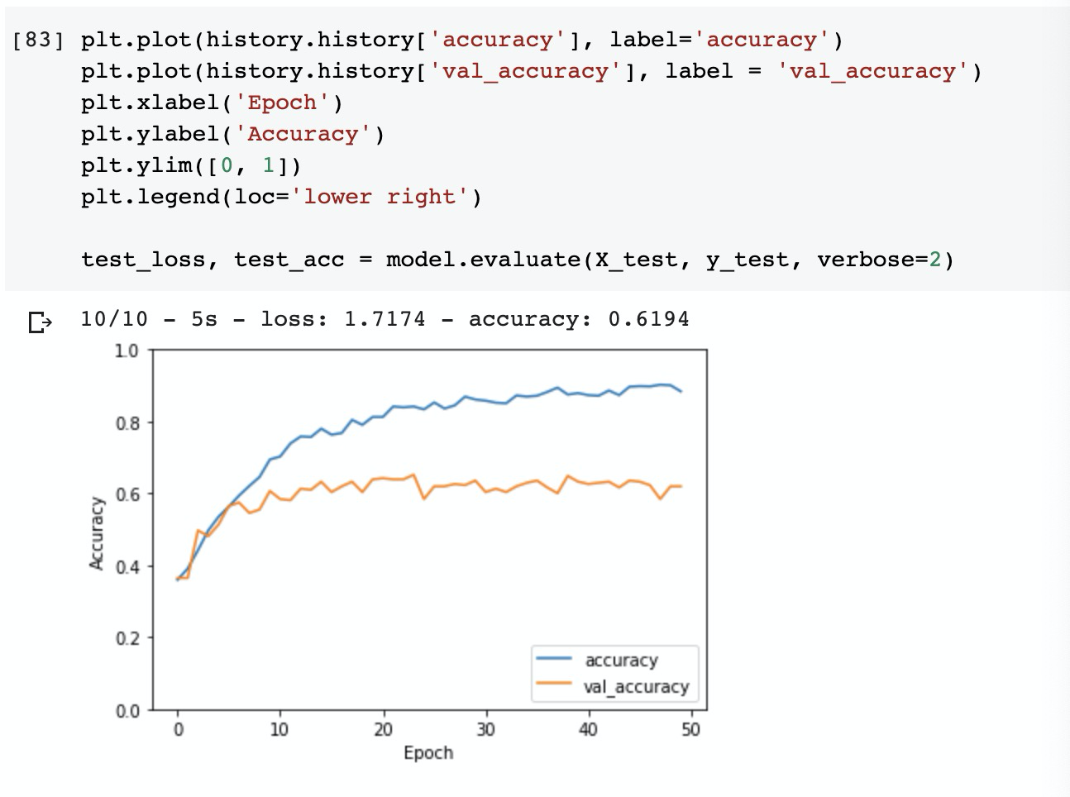
Former Model Analysis 2
Problem: Accuracy fluctuating
Solution:
❏ Increase batch size

Slide 8
Further Optimization
❏ Not suitable for complex condition
Add different layers (10 scale or even more)
❏ Limited volume of training data
Find larger dataset
Add more rotated images
❏ Poor accuracy
Create another prediction model
Add boost process

