Slide 1

Building Up End-to-End Deep Learning Environment from Open Source Frameworks
One Click Deep Learning
Presenter: Zhijing Ling
Yan Liu
Tianen Chen
Concordia University
Gina Cody School of Engineering and Computer Science
Copyright © 2019. Concordia University All rights reserved.
10/18/2019

Slide 2
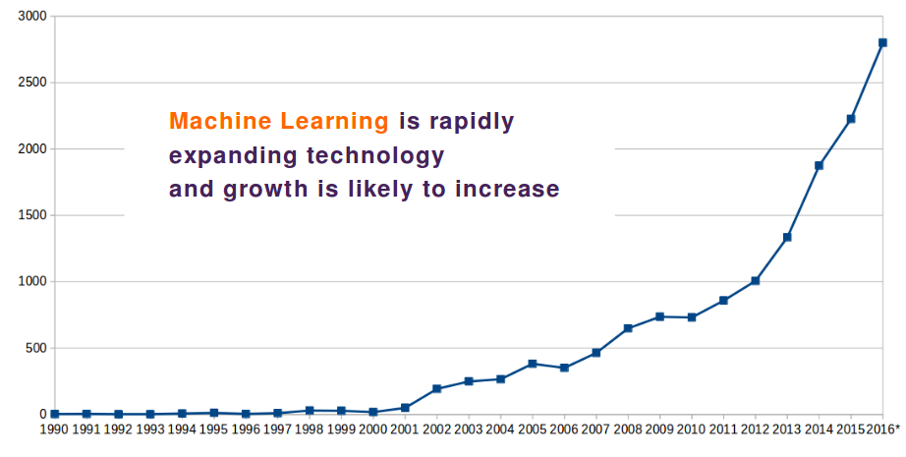
Background
As Machine Learning in 2019: Tracing The Artificial Intelligence Growth Path claimed:
Machine Learning (ML), globally recognized as a key over of digital transformation, will be responsible for cumulative investments of $58 billion by the end of 2021
The global ML industry, growing at a CAGR of 42 percent, will be worth almost $9 billion in the latter part of 2022.
The Deep Learning (DL) applications market in the US alone has been predicted to shoot from $100 million in 2018 to $935 million in 2025.
But, most of the attention/hype goes to the ML algorithms themselves (decision trees, logistic regression, deep neural networks, etc.).
Machine Learning Technology Trend 1990-2016. Machine Learning is one of the fastest emerging new technologies currently. *2016 Patenting estimated by Teqmine. Source: USPTO, Teqmine Analytics Ltd.

Slide 3
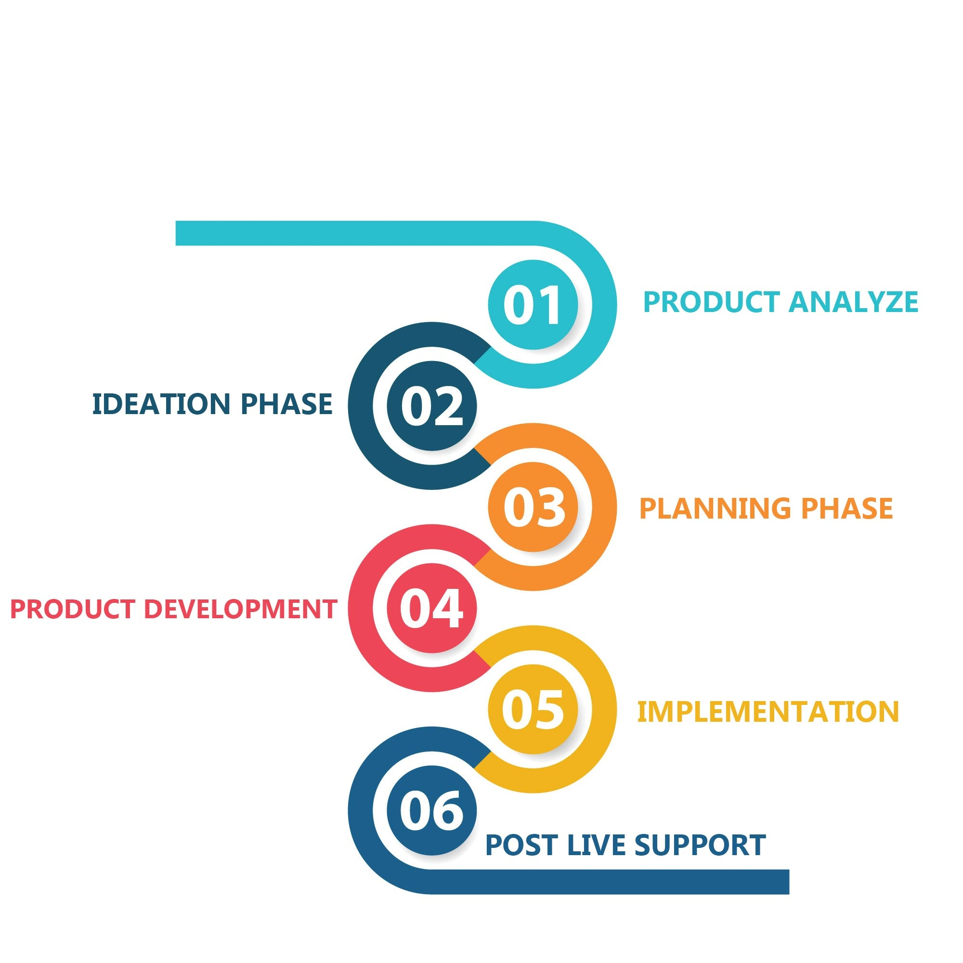
Model as a product
Planning
Model as a product, or putting models into production, means making your models available to your other business systems. By deploying models, other systems can send data to them and get their predictions, which are in turn populated back into the company systems.
And yet this is the most important step in the machine learning pipeline. Only when a model is fully integrated with the business systems, we can extract real value from its predictions.
Analysis
Design
Development & Implementation
Testing &
Deployment
Maintenance

Slide 4












OCDL Model Lifecycle
Model Building
Model Approval
One Entry for building, training and committing models
Operation empowered by DevOps tools
Tolerate Fault
Secure
Privacy
Forecasting
Computer vision
Scale Concurrent Training
Speech recognition
Cross Cloud Infrastructure
Unified
Editing and Training
Runtime
Notify
Model Update
Approve
Release
Reusable Code as Template
Assess
Models
Online CPU/GPU Switch
Data and Resource
Virtualization
Updates published to diverse model consumption
Model Training
Model Release

Slide 5





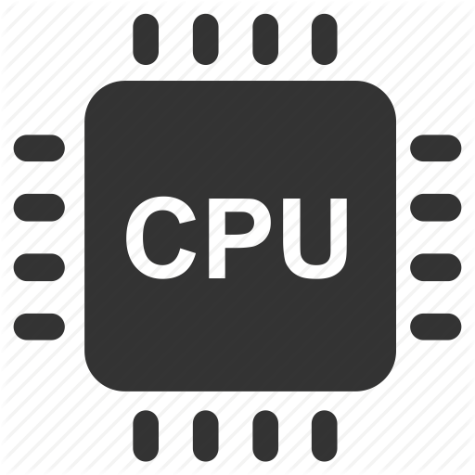

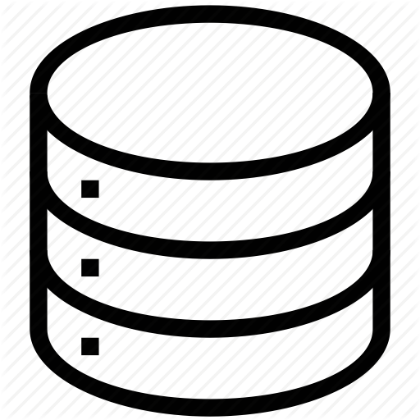

Code Vulnerability in OCDL
Data Collection
Model Building & Training
Model Release
Capsule
Web crawler
Model Building
Live Coding
Reusable Code as Template
Model Management
Data Clean
Model Training
Rover
CPU
CPU
GPU
Computer Resource Virtualization
CPU / GPU
Storage Virtualization
Data Sharing
Memory Speed access
Get Model
Save Data
Get Data
Save Model
Launcher
Model Management
DevOps Pipline
Model release

Slide 6
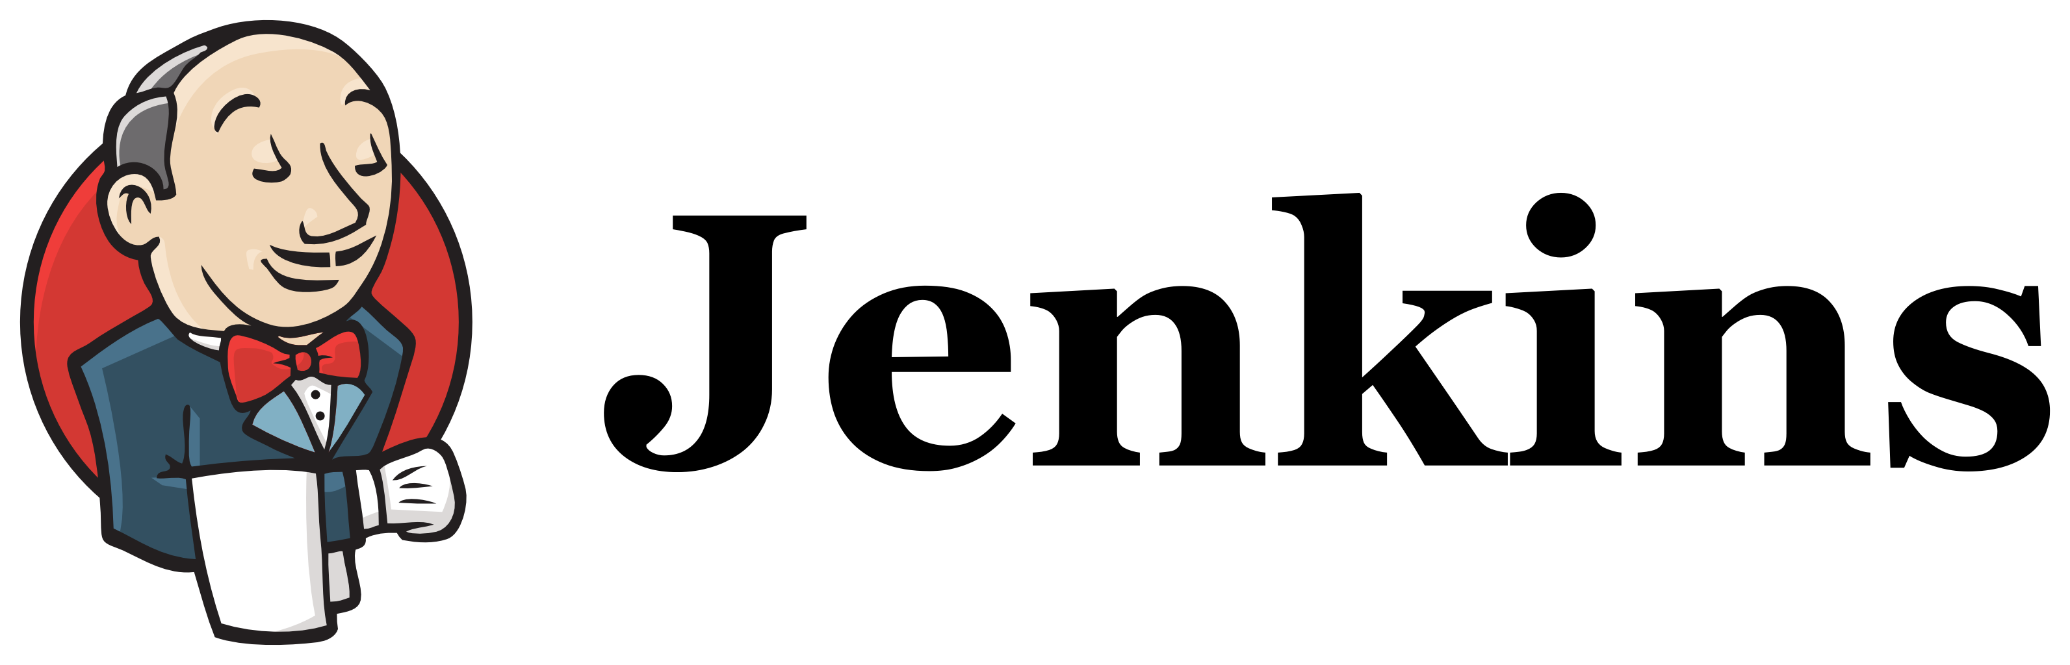

SVN
Commit
Select a Deployment Tool ?
SVN
Post Commit
hook
There is plenty of automatic deployment Tools, who can deploy job after automatic test.
Build job
But:
1. Duplicate copy of Model consumes unnecessary traffic
2. Model review requires human intervention
Test job
Deployment
job
APP
Server
Jenkins workflow based SVM commit

Slide 7
Developer
Submit
Model
Model Center
Test Model
Staging
Evaluate Model
Approve / Reject Model
Approve Model
A simple Solution
Staging
Send
Deployment
Message
APP
Pull
Model

Slide 8









Model Production Line
Model development
Model evaluation
Model training
Model reject
Model approve
Model validation
Model release
Model commit
Developer
Manager
Staging

Slide 9


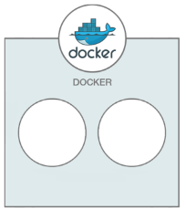



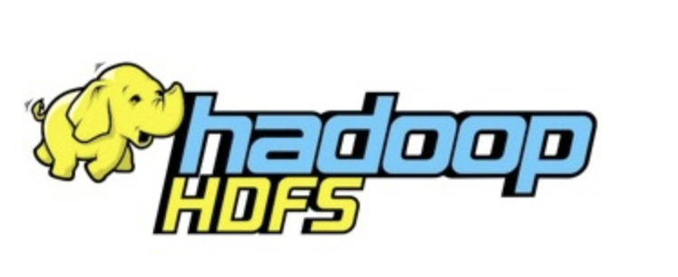
Evaluation support
Jupyter Embedded Web Portal
For evaluation model, you need:
Model
Developer submit models into Staging, which will listed in the Model center.
Data Sets
Saved in the HDFS.
Computer Resources
Provided by CPU/GPU cluster.
CPU Cluster
GPU Cluster

