Slide 1
Why you should learn financial literacy

Slide 2
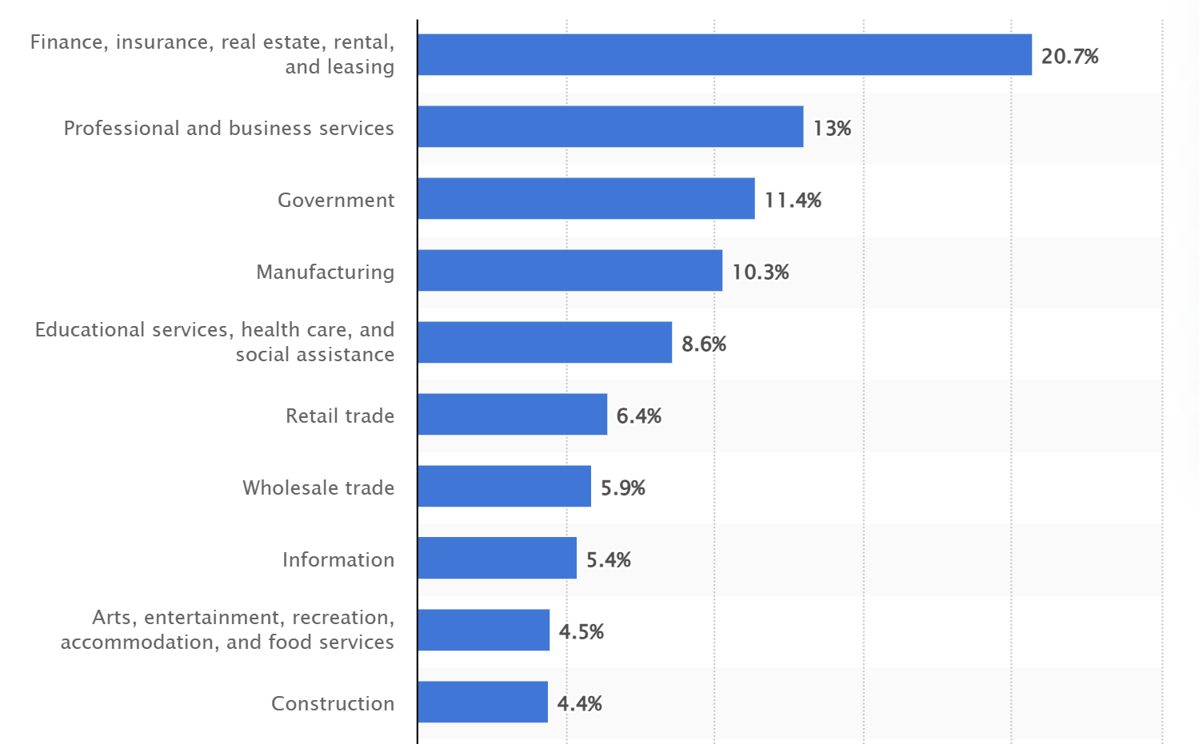
Sectors as % of U.S. GDP (2023)

Slide 3
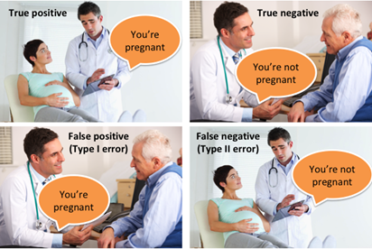
Credit cards

Slide 4
Buying a home
Real estate agents
$450,000 home * 6% = $27,000
Negotiate down 1% = $4,500
Refinancing
$450,000 home, 20% down, 30-yr, APR 6% => $2,158 / month
$450,000 home, 20% down, 30-yr, APR 3% => $1,517 / month

Slide 5
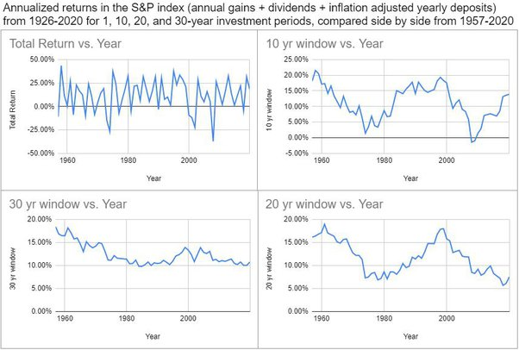
Investment

Slide 6
Learn!!!
Reddit
LinkedIn Learning --- all FREE

