Slide 1
Errors across all 12 conditions
Case | P (bar) | φ | ΔT (K) | Induction error | Exothermic error
1 | 1 | 0.5 | +1.984 | -38.06% | +35.45%
2 | 1 | 1 | +5.909 | -51.43% | -46.34%
3 | 1 | 1.5 | -8.284 | -79.18% | -38.87%
4 | 1 | 2 | +2.283 | -72.68% | -72.97%
5 | 5 | 0.5 | +10.182 | +24.67% | -45.26%
6 | 5 | 1 | +23.741 | -44.29% | -43.84%
7 | 5 | 1.5 | -12.626 | -58.42% | -81.52%
8 | 5 | 2 | +52.994 | -45.40% | -90.97%
9 | 20 | 0.5 | +1.733 | +8.98% | -53.44%
10 | 20 | 1 | -5.111 | -72.93% | -81.51%
11 | 20 | 1.5 | -5.320 | -67.14% | -87.87%
12 | 20 | 2 | -1.029 | -64.26% | -84.09%
01
Notes:
Source: user-provided validation output (12 cases, 2 November 2026). Temperature profiles: example/ethylene_ZND/validate/temperature_profiles/znd_case_01.png through znd_case_12.png. Reported values are rounded; percentages, delta T and log errors retain supplied output precision.

Slide 2
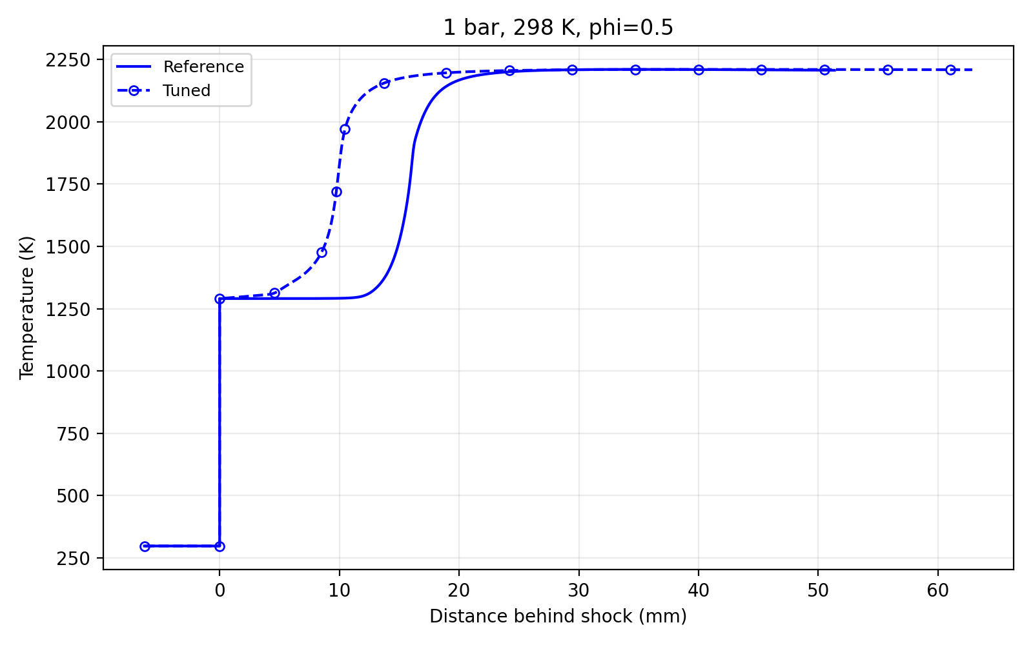
Case 1: 1 bar, φ = 0.5
Ethylene–air, initial temperature 298 K
Reported numerical comparison
Quantity | FFCM2 | Tuned | Error
T (K) | 2206.24 | 2208.23 | +0.09%
ℓind (m) | 1.6069e-2 | 9.9534e-3 | -38.06%
ℓexo (m) | 7.4218e-4 | 1.0052e-3 | +35.45%
ΔT = +1.984 K
|ln(ℓind,model / ℓind,FFCM2)| = 0.478982
|ln(ℓexo,model / ℓexo,FFCM2)| = 0.303396
02
Notes:
Source: user-provided validation output (12 cases, 2 November 2026). Temperature profiles: example/ethylene_ZND/validate/temperature_profiles/znd_case_01.png through znd_case_12.png. Reported values are rounded; percentages, delta T and log errors retain supplied output precision.
Exact supplied case data: {"case":1,"P":1,"phi":0.5,"Tref":2206.24,"Tmodel":2208.23,"Terr":0.09,"dT":1.984,"Iref":0.0160691,"Imodel":0.0099534,"Ierr":-38.06,"Ilog":0.478982,"Eref":0.000742176,"Emodel":0.00100524,"Eerr":35.45,"Elog":0.303396}

Slide 3
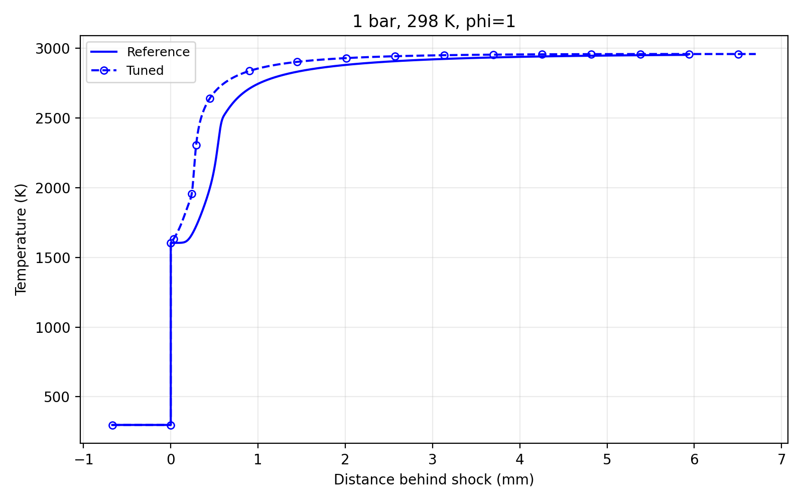
Case 2: 1 bar, φ = 1.0
Ethylene–air, initial temperature 298 K
Reported numerical comparison
Quantity | FFCM2 | Tuned | Error
T (K) | 2952.20 | 2958.11 | +0.20%
ℓind (m) | 5.4732e-4 | 2.6583e-4 | -51.43%
ℓexo (m) | 1.1799e-4 | 6.3310e-5 | -46.34%
ΔT = +5.909 K
|ln(ℓind,model / ℓind,FFCM2)| = 0.722167
|ln(ℓexo,model / ℓexo,FFCM2)| = 0.622549
03
Notes:
Source: user-provided validation output (12 cases, 2 November 2026). Temperature profiles: example/ethylene_ZND/validate/temperature_profiles/znd_case_01.png through znd_case_12.png. Reported values are rounded; percentages, delta T and log errors retain supplied output precision.
Exact supplied case data: {"case":2,"P":1,"phi":1,"Tref":2952.2,"Tmodel":2958.11,"Terr":0.2,"dT":5.909,"Iref":0.000547315,"Imodel":0.00026583,"Ierr":-51.43,"Ilog":0.722167,"Eref":0.00011799,"Emodel":0.0000633105,"Eerr":-46.34,"Elog":0.622549}

Slide 4
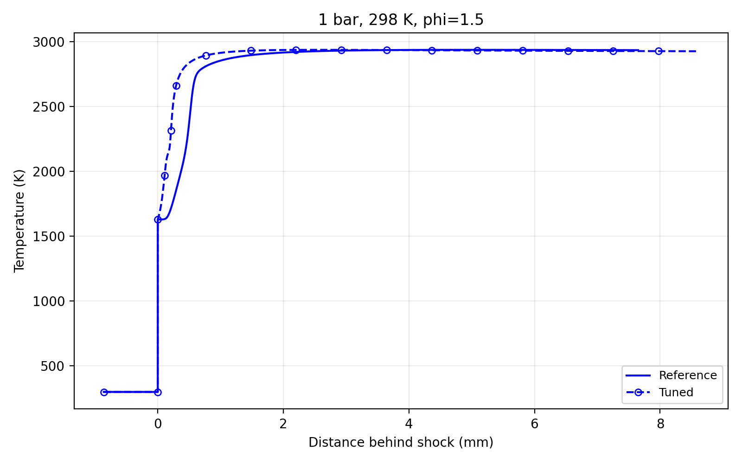
Case 3: 1 bar, φ = 1.5
Ethylene–air, initial temperature 298 K
Reported numerical comparison
Quantity | FFCM2 | Tuned | Error
T (K) | 2933.82 | 2925.53 | -0.28%
ℓind (m) | 5.2460e-4 | 1.0921e-4 | -79.18%
ℓexo (m) | 1.5716e-4 | 9.6069e-5 | -38.87%
ΔT = -8.284 K
|ln(ℓind,model / ℓind,FFCM2)| = 1.56937
|ln(ℓexo,model / ℓexo,FFCM2)| = 0.492183
04
Notes:
Source: user-provided validation output (12 cases, 2 November 2026). Temperature profiles: example/ethylene_ZND/validate/temperature_profiles/znd_case_01.png through znd_case_12.png. Reported values are rounded; percentages, delta T and log errors retain supplied output precision.
Exact supplied case data: {"case":3,"P":1,"phi":1.5,"Tref":2933.82,"Tmodel":2925.53,"Terr":-0.28,"dT":-8.284,"Iref":0.0005246,"Imodel":0.000109209,"Ierr":-79.18,"Ilog":1.56937,"Eref":0.000157159,"Emodel":0.0000960695,"Eerr":-38.87,"Elog":0.492183}

Slide 5
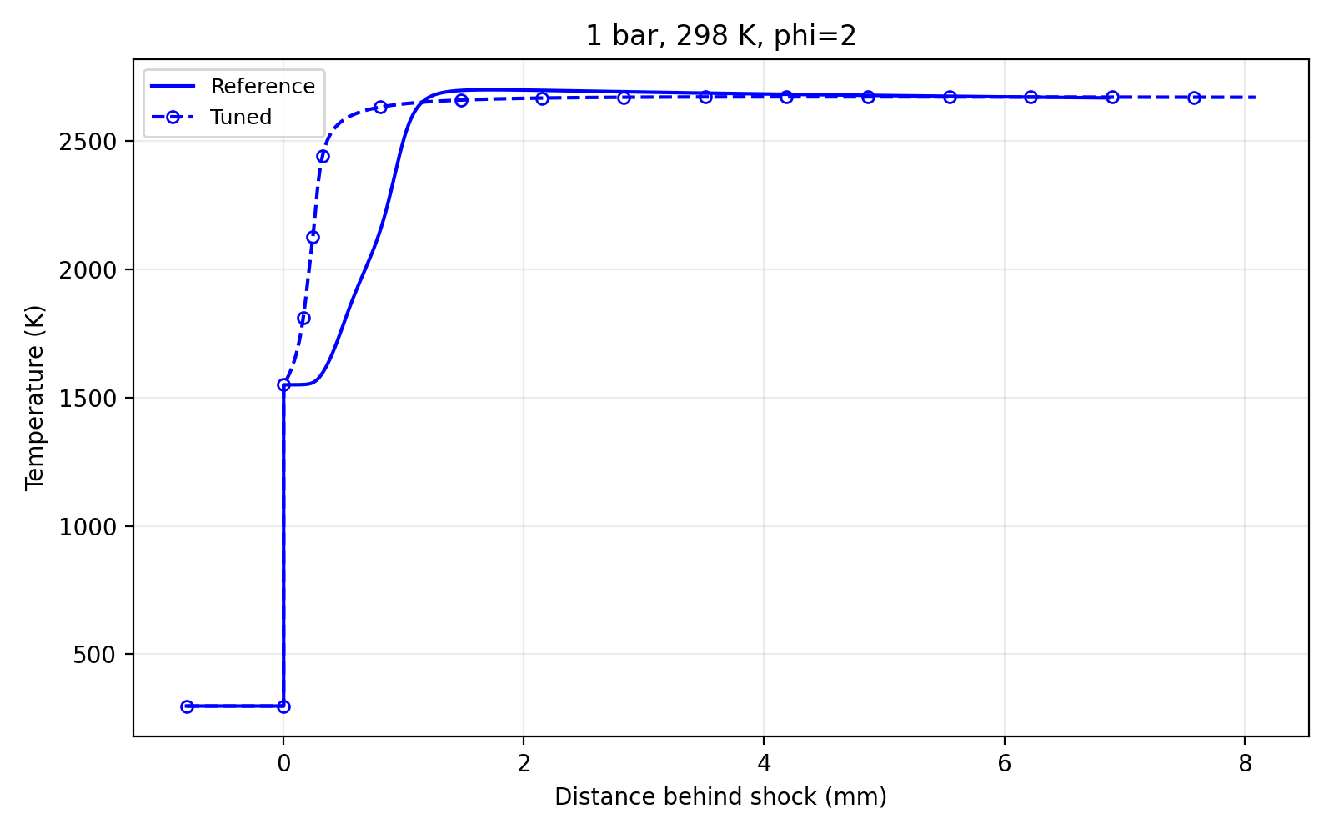
Case 4: 1 bar, φ = 2.0
Ethylene–air, initial temperature 298 K
Reported numerical comparison
Quantity | FFCM2 | Tuned | Error
T (K) | 2668.92 | 2671.20 | +0.09%
ℓind (m) | 9.4947e-4 | 2.5943e-4 | -72.68%
ℓexo (m) | 6.2757e-4 | 1.6965e-4 | -72.97%
ΔT = +2.283 K
|ln(ℓind,model / ℓind,FFCM2)| = 1.2974
|ln(ℓexo,model / ℓexo,FFCM2)| = 1.30812
05
Notes:
Source: user-provided validation output (12 cases, 2 November 2026). Temperature profiles: example/ethylene_ZND/validate/temperature_profiles/znd_case_01.png through znd_case_12.png. Reported values are rounded; percentages, delta T and log errors retain supplied output precision.
Exact supplied case data: {"case":4,"P":1,"phi":2,"Tref":2668.92,"Tmodel":2671.2,"Terr":0.09,"dT":2.283,"Iref":0.000949467,"Imodel":0.000259433,"Ierr":-72.68,"Ilog":1.2974,"Eref":0.000627569,"Emodel":0.00016965,"Eerr":-72.97,"Elog":1.30812}

Slide 6
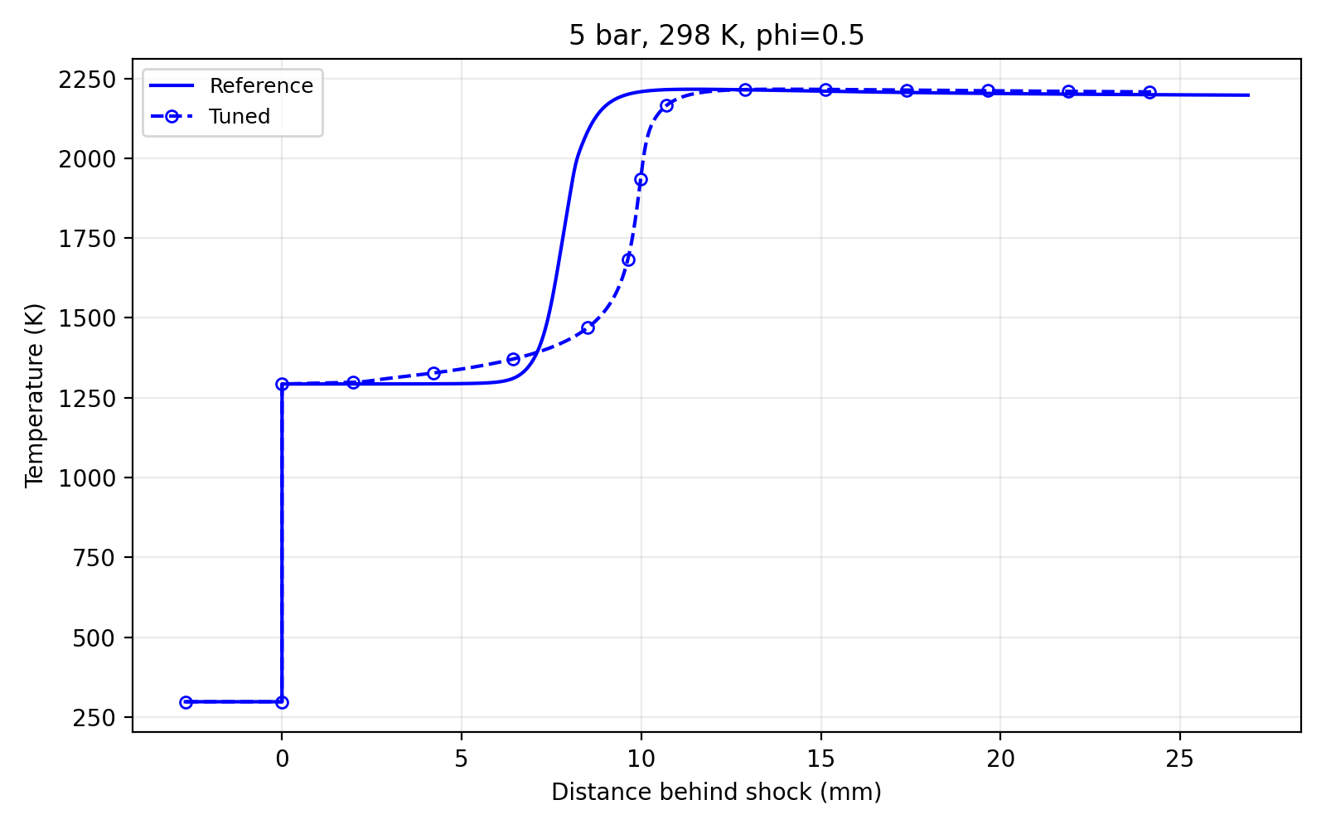
Case 5: 5 bar, φ = 0.5
Ethylene–air, initial temperature 298 K
Reported numerical comparison
Quantity | FFCM2 | Tuned | Error
T (K) | 2197.44 | 2207.62 | +0.46%
ℓind (m) | 8.0083e-3 | 9.9836e-3 | +24.67%
ℓexo (m) | 8.8781e-4 | 4.8595e-4 | -45.26%
ΔT = +10.182 K
|ln(ℓind,model / ℓind,FFCM2)| = 0.220462
|ln(ℓexo,model / ℓexo,FFCM2)| = 0.602653
06
Notes:
Source: user-provided validation output (12 cases, 2 November 2026). Temperature profiles: example/ethylene_ZND/validate/temperature_profiles/znd_case_01.png through znd_case_12.png. Reported values are rounded; percentages, delta T and log errors retain supplied output precision.
Exact supplied case data: {"case":5,"P":5,"phi":0.5,"Tref":2197.44,"Tmodel":2207.62,"Terr":0.46,"dT":10.182,"Iref":0.00800834,"Imodel":0.00998362,"Ierr":24.67,"Ilog":0.220462,"Eref":0.000887811,"Emodel":0.00048595,"Eerr":-45.26,"Elog":0.602653}

Slide 7
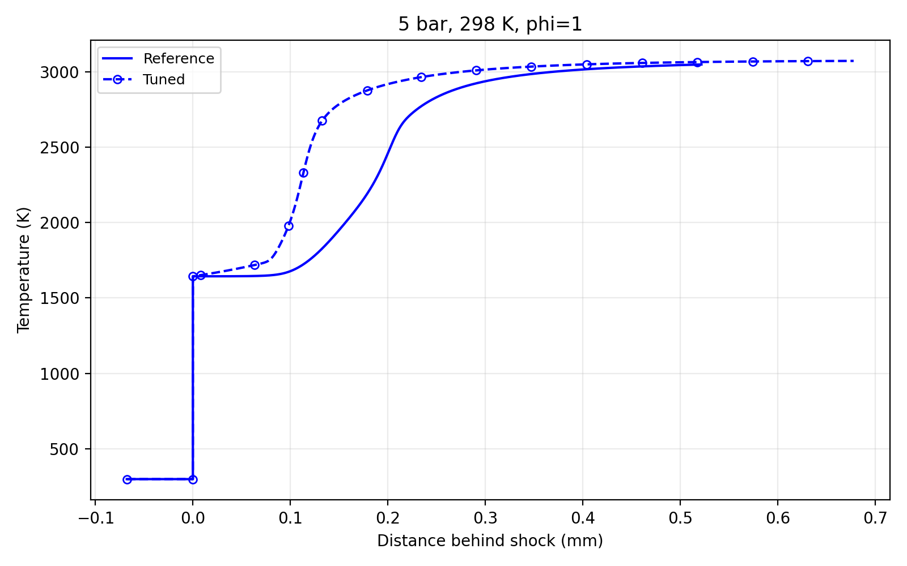
Case 6: 5 bar, φ = 1.0
Ethylene–air, initial temperature 298 K
Reported numerical comparison
Quantity | FFCM2 | Tuned | Error
T (K) | 3049.34 | 3073.08 | +0.78%
ℓind (m) | 2.0274e-4 | 1.1295e-4 | -44.29%
ℓexo (m) | 5.0900e-5 | 2.8587e-5 | -43.84%
ΔT = +23.741 K
|ln(ℓind,model / ℓind,FFCM2)| = 0.584975
|ln(ℓexo,model / ℓexo,FFCM2)| = 0.576891
07
Notes:
Source: user-provided validation output (12 cases, 2 November 2026). Temperature profiles: example/ethylene_ZND/validate/temperature_profiles/znd_case_01.png through znd_case_12.png. Reported values are rounded; percentages, delta T and log errors retain supplied output precision.
Exact supplied case data: {"case":6,"P":5,"phi":1,"Tref":3049.34,"Tmodel":3073.08,"Terr":0.78,"dT":23.741,"Iref":0.000202735,"Imodel":0.000112948,"Ierr":-44.29,"Ilog":0.584975,"Eref":0.0000508996,"Emodel":0.0000285873,"Eerr":-43.84,"Elog":0.576891}

Slide 8
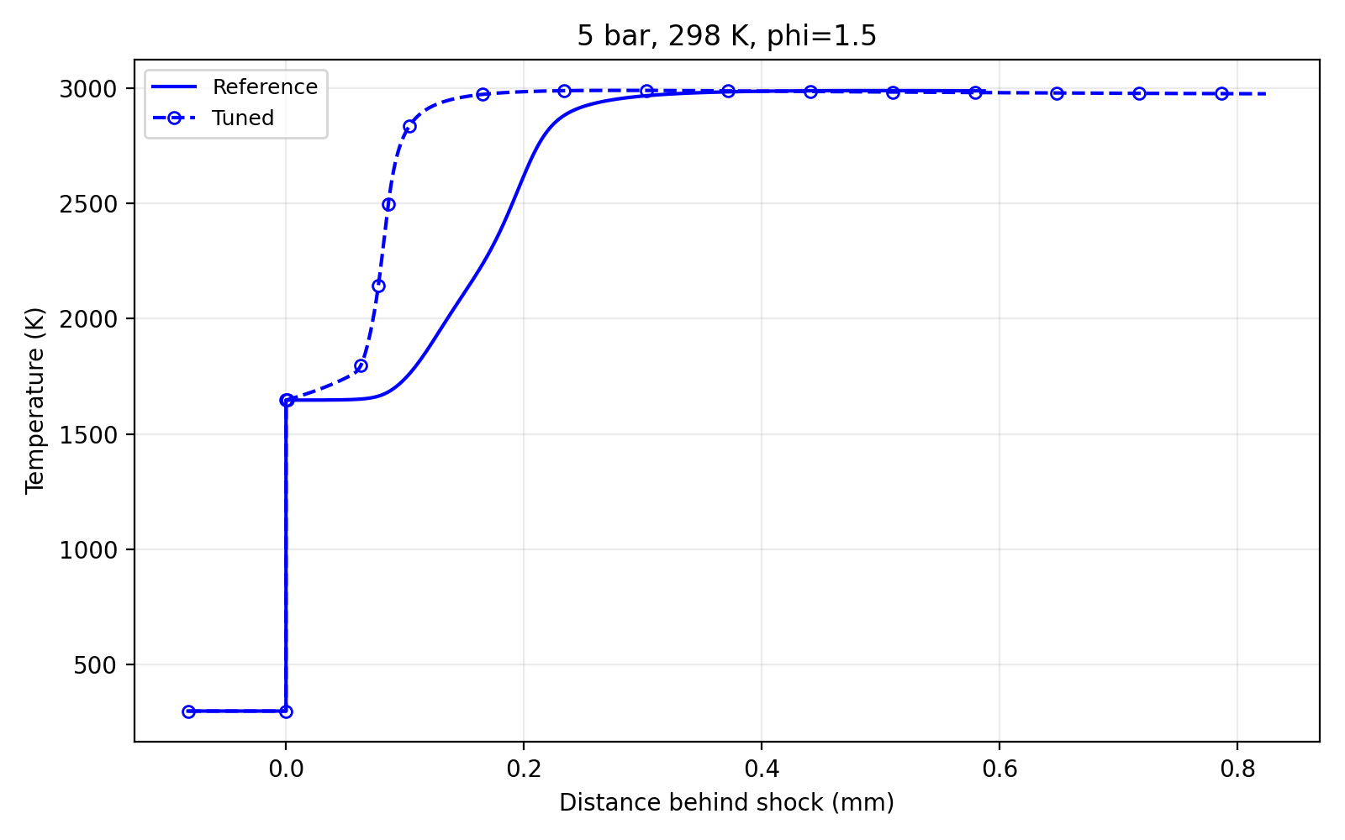
Case 7: 5 bar, φ = 1.5
Ethylene–air, initial temperature 298 K
Reported numerical comparison
Quantity | FFCM2 | Tuned | Error
T (K) | 2987.70 | 2975.08 | -0.42%
ℓind (m) | 2.0044e-4 | 8.3337e-5 | -58.42%
ℓexo (m) | 1.0433e-4 | 1.9279e-5 | -81.52%
ΔT = -12.626 K
|ln(ℓind,model / ℓind,FFCM2)| = 0.877605
|ln(ℓexo,model / ℓexo,FFCM2)| = 1.68852
08
Notes:
Source: user-provided validation output (12 cases, 2 November 2026). Temperature profiles: example/ethylene_ZND/validate/temperature_profiles/znd_case_01.png through znd_case_12.png. Reported values are rounded; percentages, delta T and log errors retain supplied output precision.
Exact supplied case data: {"case":7,"P":5,"phi":1.5,"Tref":2987.7,"Tmodel":2975.08,"Terr":-0.42,"dT":-12.626,"Iref":0.000200436,"Imodel":0.0000833366,"Ierr":-58.42,"Ilog":0.877605,"Eref":0.000104329,"Emodel":0.0000192791,"Eerr":-81.52,"Elog":1.68852}

Slide 9
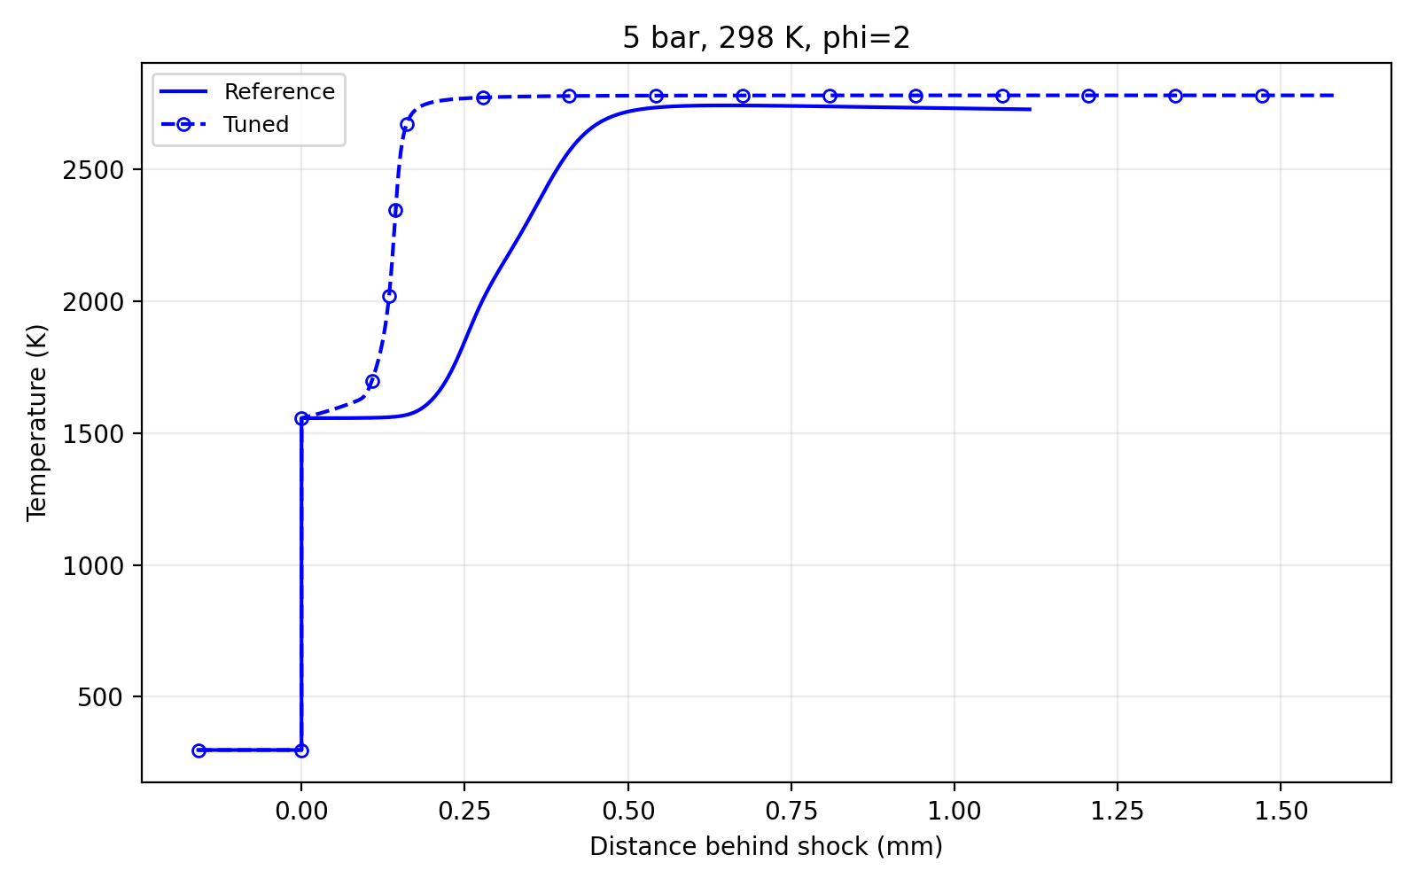
Case 8: 5 bar, φ = 2.0
Ethylene–air, initial temperature 298 K
Reported numerical comparison
Quantity | FFCM2 | Tuned | Error
T (K) | 2727.72 | 2780.71 | +1.94%
ℓind (m) | 2.6407e-4 | 1.4418e-4 | -45.40%
ℓexo (m) | 2.3135e-4 | 2.0891e-5 | -90.97%
ΔT = +52.994 K
|ln(ℓind,model / ℓind,FFCM2)| = 0.605148
|ln(ℓexo,model / ℓexo,FFCM2)| = 2.4046
09
Notes:
Source: user-provided validation output (12 cases, 2 November 2026). Temperature profiles: example/ethylene_ZND/validate/temperature_profiles/znd_case_01.png through znd_case_12.png. Reported values are rounded; percentages, delta T and log errors retain supplied output precision.
Exact supplied case data: {"case":8,"P":5,"phi":2,"Tref":2727.72,"Tmodel":2780.71,"Terr":1.94,"dT":52.994,"Iref":0.000264066,"Imodel":0.000144178,"Ierr":-45.4,"Ilog":0.605148,"Eref":0.000231351,"Emodel":0.0000208914,"Eerr":-90.97,"Elog":2.4046}

Slide 10
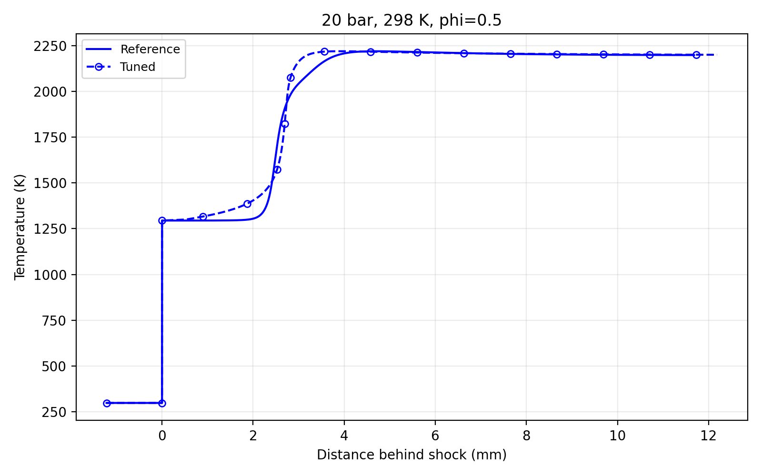
Case 9: 20 bar, φ = 0.5
Ethylene–air, initial temperature 298 K
Reported numerical comparison
Quantity | FFCM2 | Tuned | Error
T (K) | 2198.30 | 2200.03 | +0.08%
ℓind (m) | 2.4949e-3 | 2.7188e-3 | +8.98%
ℓexo (m) | 3.3413e-4 | 1.5556e-4 | -53.44%
ΔT = +1.733 K
|ln(ℓind,model / ℓind,FFCM2)| = 0.0859669
|ln(ℓexo,model / ℓexo,FFCM2)| = 0.764486
10
Notes:
Source: user-provided validation output (12 cases, 2 November 2026). Temperature profiles: example/ethylene_ZND/validate/temperature_profiles/znd_case_01.png through znd_case_12.png. Reported values are rounded; percentages, delta T and log errors retain supplied output precision.
Exact supplied case data: {"case":9,"P":20,"phi":0.5,"Tref":2198.3,"Tmodel":2200.03,"Terr":0.08,"dT":1.733,"Iref":0.00249486,"Imodel":0.00271882,"Ierr":8.98,"Ilog":0.0859669,"Eref":0.000334134,"Emodel":0.000155564,"Eerr":-53.44,"Elog":0.764486}

Slide 11
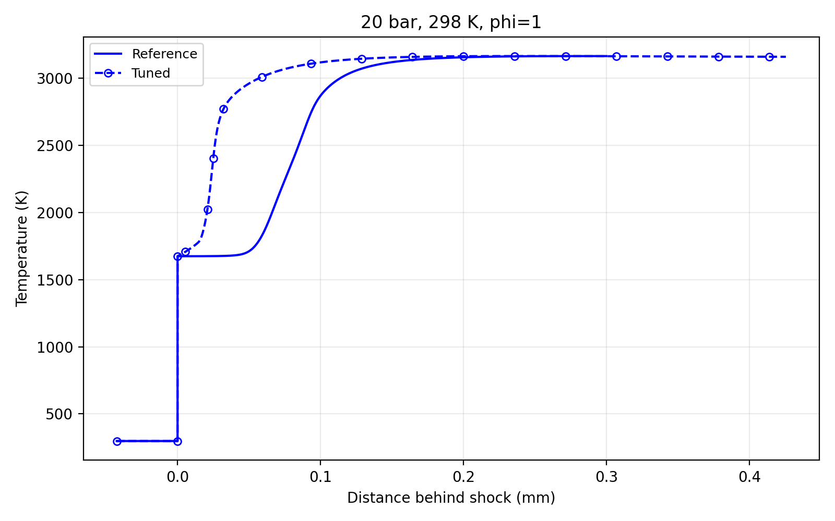
Case 10: 20 bar, φ = 1.0
Ethylene–air, initial temperature 298 K
Reported numerical comparison
Quantity | FFCM2 | Tuned | Error
T (K) | 3164.69 | 3159.58 | -0.16%
ℓind (m) | 8.8824e-5 | 2.4049e-5 | -72.93%
ℓexo (m) | 4.0357e-5 | 7.4619e-6 | -81.51%
ΔT = -5.111 K
|ln(ℓind,model / ℓind,FFCM2)| = 1.30657
|ln(ℓexo,model / ℓexo,FFCM2)| = 1.68795
11
Notes:
Source: user-provided validation output (12 cases, 2 November 2026). Temperature profiles: example/ethylene_ZND/validate/temperature_profiles/znd_case_01.png through znd_case_12.png. Reported values are rounded; percentages, delta T and log errors retain supplied output precision.
Exact supplied case data: {"case":10,"P":20,"phi":1,"Tref":3164.69,"Tmodel":3159.58,"Terr":-0.16,"dT":-5.111,"Iref":0.0000888237,"Imodel":0.0000240488,"Ierr":-72.93,"Ilog":1.30657,"Eref":0.0000403567,"Emodel":0.00000746188,"Eerr":-81.51,"Elog":1.68795}

Slide 12
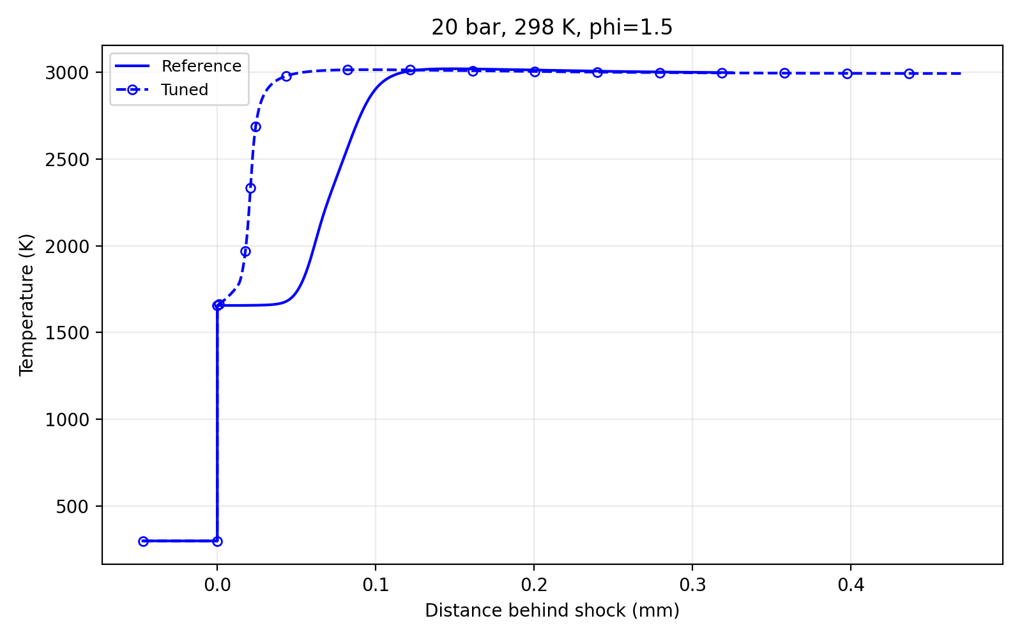
Case 11: 20 bar, φ = 1.5
Ethylene–air, initial temperature 298 K
Reported numerical comparison
Quantity | FFCM2 | Tuned | Error
T (K) | 2998.07 | 2992.75 | -0.18%
ℓind (m) | 6.4302e-5 | 2.1132e-5 | -67.14%
ℓexo (m) | 4.7288e-5 | 5.7344e-6 | -87.87%
ΔT = -5.320 K
|ln(ℓind,model / ℓind,FFCM2)| = 1.11279
|ln(ℓexo,model / ℓexo,FFCM2)| = 2.10979
12
Notes:
Source: user-provided validation output (12 cases, 2 November 2026). Temperature profiles: example/ethylene_ZND/validate/temperature_profiles/znd_case_01.png through znd_case_12.png. Reported values are rounded; percentages, delta T and log errors retain supplied output precision.
Exact supplied case data: {"case":11,"P":20,"phi":1.5,"Tref":2998.07,"Tmodel":2992.75,"Terr":-0.18,"dT":-5.32,"Iref":0.0000643022,"Imodel":0.0000211322,"Ierr":-67.14,"Ilog":1.11279,"Eref":0.0000472884,"Emodel":0.00000573436,"Eerr":-87.87,"Elog":2.10979}

Slide 13
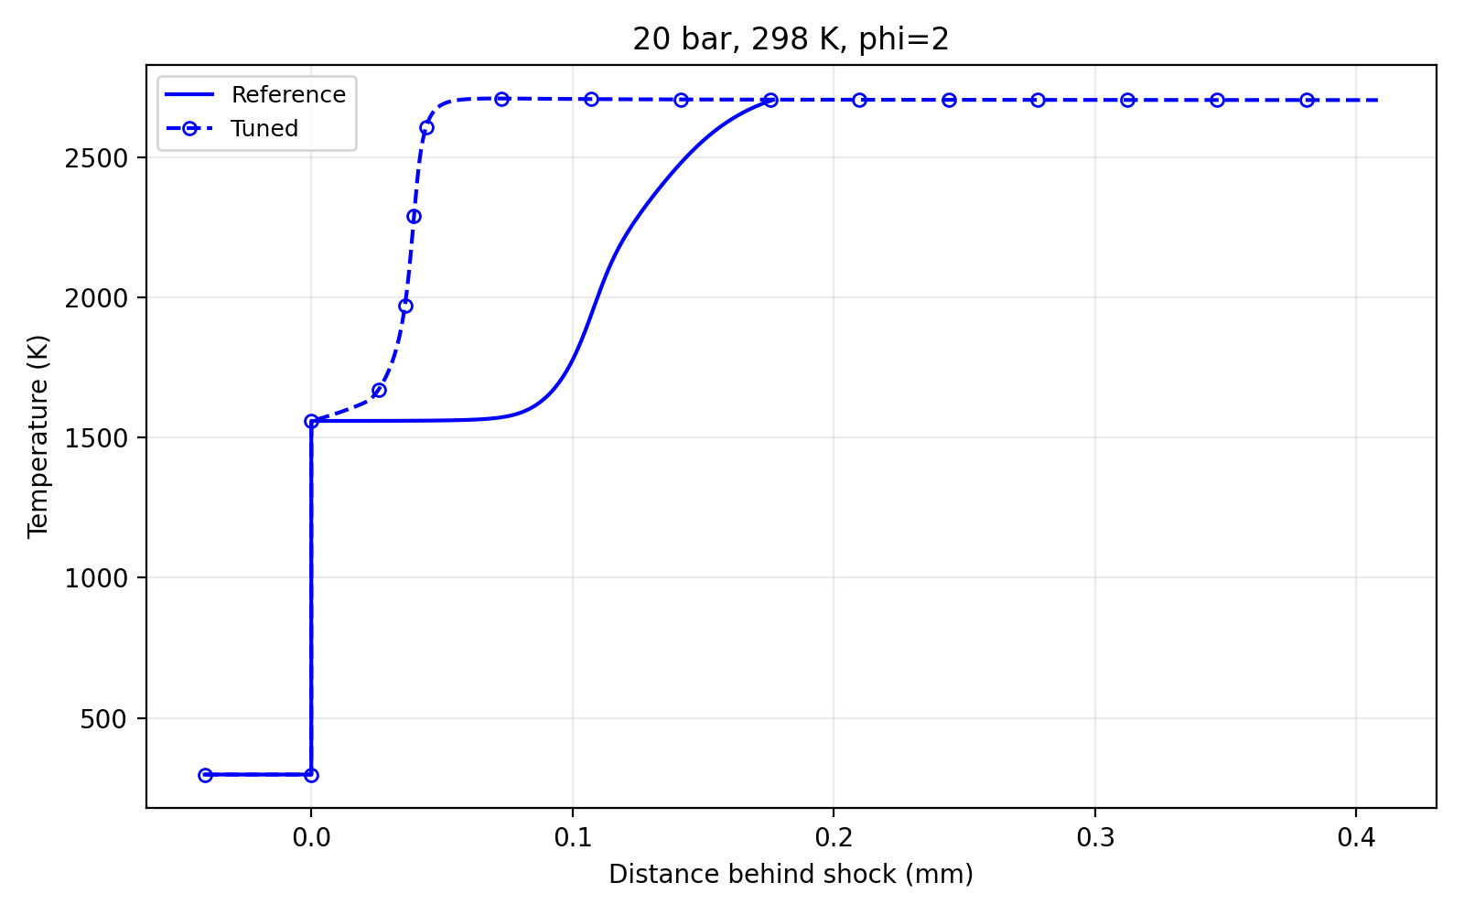
Case 12: 20 bar, φ = 2.0
Ethylene–air, initial temperature 298 K
Reported numerical comparison
Quantity | FFCM2 | Tuned | Error
T (K) | 2705.06 | 2704.03 | -0.04%
ℓind (m) | 1.1070e-4 | 3.9561e-5 | -64.26%
ℓexo (m) | 4.2647e-5 | 6.7873e-6 | -84.09%
ΔT = -1.029 K
|ln(ℓind,model / ℓind,FFCM2)| = 1.029
|ln(ℓexo,model / ℓexo,FFCM2)| = 1.83791
13
Notes:
Source: user-provided validation output (12 cases, 2 November 2026). Temperature profiles: example/ethylene_ZND/validate/temperature_profiles/znd_case_01.png through znd_case_12.png. Reported values are rounded; percentages, delta T and log errors retain supplied output precision.
Exact supplied case data: {"case":12,"P":20,"phi":2,"Tref":2705.06,"Tmodel":2704.03,"Terr":-0.04,"dT":-1.029,"Iref":0.000110702,"Imodel":0.0000395608,"Ierr":-64.26,"Ilog":1.029,"Eref":0.0000426472,"Emodel":0.00000678726,"Eerr":-84.09,"Elog":1.83791}

