Slide 1
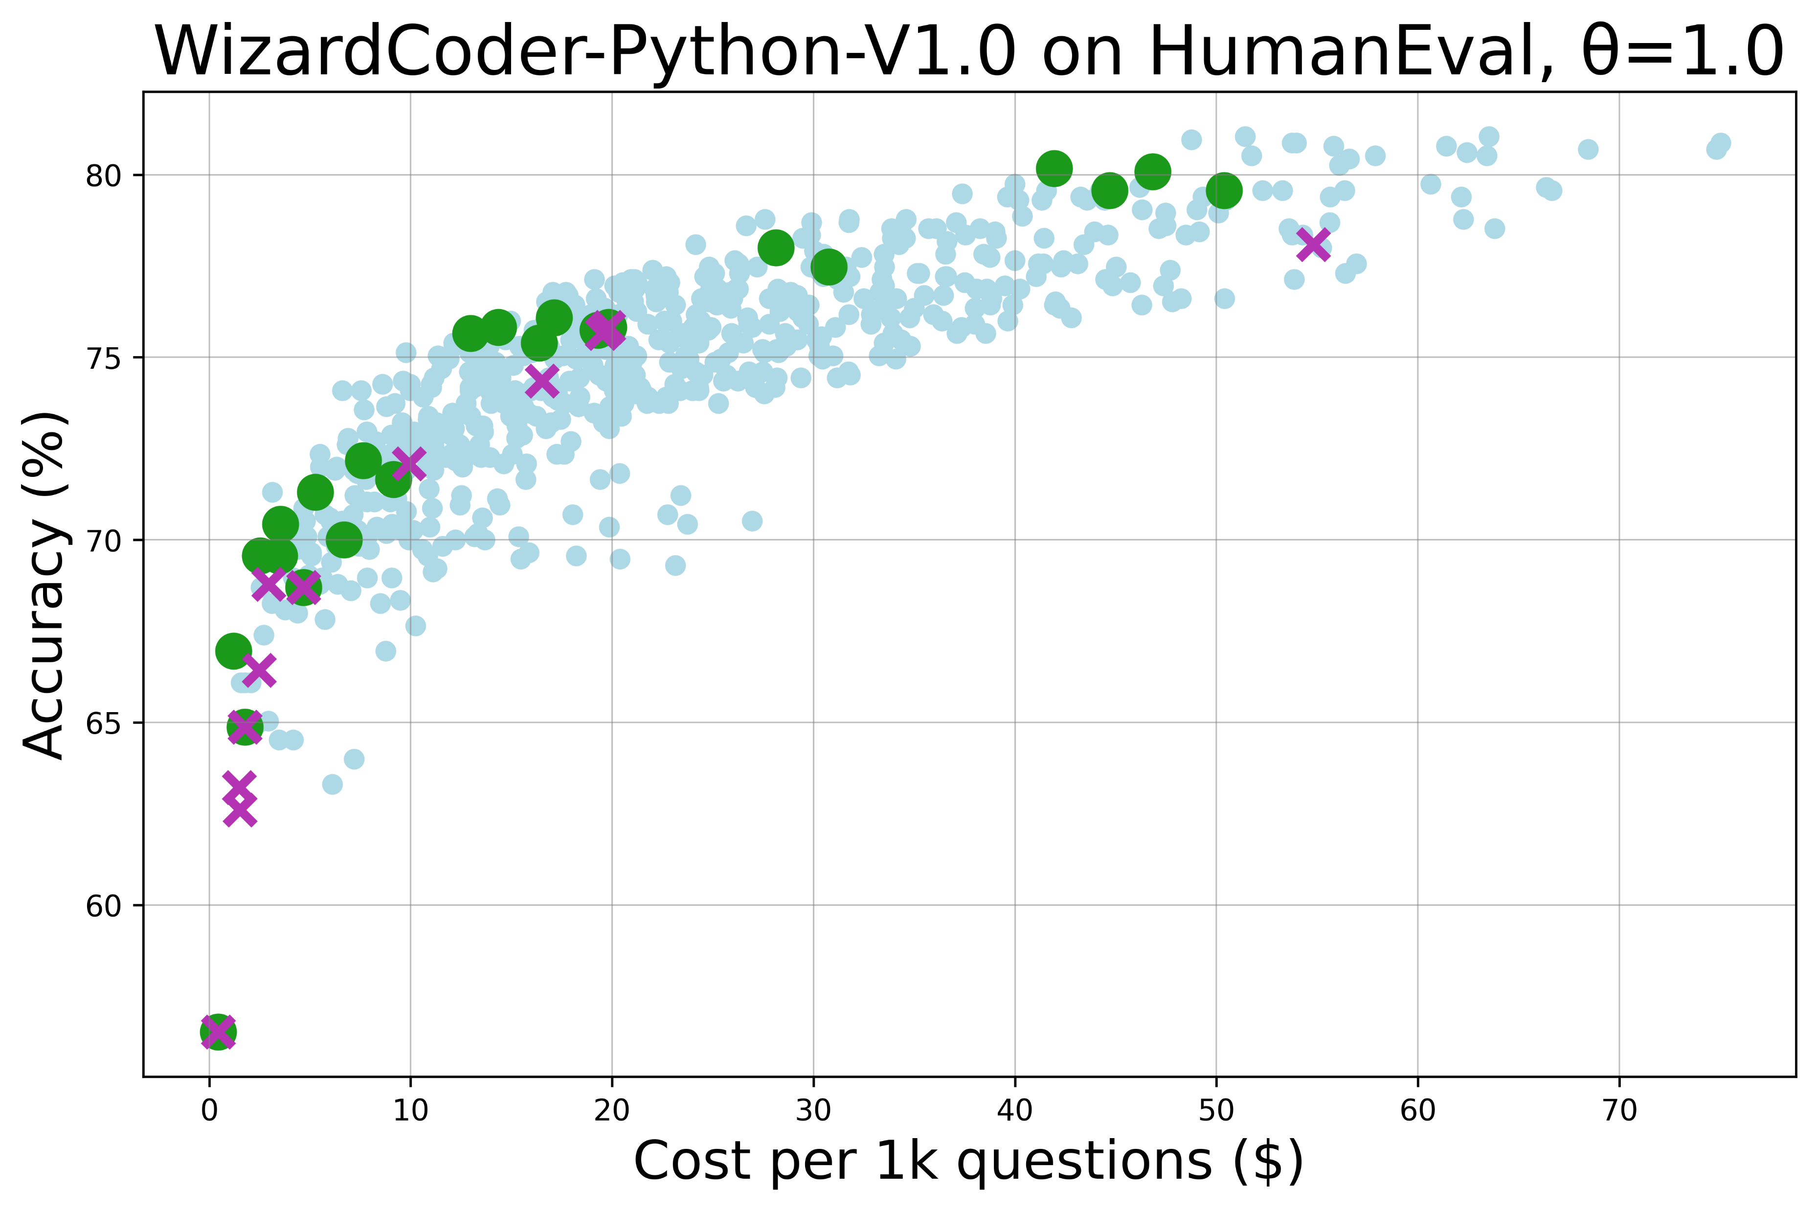
[3,5,5,4,4,2] saves 49% cost than the singular dot [-1,-1,10,0,0,2], while reaching same accuracy 78%;
[3,3,10,4,4,2] saves 24% cost than the singular dot, while achieving 2% higher accuracy.
[3,3,3,4,2,2] saves 34% cost than the singular dot [-1,10,-1,0,4,0], while reaching same accuracy 76%.

Slide 2
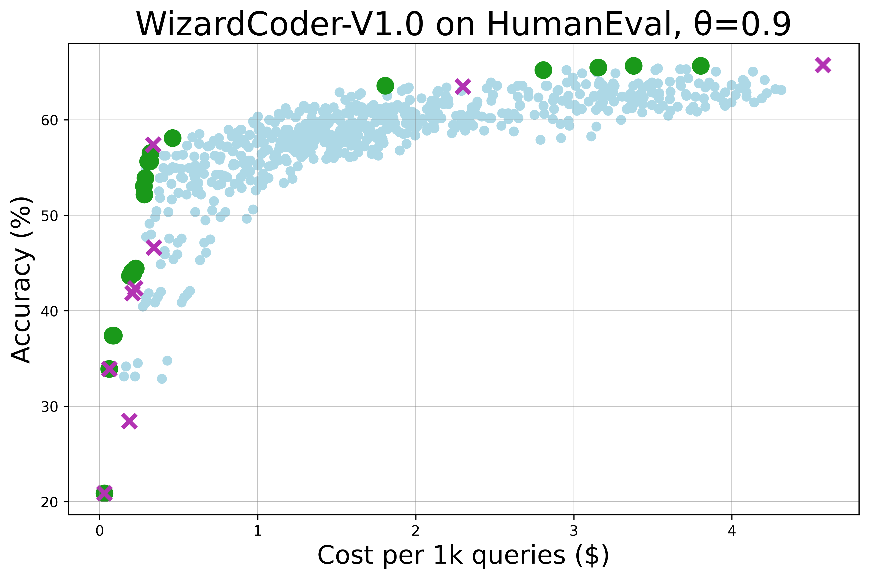
[1,3,10,4,4,2] saves 38% cost than the singular dot [-1,-1,10,0,0,4], while reaching same accuracy 65%
[1,3,5,4,4,4] saves 22% cost than the singular dot [-1,-1,5,0,0,4], while reaching same accuracy 63%

Slide 3
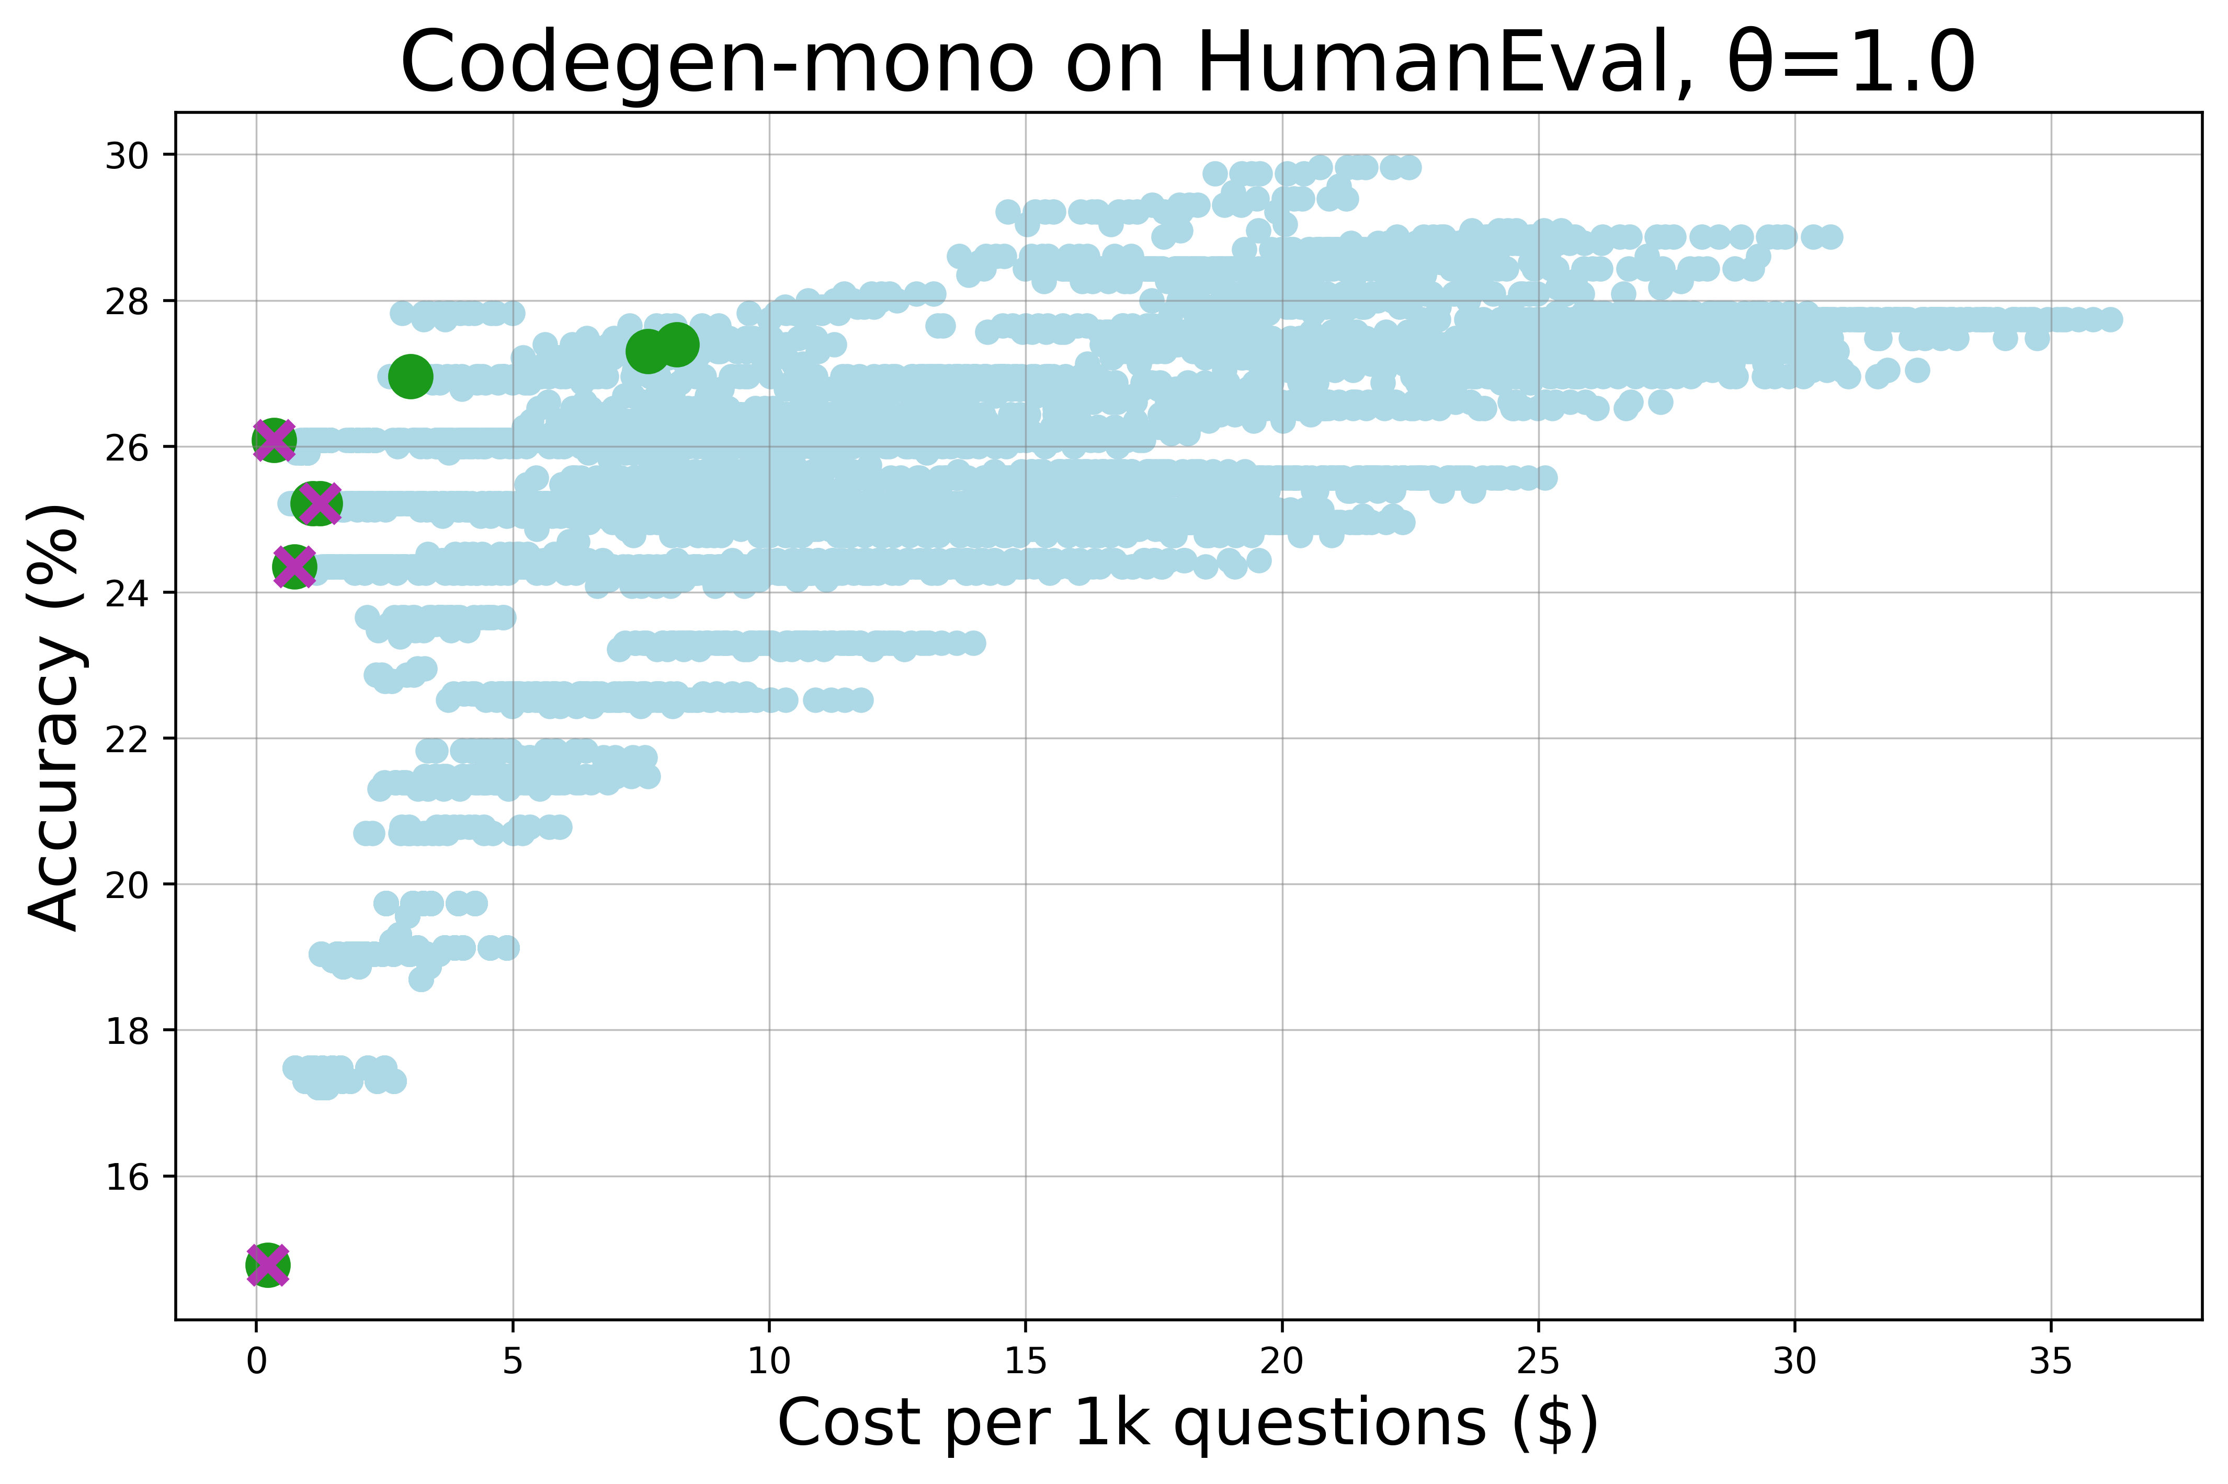

Slide 4
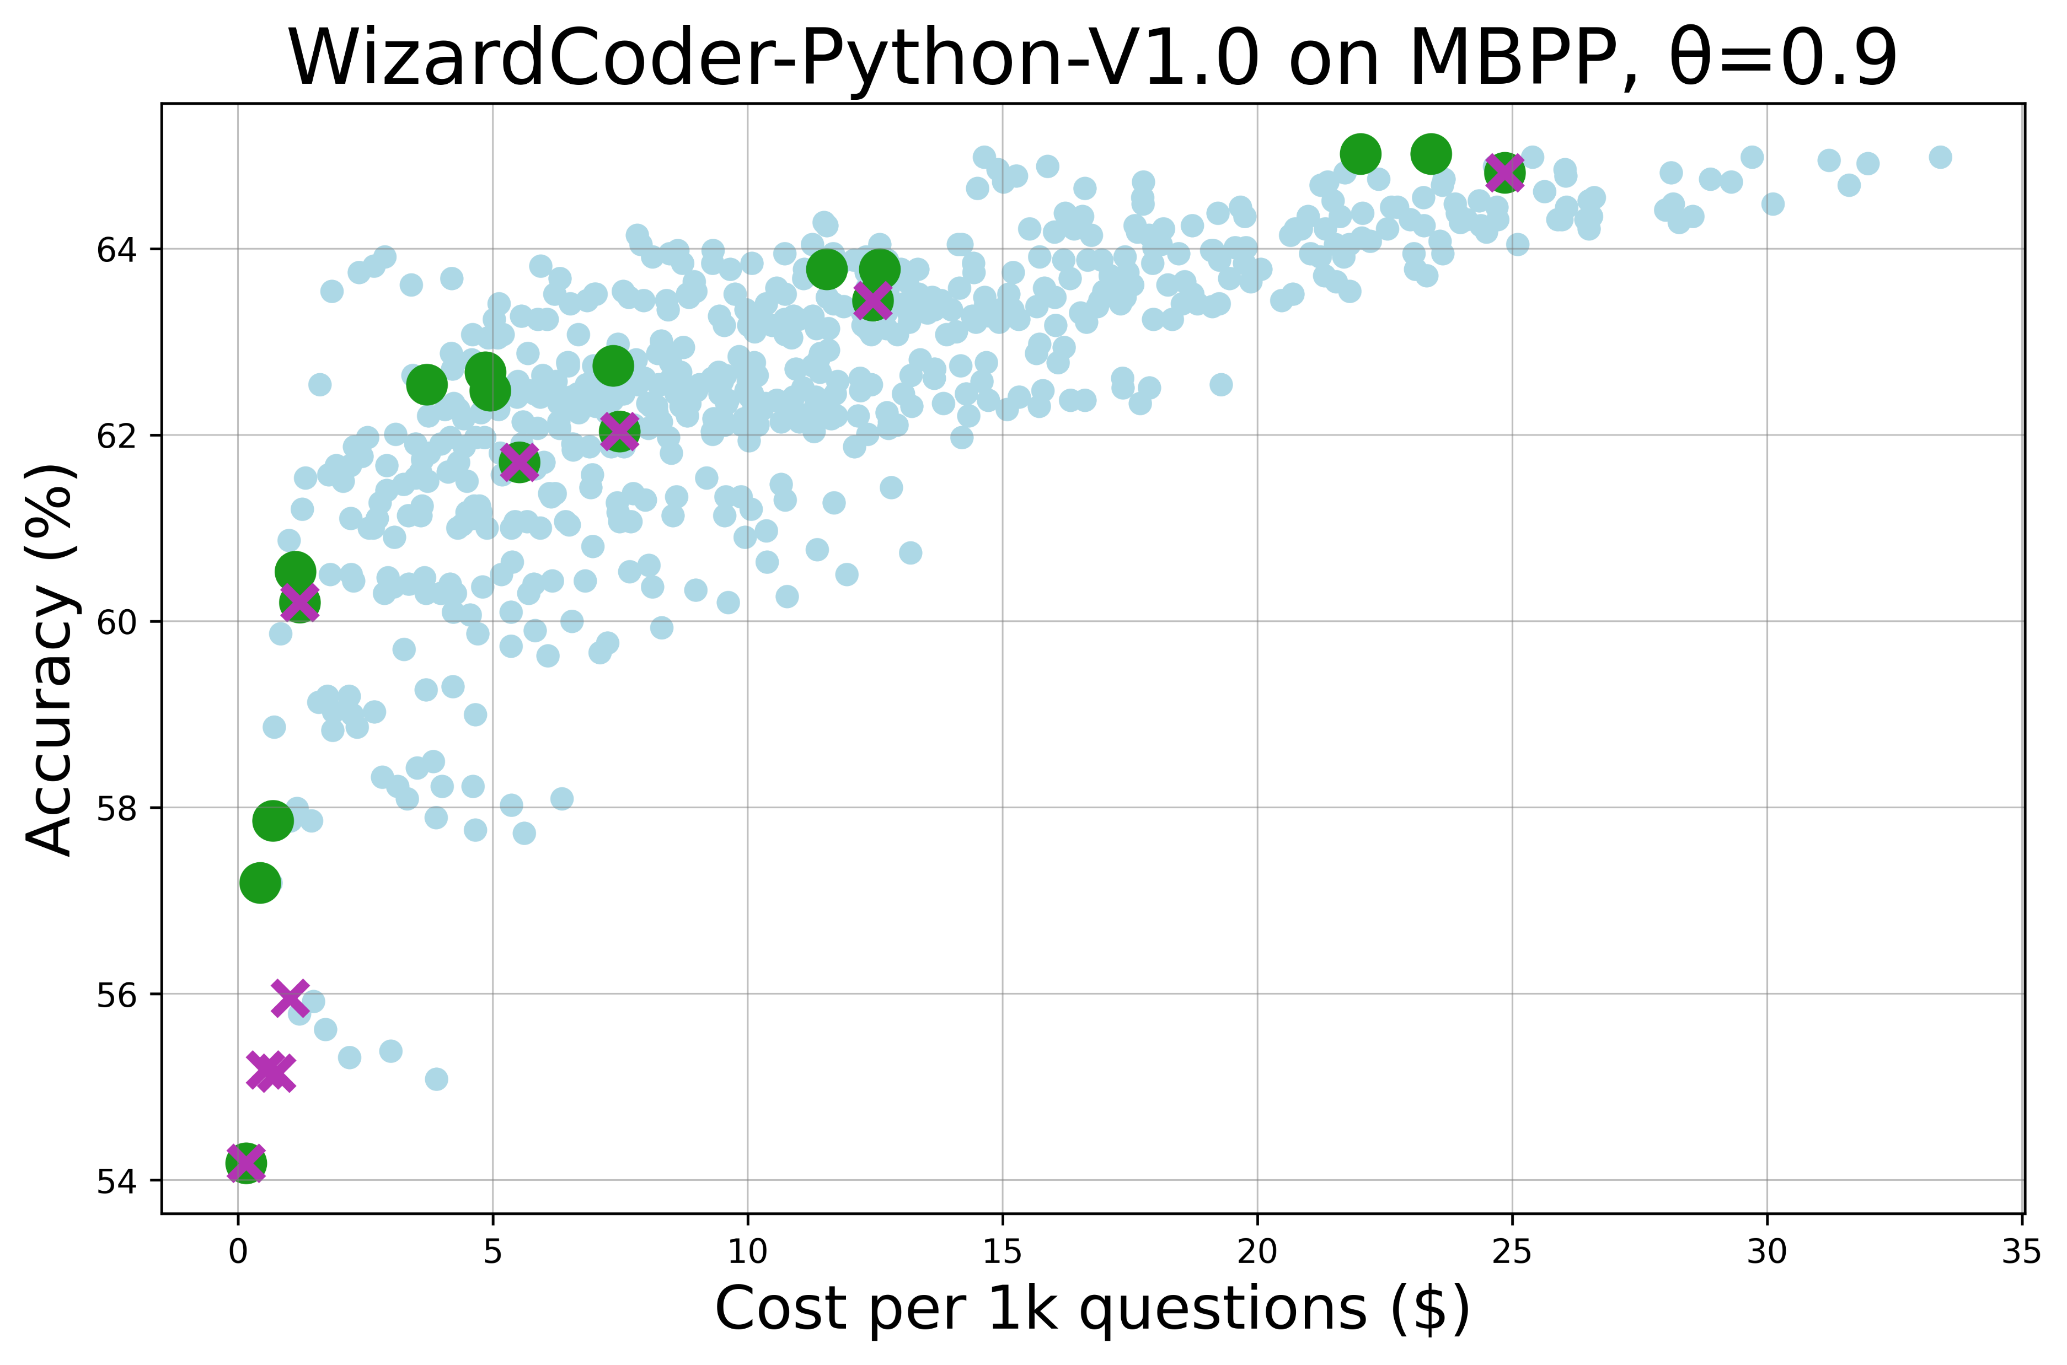

Slide 5
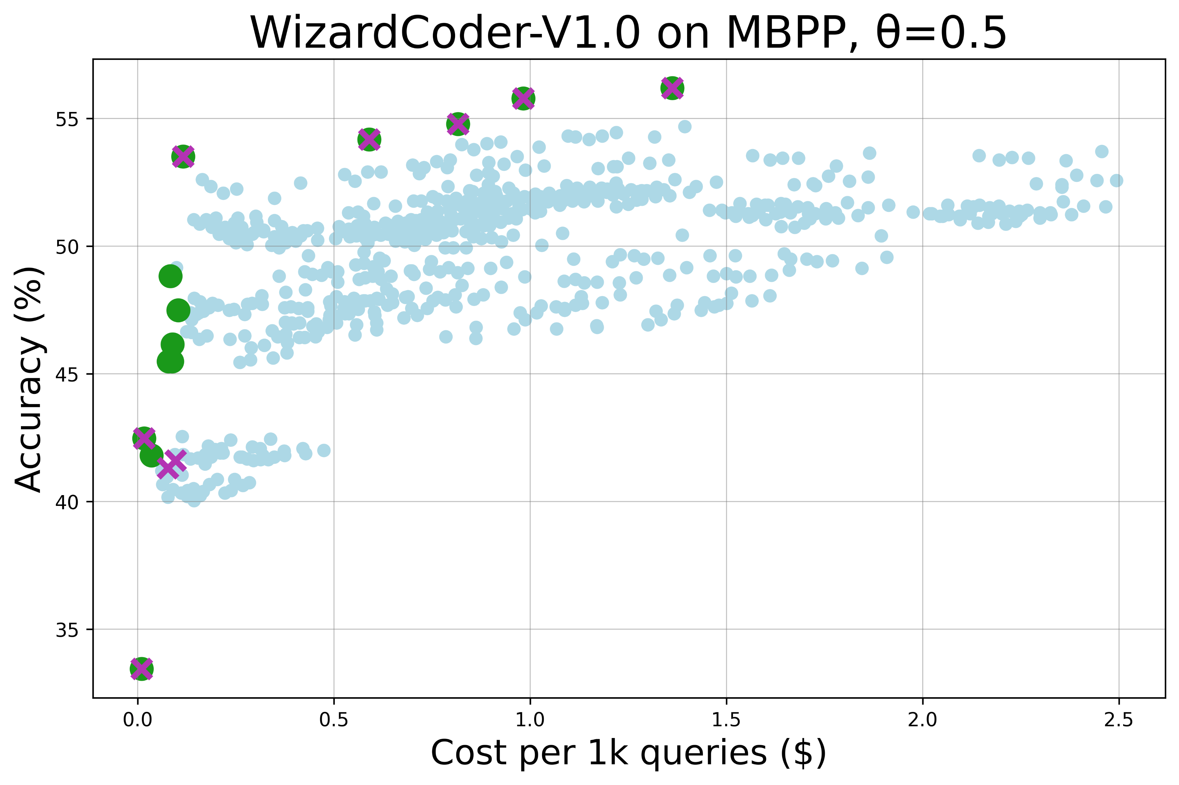

Slide 6
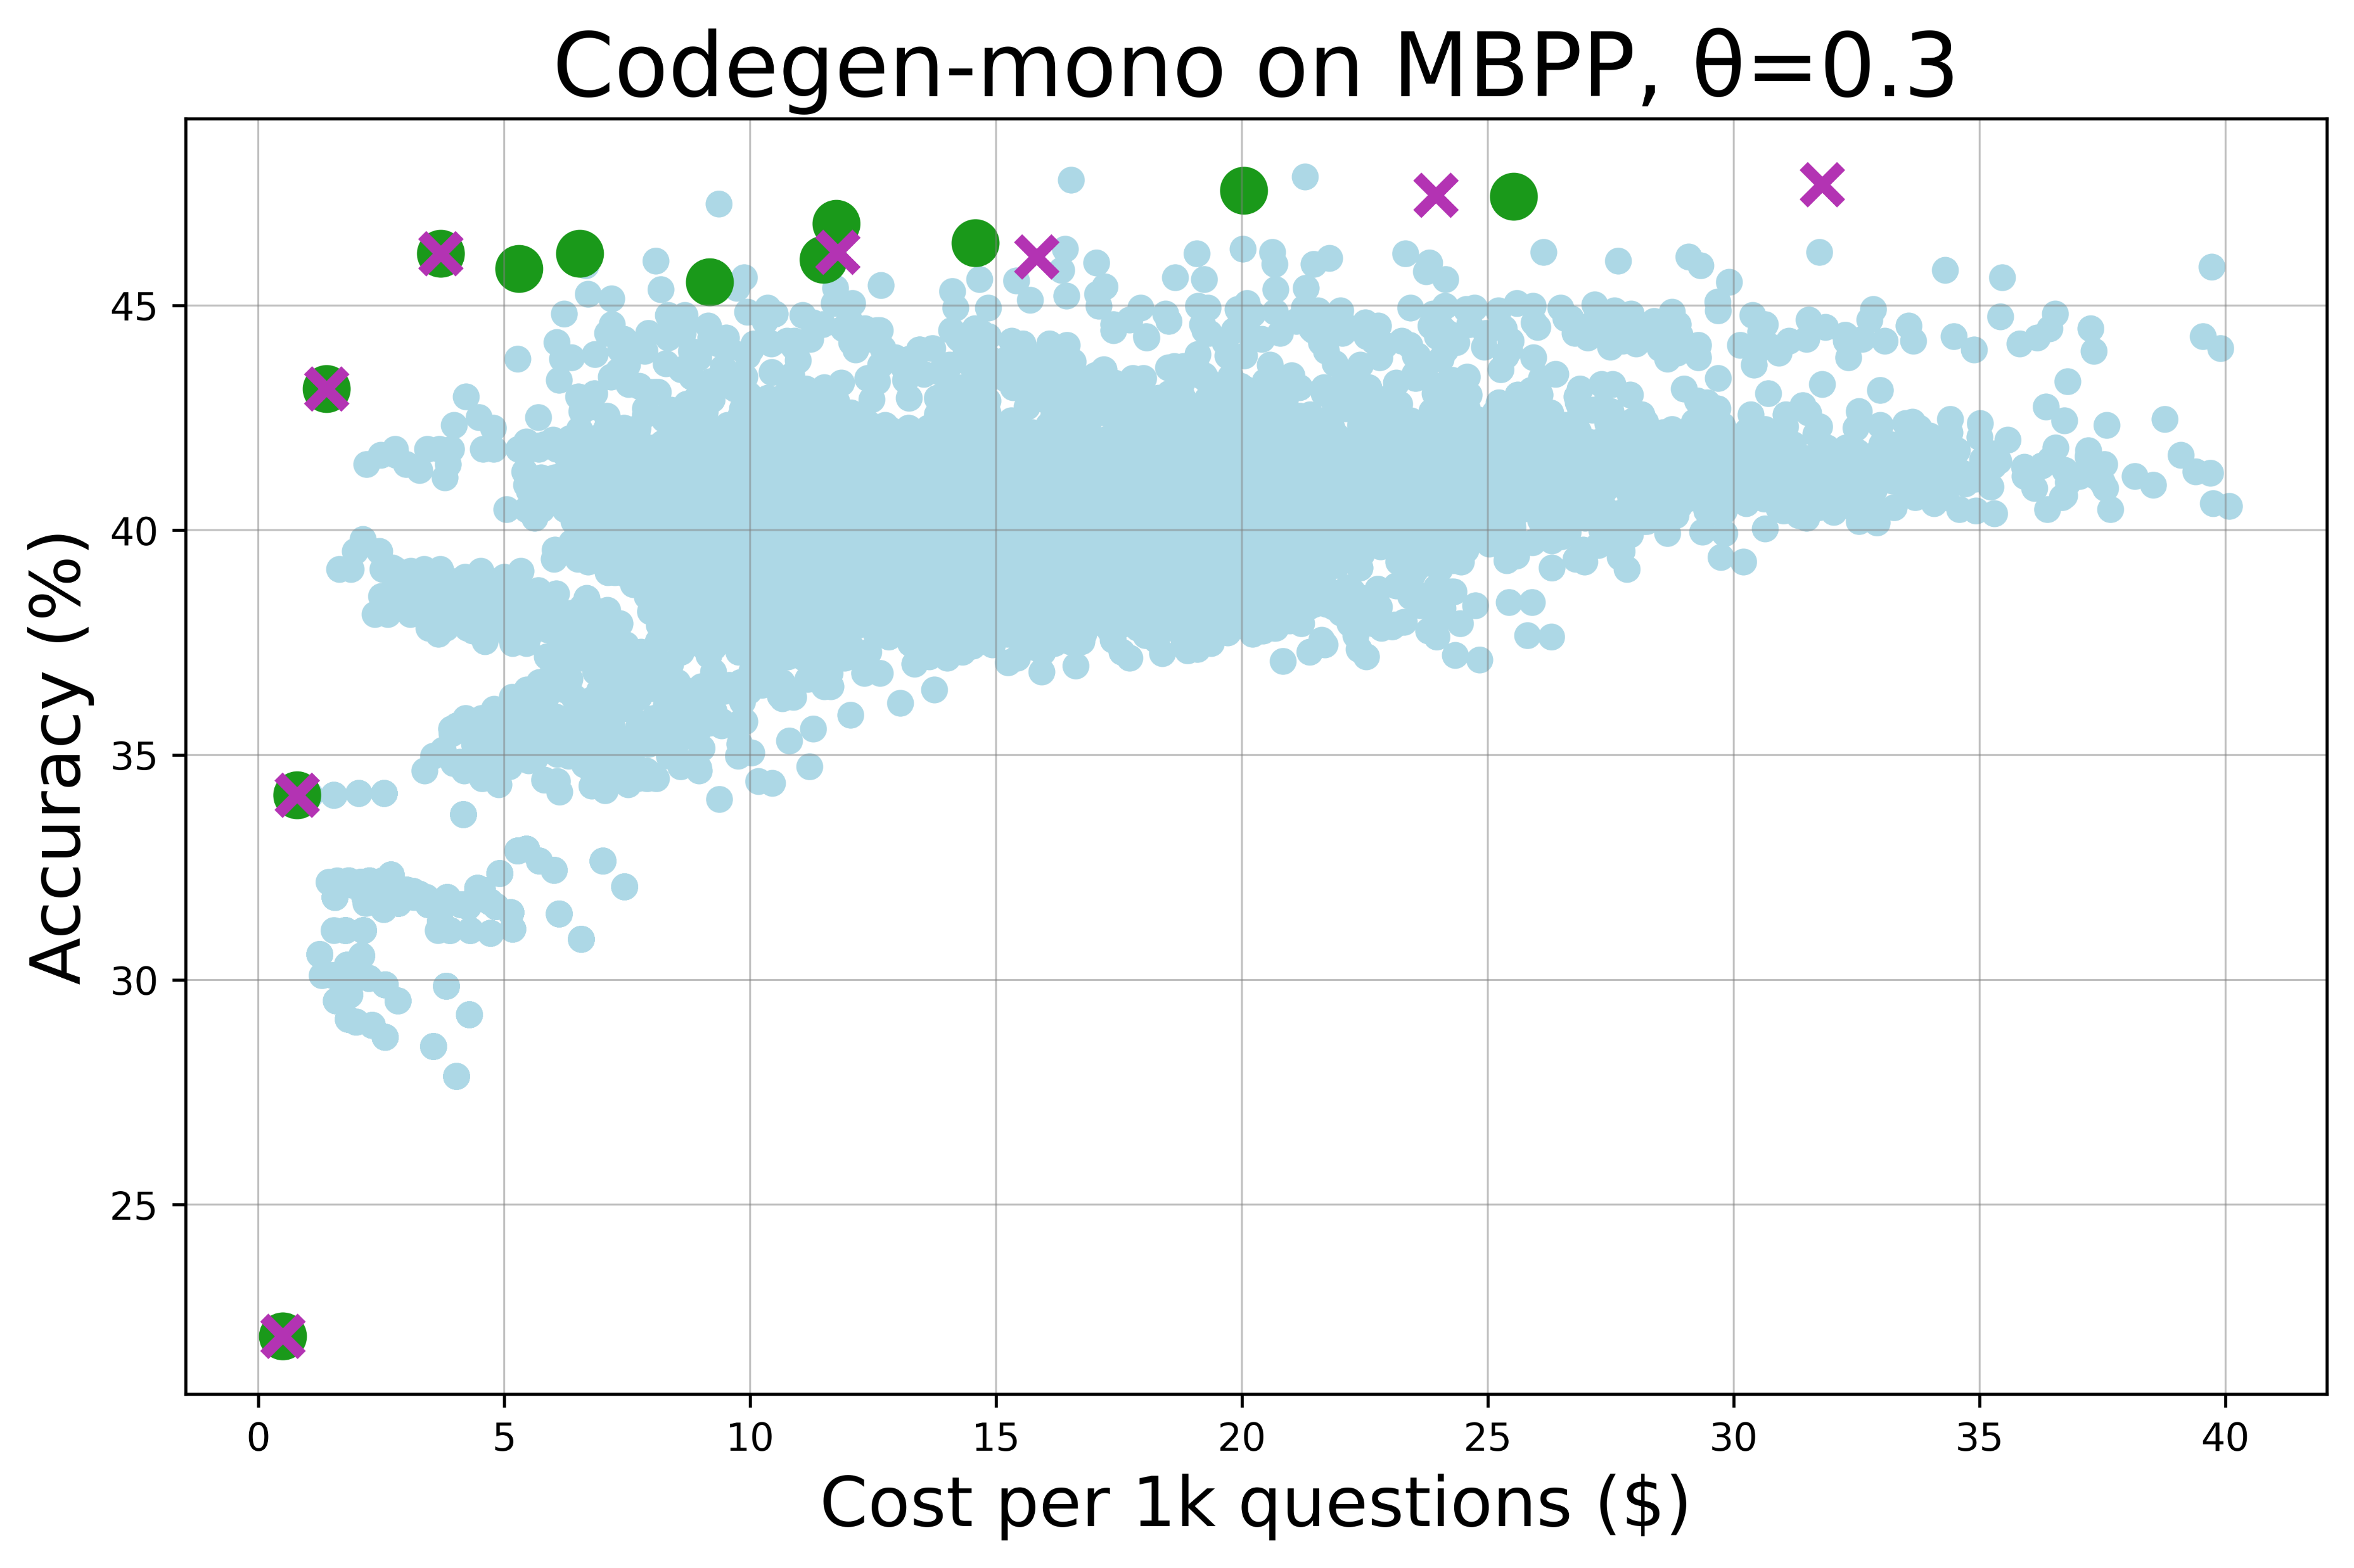

Slide 7
