Slide 1
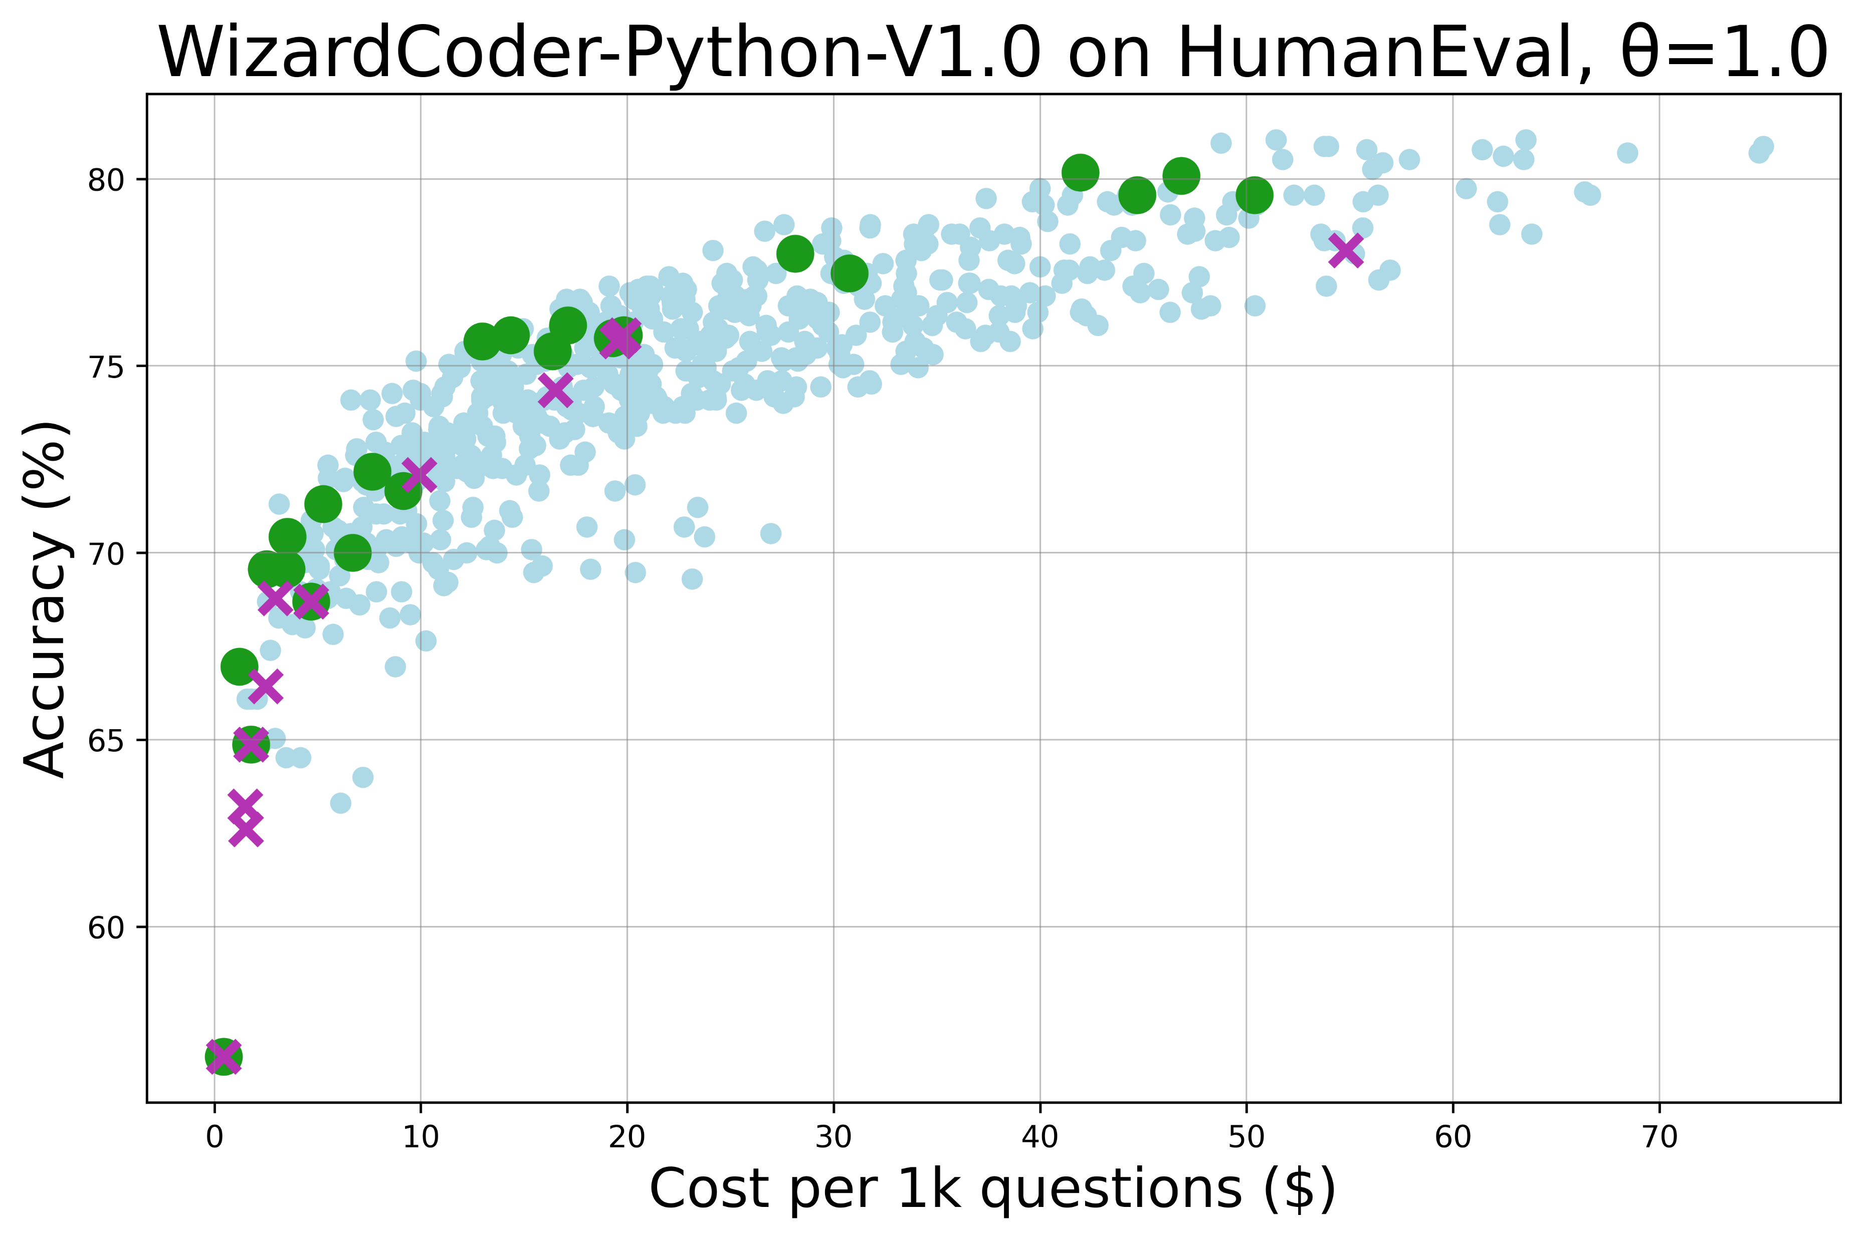
[3,5,5,4,4,2] saves 49% cost than the singular dot [-1,-1,10,0,0,2], while reaching same accuracy 78%;
[3,3,10,4,4,2] saves 24% cost than the singular dot, while achieving 2% higher accuracy.
[3,3,3,4,2,2] saves 34% cost than the singular dot [-1,10,-1,0,4,0], while reaching same accuracy 76%.
[1,0,-1,2,0,0] achieves 2-4% higher accuracy at the same cost of singular combinations.

Slide 2
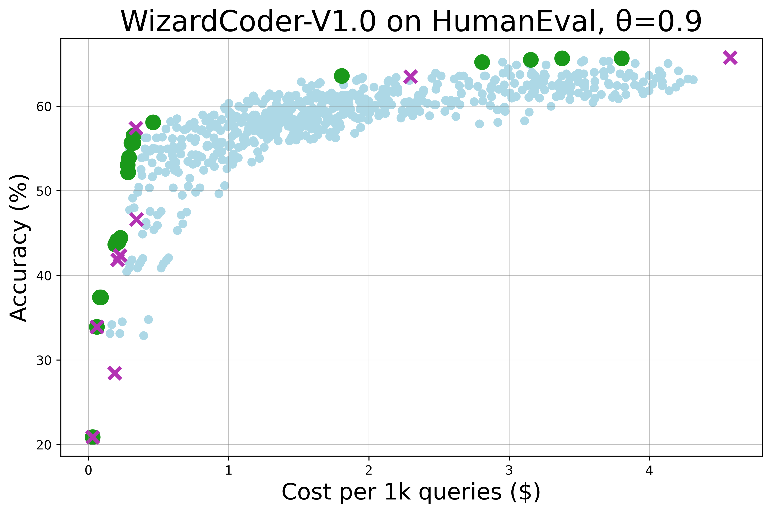
[1,3,10,4,4,2] saves 38% cost than the singular dot [-1,-1,10,0,0,4], while reaching same accuracy 65%
[1,3,5,4,4,4] saves 22% cost than the singular dot [-1,-1,5,0,0,4], while reaching same accuracy 63%
Cascading results are 1-2% more accurate than singular combinations at similar costs in lower-budget.

Slide 3
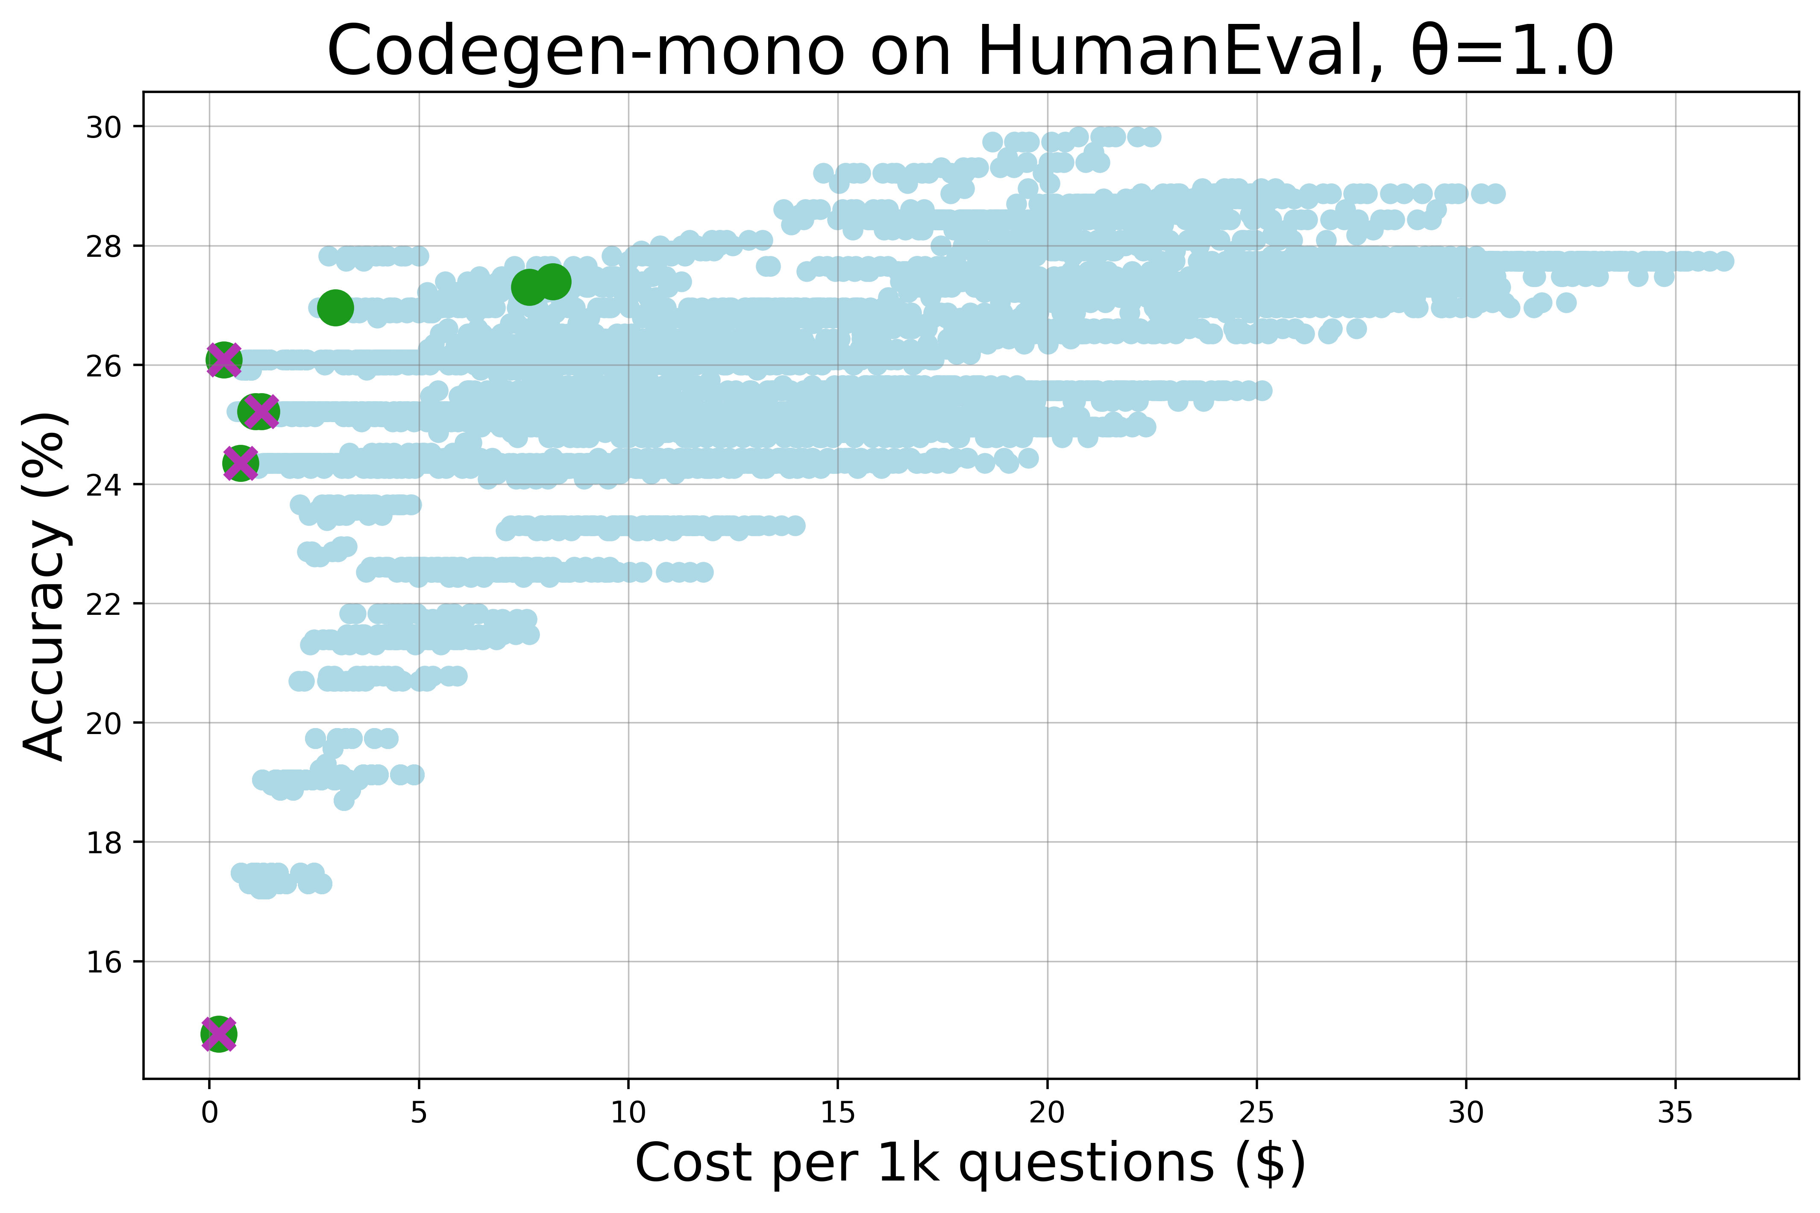
Cascading scheme picks equally optimal combinations in the low-cost range, and offers pareto options for higher-cost range.

Slide 4
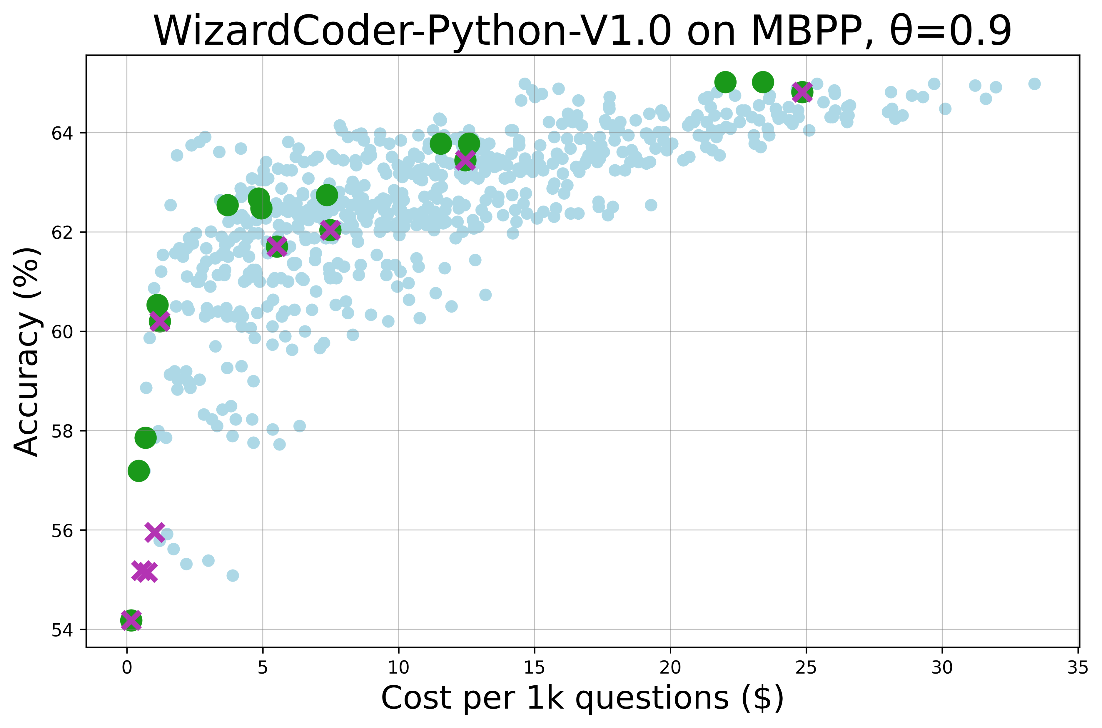
[3,3,3,4,2,2] saves 34% cost than the singular dot [-1,10,-1,0,4,0], while reaching same accuracy 76%.
Cascading combinations are constantly more optimal than singular combinations in middle-budget.
[1,0,-1,4,0,0] is 2-3% more accurate than singular combinations at similar costs in lower-budget.

Slide 5
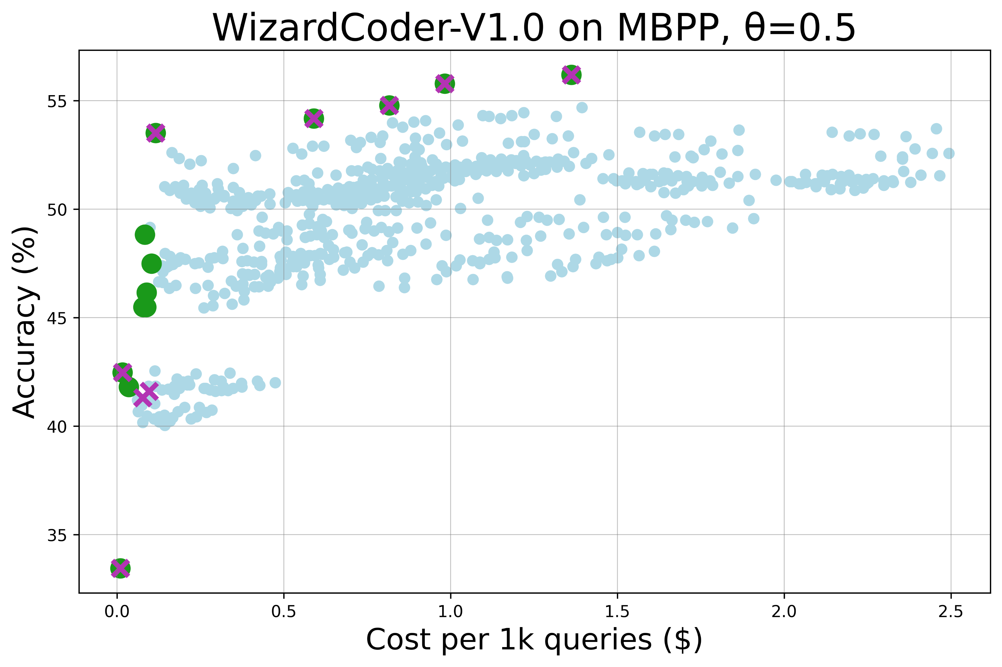
Cascading scheme finds the same optimal combinations as singular ones.
[1,0,-1,4,0,0] is 2-3% more accurate than singular combinations at similar costs in lower-budget.

Slide 6
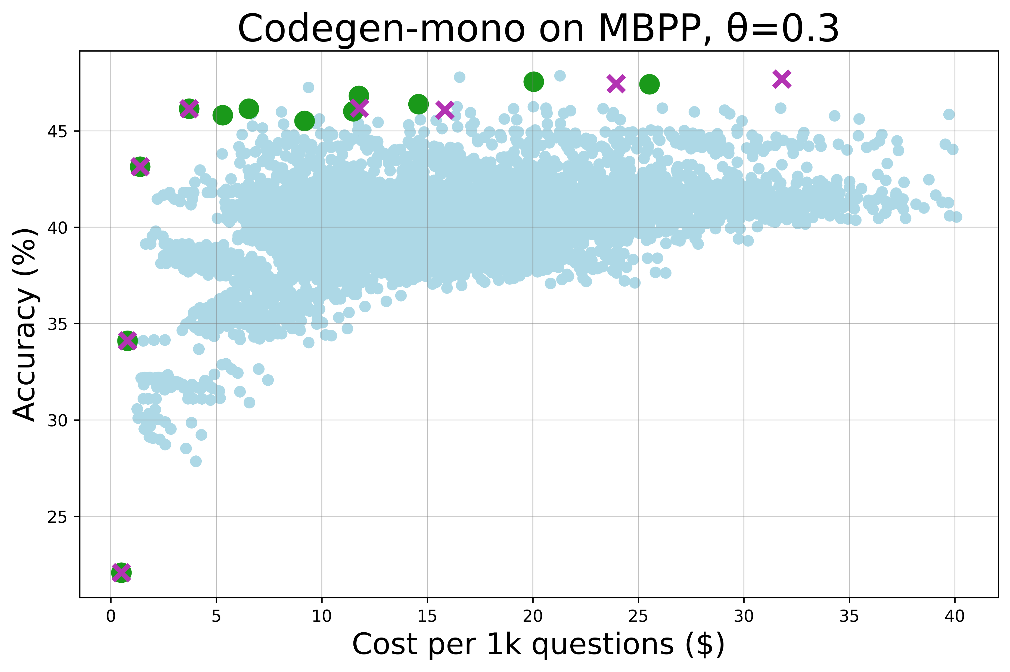
Cascading scheme finds lower cost combinations than singular ones in higher budget.
Cascading scheme finds the same optimal combinations as singular ones.

Slide 7
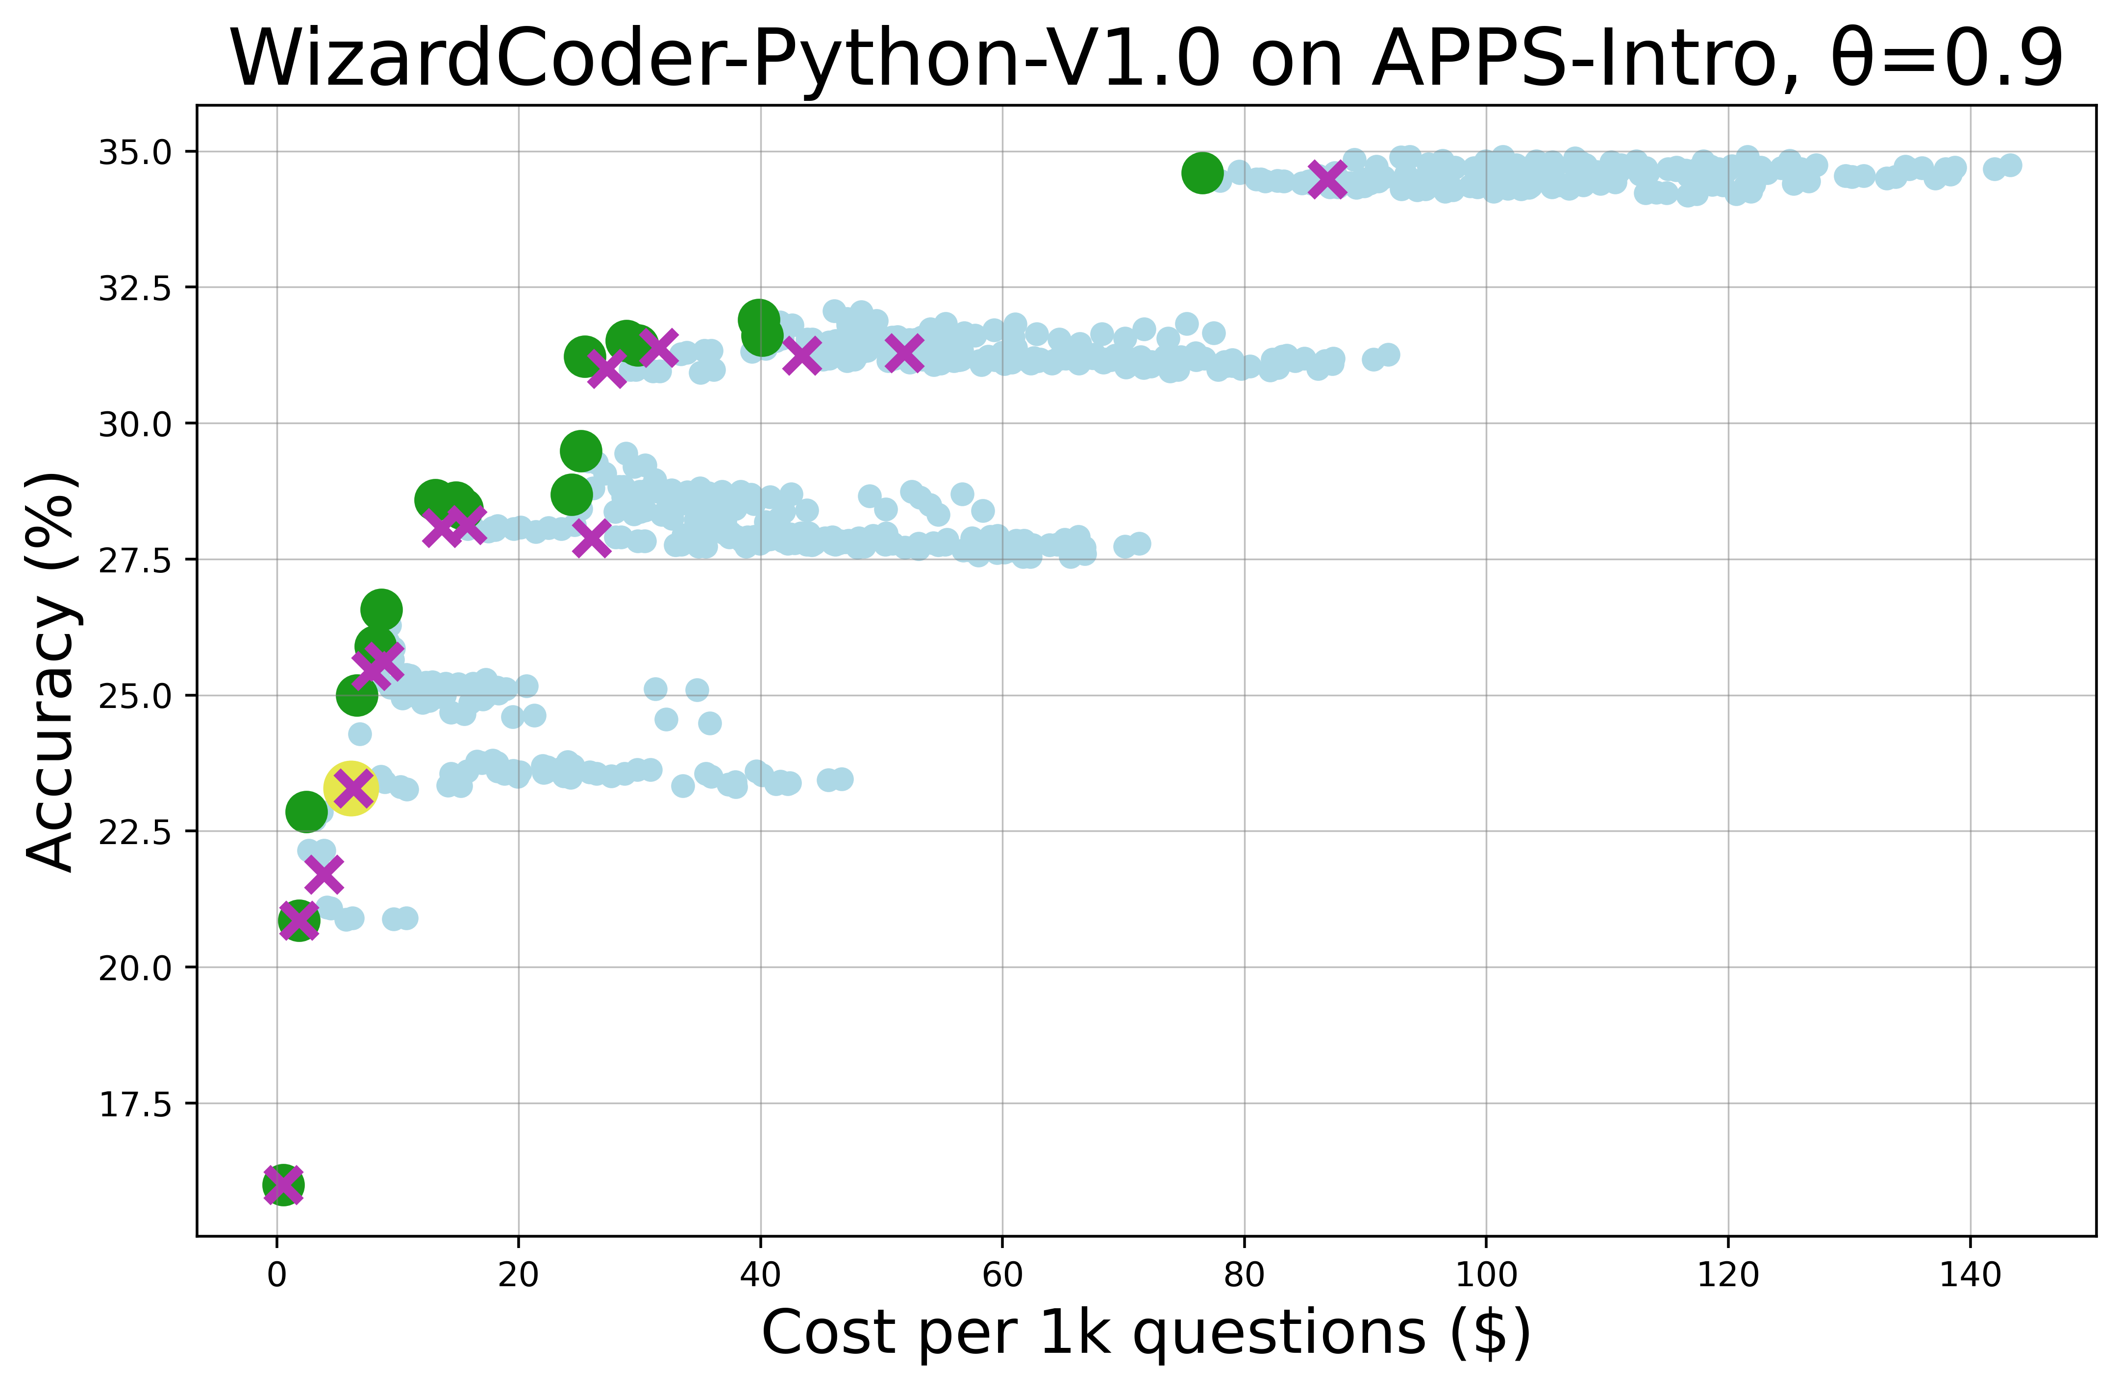
[1,1,10,2,2,2] saves 12% cost than the singular dot [-1,-1,10,0,0,2], while reaching same accuracy 34.6%.
SD result has a 3.1% cost reduction than greedy baseline, slower than [1,0,-1,2,0,0], less accurate than [1,-1,0,2,0,0]

