Slide 1
Restylization Network: Restynet
Batuhan Ozcomlekci

Slide 2
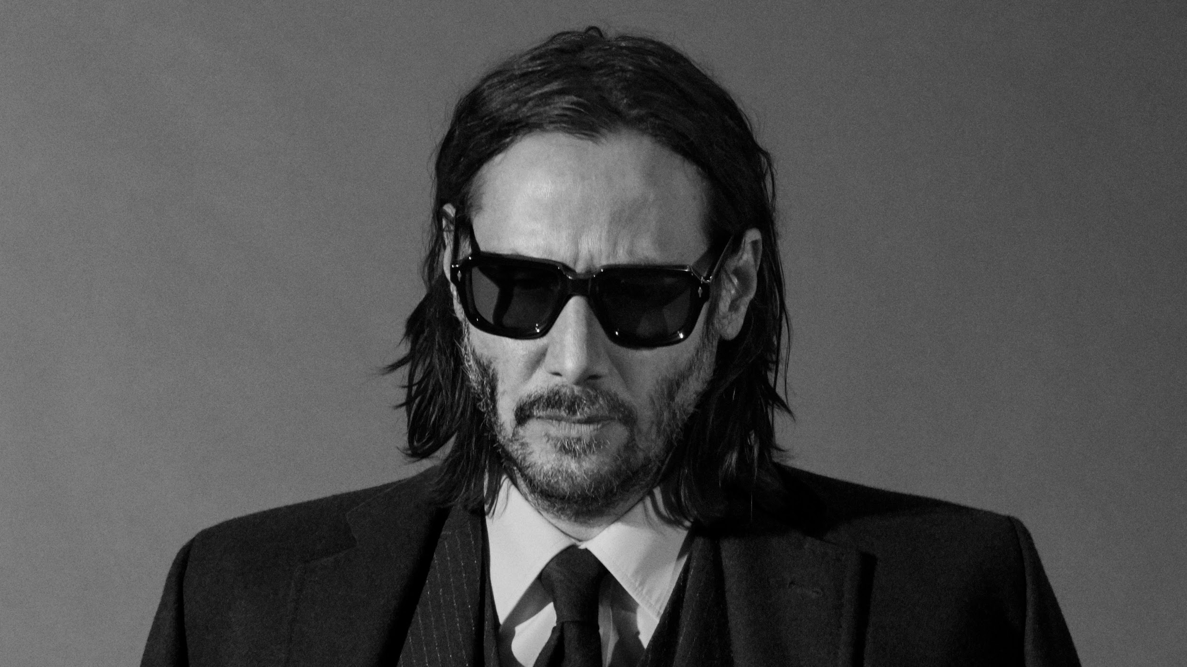
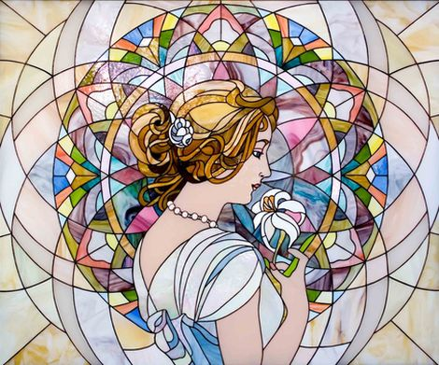
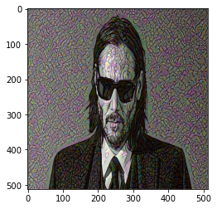
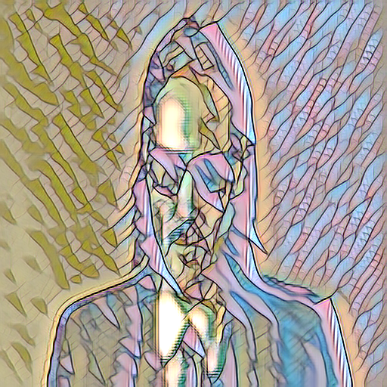
Style Transfer
Style transfer is an image stylization task where the content of an image is blended with the style of another image. Style transfer task can be divided into two subcategories which are photorealistic image stylization and non-photorealistic image stylization

Slide 3
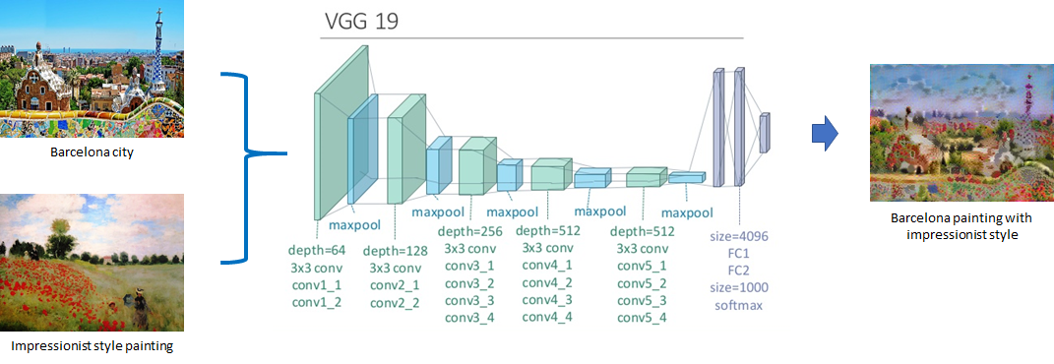
Style Transfer with Convolutional Neural Networks
Style Transfer with CNNs covers non-photorealistic style transfer
For this purpose, VGG16 or VGG19 networks are frequently used
1071 × 370

Slide 4
Style Transfer with Convolutional Neural Networks
In the paper classic Gatys et. al., this task is achieved by optimizing two loss functions which are Style Loss and Content Loss.
These losses contribute to the style information and content information of the constructed image.
These losses depend on the tensors extracted from the intermediate layers of a VGG network.

Slide 5

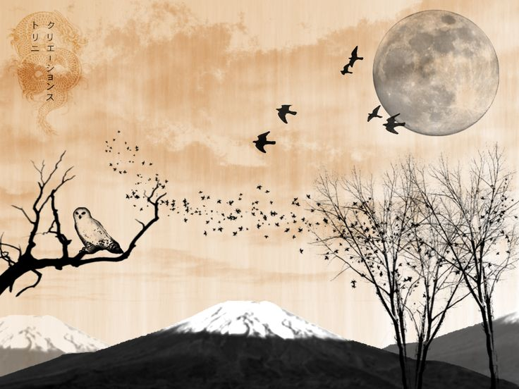
Content Loss
Content loss is defined as the sum of per pixel differences between the corresponding tensors extracted from the layers of content image and output image.

Slide 6
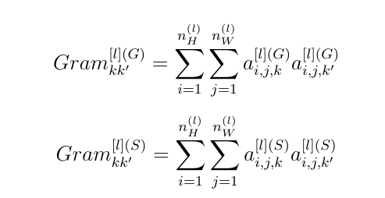
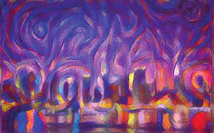
Gram MAtrix Representation of Style
Gatys et al. relates the style to the Gram matrices of the images which are defined as:

Slide 7
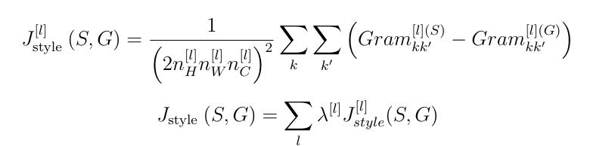
Style Loss
Style Loss depends on the difference between the Gram matrices of style image and outputted image.

Slide 8
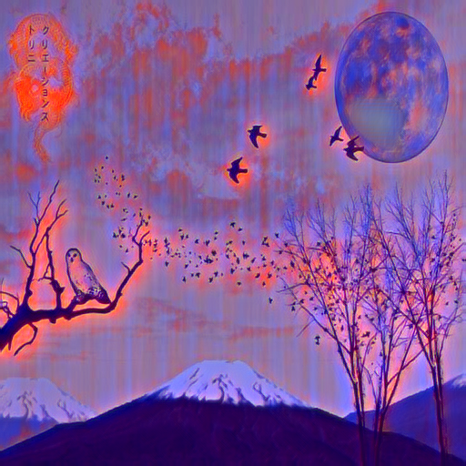
Loss Total
Finally, the total loss is the sum of style loss and content loss.
One can optimize and restylize the image by iterating this process.

Slide 9
Improvements That can be made
The speed of classic network (Gatys et. al.) is poor
The real time style transfer is impossible with this approach

Slide 10
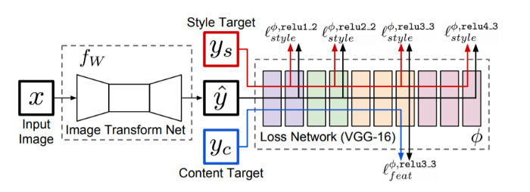
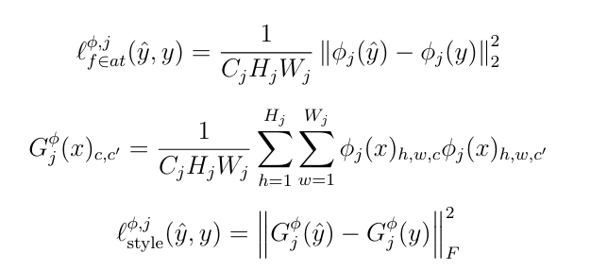
Perceptual Loss
Perceptual losses which depend on the feature difference instead of per pixel difference turns out to be faster than the classic approach.

Slide 11
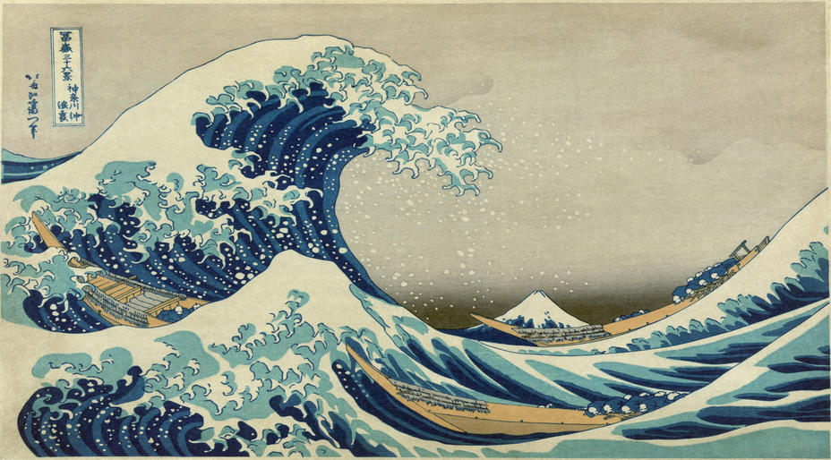
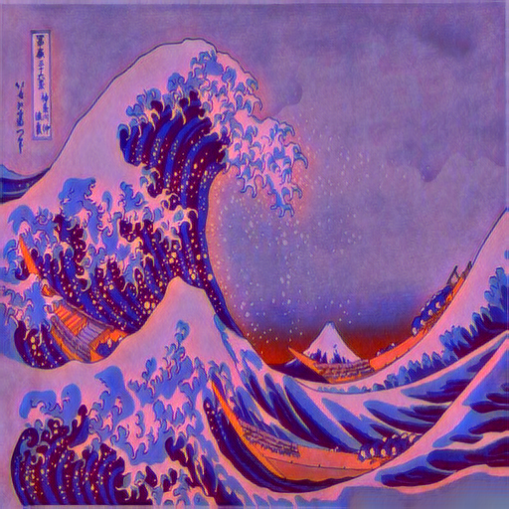
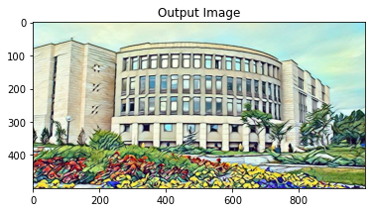
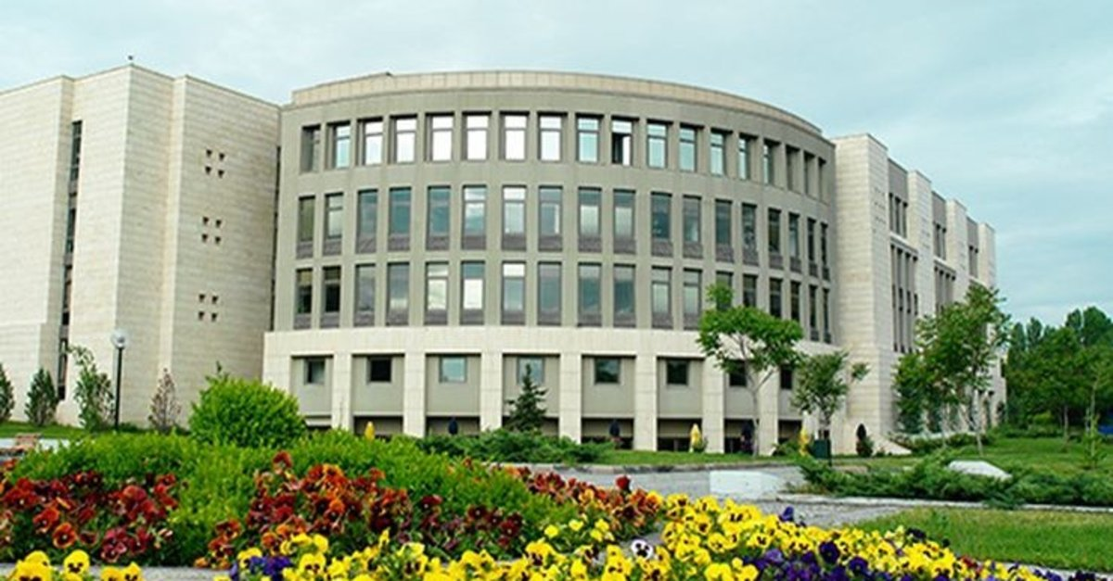
Some Qualitative Results

Slide 12
Conclusion
Throughout the project, CNN based style transfer networks are tested. The style transfer task on these CNN networks outputted decent results yet they were poor for computational efficiency. Both of the methods require some time to process arbitrary images. Also, the outputted image doesn’t seem realistic. Among CNN methods, the method with perceptual loss outperform the classic neural style transfer network.

Slide 13
REFERENCES
[1] L. A. Gatys, A. S. Ecker, and M. Bethge, “A Neural Algorithm of Artistic Style,” 02-Sep-2015.[Online]. Available: https://arxiv.org/abs/1508.06576. [Accessed: 16-Nov-2020].
[2] “torch.utils.data,” torch.utils.data - PyTorch 1.7.0 documentation. [Online]. Available:https://pytorch.org/docs/stable/data.html. [Accessed: 25-Dec-2020].
[3] Dxyang, “dxyang/StyleTransfer,” GitHub. [Online]. Available: . [Accessed: 16-Nov-2020].
[4]“NeuralTransferUsingPyTorch,”NeuralTransferUsingPy-Torch-PyTorchTutorials1.7.1documentation.[Online].Available:https://pytorch.org/tutorials/advanced/neuralstyletutorial.html. [Accessed: 25-Dec-2020].
[5] J. Johnson, A. Alahi, and L. Fei-Fei, “Perceptual Losses for Real-Time Style Transfer and Super-Resolution,” Computer Vision – ECCV 2016 Lecture Notes in Computer Science, pp. 694–711,2016.
[6] D. Ulyanov, A. Vedaldi, and V. Lempitsky, “Instance Normalization: The Missing Ingredient forFast Stylization,” arXiv.org, 06-Nov-2017. [Online]. Available: https://arxiv.org/abs/1607.08022.[Accessed: 25-Dec-2020].

Slide 14
[7] TensorFlow Implementation of ”A Neural Algorithm of Artistic Style”. [Online]. Available:http://www.chioka.in/tensorflow-implementation-neural-algorithm-of-artistic-style. [Accessed: 16-Nov-2020].
[8] K. Simonyan and A. Zisserman, “Very Deep Convolutional Networks for Large-Scale Image Recog-nition,” arXiv.org, 10-Apr-2015. [Online]. Available: https://arxiv.org/abs/1409.1556. [Accessed:16-Nov-2020].
[9] H. Narayanan, “Convolutional neural networks for artistic style transfer,” Convolutional neural networks for artistic style transfer - Harish Narayanan, 31-Mar-2017. [Online]. Available:https://harishnarayanan.org/writing/artistic-style-transfer/. [Accessed: 16-Nov-2020].
[10] “Pretrainedmodels,”PretrainedCNNs-MatConvNet.[Online].Available:https://www.vlfeat.org/matconvnet/pretrained/. [Accessed: 16-Nov-2020].
[11]Nvidia,“NVIDIA/FastPhotoStyle,”GitHub,26-Jul-2018.[Online].Available:https://github.com/NVIDIA/FastPhotoStyle/blob/master/photowct.py.[Accessed:16-Nov-20

