Slide 1
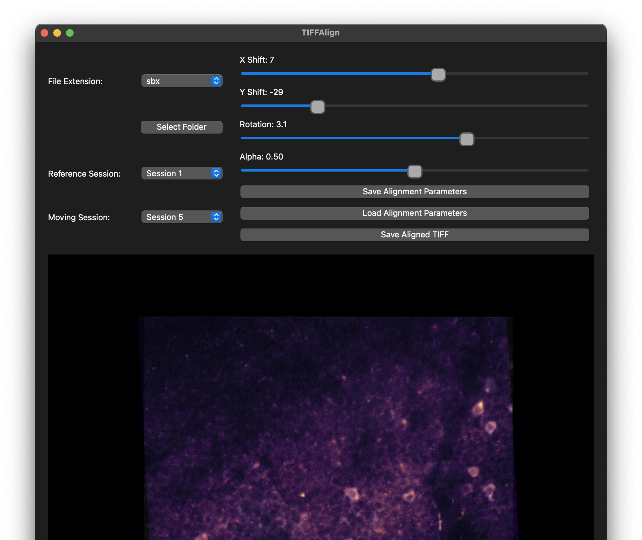
TIFFAlign
A simple GUI for manual alignment across calcium imaging sessions

