Slide 1
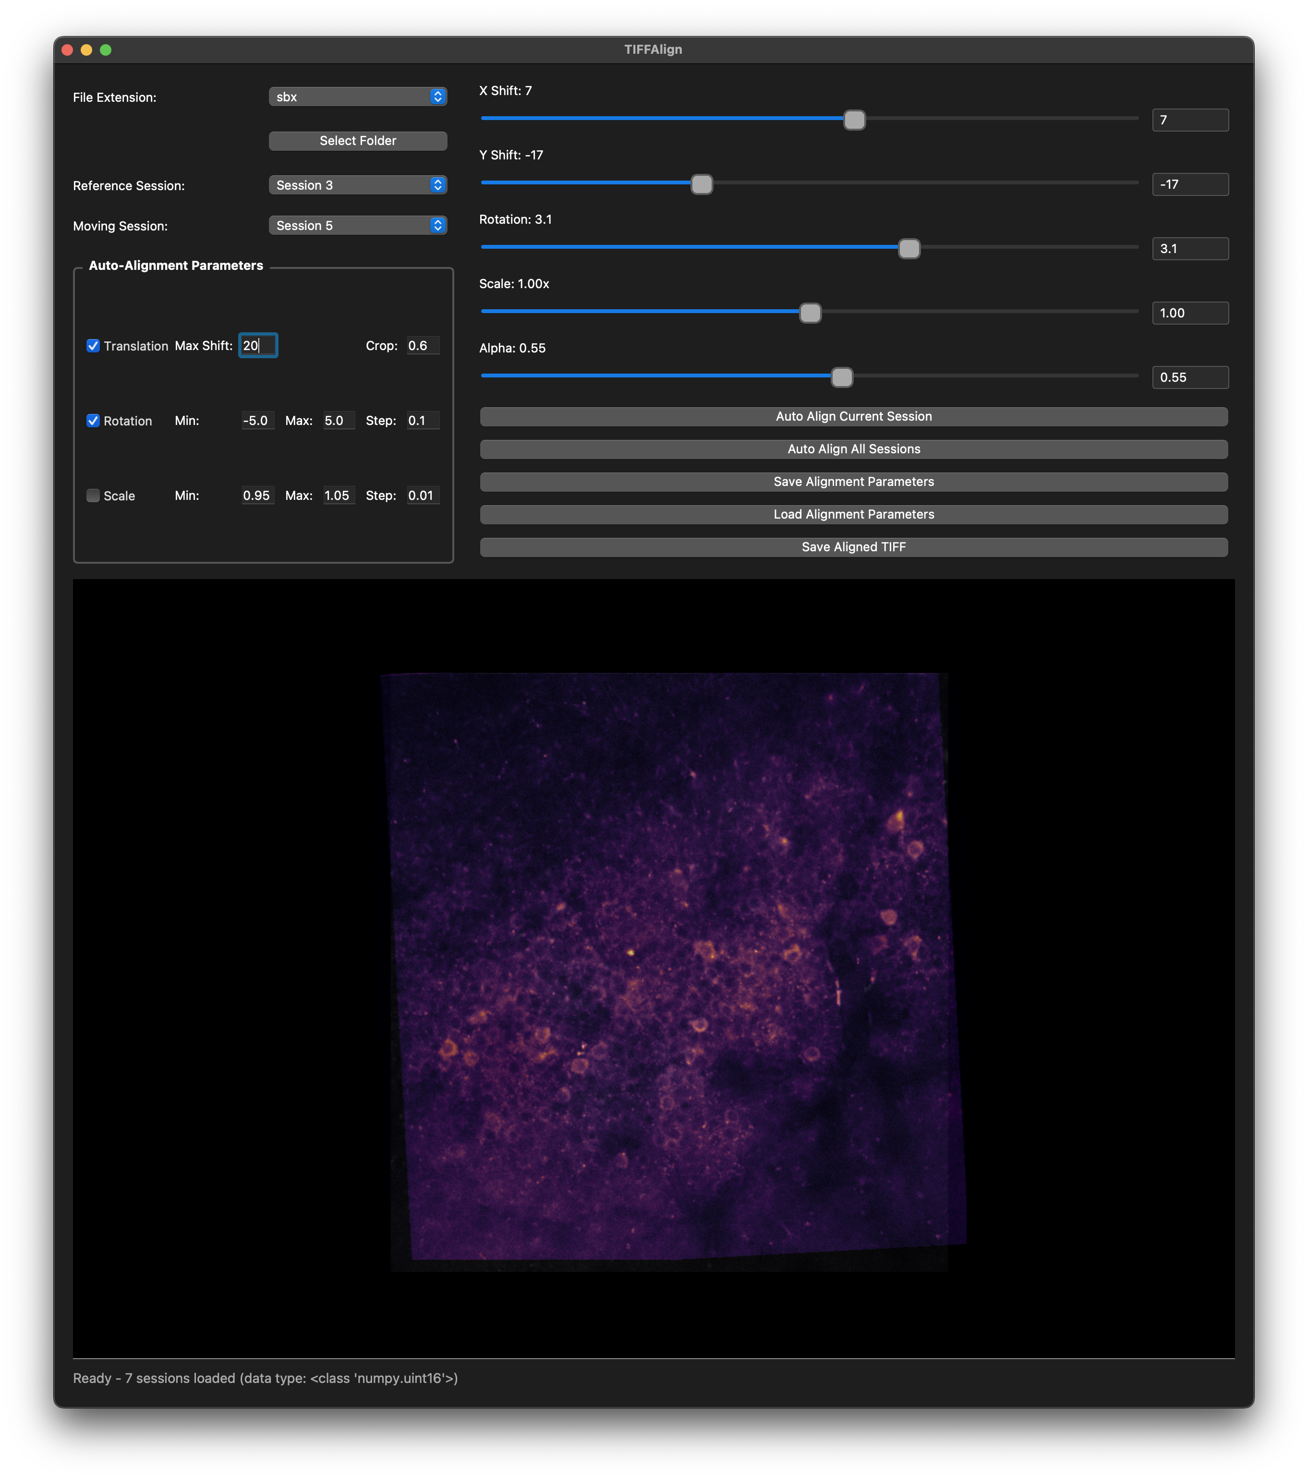
TIFFAlign
A simple GUI for automatic and manual alignment across calcium imaging sessions

