Slide 1
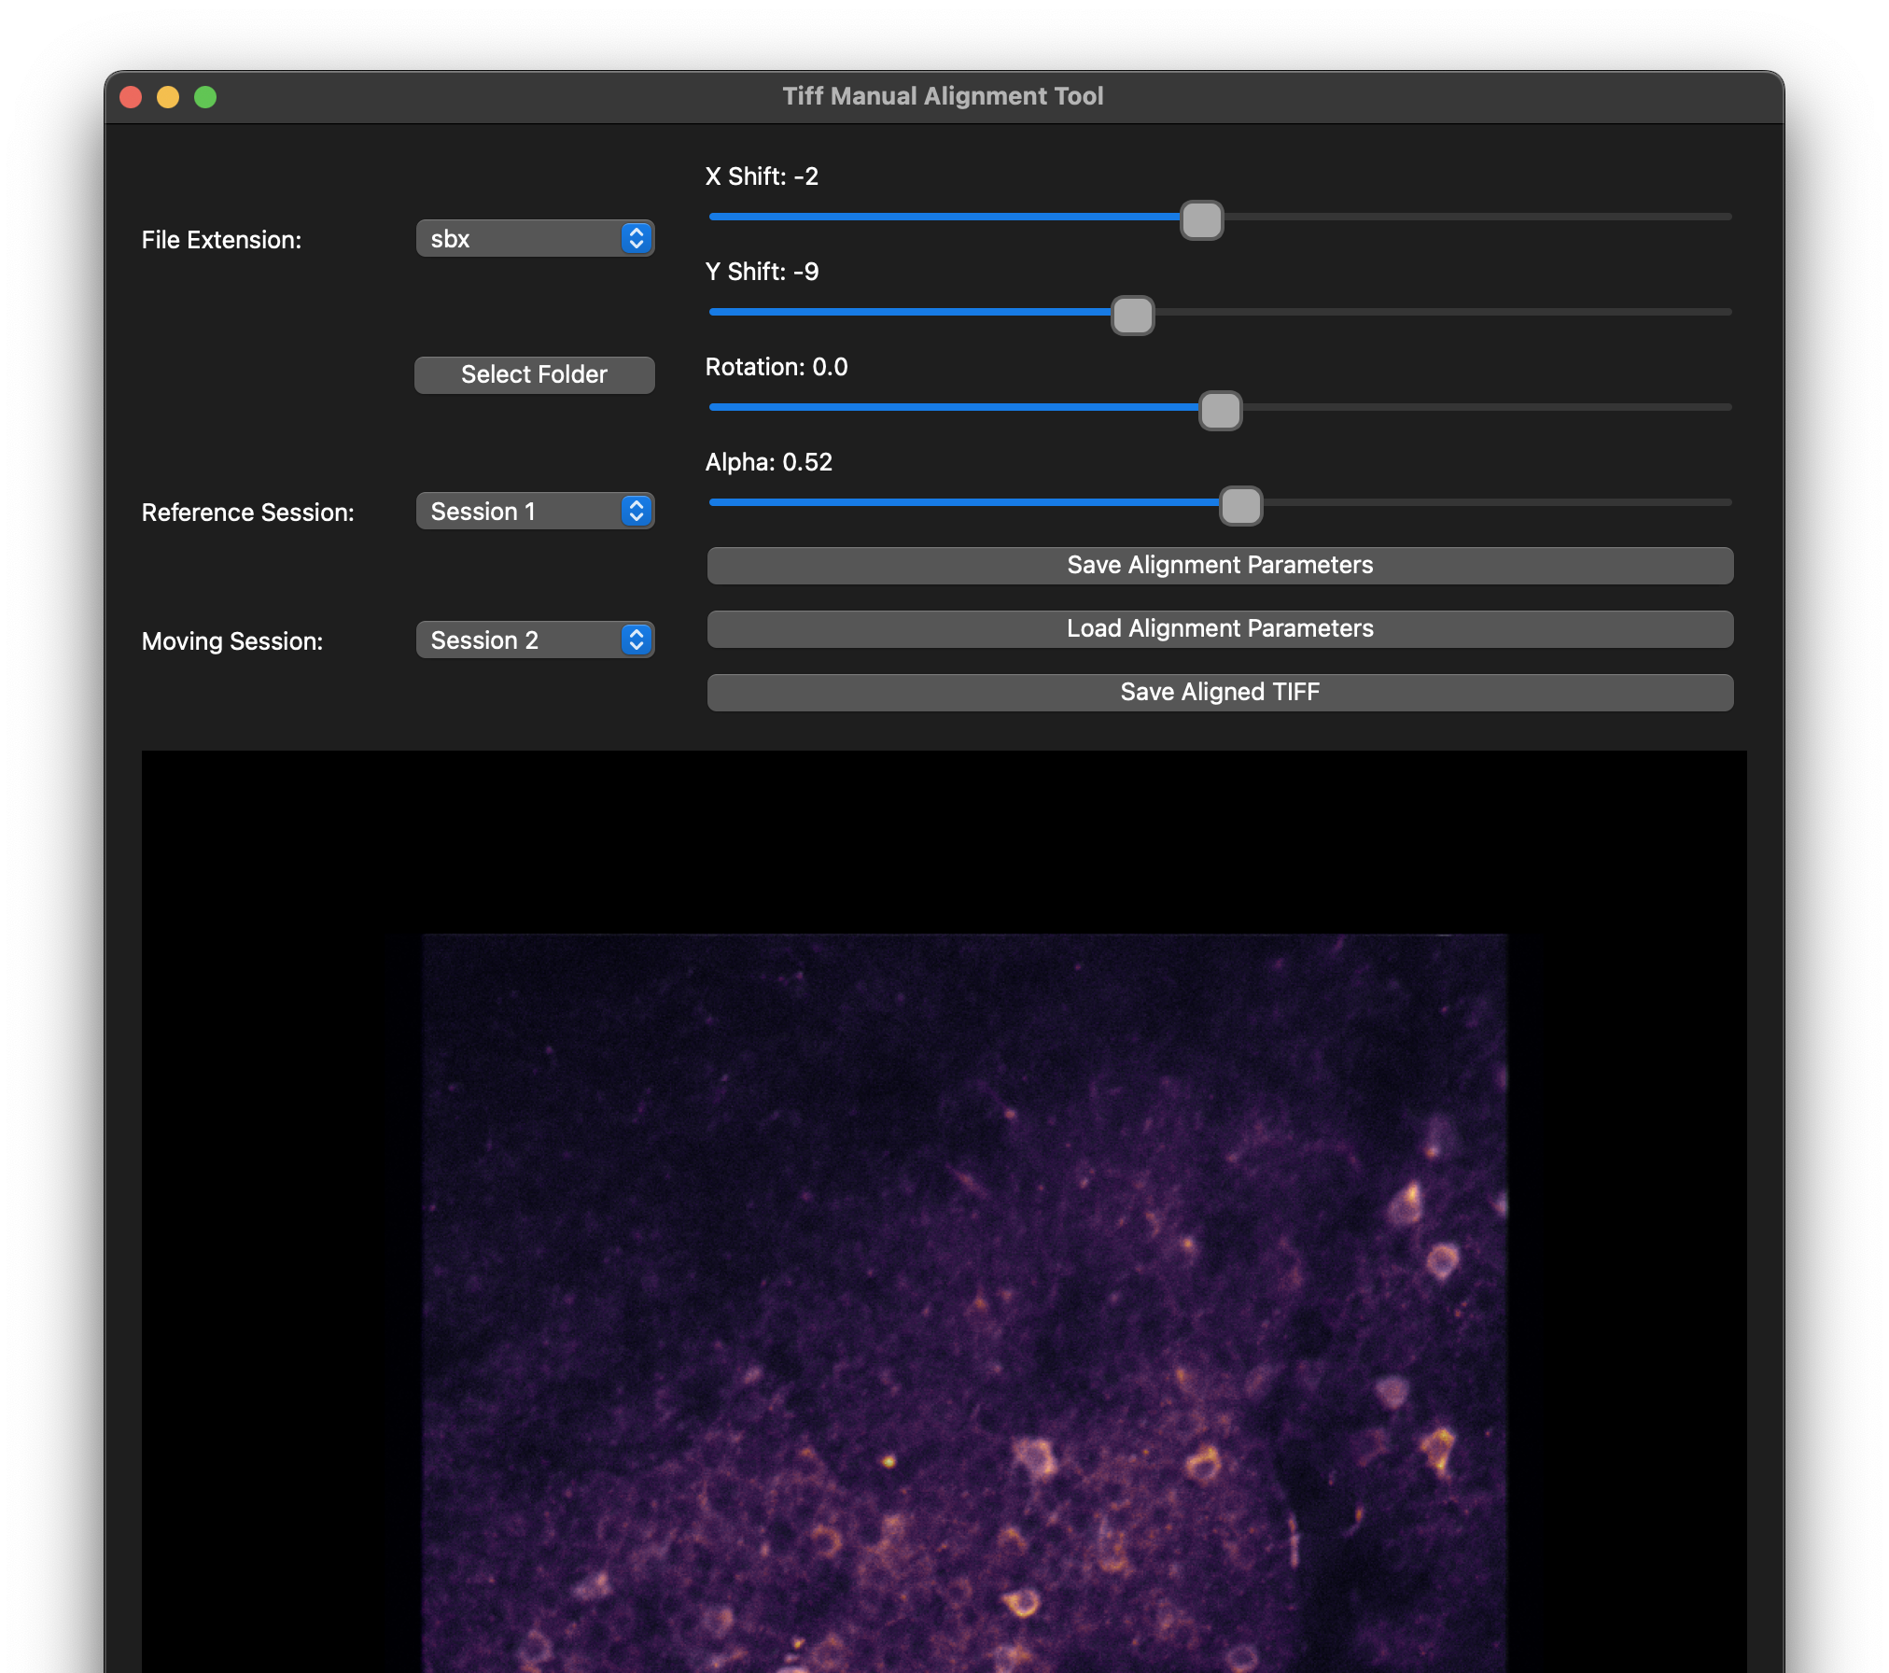
A simple GUI for manual alignment across calcium imaging sessions

