Slide 1
Pollen classification challenge
Božidar Vladislav

Slide 2
Data Set
Novi Sad and Osijek
8 different pollen types
22 200 samples for training
6169 training samples

Slide 3
Neural Network
Scattering images
Fluorescence spectrum
Fluorescence lifetime
Convolutional block
Convolutional block
Convolutional block
Convolutional block
Convolutional block
Convolutional block
Convolutional block
Convolutional block
Convolutional block
Concatenate
Dense layer
Dense layer
Output

Slide 4
Scattering images
5x5 convolutional layer (64 filters)
batch normalization
max pooling
3x3 convolutional layer (32 filters)
batch normalization
max pooling
3x3 convolutional layer (32 filters)
batch normalization
max pooling
flatten

Slide 5
Fluorescence spectrum
1x8 convolutional layer (64 filters)
batch normalization
max pooling
1x8 convolutional layer (32 filters)
batch normalization
max pooling
1x3 convolutional layer (32 filters)
batch normalization
max pooling
flatten

Slide 6
Fluorescence lifetime
1x6 convolutional layer (64 filters)
batch normalization
max pooling
1x6 convolutional layer (32 filters)
batch normalization
max pooling
1x3 convolutional layer (32 filters)
batch normalization
max pooling
flatten

Slide 7
Concatenate
Dense layer (64 units)
Dense layer (8 units)
Output

Slide 8
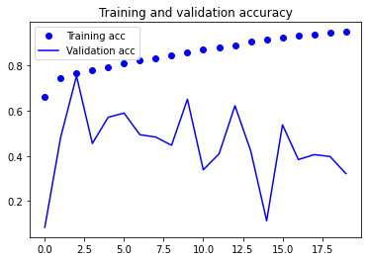
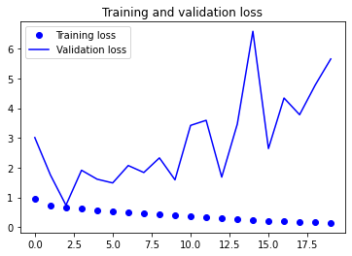
Results (batch size 32)

Slide 9
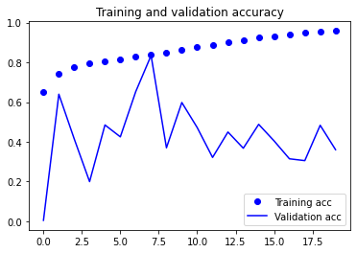
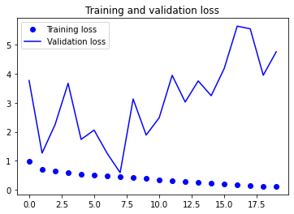
Results (batch size 64)

Slide 10
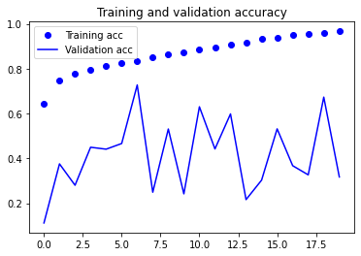
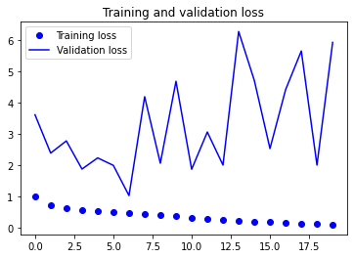
Results (batch size 128)

Slide 11
Best Results
7 epochs
Batch size 128
Accuracy 68%

Slide 12
Thank you!

