Slide 1

Cryptocurrency price predictions using LSTMS
Predict Bitcoin Price Using LSTM In Tensorflow
Notes:
1. Table of contents
2. Introduction
3. Our company
4. Our team
5. Problem
6. Them vs. us
7. Solution
8. SWOT analysis
9. Product overview
10. Our plans
11. Product demo
12. Traction
13. Case study
14. Reviews
15. Awards
16. Market size
17. Target
18. Competitors
19. Business model
20. Timing
21. Predicted growth
22. Investment

Slide 2
IBM Innovac
Shriraj Patil
Mrunali Ghate
Bhavesh Patil
Poonam Shinare
Janhavi Gosavi

Slide 3
Summary
Cryptocurrencies are a digital way of money in which all transactions are held electronically. It is a soft currency which doesn’t exist in the form of hard notes.
There are several virtual currencies such as bitcoin, ripple, ethereum, ethereum classic, lite coin, etc. In our study,we especially focused on popular cryptocurrency,i.e,bitcoin.
Bitcoin has a great acceptance by different bodies such as investors, researchers, traders, and policy-makers. but Stock markets are influenced by many risks of factors,that keep rising in recent few years, and sometimes sudden fall without knowing influence behind it on the stock market.
Because of its fluctuations, there’s a need and automation tool to predict bitcoin on the stock market.
So, our target is to implement the efficient deep learning-based prediction models, specifically long short-term memory (LSTM) and recurrent neural network (RNN) to handle the price volatility of bitcoin and to obtain high accuracy.

Slide 4
Table of Contents
01
02
03
04
Purpose of the project and Introduction
Data Procurement and Data sources
Data Visualization charts and graphs
Data Analysis and Findings

Slide 5


Introduction
Bitcoin is a cryptocurrency that was created in January 2009. It is the world’s most valuable cryptocurrency and is traded on over 40 exchanges around the world, accepting over 30 different currencies. As a currency, Bitcoin offers a new opportunity for price forecasting as it has high volatility, which is much higher compared to traditional currencies.

Slide 6
Purpose of the project
Can we still get rich with cryptocurrency?Of course, the answer is fairly nuanced.Therefore we have a look at how you might build a model to help you along the crazy journey.Of course, Bitcoin made some people really rich and for some went really poor. The question remains though, will it happen again? We were intrigued how the bitcoin changed the life of peoples. So we wanted to build the model which can predict prices which will help people in better trading and benefits the trader.

Slide 7
Data Procurement and Data sources
For ML operations on any dataset we need to clean and process data.Our dataset comes from Yahoo! Finance and covers all available (at the time of this writing) data on Bitcoin-USD price. We have a total of 3201 data points representing Bitcoin-USD price for 3201 days (~9 years).
We have taken time series data ,Temporal datasets are quite common in practice. Your energy consumption and expenditure (calories in, calories out), weather changes, stock market, analytics gathered from the users for your product/app and even your heart produce Time Series.

Slide 8
Data Analysis and Findings
Analysis of Dataset:- Dataset includes daily level information on the number of Price of Bitcoin Price.It has 8 columns which are as follows:-
DATE
OPEN
HIGH
LOW
CLOSE
VOLUME

Slide 9
Data Analysis and Findings
Prediction and Estimation:- For ML operations on any dataset we need to clean and process data.
Clean Data: No missing value is there in BTC_USD.csv Dataset.
Select Feature: Last three features are selected for prediction.

Slide 10
Models
Autocorrelation
Seasonality
Stationarity
The autocorrelation function is a measure of the correlation between observations of a time series that are separated by k time units (yt and yt–k)
It is the correlation between two variables under the assumption that we know and take into account the values of some other set of variables
A time series has stationarity if a shift in time doesn’t cause a change in the shape of the distribution. Basic properties of the distribution like the mean , variance and covariance are constant over time.

Slide 11
Models
All models do not allow for operating on sequence data. Fortunately, we can use a special class of Neural Network models known as Recurrent Neural Networks (RNNs) just for this purpose. RNNs allow using the output from the model as a new input for the same model. The process can be repeated indefinitely.
One serious limitation of RNNs is the inability of capturing long-term dependencies in a sequence. One way to handle the situation is by using an Long short-term memory (LSTM) variant of RNN.
The default LSTM behavior is remembering information for prolonged periods of time.

Slide 12
Conclusion
Since Bitcoin and the Blockchain technology were introduced in 2008, it has taken a pre-
dominant place in the cryptocurrency field. There are millions of users around the world,
especially in the United States. Predicting the price of cryptocurrencies has been a popular
topic, from which we can take advantage of the arbitrage for an investment
Cryptocurrency price prediction using LSTMs by utilizing the recurrent neural network. The model is developed using LSTM and achieves higher precision and recall than the traditional autoregressive approach. This Cryptocurrency price prediction using LSTMs can be used to predict the price fluctuation of the cryptocurrency and integrated to an autonomous trading system to assist the buying or selling of digital assets.

Slide 13
Conclusion
Our proposed model has succeeded to provide the result prediction of bitcoin from yahoo finance stock market. Our model with time series techniques can produce the results and the results can predict the price for the next days with split the data to train and test that we mention in the article above.
Future research will focus on modified LSTM layers, adding dropout and modified number epochs, and using different instability dataset to test how good the prediction results or try to use sentiment analysis combined with LSTM method to see the impact of the uncertainty in value bitcoin.

Slide 14
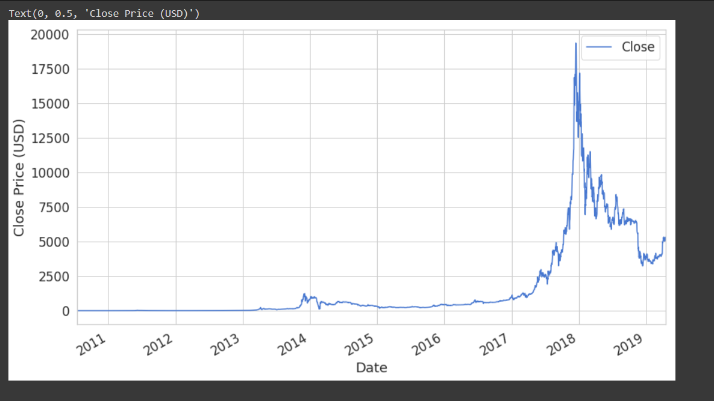
Data Visualization charts and graphs
CLOSING PRICE

Slide 15
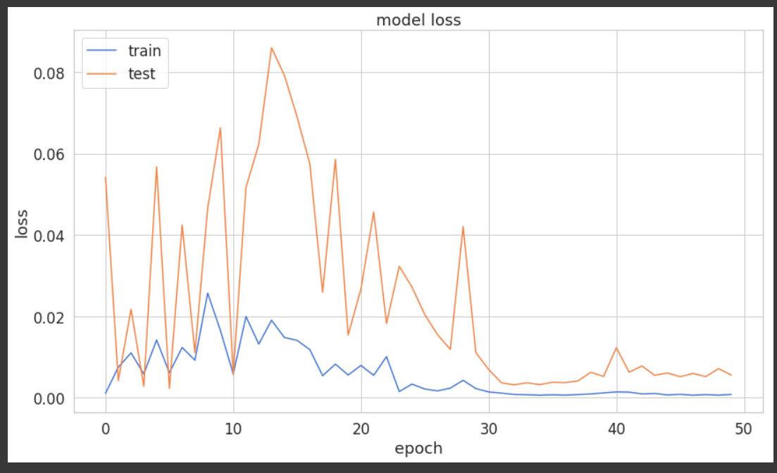
TRAINING GRAPH

Slide 16
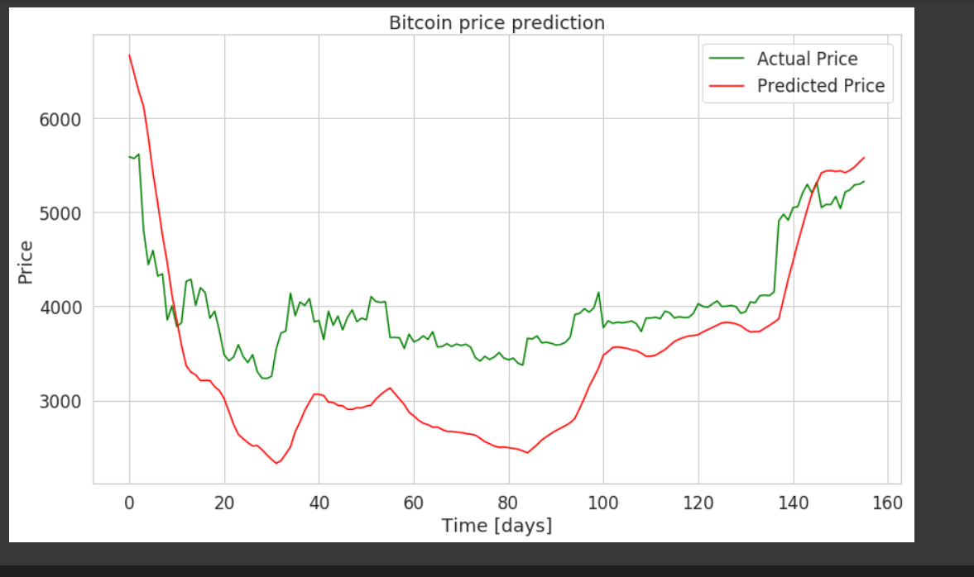
BITCOIN PRICE PREDICTION

Slide 17
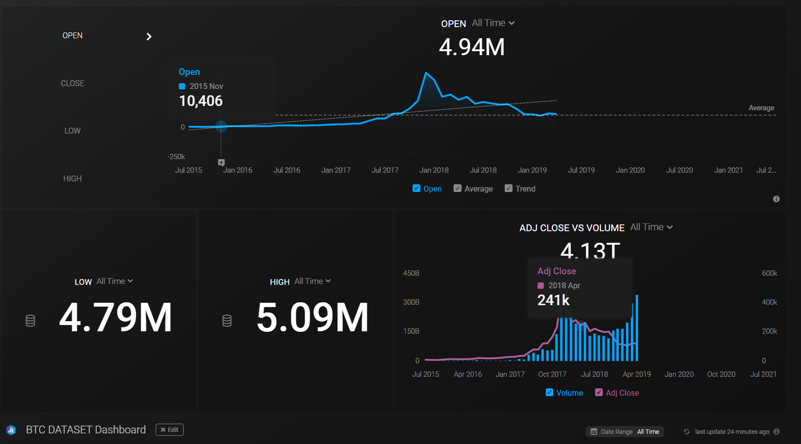
Dashboard

Slide 18
Thank you!

