Slide 1
SOFTWARE DEVELOPMENT PROJECT MANAGEMENT (CSC4125)
Foundational Concepts

Slide 2

Self Introduction
Md. Anwarul Kabir (MAK) MPhil (Wales)MSc(Wales), MSc(DU) BSc(Hons)
Senior Assistant Professor Department of Computer Science Freelance Consultant (Software Development)
Email – kabir@aiub.edu Room D0323

Slide 3
Research Interests
Software Engineering
Supply Chain Management
E-Commerce and E-Government
Software Requirement Engineering
Software Project Management
ERP

Slide 4
Ongoing Theses/Projects
a. Optimization of Supply-Chain Management
b. Academic-Industry Partnership
c. Developing an organizational web-portal
d. Introducing A New Agile Model in the context of Bangladesh

Slide 5
Hobbies
Reading and writing
Contributor to the Daily Star
Published Books
Magicians (micro-stories)
Mind Readers (micro-stories)
A Poetry Book

Slide 6
What is a Project?
A project is a temporary endeavor undertaken to create a unique product, service, or result.
A project is a time and cost constrained operation to realize a set of defined deliverables (the scope to fulfill the project's objectives) up to quality standards and requirements.
A project is an endeavor
that produces a clearly specified product, service, or result
in a limited period of time
within a limited budget

Slide 7
Characteristics of projects
Key Characteristics of a Project:
Non-routine tasks are involved
Planning is required
Specific objectives are to be met or a specified product is to be created
The project has a predetermined time span
Work is carried out for someone other than yourself
Work involves several specialism
People are formed into a temporary work group to carry out the task
Work is carried out in several phases
The resources that are available for use on the project are constrained
The project is large or complex

Slide 8
Are software projects really different from other projects?
Not really! ...but... there are some characteristics that make software more problematic to build than other engineered artefacts.
Software projects are similar to other projects but have some attributes that present particular difficulties.
Invisibility
Complexity
Conformity
Flexibility
One way of perceiving software project management is as the process of making visible that which is invisible.

Slide 9
Software Projects vs. Other Types of Projects
Comparisons of Software Project with Other Types of Projects:
Invisibility:
When a bridge is being constructed the progress being made can actually be seen.
Complexity:
Software products contain more complexity than other engineered artifacts. We can't measure complexity of software project until we actually work on it.
Conformity:
‘Traditional’ engineers usually work with physical systems and materials (e.g. cement, steel) that have complexity, but these are governed by consistent physical laws. Software developers have to conform to the requirements of human clients.
Flexibility:
Software systems are likely to be subject to a higher degree of change

Slide 10
What is Project Management?
Project management is the application of knowledge, skills, tools, and techniques to project activities to meet the project requirements.

Slide 11
Project Manager
The Project Manager is the person assigned by the performing organization to lead the team that is responsible for achieving the project objectives.
The PM plays a critical role in the leadership of a project team in order to achieve the project’s objectives
The Project Manager is:
Formally empowered to use organizational resources
In control of the project
Authorized to spend the project’s budget
Authorized to make decisions for the project

Slide 12
Software Project Management Activities
1) The Feasibility Study
Is the project technically feasible and worthwhile from a business point of view?
Investigation to decide whether a prospective project is worth starting
2) Planning
Guidance to execute, monitor and control a project
Only done if project is feasible
3) Project Execution
The implementation of a project
Implement plan, but plan may be changed as we go along

Slide 13
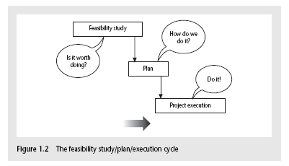
Software Project Management Activities

Slide 14
Process & Phases
Software Process:
Defines all the tasks required for developing and maintaining software
Software Process Phases:
The activities of a software process are termed as phases

Slide 15
Typical Software Project Life-Cycle
Requirements Analysis
Specification
Design
Coding
Verification & Validation
Implementation/Installation
Maintenance & Support

Slide 16
Some ways of Categorizing Software Project
Distinguishing different types of project is important as different types of task need different project approaches e.g.
Compulsory Users versus Voluntary Users
Information systems versus Embedded systems
Objective-based versus Product-based

Slide 17
Some ways of Categorizing Software Project
Compulsory Users vs. Voluntary Users
Compulsory Users
In workplaces there are systems that staff have to use if they want to do something
e.g., Recording a sale
Voluntary Users
Use of a system may be voluntary
Computer games, Google

Slide 18
Some ways of Categorizing Software Project
Information Systems vs. Embedded Systems
Information systems
interface with the organization
enable staff to carry out office processes
Example: A stock control system
Embedded systems
interface with a machine
control machines
Example: An embedded system might control the air conditioning equipment in a building

Slide 19
Some ways of Categorizing Software Project
Objective-based vs. Product-based
Projects may be distinguished by whether their aim is to produce a product or to meet certain objectives.
A project might be to create a product, the details of which have been specified by the client (The client has the responsibility for justifying the product)
Project requirement might be to meet certain objectives which could be met in a number of ways. An organization might have problem and ask a specialist to recommend a solution.
Note: Many software projects have two stages:
First is an objective-driven project resulting in recommendations (this might identify the need for a new software system)
The next stage is a project actually to create software product

Slide 20
What Is Management?
Management involves the following activities:
Planning – deciding what is to be done
Organizing – making arrangements
Staffing – selecting the right people for the job
Directing – giving instructions
Monitoring – checking on progress
Controlling – taking action to remedy hold-ups
Innovating – coming up with new solutions
Representing – liaising with clients, users, developer, suppliers and other stakeholders

Slide 21
(Common) Problems with Software Projects
Poor estimates and plans
Lack of quality standards and measures
Lack of guidance about making organizational decisions
Lack of techniques to make progress visible
Poor role definition – who does what?
Incorrect success criteria

Slide 22
(Other) Problems with Software Projects
Inadequate specification of work
Management ignorance of IT
Lack of knowledge of application area
Lack of standards
Lack of up-to-date documentation
Schedule slips
Lack of communication
Lack of commitment
Narrow scope of technical expertise
Changing statutory/established/ mandatory requirements
Changing software environment
Deadline pressure
Lack of quality control
Remote management
Lack of training

Slide 23
Management Control
MANAGEMENT, in general, involves setting objectives for a system and then monitoring the performance of the system.

Slide 24
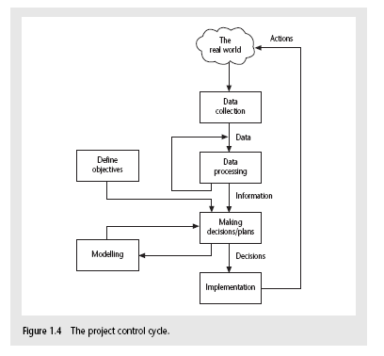
The Project Control Cycle

Slide 25
Management Control (cont.)
SETTING OBJECTIVES:
A key factor in project success is having clear objectives. Therefore, project objectives should be clearly defined at the beginning of the project
To have a successful software project, the manager and the project team members must know what will constitute success
For more than one user group, a project authority needs to be identified. Project authority has overall authority over what the project is to achieve.
Project Authority ➔ project board/project management board/ steering committee
Project steering committee has overall responsibility for setting, monitoring and modifying objectives. The committee is likely to contain user, development and management representatives.
Only the steering committee can authorize changes to the project objectives and resources.

Slide 26
Management Control (cont.)
SUB-OBJECTIVES/GOALS:
In order to keep things manageable, objectives might need to be broken down into sub-objectives
Sub-objectives are also known as goals
Goals –these are the steps on the way to achieving an objective

Slide 27
Management Control (cont.)
MEASURES OF EFFECTIVENESS:
Effective objectives are concrete and well defined
Objectives should be such that it is obvious to all whether the project has been successful or not
Measures of effectiveness tell us how successful the project has been.
Example: ‘to reduce customer complaints by 50%’ would be more satisfactory than ‘to improve customer relations’.
The measure can, in some cases, be an answer to simple yes/no question, “Did we install the new software by 1st January?”

Slide 28
The Business Case
Most projects need to have a justification or business case: the effort and expense of pushing the project through must be seen to be worthwhile in terms of the benefits that will eventually be felt.
A cost-benefit analysis will often be part of the project’s feasibility study.
The benefits will be affected by the completion date –the sooner the project is completed, the sooner the benefits can be experienced
The quantification of benefits will often require the formulation of a business model which explains how the new application can generate the claimed benefits.
Any project plan must ensure that the business case is kept intact.

Slide 29
STAKEHOLDERS
Stakeholders are people who have a stake or interest in the project.
It is important that they be identified as early as possible, because PMs need to set up adequate communication channels with them right from the start
Different types of stakeholders might have different objectives and a successful PM recognizes these different interests and reconciles (find a solution) them.
The PM needs to be a good communicator and negotiator.

Slide 30
Stakeholder Categories
Stakeholders can be categorized as:
Internal to the project team
They will be under the direct managerial control of the project leader
External to the project team but in the same organization
Examples: Project leader might need assistance of
information management group
the users
The commitment of the people involved has to be negotiated
External to both the project and the organization
Examples of external stakeholders:
Customers/users who will benefit from the system that the project implements
Contractors who will carry out work for the project

Slide 31
Requirement Specification
Functional Requirements
Define what the system that will be the end product of the project is to do
Quality Requirements (AKA non-functional requirements)
Define how the system that will be the end product of the project is to do
Resource Requirements
Define a record of how much the organization is willing to spend on the system
Usually trade-off between this and the time it takes to implement the system
Trade-off between functional & quality requirements & cost
Everybody likes exceptionally reliable and user-friendly systems with the exact required functionality but might be expensive

Slide 32
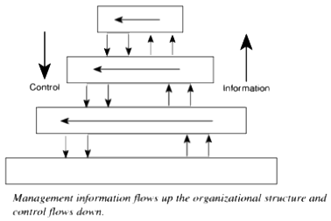
Information & Control in Organization

Slide 33
Information & Control in Organization (cont.)
Levels of DECISION MAKING & INFORMATION:
Strategic Decision Making
essentially about deciding objectives
Tactical Decision Making
ensures that the objectives are fulfilled
Operational Decision Making
relates to the day-to-day work of implementing the project

Slide 34
Information & Control in Organization (cont.)
DIFFERENCES IN TYPES OF INFORMATION:
Table on the next slide gives some idea of the differences in the kind of information needed for decision making
Effectiveness is concerned with doing the right thing
Efficiency is carrying out a task making the best possible use of the resources

Slide 35
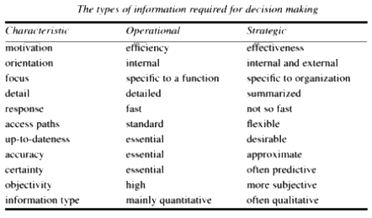
Types of Information required for decision making

Slide 36
Information & Control in Organization (cont.)
Measurement:
For objectives to be effective, there must be practical ways of testing that the objectives have been met
There is a need for measurement
Software measurements can be divided into performance measures and predictive measures.

Slide 37
Information & Control in Organization (cont.)
SOFTWARE MEASUREMENT :
Performance measures
Measures the characteristics of a system that has been delivered
They are important when we are trying to specify unambiguously the quality requirements of a proposed system
Performance measures requires a system to be up and running before any measurements can be taken
Predictive measures
Measurements are taken during development and indicate what the performance of the final system is likely to be.

