Slide 1
SOFTWARE DEVELOPMENT PROJECT MANAGEMENT (CSC4125)
Lecture 10: Monitoring & Control

Slide 2
Introduction
Once work schedules have been published and the project is started, attention must be focused on progress. This needs –
Monitoring of what is happening
Comparison of actual achievement against the schedule
Where necessary, revision of plans and schedules to bring the project back to target

Slide 3
Creating the Framework
Exercising control over a project and ensuring that targets are met is a matter of regular monitoring –finding out what is happening and comparing it with targets.
There may be mismatch between the planned outcomes and the actual ones.
Re-planning may be needed to bring the project back on target.
The next slide illustrates a model of the project control cycle.

Slide 4
Project Control Cycle
Start
Publish Initial Plan
Gather Project Information
End
Publish revised plan
Document conclusions
Compare progress vs. targets
Satisfactory ?
Take remedial action
Review
project
No
Yes
Project Completed?
No
Yes
End Project

Slide 5
What can go wrong in product?
Inadequate functionality of a product
Related to software requirements specification
Poor quality of a product
Related to quality management
Late delivery of the product
Overly exceeding the budget

Slide 6
Responsibility
The overall responsibility for ensuring satisfactory progress on a project is often the role of the project steering committee, project management board, or project board (in PRINCE 2)
Day-to-day responsibility will rest with the PM, in all but the smallest of projects, aspects of this can be delegated to team leaders.
With small projects, individual team members usually report directly to the PM, but in most cases team leaders will collate reports on their section’s progress and forward summaries to the PM. These, in turn, will be incorporated into project-level reports for the steering committee and, via them or directly, progress reports for the client.

Slide 7
Project Reporting Structures
Steering Committee
client
Project Manager
Team Leader
Team Leader
Team Leader
Team Leader
Analysis/Design
section
Programming
section
Quality control
section
User
Documentation
section

Slide 8
Project Reporting
Reporting may be oral or written, formal or informal, and regular or ad hoc.
Informal communication is necessary and important, but any such informal reporting of project progress must be complemented by formal reporting procedures.
Different categories of reporting is shown in the next slide.

Slide 9
Categories of Reporting
Report type | Examples | Comment
Oral formal regular | Weekly or monthly progress meetings | While reports may be oral, formal written minutes should be kept
Oral formal ad hoc | End-of-stage review meetings | While largely oral, likely to receive and generate written reports
Written formal regular | Job sheets, progress reports | Normally weekly using forms
Written formal ad hoc | Exception reports, change reports
Oral informal ad hoc | Canteen discussion, social interaction | Often provides early warning; must be backed up by formal reporting

Slide 10
Assessing Progress
Some information used to assess project progress will be collected routinely, while other information will be triggered by specific events.
Whenever possible, this information should be objective and tangible.
For example, whether or not a particular report has been delivered
Sometimes, assessment will have to depend on estimates of the proportion of the current activity that has been completed.
Assessing progress requires –
Setting check points
Collecting data

Slide 11
Setting Checkpoints
It is essential to set a series of checkpoints in the initial activity plan.
Checkpoints may be:
Regular (e.g., monthly)
Tied to specific events such as the production of a report or other deliverable
Checkpoints should be set before the plan was published
Make sure everyone knows when and what the check points are

Slide 12
Taking Snap-Shots
The frequency of progress reports will depend upon the size and degree of risk of the project.
Team leaders need to assess progress daily.
Project managers may find weekly or monthly reporting appropriate.
In general, the higher the level, the less frequent and less detailed the reporting needs to be.
Major, or project-level, progress reviews will generally take place at particular points during the life of a project –commonly known as review points or control points.
For example, PRINCE 2 designates a series of checkpoints where the status of work in a project or for a team is reviewed
At the end of each project Stage, an End Stage Assessment is conducted.

Slide 13
Collecting the Data
We need to collect data to review the progress of a project.
It is crucial to know what to collect and how.
As a rule, managers will try to break down long activities into more controllable tasks of one or two weeks duration.

Slide 14
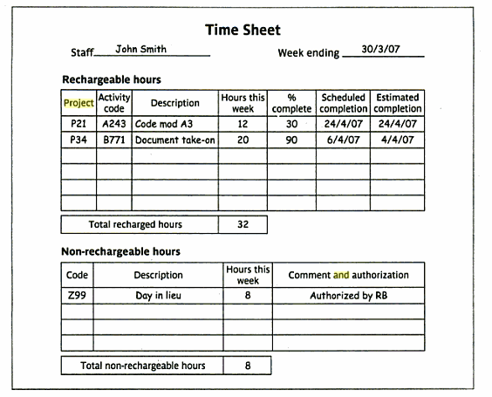
Partial Completion Reporting: Weekly Timesheet and Progress Review Form

Slide 15
The traffic-light method: RAG reporting
For assessing a product –
Identify the key (first-level) elements/tasks
Break them into smaller components (sub-tasks)
Assess each component (sub-task) by
Green as ‘on target’
Amber as ‘not on target but recoverable’
Red as ‘not on target and recoverable only with difficulty’

Slide 16
The traffic-light method: RAG reporting
Assess the key-level element based on the assessments of their components
Assess the overall product based on all the assessments (key elements and their components)

Slide 17
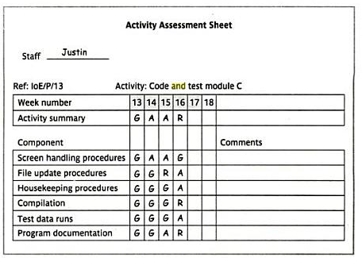
The traffic-light method: Example of Activity Assessment Sheet

Slide 18
Visualizing Progress
Gantt chart
Slip chart
Ball chart
Timeline chart

Slide 19
Visualizing Progress: Gantt Chart
One of the simplest and oldest techniques for tracking project progress is the Gantt chart.
Gantt chart is an activity bar chart indicating scheduled activity dates and durations, frequently augmented with floats.
Shading (for schedule completion) and ‘today cursor’

Slide 20
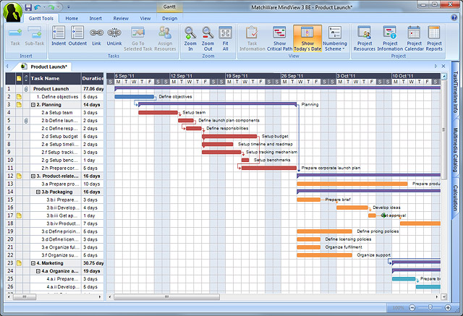
Visualizing Progress: Gantt Chart

Slide 21
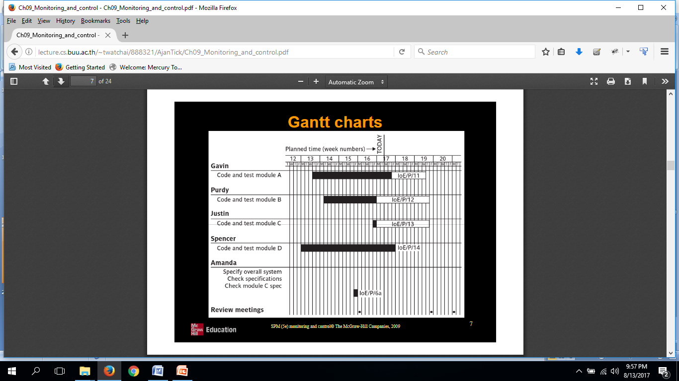
Visualizing Progress: Another View of Gantt Chart

Slide 22
Visualizing Progress : Slip Chart
The Slip Chart provides a more striking visual indication of those activities that are not progressing to schedule –the more the slip bends, the greater the variation from the plan.
A very jagged slip line indicates a need for rescheduling.
Gantt chart plus slip line ( bending = bad )

Slide 23
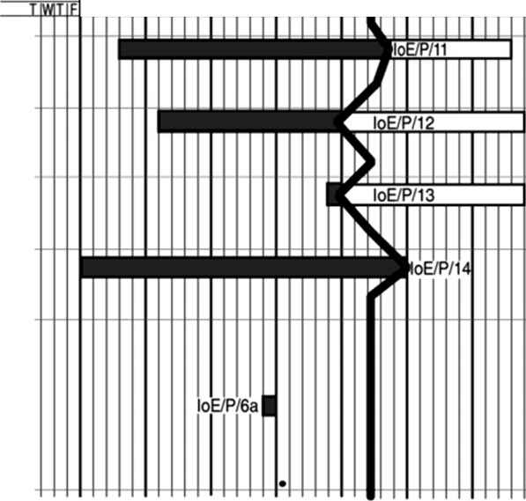
Visualizing Progress : Slip Chart

Slide 24
Visualizing Progress : Ball Chart
Circles indicate estimated and actual start and completion points for activities
Green and Red shading
Green ==> ‘on time’
Red ==> ‘missed the target’

Slide 25
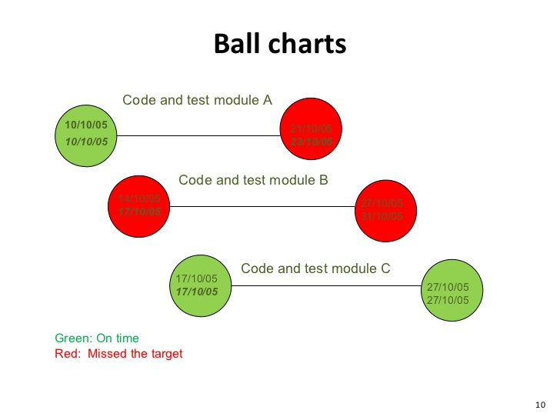
Visualizing Progress : Ball Chart

Slide 26
Visualizing Progress : Timeline Chart
The Timeline chart is a method of recording and displaying the way in which targets have changed throughout the duration of the project.
Slipping more clearly visualized!

Slide 27
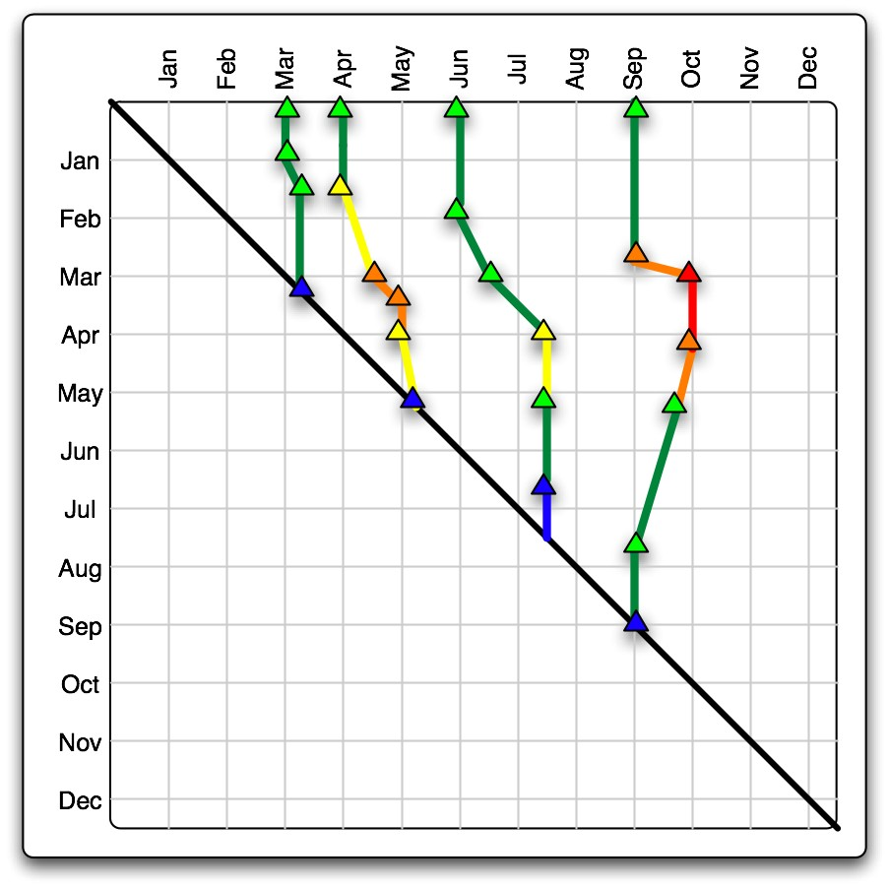
Visualizing Progress : Timeline Chart

Slide 28
Cost Monitoring: Earned Value Analysis
Some common methods of assigning earned value must be applied:
0/100 technique: value of zero at start and 100% at completion
50/50 technique: value of 50% at start and 100% at completion
Milestone technique: values are assigned based on milestones

Slide 29
Monitoring Earned Value
ACWP = Actual Cost of Work Performed
BCWP = Budgeted Cost of Work Performed
BCWS = Budgeted Cost of Work Scheduled
BAC = ∑ (BCWS_{k}) for all tasks k
Schedule Variance (SV) = BCWP – BCWS
Cost Variance (CV) = BCWP – ACWP
Performance ratios:
Cost performance index = CPI = BCWP/ACWP
Schedule performance index = SPI = BCWP/BCWS
Note: A value greater than one indicates that work is being completed better than planned, whereas a value of less than one means work is costing more and/or proceeding more slowly than planned

Slide 30
Example
Assume you are a software project manager and that you’ve been asked to compute earned value statistics for a small software project.
The project has 56 planned work tasks that are estimated to require 582 person-days to complete.
At the time that you’ve been asked to do the earned value analysis, 12 tasks have been completed.
However the project schedule indicates that 15 tasks should have been completed.
The following scheduling data (in person-days) are available:

Slide 31
Example(cont.)
Task Planned Effort Actual Effort
1 12.0 12.5
2 15.0 11.0
3 13.0 17.0
4 8.0 9.5
5 9.5 9.0
6 18.0 19.0
7 10.0 10.0
8 4.0 4.5
9 12.0 10.0
10 6.0 6.5
11 5.0 4.0
12 14.0 14.5
13 16.0 —
14 6.0 —
15 8.0 —
Given Total Task = 56; Effort Estimated= 582 Person-Day
BCWP= 126.50
ACWP= 127.50
BCWS= 156.50

Slide 32
Example(cont.)
BAC = 582.00
SPI = BCWP/ BCWS = 126.5/ 156.5 = 0.808307
SV = BCWP - BCWS = 126.5 - 156.5 = -30 person-day
% schedule for completion = BCWS/ BAC = 156.5/ 582.00 = 26.89%
% complete = BCWP/ BAC = 126.5/ 582.00 = 21.74%
CPI = BCWP/ ACWP = 0.99
CV = BCWP – ACWP = -1

Slide 33
Prioritizing Monitoring
Critical path activities
Activities with no free float
Activities with less than a specified float
High risk activities
Activities using critical resources

Slide 34
Getting The Project Back To Target
Shorten the critical path
Reconsider the precedence requirements

Slide 35
CHANGE CONTROL : Configuring Librarian’s Role
Identify all items that are subjected to change control
Establish and maintain a central repository of the master copies of all project documentation and software products
Set up and run a formal set of procedures to deal with changes
Maintain records of who has access to which library items and the status of each library item.

Slide 36
Change Control procedures
One or more users might perceive a need for a modification to a system and ask for a change request to be passed to the development staff.
The user management consider the change request and if they approve it pass it to the development management.
The development management delegate a member of staff to look at the request and to report on the practicality and cost of carrying out the change. They would, as part of this, assess the products that would be affected by the change.

Slide 37
Change Control procedures (cont.)
The development management report back to the user management on the findings and the user management decide whether, in view of the cost quoted, they wish to go ahead.
One or more developers are authorized to take copies of the master products that are to be modified.
The copies are modified. In the case of software components this would involve modifying the code and recompiling and testing it.

Slide 38
Change Control procedures (cont.)
When the development of new versions of the product has been completed, the user management will be notified and copies of the software will be released for user acceptance testing.
When the user is satisfied that the products are adequate they will authorize their operational release. The master copies of configuration items will be replaced.

