Slide 1
SOFTWARE DEVELOPMENT PROJECT MANAGEMENT (CSC 4125)
Lecture 6: Software Effort Estimation

Slide 2
What makes a successful project?
Delivering:
agreed functionality
on time
at the agreed cost
with the required quality
Stages:
1. Set targets
2. Attempt to achieve targets
BUT what if the targets are not achievable?
A key point here is that developers may in fact be very competent, but incorrect estimates leading to unachievable targets will lead to extreme customer dissatisfaction.

Slide 3
Introduction
A successful project is one that is delivered on time, within budget and with the required quality.
Targets are set which the project manager then tries to meet. This assumes that the targets are reasonable.
Realistic estimates are therefore crucial
A project manager has to produce estimates of
Effort (which affects costs), and
Activity durations (which affect the delivery time)

Slide 4
Difficulties in Software Estimation
Complexity & invisibility of software
Novel applications of software
Changing technology
Lack of homogeneity of project experience
Lack of standard definitions
Political implications
Subjective nature of estimating

Slide 5
Where Are Estimates Done?
Estimates are carried out at various stages of a software
project for a variety of reasons.
Strategic Planning
Feasibility Study
System Specification
Evaluation of Suppliers’ Proposals
Project Planning
Accuracy of estimates should improve as project proceeds
Some speculation(assumptions) about physical implementation may be necessary for estimation

Slide 6
Problems with Over- and Under-Estimates
Over Estimates: An over-estimate is likely to cause project to take longer than it would otherwise.
Parkinson’s Law – ‘work expands to fill the time available’ (Does not apply universally, can be controlled)
Brooks’ Law – ‘putting more people on a late job makes it later’
Under Estimates: Under-estimated projects might not be completed on time or to cost. The danger with under-estimate is the effect on quality.
Weinberg’s Zeroth Law of reliability – ‘If a system does not have to be reliable, it can meet any other objective’
Demotivation and low productivity
Burnout and turnover
Having Realistic and Achievable Estimates is Critical
Artificial Urgencies and Deadlines MUST be avoided

Slide 7
Basis for Software Estimating
The need for Historical Data
Most estimating methods need information about past projects
BUT, Care should be taken when applying because of possible differences in factors (e.g., programming languages, experience of staff)
Measure of Work (Size, effort & time)
Complexity

Slide 8
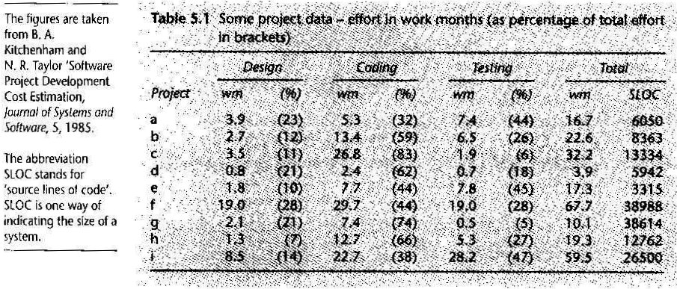
Sample Historical Data

Slide 9
Software Effort Estimation Techniques
Algorithmic Models – use ‘effort drivers’ representing characteristics of the target system and implementation environment to predict effort
Expert Judgment – based on the advice of knowledgeable staff
Analogy – similar, completed projects are identified and their actual effort is used as the basis of estimate ( case-based reasoning, comparative)
Parkinson – identifies the staff effort available to do a project and uses that as an ‘estimate’

Slide 10
Software Effort Estimation Techniques (cont.)
Price to Win – the ‘estimate’ is a figure that is sufficiently low to win a contract
Top-Down – an overall estimate is formulated for the whole project and is then broken down into the effort required for component tasks
Bottom-Up – Component tasks are identified & sized and these individual estimates are aggregated

Slide 11
Bottom-Up Estimating
Detailed Work Breakdown Structure (WBS) is made
Effort for each bottom-level activity is estimated
Estimates for bottom-level activities are added to get estimates for upper-level activities until overall project estimate is reached
Identify all tasks that have to be done – so quite time-consuming
Appropriate at later, more detailed, stages of project planning
Advisable where a project is completely novel or there is no historical data available

Slide 12
Top-Down Approach
Normally associated with parametric/algorithmic models
Effort will be related mainly to variables associated to characteristics of the final system (and development environment)
Based on past project data
Form of parametric model will normally be
effort = (system size) x (productivity rate)
Important to distinguish between size models and effort models
After calculating the overall effort, proportions of that effort are allocated to various activities
Combinations of top-down and bottom-up estimation may (and should) be used

Slide 13
Top-Down Approach
Produce overall estimate using effort driver(s)
Distribute proportions of overall estimate to components
Estimate
100 days
overall
project
design
code
test
30%
i.e.
30 days
30%
i.e.
30 days
40%
i.e. 40 days

Slide 14
Estimating by Analogy
Also called Case-Based Reasoning
Estimators seek out projects that have been completed (source cases) that have similar characteristics to the new project (target case)
Actual effort for the source cases can be used as a base estimate for the target
Estimator then identifies differences between the target and the source and adjusts the base estimate to produce an estimate for the new project
Historical data must include all relevant dimensions included in the model

Slide 15
Estimating by Analogy (cont.)
Problem is to identify similarities and differences between applications where you have a large number of past projects to analyze.
One method is to use shortest Euclidean distance to identify the source case that is nearest the target
Euclidean Distance = square root of [(target_parameter₁ – source_parameter₁)² + … + (target_parameter_{n} – source_parameter_{n})² ]

Slide 16
Calculating Euclidean Distance : Example 5.1 (page 113)
Say that the cases are being matched on the basis of two parameters, the number of inputs to and the number of outputs from the application to be built. The new project is known to require 7 inputs and 15 outputs. One of the past cases, project A, has 8 inputs and 17 outputs. The Euclidean distance between the source and the target is therefore the square-root of (( 7 – 8)² + (15 – 17)² ), that is 2.24

Slide 17
Exercise 5.6 (Page 113): Calculating Euclidean distance & Deciding about best analogy
Project B has 5 inputs and 10 outputs. What would be the Euclidean distance between this project and the target new project being considered in Example 5.1?
Is Project B a better analogy with the target than Project A?
Solution: The Euclidean distance between Project B and the target case is square-root of (( 7 – 5)² + (15 – 10)² ), that is 5.39. Project A is therefore a closer analogy.

Slide 18
Albrecht Function Point Analysis
Top-Down method devised by Allan Albrecht and later adopted by International Function Point Users Group (IFPUG)
Quantifies the functional size of programs independently of the programming language
Based on five major components or ‘external user types’
External Input Types
External Output Types
Logical Internal File Types
External Interface File Types
External Inquiry Types

Slide 19
Albrecht Function Point Analysis (cont.)
Each instance of each external user type in the system is identified
Each component is then classified as having high, average, or low complexity
Counts of each external user type in each complexity band are multiplied by specified weights and summed to get Unadjusted FP (UFP) count
Fourteen Technical Complexity Factors (TCFs) are then applied in a formula to calculate the final FP count

Slide 20
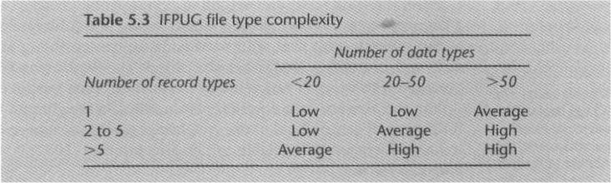
FP File Type Complexity

Slide 21
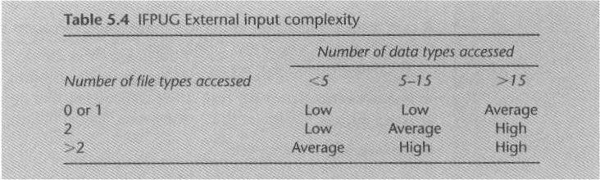
FP External Input Complexity

Slide 22
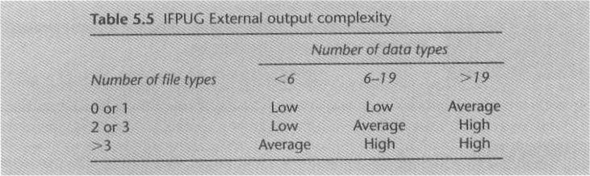
FP External Output Complexity

Slide 23
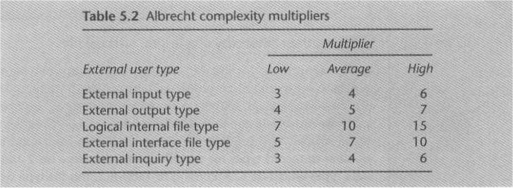
FP Complexity Multipliers

Slide 24
Function Points Mark II
Developed by Charles R. Symons
Recommended by Central Computer and Telecommunications Agency (CCTA)
Used by a minority of FP specialists in the UK
UFPs = W_{i} x (number of input data element types) +
W_{e} x (number of entity types referenced) +
W_{o} x (number of output data element types)
– where W_{i} , W_{e} , and W_{o} are weightings derived from previous projects or industry averages normalized so they add up to 2.5
It has 5 Technical Complexity Adjustments (TCAs) factors in addition to the 14 in the original Albrecht FP method

Slide 25
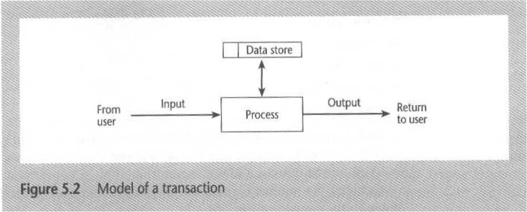
Model of a Transaction

Slide 26
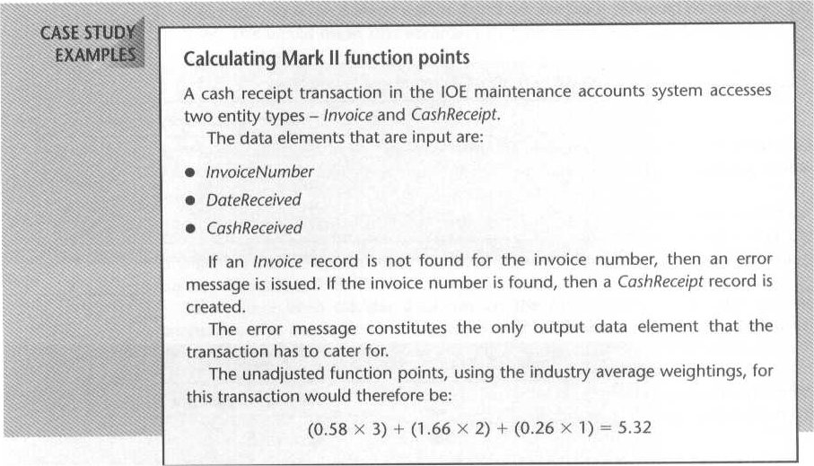
Calculating Mark II FP: An Example
UFP =

Slide 27
Object Points
Similarities with FP approach, but takes account of more readily identifiable features
No direct bearing on object-oriented techniques, but can be used for object-oriented systems as well
Uses counts of screens, reports, and 3GL components, referred to as Objects
Each object has to be classified as simple, medium, or difficult
Number of objects at each level are multiplied by appropriate complexity weighting and summed to get an overall score
Object point score can be adjusted to accommodate reusability factor
Finally is divided by a productivity rate(PROD) (derived from historical data or industry averages) to calculate effort

Slide 28
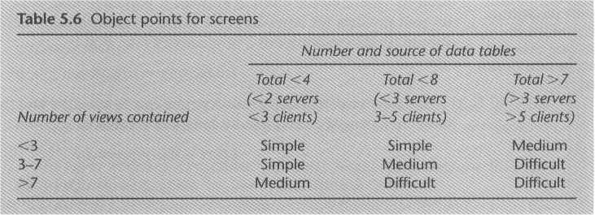
Object Points for Screens

Slide 29
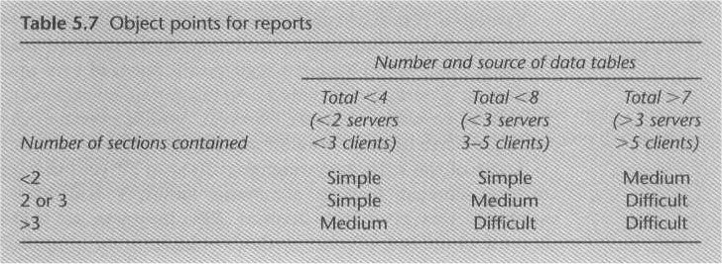
Object Points for Reports

Slide 30
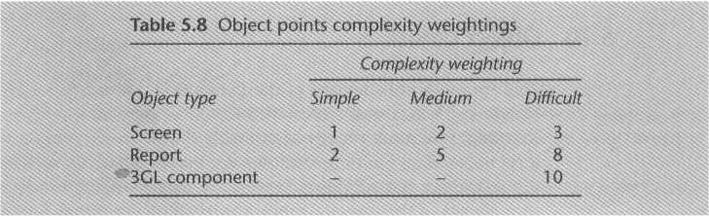
Object Point Complexity Weightings

Slide 31
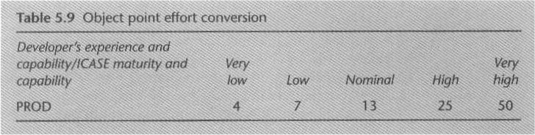
Object Point Effort Conversion

Slide 32
Procedural Code-Oriented Approach
Envisage the number and type of programs in the final system
Estimate the SLOC of each identified program
Estimate the work content, taking into account complexity and technical difficulty
Calculate the work-days effort

Slide 33
COCOMO (COnstructive COst MOdel) II : A Parametric Productivity Model
Based on SLOC (source lines of code) characteristic, and operates according to the following equations:
Effort = PM = Coefficient<EffortFactor>*(SLOC/1000)^P
Development Time = DM = 2.50*(PM)^T
Required Number of people = ST = Effort(PM)/Development Time(DM)
where: PM : person-months needed for project SLOC : source lines of code P : project complexity (1.04-1.24) DM : duration time in months for project T : SLOC-dependent coefficient (0.32-0.38) ST : average staffing necessary
Software Project Type | Coefficient _{<Effort Factor>} | P | T
Organic | 2.4 | 1.05 | 0.38
Semi-detached | 3.0 | 1.12 | 0.35
Embedded | 3.6 | 1.20 | 0.32

Slide 34
COCOMO applies to Three classes of software projects
Organic projects
"small" teams develop s/w in a highly familiar in-house environment
with "good" experience
working with "less than rigid" requirements
Semi-detached projects
"medium" teams
with mixed experience
working with a mix of rigid and less than rigid requirements
Embedded projects
developed within a set of very "tight" constraints (hardware, software, operational, ...)
changes to system very costly

Slide 35
Summary
Estimates are really management targets
Collect as much information about previous projects as possible
Use more that one method of estimating
Top-down approaches will be used at the earlier stages of project planning while bottom-up approaches will be more prominent later on
Be careful about using other people’s historical productivity data as a basis for your estimates, especially if it comes from a different environment
Seek a range of options
Document your method of doing estimates and record all your assumptions

