Slide 1
SOFTWARE DEVELOPMENT PROJECT MANAGEMENT (CSC4125)
Precedence Network
(Supplementary Materials)

Slide 2
Some Terminologies
Float –The difference between an activity’s earliest start date and its latest start date (or, equally, difference between its earliest and latest finish dates) is known as the activity’s float.
Float = LS – ES = LF – EF
It is measure of how much the start/completion of an activity may be delayed without affecting the end date of the project
Any activity with a float of zero is critical in the sense that any delay in carrying out the activity will delay completion date of the project as a whole
Float is AKA Total Float
Float is AKA Slack

Slide 3
Some Terminologies
Free Float –the time by which an activity may be delayed without affecting any subsequent activity.
Free Float is the amount of time that an activity can be delayed without delaying the early start date of any successor activity
It is calculated as the difference between the earliest completion (EF) date for the activity and (minimum of the) earliest start (ES) date of the succeeding activity (activities)
Free Float = Minimum of ES of the succeeding activities – EF of that activity
Example: FF_{A} = ES _{min.succd} – EF_{A}

Slide 4
Some Terminologies
Interfering Float – how much the activity may be delayed without delaying the project end date –even though it will delay the start of subsequent activities
Interfering Float = Total float –Free float

Slide 5
Some Terminologies
Forward pass is carried out to calculate the earliest dates on which each activity may be started and completed.
During the forward pass, earliest dates are recorded as they are calculated.
The forward pass rule: The earliest start date for an activity is the earliest finish date for the preceding activity. Where there is more than one immediately preceding activity we take the latest of the earliest finish dates for these activities.

Slide 6
Some Terminologies
Backward pass is carried out to calculate the latest date at which each activity may be started and finished without delaying the end date of the project.
Note: We assume that the latest finish date for the project is the same as the earliest finish date (that is, we wish to complete the project as early as possible)

Slide 7
Forward Pass & Backward Pass
Forward Pass:
ES = Max. EF of related predecessor
EF = ES + Duration
Backward Pass:
LF = Min. LS of related successor
LS = LF – Duration

Slide 8
Some Terminologies
Critical path –There will be at least one path through the network that defines the duration of the project. This is known as critical path. Any delay to any activity on this critical path will delay the completion of the project.
Critical path is the longest path through the network
Critical path is characterized by least amount of float (usually zero float)

Slide 9
Activity Labeling Convention
Earliest Start (ES) | Duration | Earliest Finish (EF)
Activity Label, Activity Description
Latest Start (LS) | Float |  | Latest Finish (LF)

Slide 10
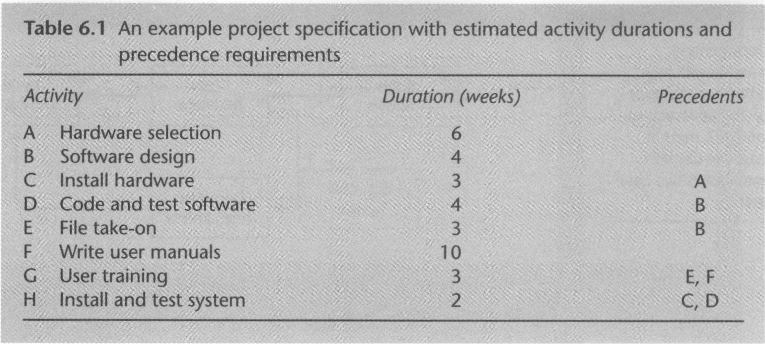
Project Activity: Example 1

Slide 11
How the Question is Asked?
Draw/Establish the Precedence Network
Identify the critical path
What is the shortest time by which the project can be completed?
Calculate the total float, free float for each activity

Slide 12
Example 2
An example project specification with estimated activity durations and precedence requirements are given in the next slide.
Establish/Draw the Precedence Network
Find the critical path
What is the shortest time by which the project can be completed?
Calculate the free float for each activity

Slide 13
Example 2
Activity | Duration (Week) | Precedents
A | 3 | None
B | 9 | A
C | 4 | A
D | 8 | B
E | 2 | B
F | 4 | C, D, E

