Slide 1

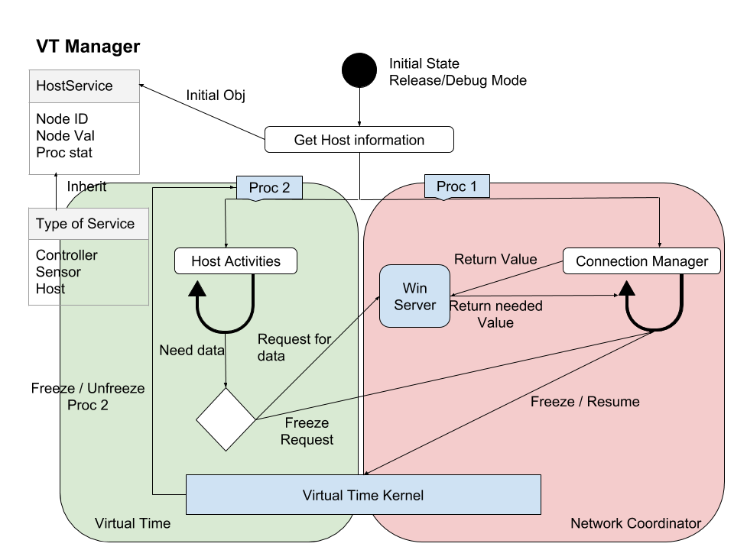
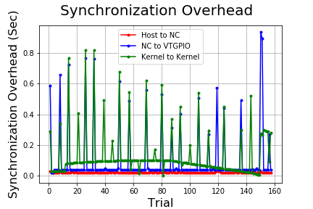
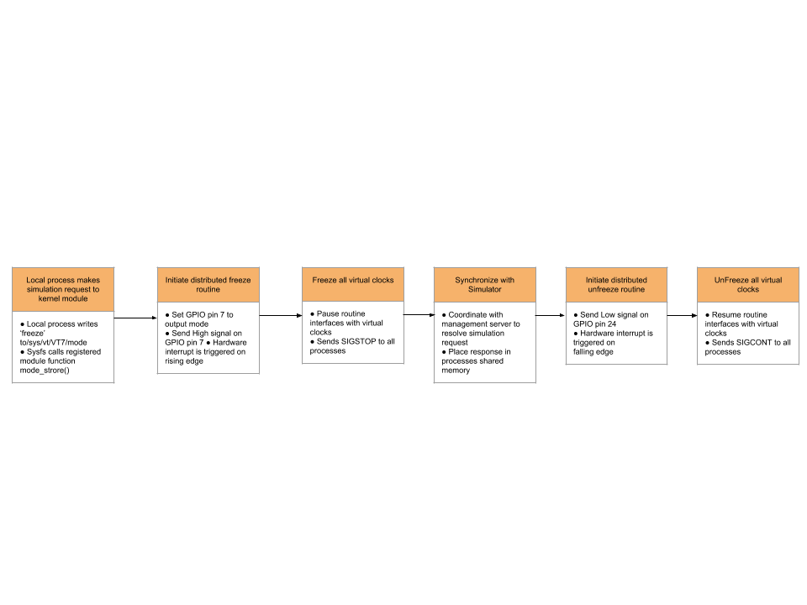
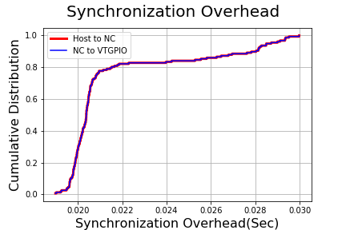
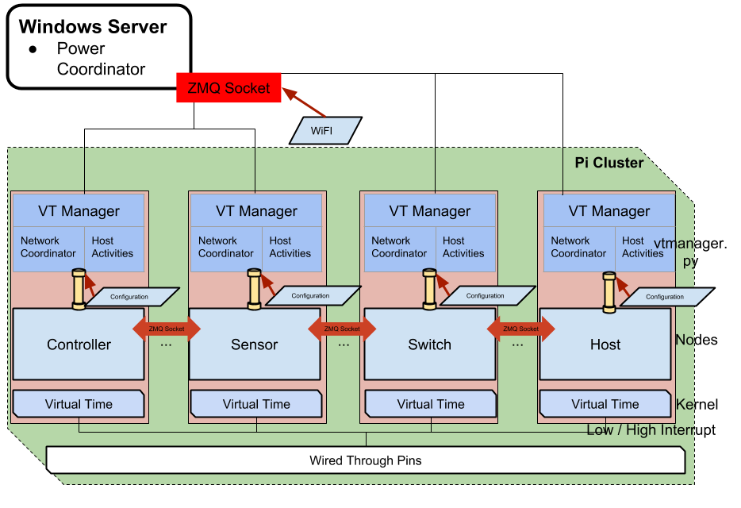
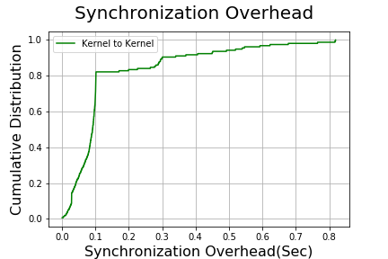
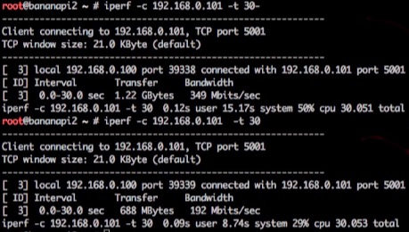
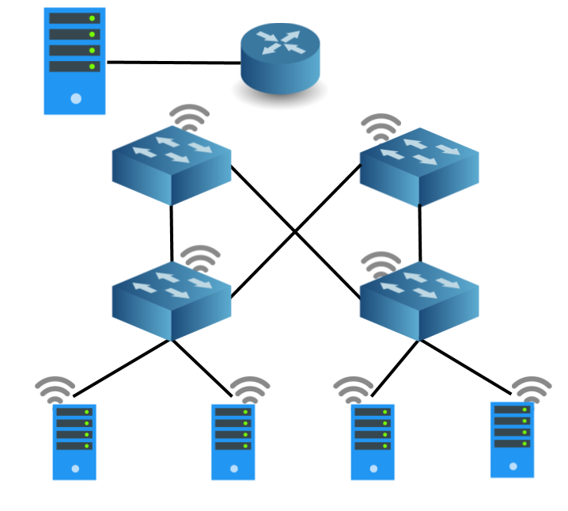


A Distributed Virtual Time System for Embedded Linux Devices
Yuan-An Liu, Christopher Hannon, Dong Jin
Abstract
Methods
This work focuses on creating a hybrid testing platform combining electric power simulation with Linux network devices such as hosts and switches. This system supports a distributed communication network using real networking hardware to support high fidelity analysis of communication network applications and their impacts on the power systems. The challenge in designing such a hybrid system is in the synchronization of combining real networking devices to an electric power simulator. We implement a solution for this synchronization challenge through a virtual time system.
⟵ Virtual Time Manager contains two subprocesses:
The green part of the diagram represents the host activity. The host can be either a Controller, a Switch or a Sensor.
The red part of the diagram represents the Network Coordinator (NC) which handles all pausing, resuming and other network communications.
Result
↑ The flow diagram represents the overview of distributed algorithm within the kernel module, VTGPIO, layer.
Architecture
⟵ The relationship between distributed systems.
Each node has 2 major layers: Virtual Time Manager and Virtual Time kernel.
They are all connected using Ethernet, wireless networking, and direct hardware connection.
↑ Host to NC: The overhead between Host and Network Coordinator
NC to VTGPIO: The overhead between Network Coordinator and Kernel Module.
⟵ iPerf Benchmarking result:
Top: Not in Virtual Time (VT )
Bottom: In VT
⟵ Architecture of distributed system composed of 3 communication channels: Ethernet, wireless management, and direct hardware connection with general purpose and router Linux hardware.
The top node
Monitoring machine which is not in Virtual Time. The bottom nodes
Embedded Linux devices
wireless and wired indicate the connection between switches, router and nodes
References
Christopher Hannon, Jiaqi Yan, Dong Jin: DSSnet: A Smart Grid Modeling Platform Combining Electrical Power Distribution System Simulation and Software Defined Networking Emulation
Christopher Hannon, Neil Getty: Heterogeneous Distributed Embedded Linux System for Hardware-in-the-Loop Smart Grid Testbed

