Slide 1
Group 3
Banking System Final Presentation
Sungmo Koo, Daniel Z. Rodriguez, Breanne Loo, Dongping Guo
Notes:
30 Seconds

Slide 2
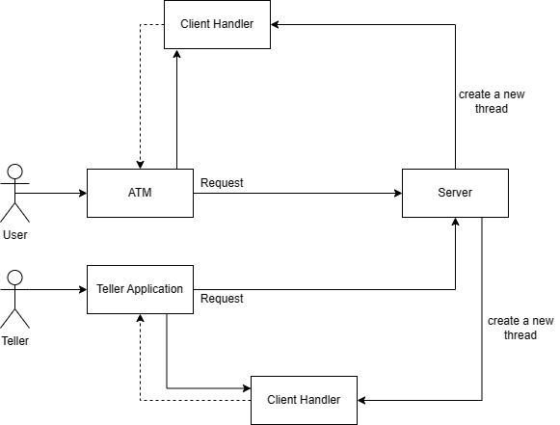
1. Overview
Notes:
Dongping

Slide 3
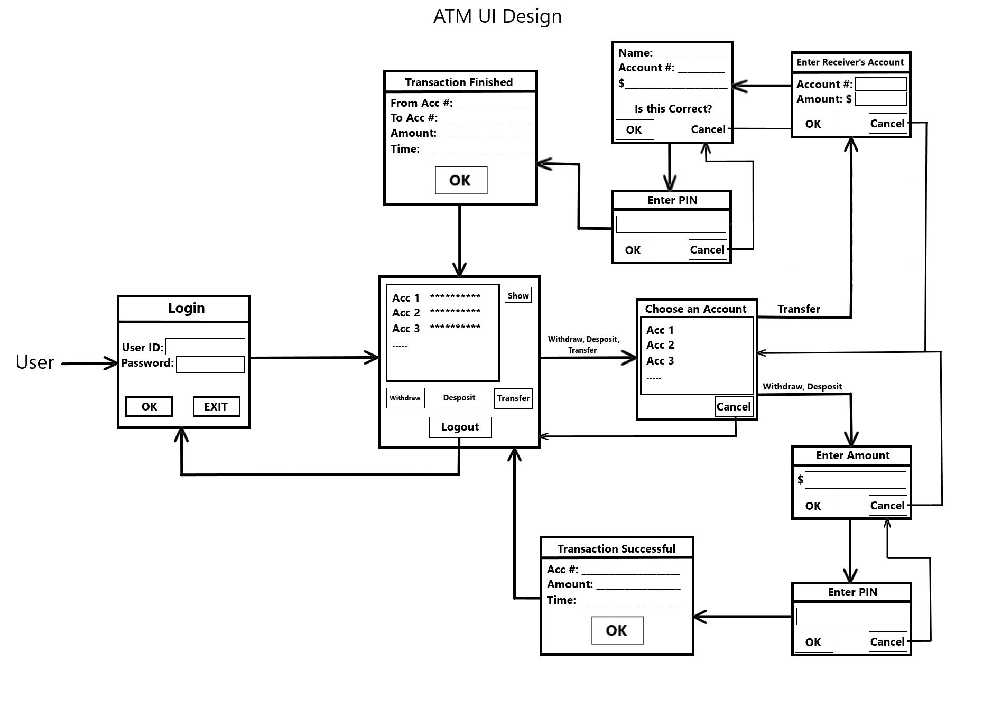
2. ATM UI
Notes:
Breanne

Slide 4
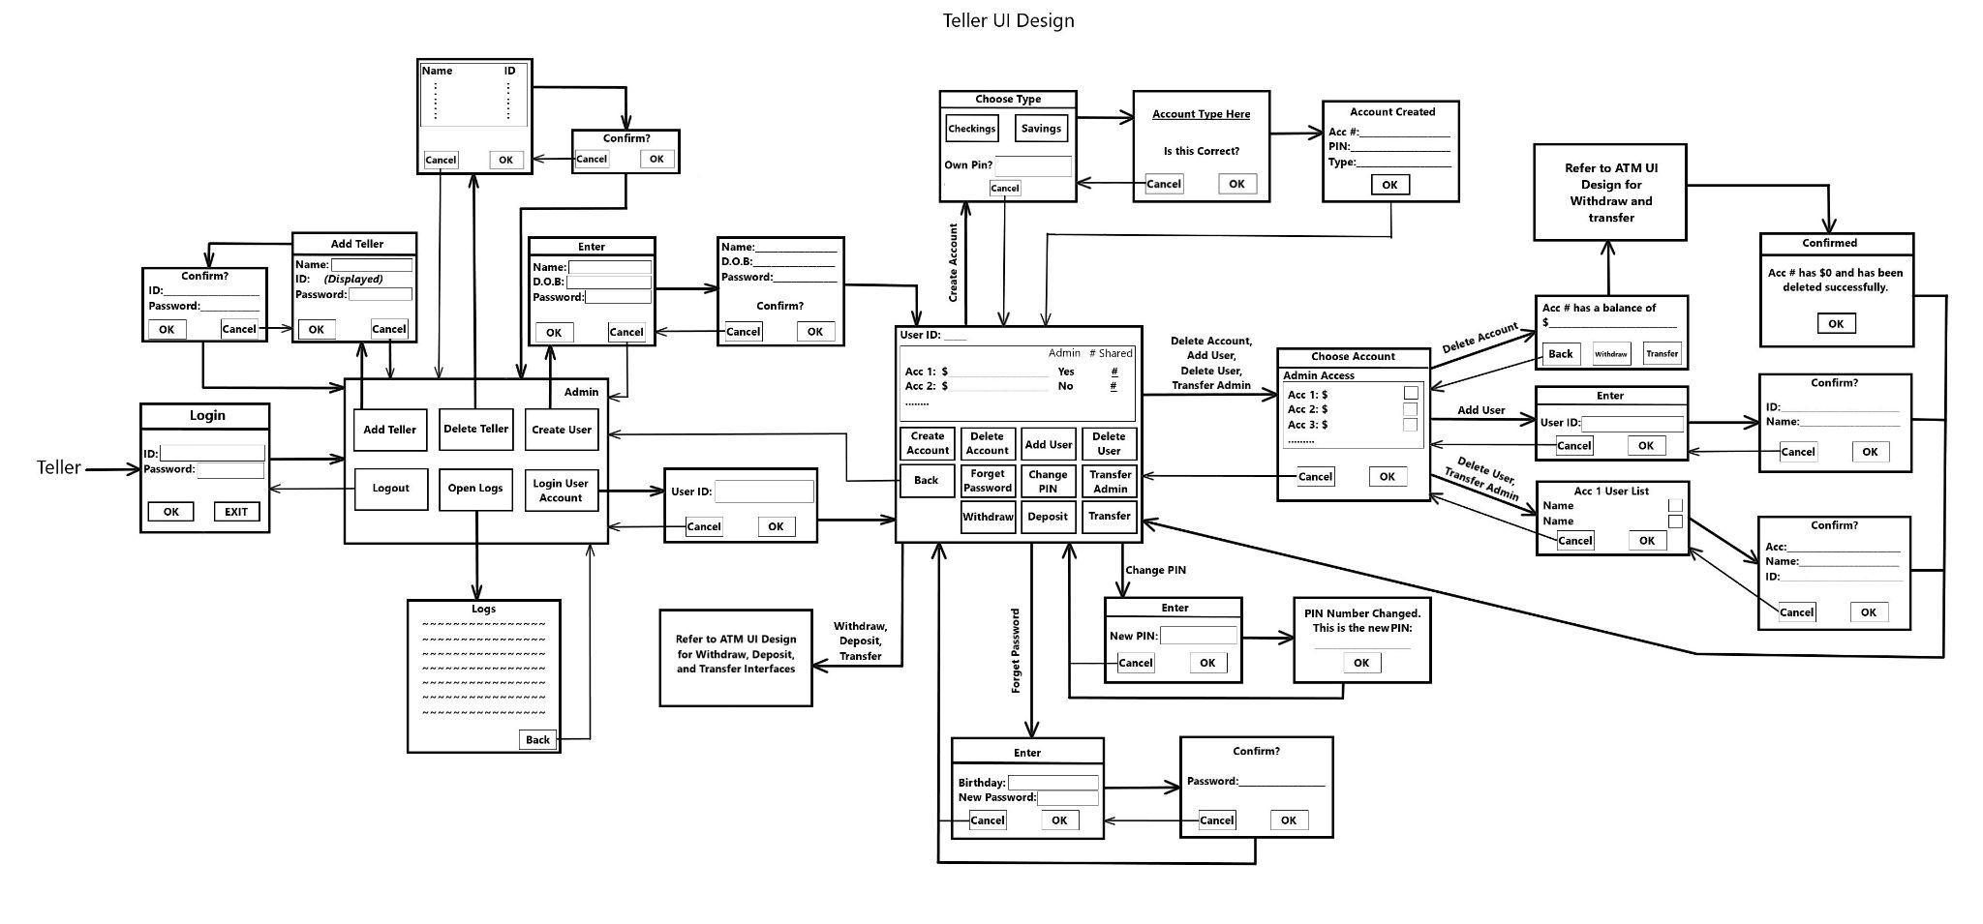
3. Teller UI
Notes:
Breanne

Slide 5
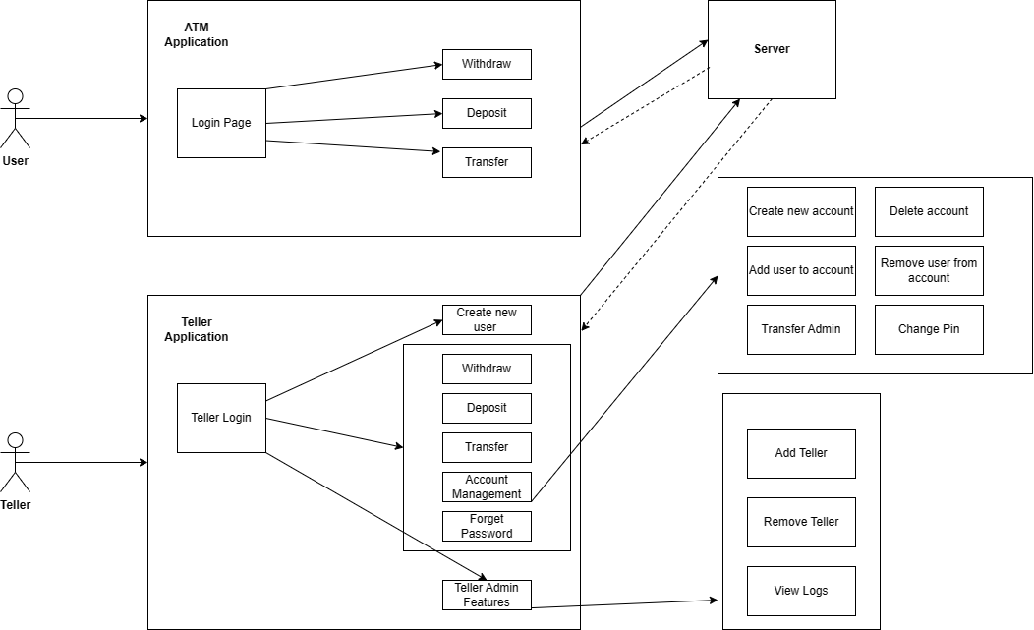
Use Case Diagram
Notes:
DongPing

Slide 6
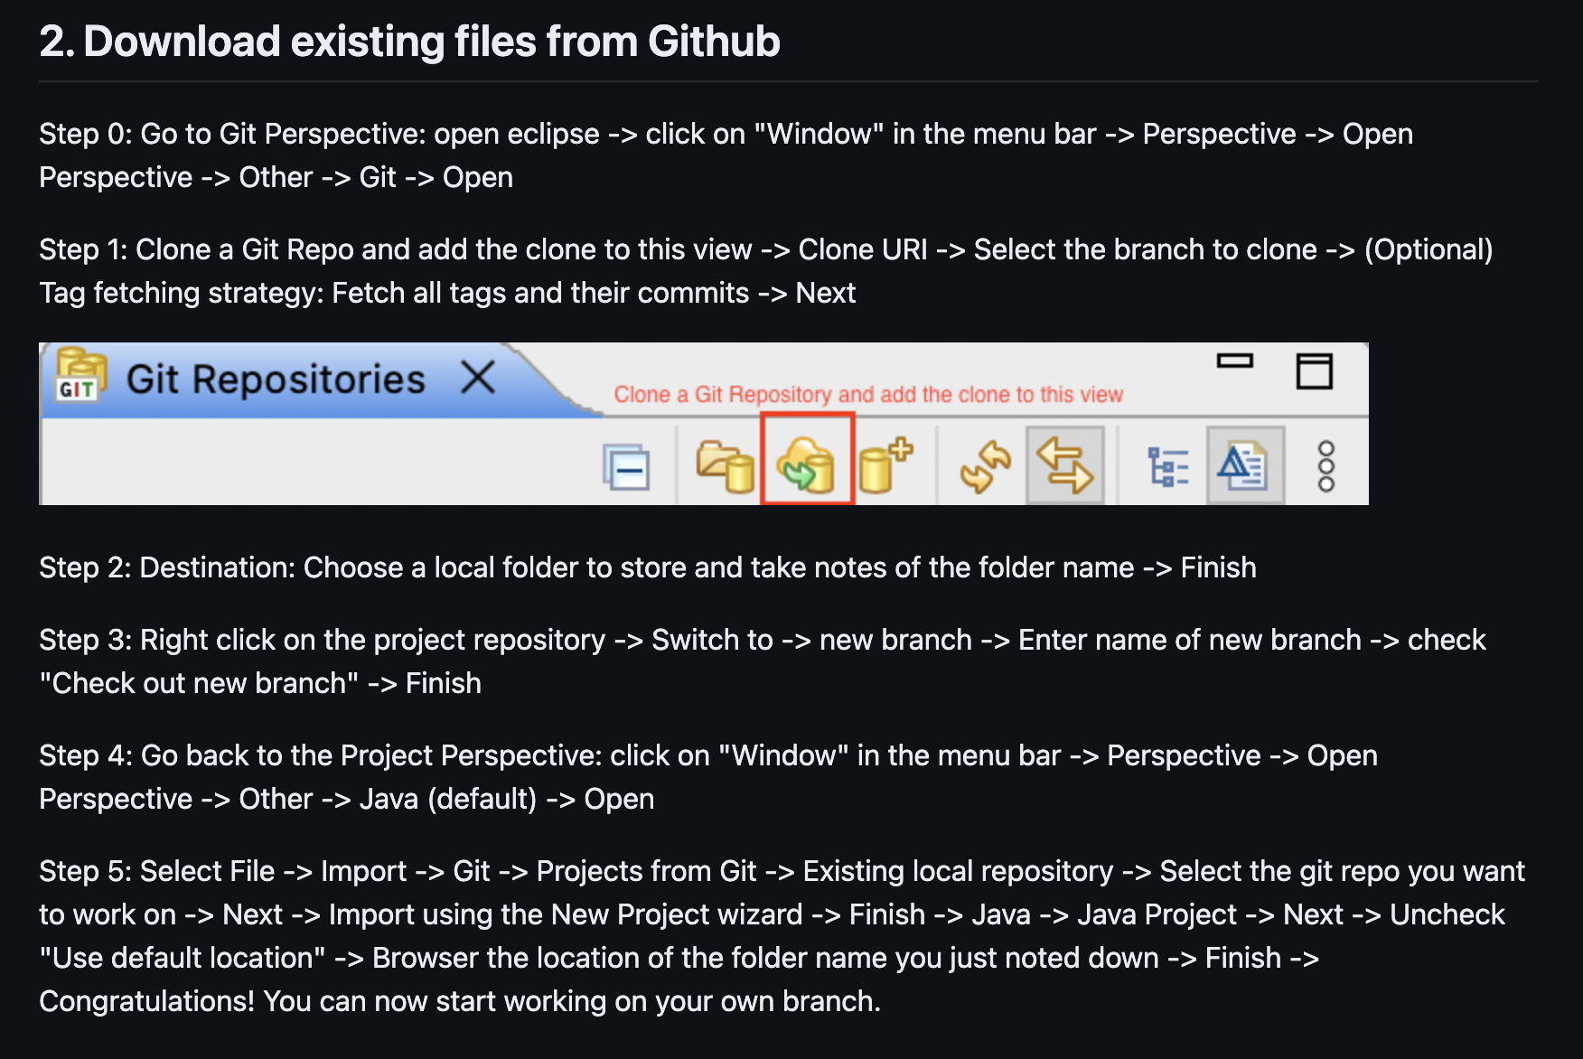
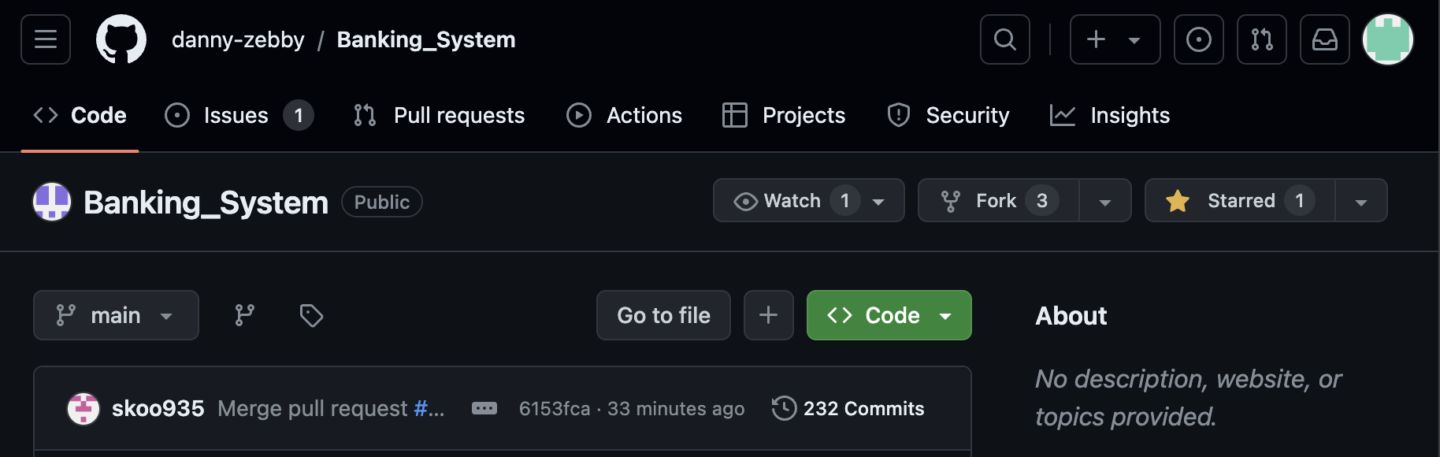
Development Workflow
ConsoleUI -> GUI
Learn Git workflow
200+ commits

Slide 7
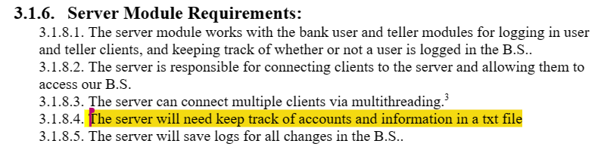
What we would want to add
Notes:
Daniel

Slide 8
THANK YOU!!

