Slide 1
Group 3: Banking System phase 2
Sungmo Koo, Daniel Z. Rodriguez, Breanne Loo, Dongping Guo
Notes:
30 Seconds

Slide 2
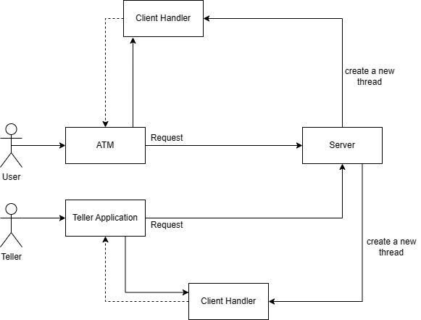
Overview
Notes:
Dongping

Slide 3
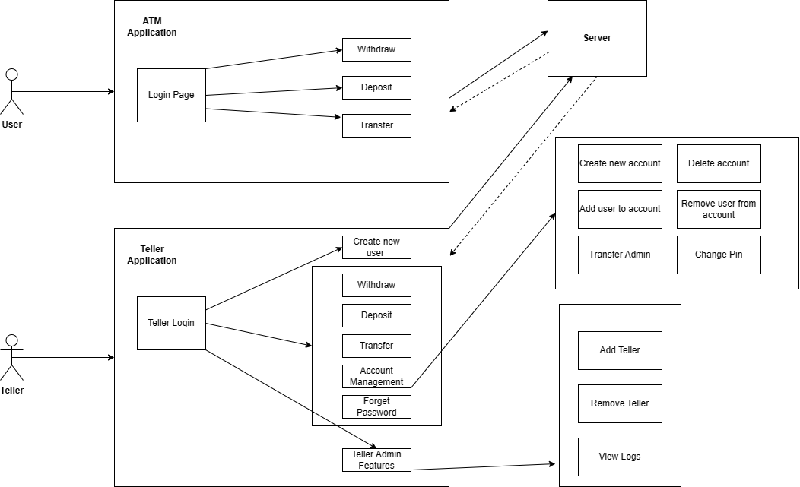
Use Case Diagram
Notes:
Dongping

Slide 4
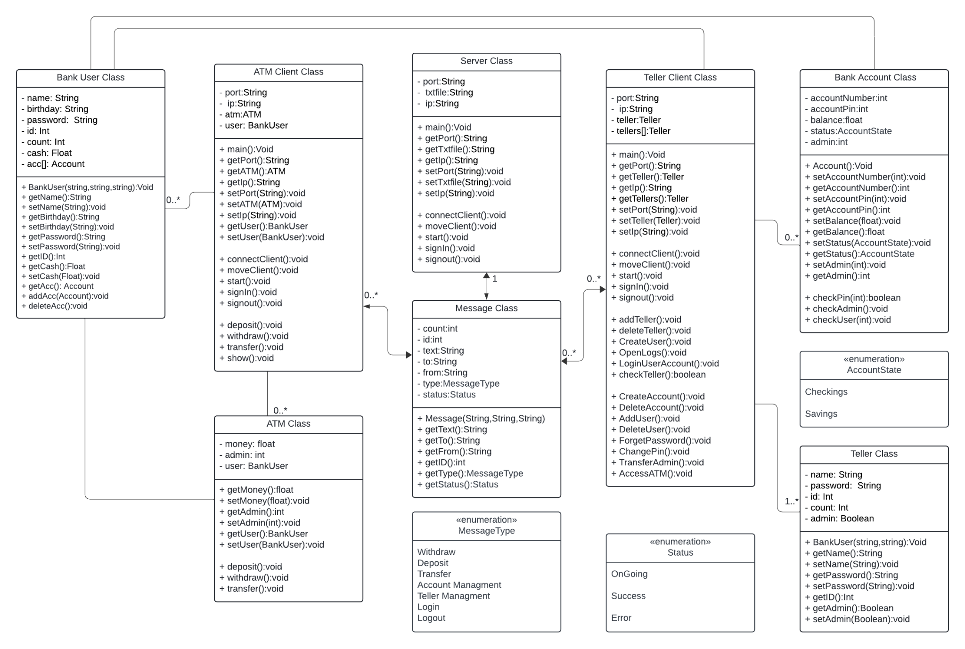
Banking System UML Class Diagram
Notes:
Daniel

Slide 5
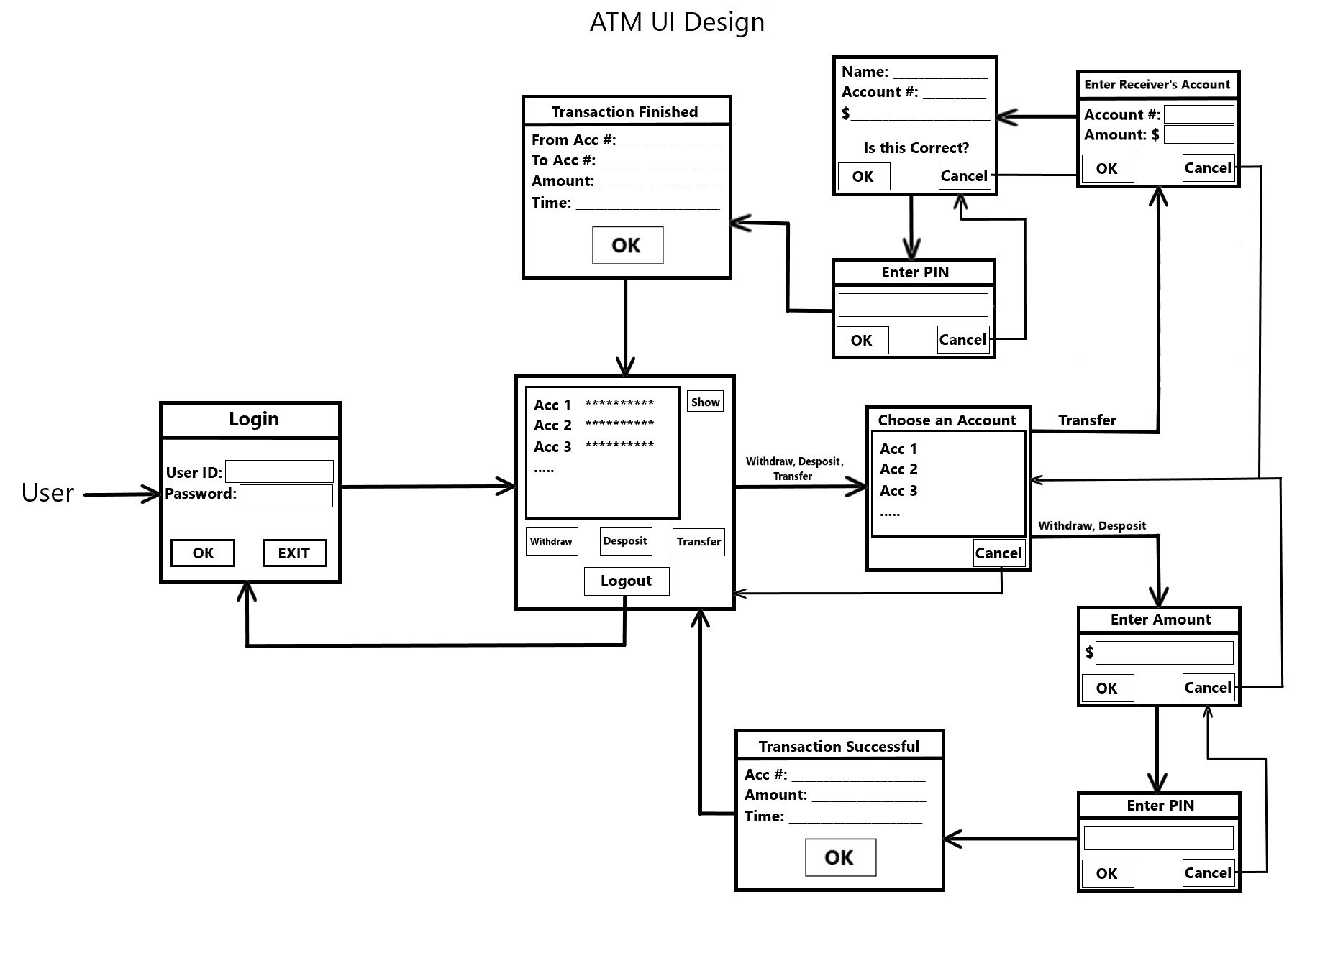
ATM Application UI
Notes:
Breanne

Slide 6
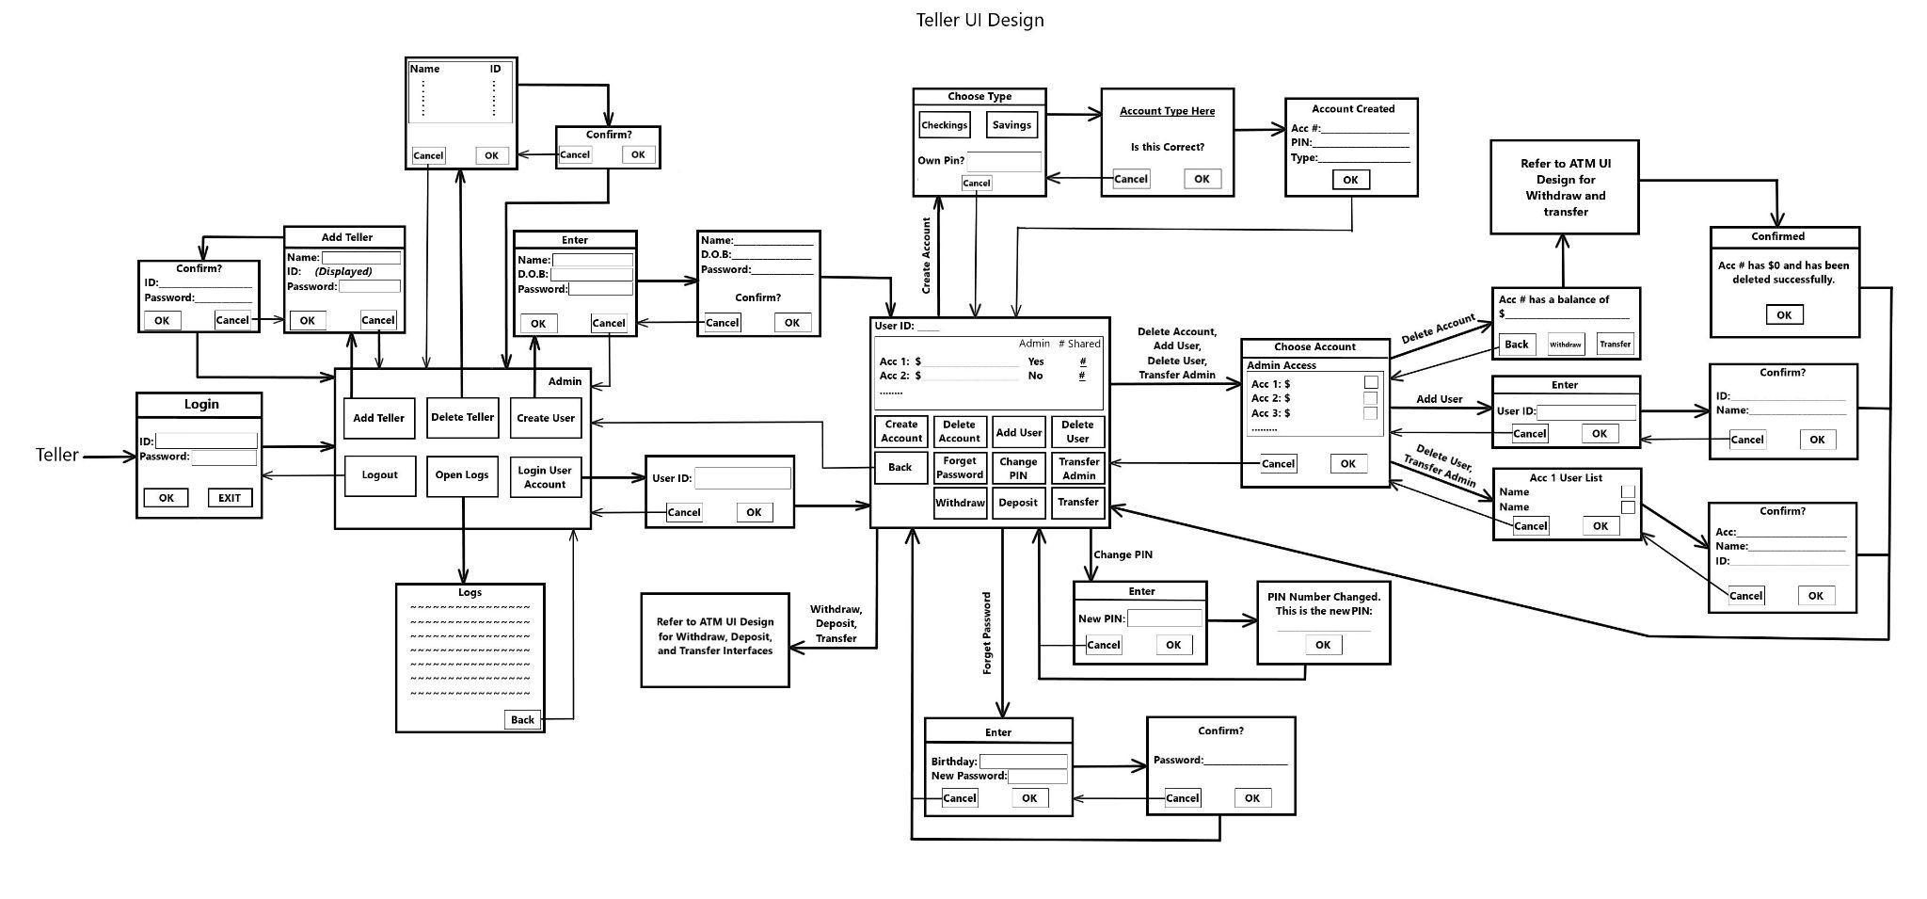
Teller Application UI
Notes:
Sungmo

Slide 7
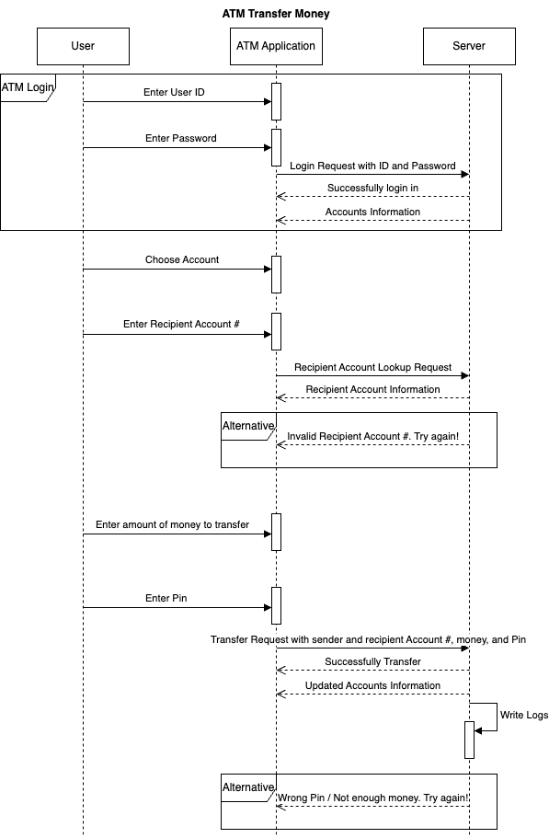
Sequence Diagram
Notes:
Dongping

Slide 8
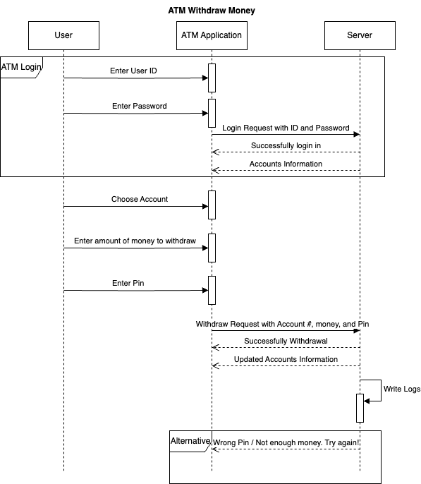
Sequence Diagram
Notes:
Daniel

Slide 9
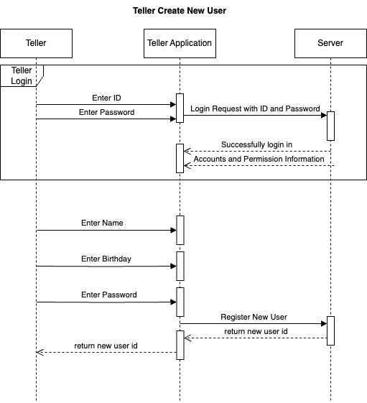
Sequence Diagram
Notes:
Breanne

Slide 10
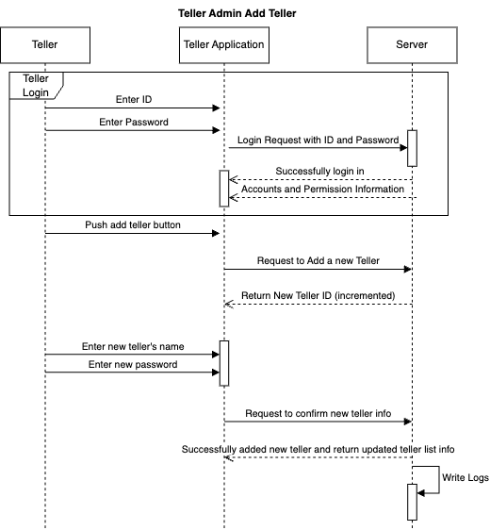
Sequence Diagram
Notes:
Sungmo

Slide 11
THANK YOU!!

