Slide 1
Group 3: Banking System phase 1
Sungmo Koo, Daniel Z. Rodriguez, Breanne Loo
Notes:
30 Seconds

Slide 2
Top Requirements
User:
A user logins in as a bank user or teller with their name, birthday, unique username, and password.
User are presented with two options, ATM service and Teller assistance if available.
Users can own as many accounts as they like.
A user with access to an account can via the teller add other users to the account. Any user can choose how many people can enter an account.
Teller:
A Teller can create and delete saving and checkings accounts.
The accounts the teller creates have a pin that is randomly generated
Tellers can change the pin of a user’s account at their request.
Owners:
The owners have access to turn users into tellers and teller to users or creating new.
ATM
ATM function would be able to deposit, withdraw, and transfer money.

Slide 3
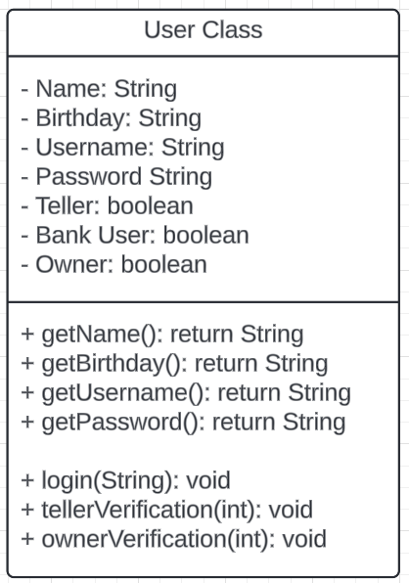
Class Candidates (User)
The user class has four attributes which are used to login as a bank user
Teller and owner verification methods are to check if the user is a teller or an owner

Slide 4
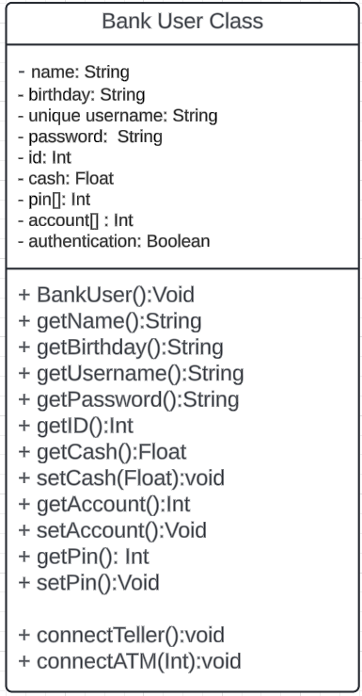
Class Candidates (Bank User)
The Bank User get’s their first 5 attributes from the creation of the User class
The Bank User additional has cash and a set of pins and account numbers.
The Bank user has a connecting function to Teller and ATM

Slide 5
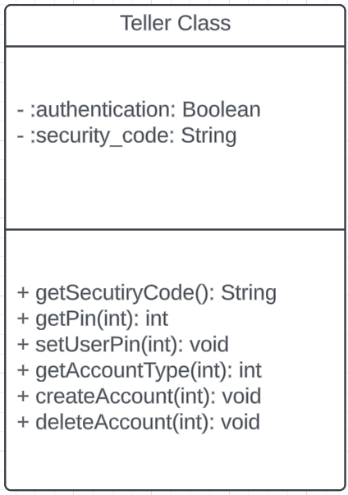
Class Candidates (Teller)
The authentication is for verifying the teller’s status.
The security code is used for teller login.
Since teller can change the user’s PIN, there is a setter for the user PIN.
Create & delete methods take the account # as a parameter.

Slide 6
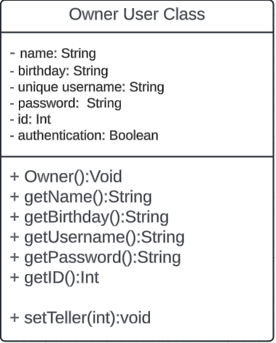
Class Candidates (Owner)
The Owner get’s their first 5 attributes from the creation of the User class
When Given a User’s id, the owner can determine the status of a user’s

Slide 7
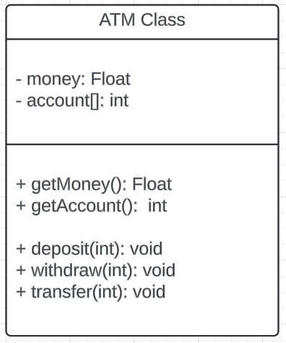
Class Candidates (ATM)
An account is needed for transactions so a getter is used
Deposit, withdraw, and transfer methods take money and account as an int parameter

Slide 8
THANK YOU!!

