Slide 1
Performance Practices
Dmitry Vlasov

Slide 2

Performance Practices
Sometimes we all face performance issues..

Slide 3
Performance Practices
There's a specific set of practices, which, if applied, will help you to eliminate most of the performance problems and save a lot of your time!

Slide 4
Agenda
Part 1: practices
Pagination
Avoiding N+1
Caching (service level, request level, Redis, conditional Get)
Avoiding stupid logic problems
Preliminary work (aggregating some data to DB, pre-filling cache)
Dealing with Too long DB queries (e.g. Use index, Luke!)
Part 2: general tips
how to catch performance problems at the place
when to optimize

Slide 5
Performance Practices
Pagination

Slide 6

1. Pagination

Slide 7
Performance Practices
Avoiding N+1 requests

Slide 8
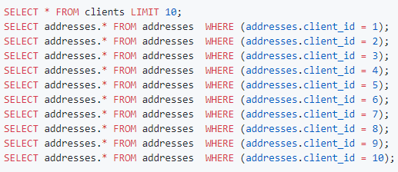
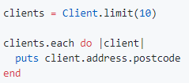
2. Avoiding N+1 requests
Problem:
->
(11 requests)

Slide 9
2. Avoiding N+1 requests
It doesn't seem scary...

Slide 10
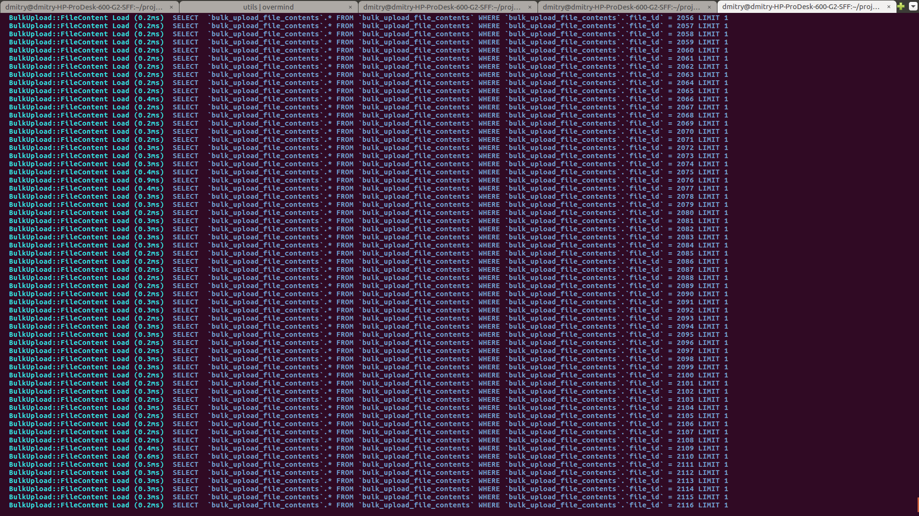

2. Avoiding N+1 requests
But with time, you end with:
->
(it’s only part of the actual log)

Slide 11
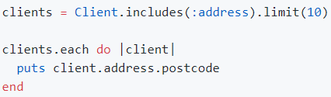

2. Avoiding N+1 requests
Solution:
->
(11 requests)

Slide 12
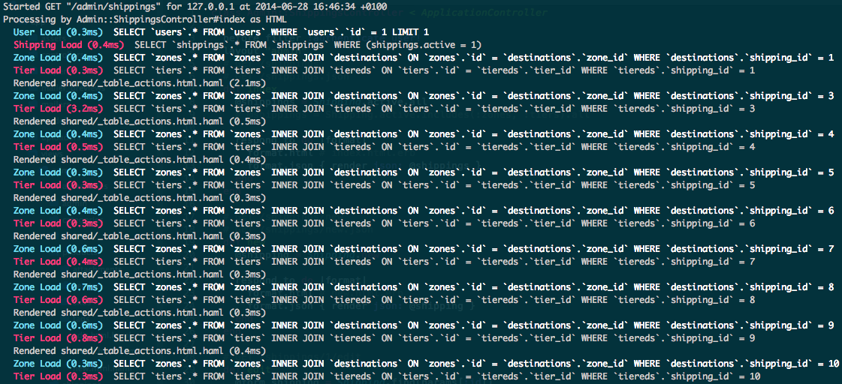
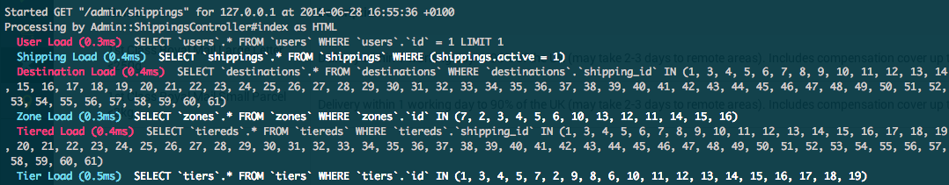
2. Avoiding N+1 requests
Result:
->

Slide 13
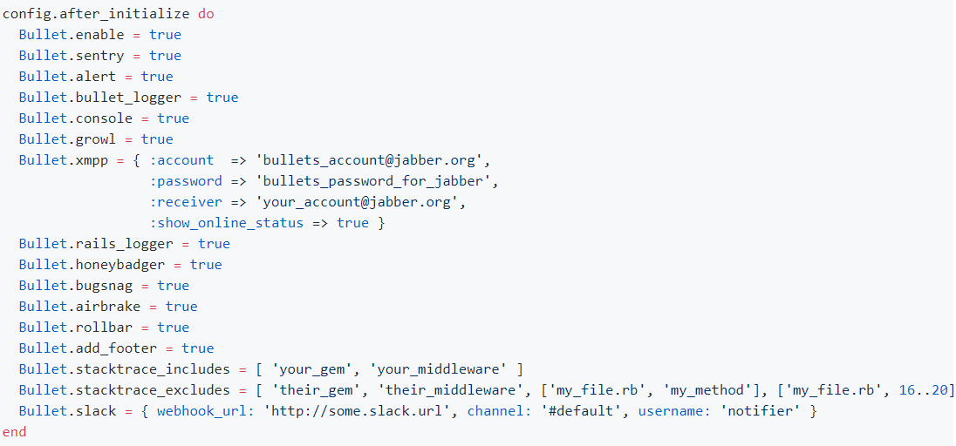
2. Avoiding N+1 requests
How to not forget:
For ruby : https://github.com/flyerhzm/bullet Configuration:
I'm sure something similar is already implemented for your language

Slide 14
Performance Practices
Caching

Slide 15
Performance Practices
Memoization
Or “god bless ||=“

Slide 16
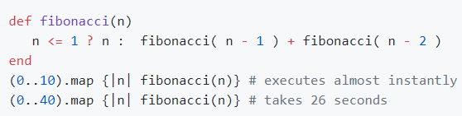
3.1 Memorization
Problem:
(Yes, it's slow Ruby, but it will hang on every lang with big number)

Slide 17
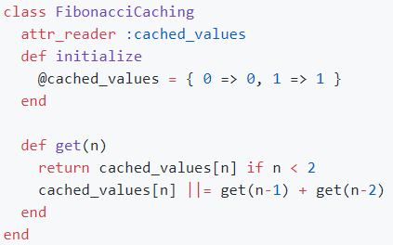
3.1 Memorization
Solution:

Slide 18
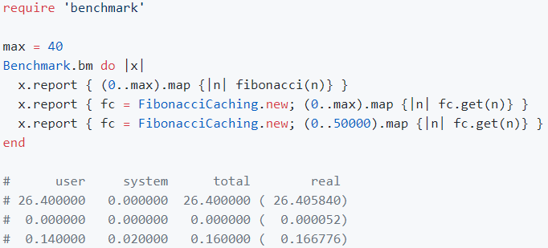
3.1 Memorization
results:

Slide 19
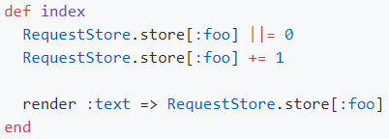
3.2 Caching something for the whole request
For ruby: https://github.com/steveklabnik/request_store

Slide 20
Performance Practices
Redis
(one love)

Slide 21
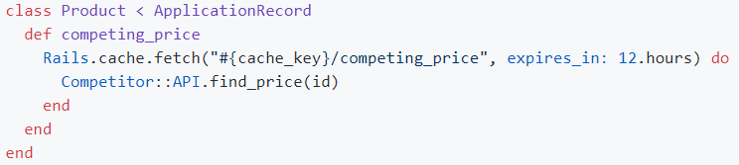
3.3 Redis

Slide 22
Performance Practices
Conditional GET
(when you're so lazy you don't even want to render response)

Slide 23
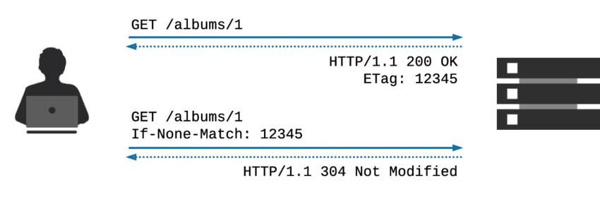
3.3 Conditional GET
Uses HTTP ETag and If-None-Match headers
! Doesn't work together with previous example

Slide 24
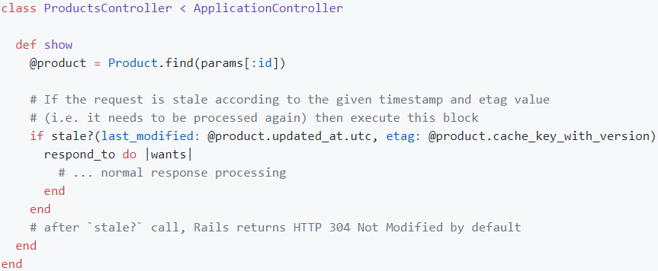
3.3 Conditional GET
Ruby solution:

Slide 25

Performance Practices
Keep in mind the whole picture
(Avoiding stupid logic problems)

Slide 26
4. Logic problems
Example:
service1 receives up to 50k transfers and should process them
system should validate that any of the transfers has amount less than some limit, if not - render "At least one transfer exceeds your allowed limit"
such validation endpoint is on service2, accepts ONE value
How to implement?

Slide 27

Performance Practices
Preliminary work

Slide 28
5. Preliminary work
Save to database (aggregating some data)
Save to cache (pre-filling)

Slide 29
Performance Practices
Dealing with Too long
requests to Database
(e.g. Use index, Luke!)

Slide 30
6. Dealing with Too long requests to DB
EXPLAIN ANALYZE - your best friend
Understand difference between INDEX FULL SCAN / INDEX UNIQUE SCAN / TABLE SCAN etc.
Understand what index types does your DB support (not only B-tree exist, for example indexes for geo data (lat/long))
Check indexes on all heavy queries fields used in WHERE, ON, GROUP BY, ORDER BY

Slide 31
Performance Practices
General tips:

Slide 32
7. General tips
Amount of data

Slide 33
7.1 Amount of data
Always test with the amount of data compared to how much you'll have on prod
Fill DB with scripts generating fake data
Upload big files

Slide 34
7. General tips
Profiling

Slide 35

7.2 Profiling and optimization
You MUST do profiling before doing optimization, to be sure you're not just wasting time, unless you're sure in advance it's 100% required in this particular place (comes with years of work experience)
Profiling:
Datadog/newRelic (good for production, costly)
something like Flamegraph (good for local debugging, open-source)

Slide 36

Performance practices

Slide 37
Performance Practices

