Slide 1
Performance Practices
Dmitry Vlasov

Slide 2

Performance Practices
Sometimes we all face performance issues..

Slide 3
Performance Practices
There's a specific set of practices, which, if applied, will help you to eliminate most of the performance problems and save a lot of your time!

Slide 4
Performance Practices
Agenda
Part 1: practices
Pagination
Avoiding N+1
Caching (service level, request level, Redis, conditional Get)
Avoiding stupid logic problems
Preliminary work (aggregating some data to DB, pre-filling cache)
Dealing with Too long DB queries (e.g. Use index, Luke!)
Part 2: general tips
how to catch performance problems at the place
when to optimize

Slide 5
Performance Practices
1. Pagination

Slide 6

Performance Practices
1. Pagination

Slide 7
Performance Practices
2. Avoiding N+1 requests

Slide 8
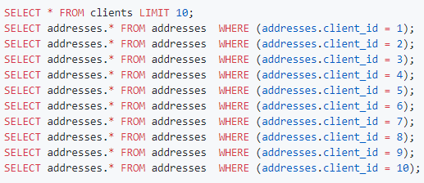
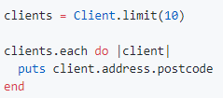
Performance Practices
2. Avoiding N+1 requests
Problem:
->
(11 requests)

Slide 9
Performance Practices
2. Avoiding N+1 requests
It doesn't seem scary...

Slide 10
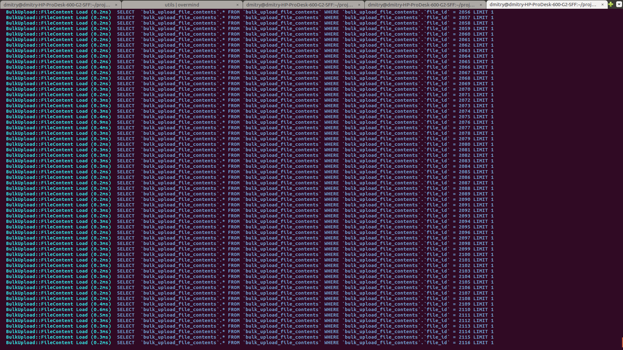

Performance Practices
2. Avoiding N+1 requests
But with time, you end with:
->
(it’s only part of the actual log)

Slide 11
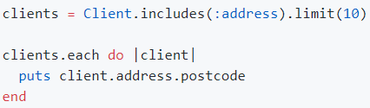

Performance Practices
2. Avoiding N+1 requests
Solution:
->
(11 requests)

Slide 12
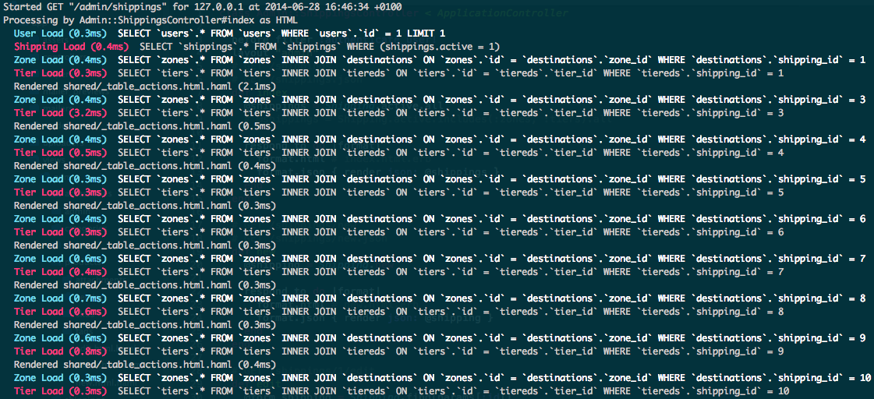
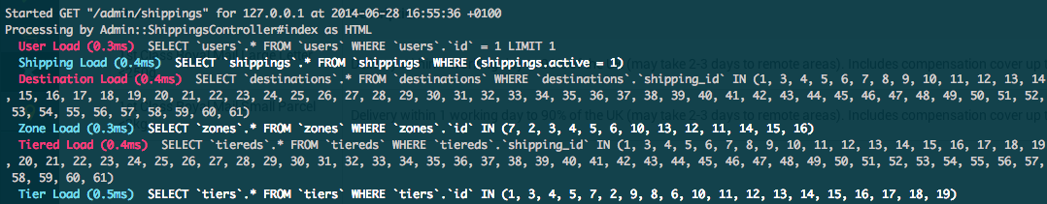
Performance Practices
2. Avoiding N+1 requests
Result:
->

Slide 13
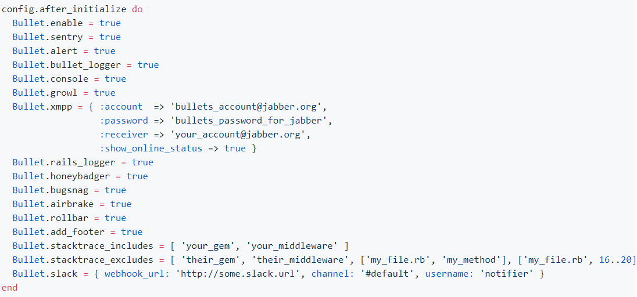
Performance Practices
2. Avoiding N+1 requests
How to not forget:
For ruby : https://github.com/flyerhzm/bullet Configuration:
I'm sure something similar is already implemented for your language

Slide 15
Performance Practices

