Slide 1
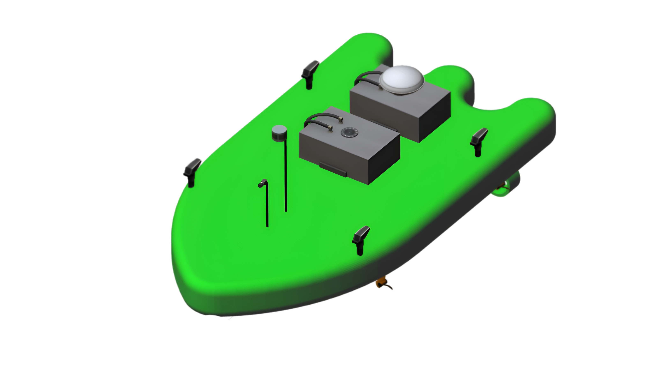
B
Z
<𝔹>
I
Z
Z
B
Y
B
X
<𝕀>
I
I
Y
X

Slide 2
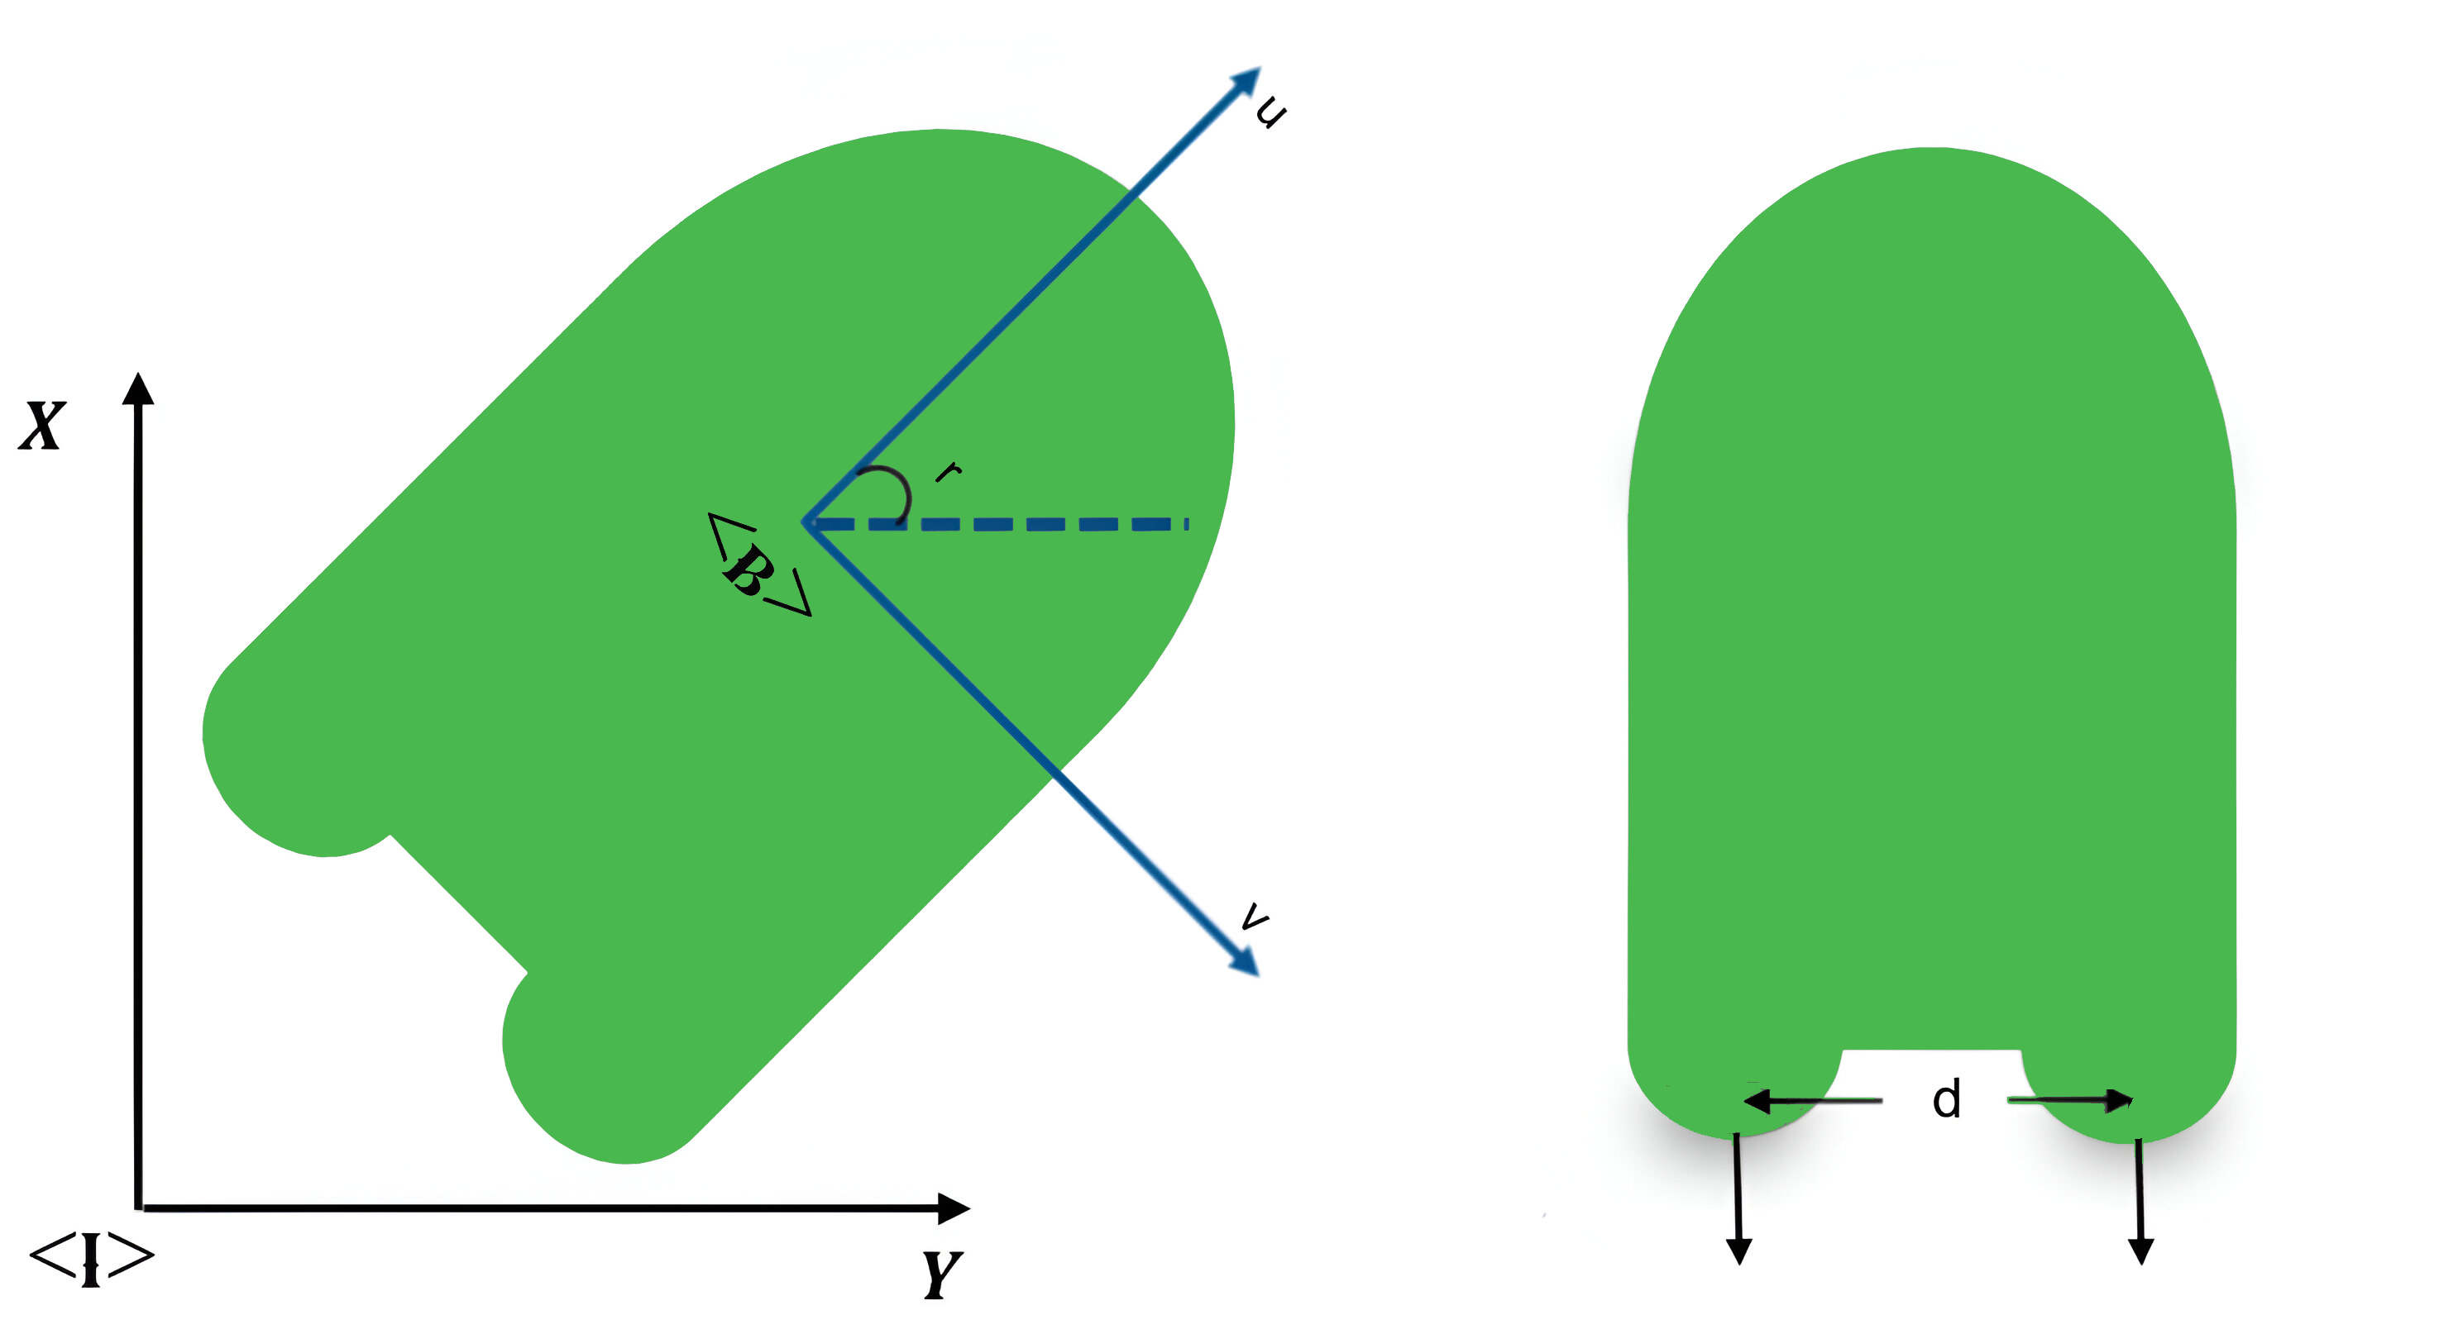
LF
Thruster
RF
Thruster
LR
Thruster
RR
Thruster
FL
FR

