Slide 1


GRADUATION PROJECT
Health Insurance
Management System
Software Engineering Department
Syrian Private University
PREPARED BY
Baraa Alhayek • Abdulaziz Haj Ali
SUPERVISED BY
Dr. Kadan Jumaa
A Role-Based Web Platform for Health Insurance Operations
October 2026

Slide 2
01 / PROJECT OVERVIEW
Health Insurance
SYSTEM AT A GLANCE
Management System
A web-based platform that manages insurance plans, subscriptions,
reimbursement requests, and subscriber eligibility through secure,
role-based workflows.
Subscriber
System Admin
Medical Provider
View coverage
Manage workflows
Verify eligibility
Project Type
Main Users
HEALTH INSURANCE / OVERVIEW
01
Web-based information system for health insurance management.
02
Subscriber, System Administrator, and Medical Service Provider.
Core Workflows
Plans
Subs.
Plans & Coverage
Subscriptions
Core Functions
Key Characteristic
Requests
03
04
Eligibility
Reimbursements
Eligibility
Plans, subscriptions, reimbursement requests, and eligibility checks.
Separate interfaces and permissions for each user role.
Role-based workflows · Centralized records
Illustrative platform overview
✓
PROJECT FOCUS
Integrating core insurance services in one platform to improve organization, access, and efficiency.
Health Insurance Management System | Graduation Project
02

Slide 3
Problem Statement
Why the system is needed
≡
Manual Processes
▤
Poor Data Organization
Administrative operations are slow and repetitive.
Subscriber records and plan information are difficult to manage.
Limited Coverage Visibility
Slow Eligibility Verification
◉
◷
Subscribers cannot easily access coverage details.
Providers lack a quick verification method.
✓
consequences
Delays, administrative errors, and weaker access to health insurance services.
+
Health Insurance Management System
03

Slide 4
Project Objectives
Project Goals
01
02
Manage Insurance Plans and Coverage
◉
Enable Role-Based Access
▤
Role-based sign-in for all three user types, with account creation for subscribers and medical service providers.
Create plans, define covered services, and assign coverage percentages.
03
04
Manage Reimbursement Requests and Verify Eligibility
▣
Manage Subscriptions and Coverage Access
✓
Enable administrators to activate subscriptions and subscribers to view their coverage details.
Submit and track reimbursement requests, support approval or rejection decisions, and verify subscriber eligibility.
✓
Outcome
A working prototype of the Health Insurance Management System.
+
Health Insurance Management System
04

Slide 5
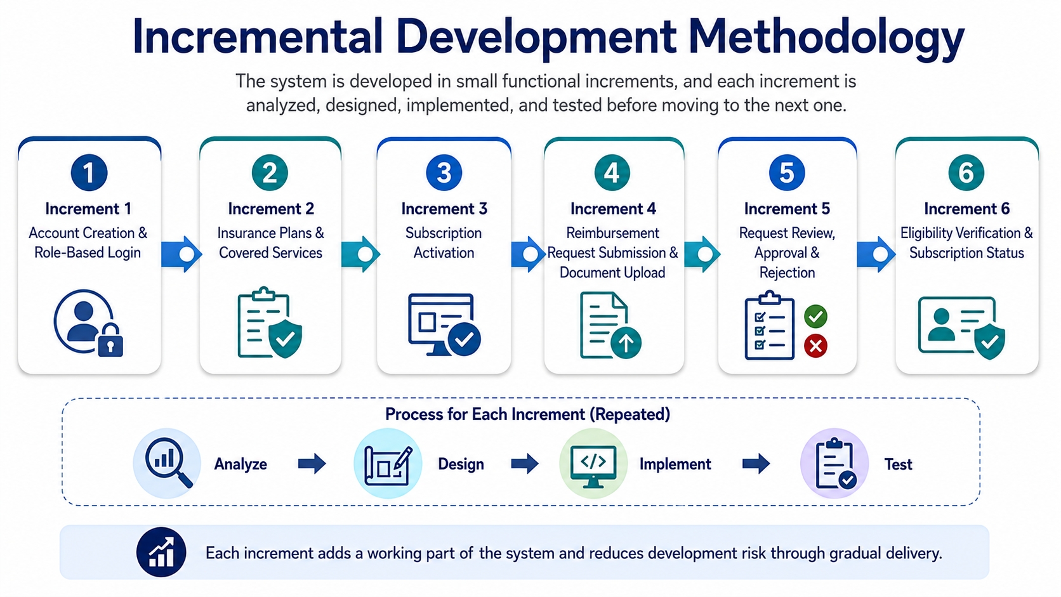
Development Methodology
Incremental development
Incremental development methodology used in the project.
+
Health Insurance Management System
05

Slide 6
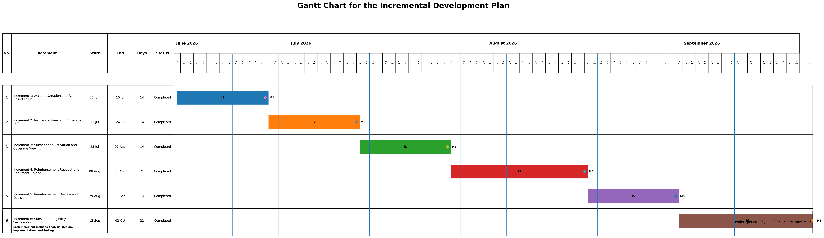
Gantt Chart
Project schedule
Figure: Gantt chart for the incremental development plan.
+
Health Insurance Management System
06

Slide 7
Functional Requirements
Account & insurance management
+
FR-01
⌂
FR-02
Create subscriber account
Create provider account
◎
FR-03
▤
FR-04
Role-based sign-in
Add health insurance plan
%
FR-05
✓
FR-06
Define covered services and percentages
Activate subscriber subscription
▣
FR-07
✓
Account access and the setup of insurance plans and services.
View subscription details and coverage
+
Health Insurance Management System
07

Slide 8
Functional Requirements
Reimbursement & eligibility
+
FR-08
↑
FR-09
Submit reimbursement request
Upload invoice or medical document
⌕
FR-10
▤
FR-11
Track reimbursement request status
Review medical reimbursement requests
✓
FR-12
×
FR-13
Approve reimbursement request
Reject request with reason
◇
FR-14
✓
Request processing, decision tracking, and provider verification.
Verify subscriber eligibility and subscription status
+
Health Insurance Management System
08

Slide 9
Non-Functional Requirements
Quality attributes
◷
Performance — Pages
↗
Performance — Actions
▣
Security — Accounts
NFR-01: Main pages should load within 3 seconds under normal use.
NFR-02: Login, subscription viewing and status tracking target 3s in normal use.
NFR-03: Protected functions require valid email and password.
✓
Security — Roles
♙
Usability
✓
Reliability — Inputs
NFR-04: Each role can access only its authorized system functions.
NFR-05: Main functions should be reachable in 3–5 clear steps.
NFR-06: Check required fields before signup, activation and request submission.
+
Health Insurance Management System
09

Slide 10
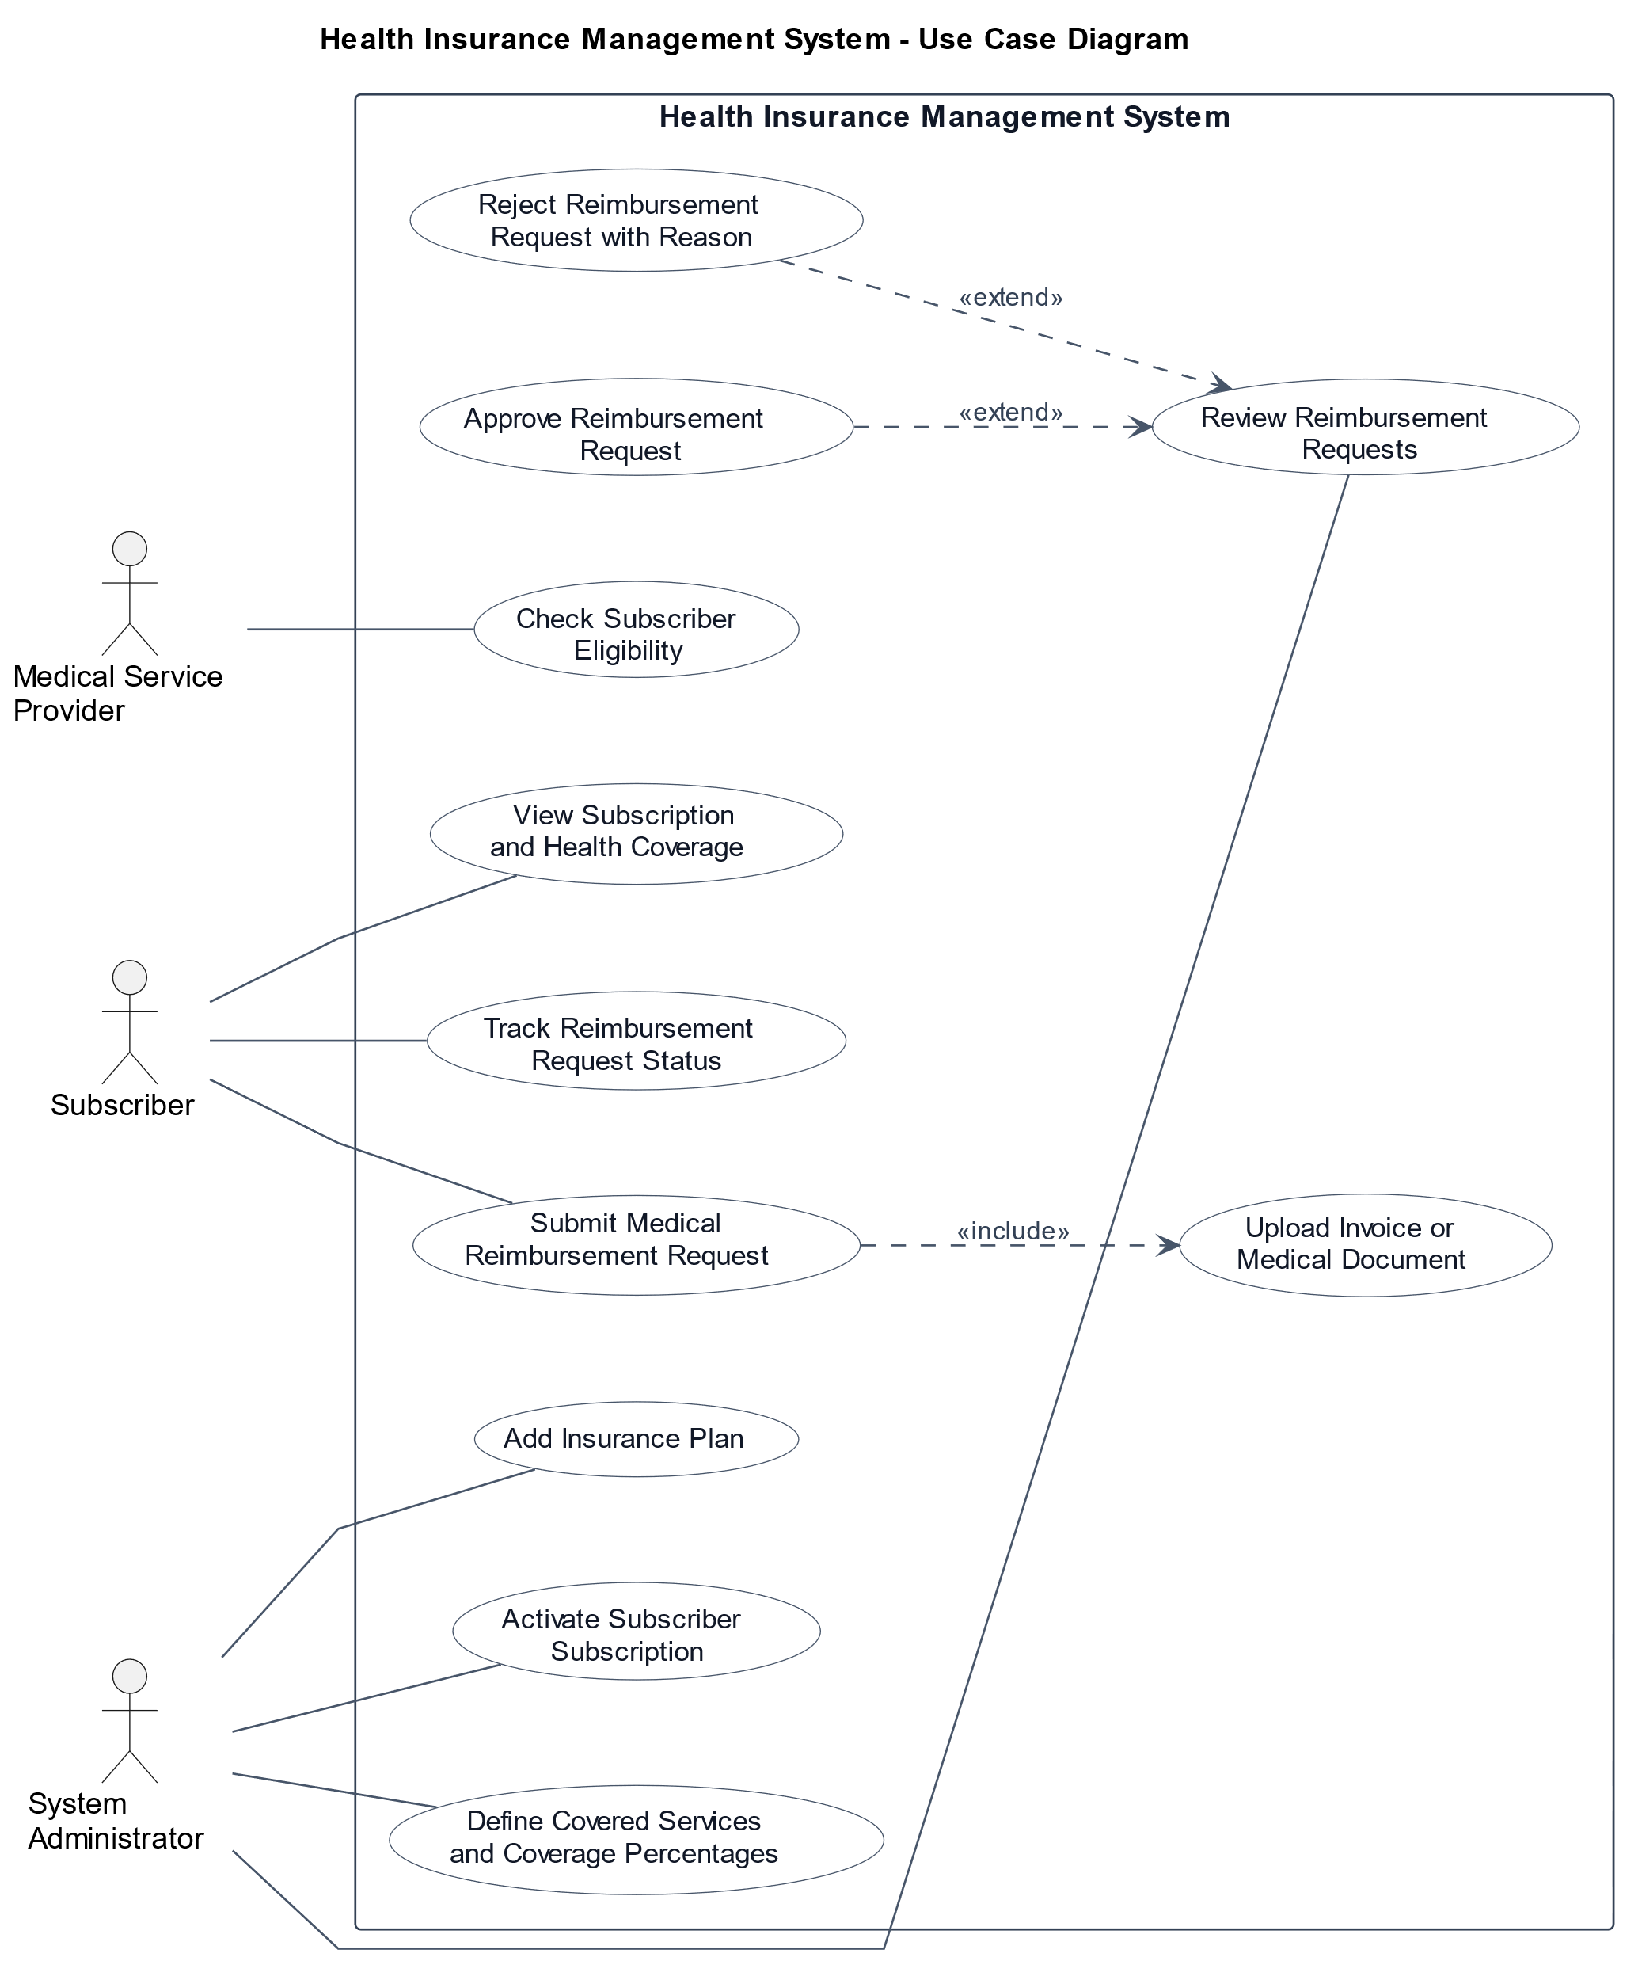
Use Case Diagram
System behavior
Main actors and their interactions with the Health Insurance Management System.
+
Health Insurance Management System
10

Slide 11
Use Case Description
Add New Health Insurance Plan
Table 10. Use Case Description: Add New Health Insurance Plan
Use Case Name
Add New Health Insurance Plan
Actor
System Administrator
Case Description
The system administrator adds a health insurance plan by entering its name, description, coverage limits, and pricing.
Preconditions
The administrator is logged in, and the required plan information is available.
Postconditions
A new health insurance plan is created and becomes available for subscription.
Main Flow
1. Open the Add Health Insurance Plan page.
2. Enter plan details (name, description, limits, and price).
3. Submit the form; the system validates the data.
4. The system creates the new plan.
Exceptional Flow
Missing or invalid data, duplicate plan name, or server error.
+
Health Insurance Management System
11

Slide 12
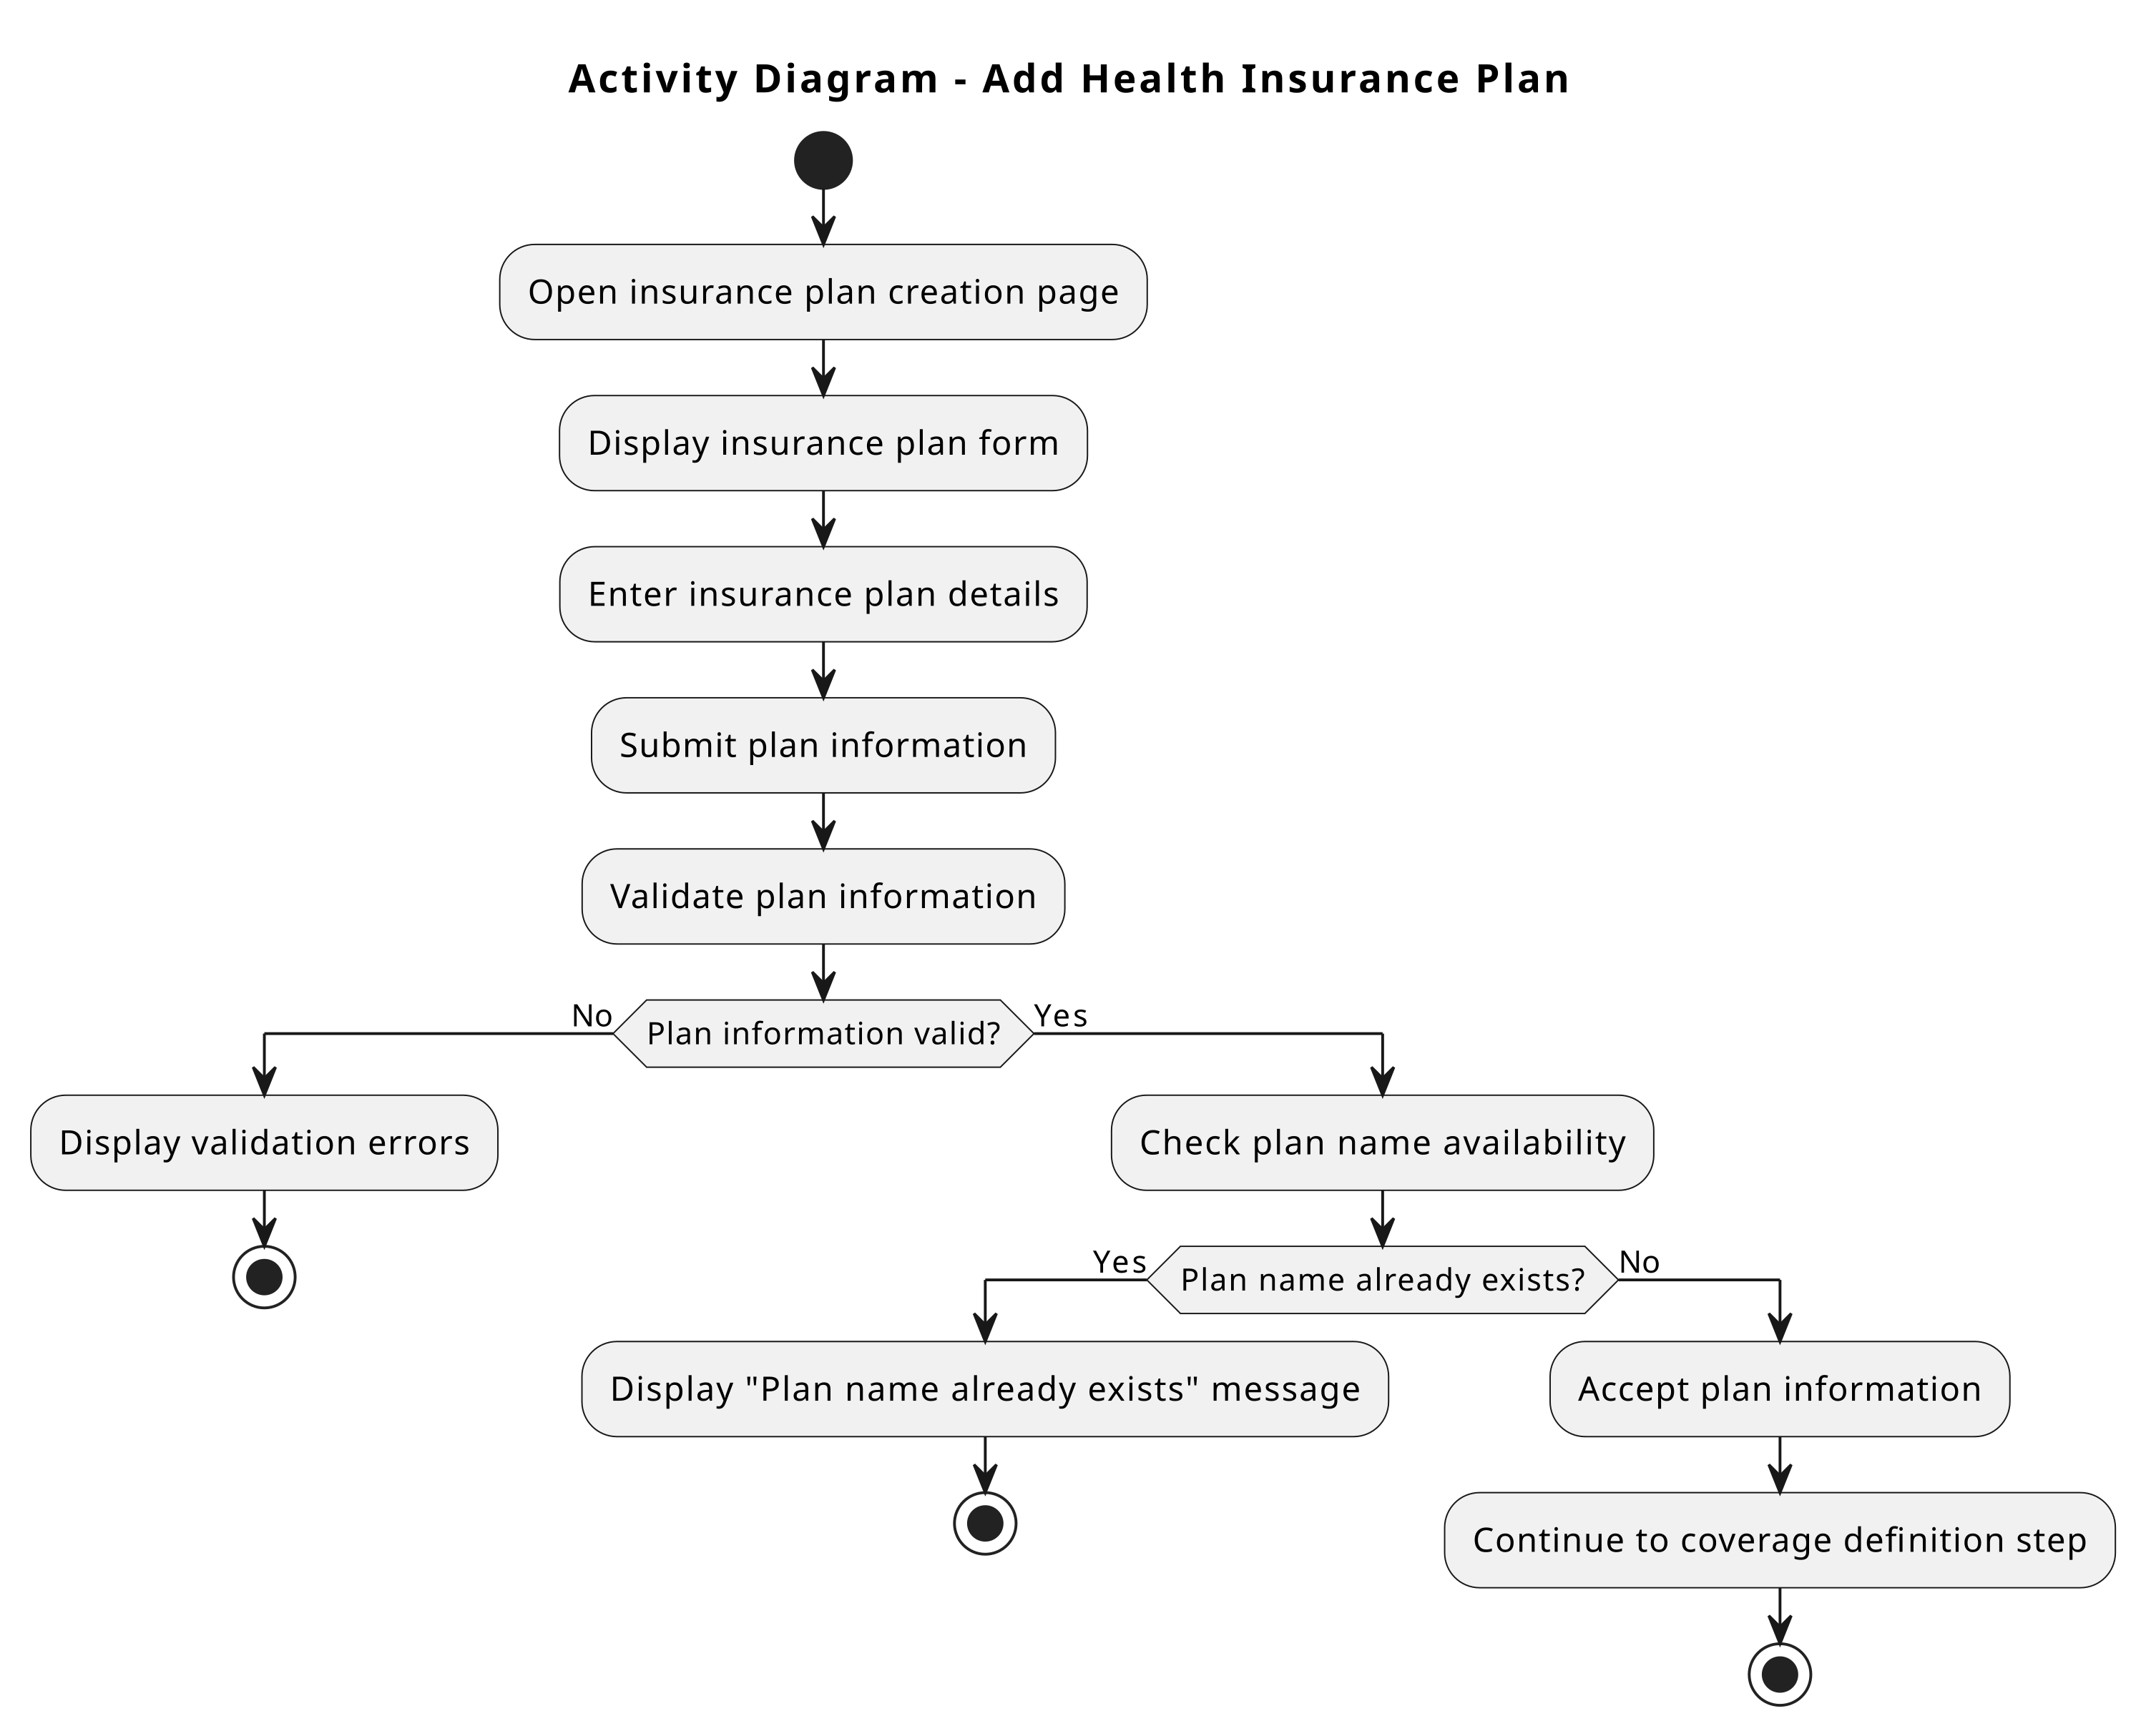
Activity Diagram — Add Health Insurance Plan
Analysis model
Main activity flow for adding a health insurance plan.
+
Health Insurance Management System
12

Slide 13
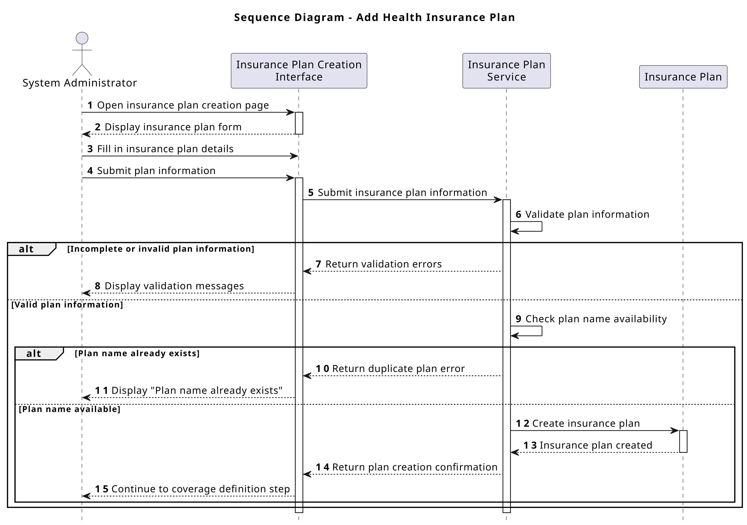
Sequence Diagram — Add Health Insurance Plan
Interaction model
Interaction flow among the administrator, interface, service, and insurance plan.
+
Health Insurance Management System
13

Slide 14
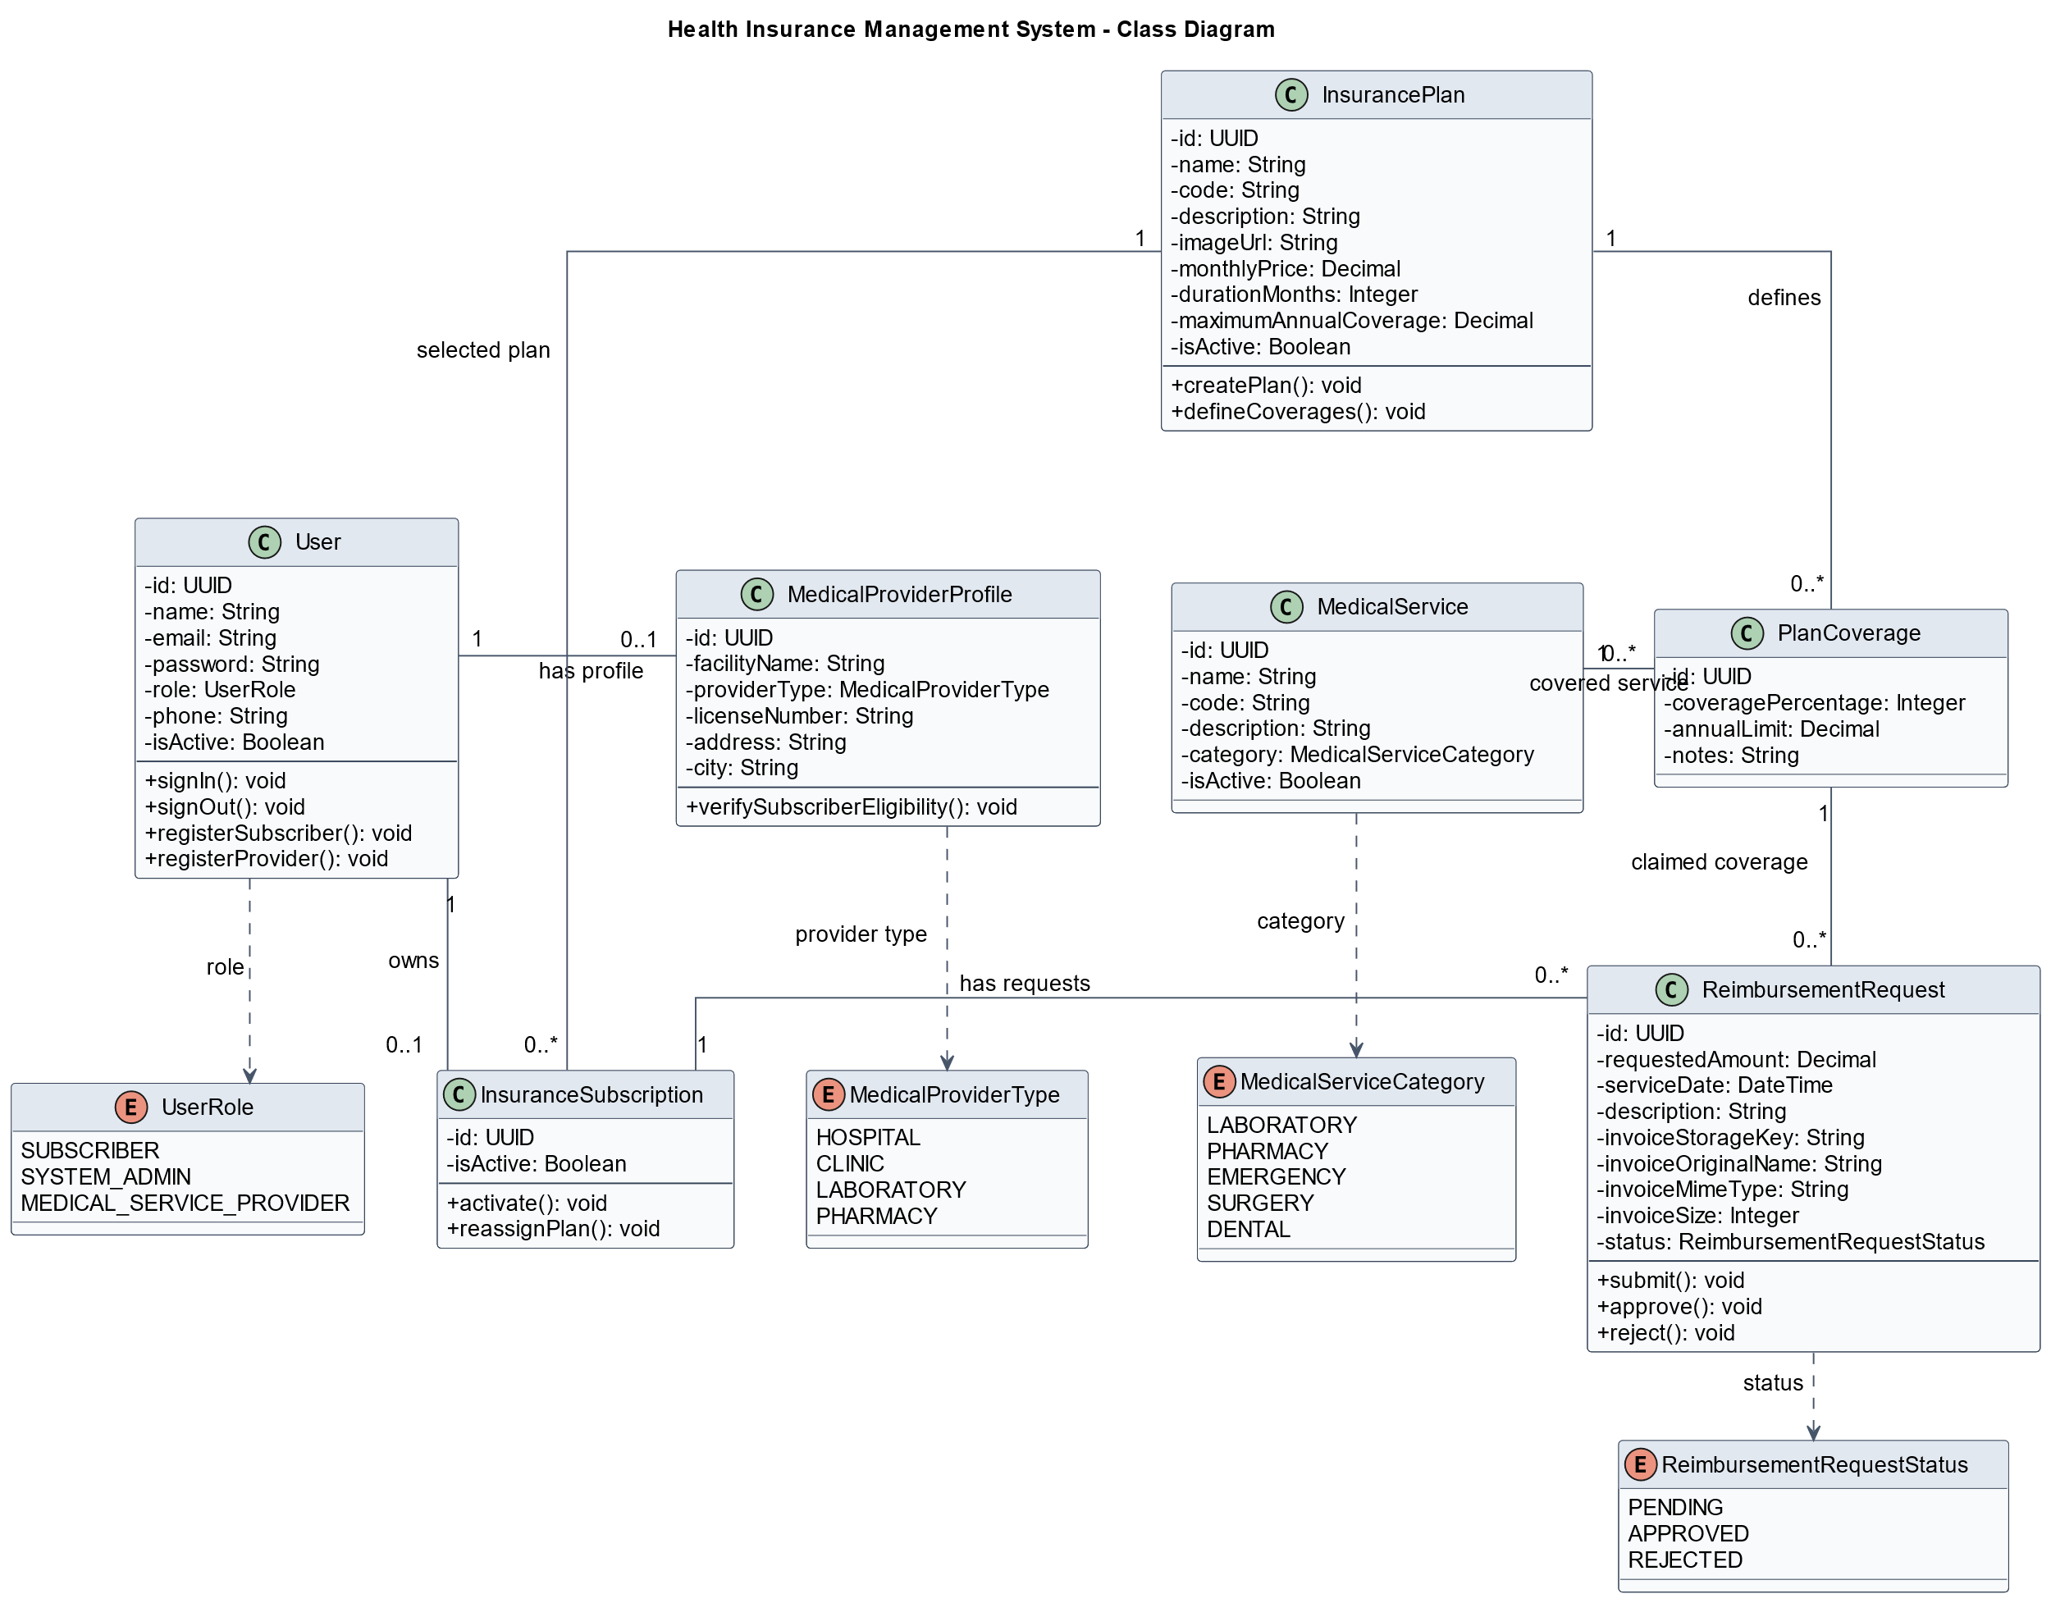
Class Diagram
Static system structure
Main classes, attributes, operations, and relationships of the system.
+
Health Insurance Management System
14

Slide 15
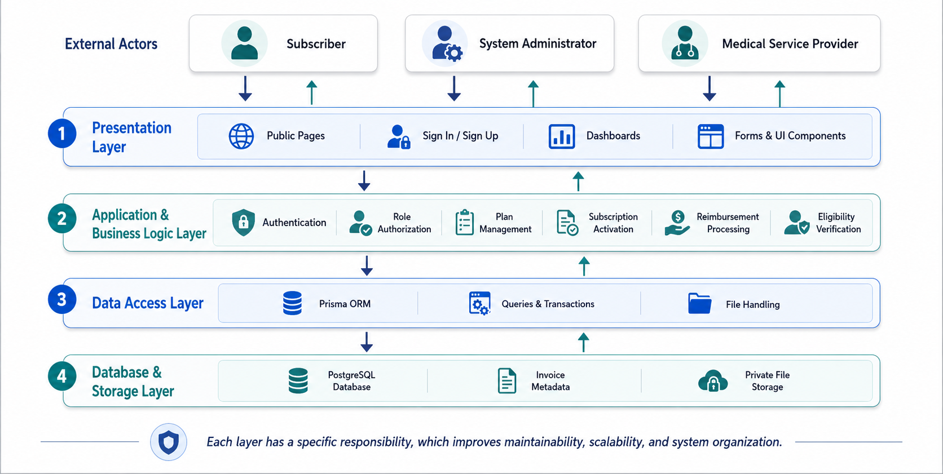
System Architecture
Layered architecture
The system separates the presentation, business logic, data access, and database layers.
+
Health Insurance Management System
15

Slide 16
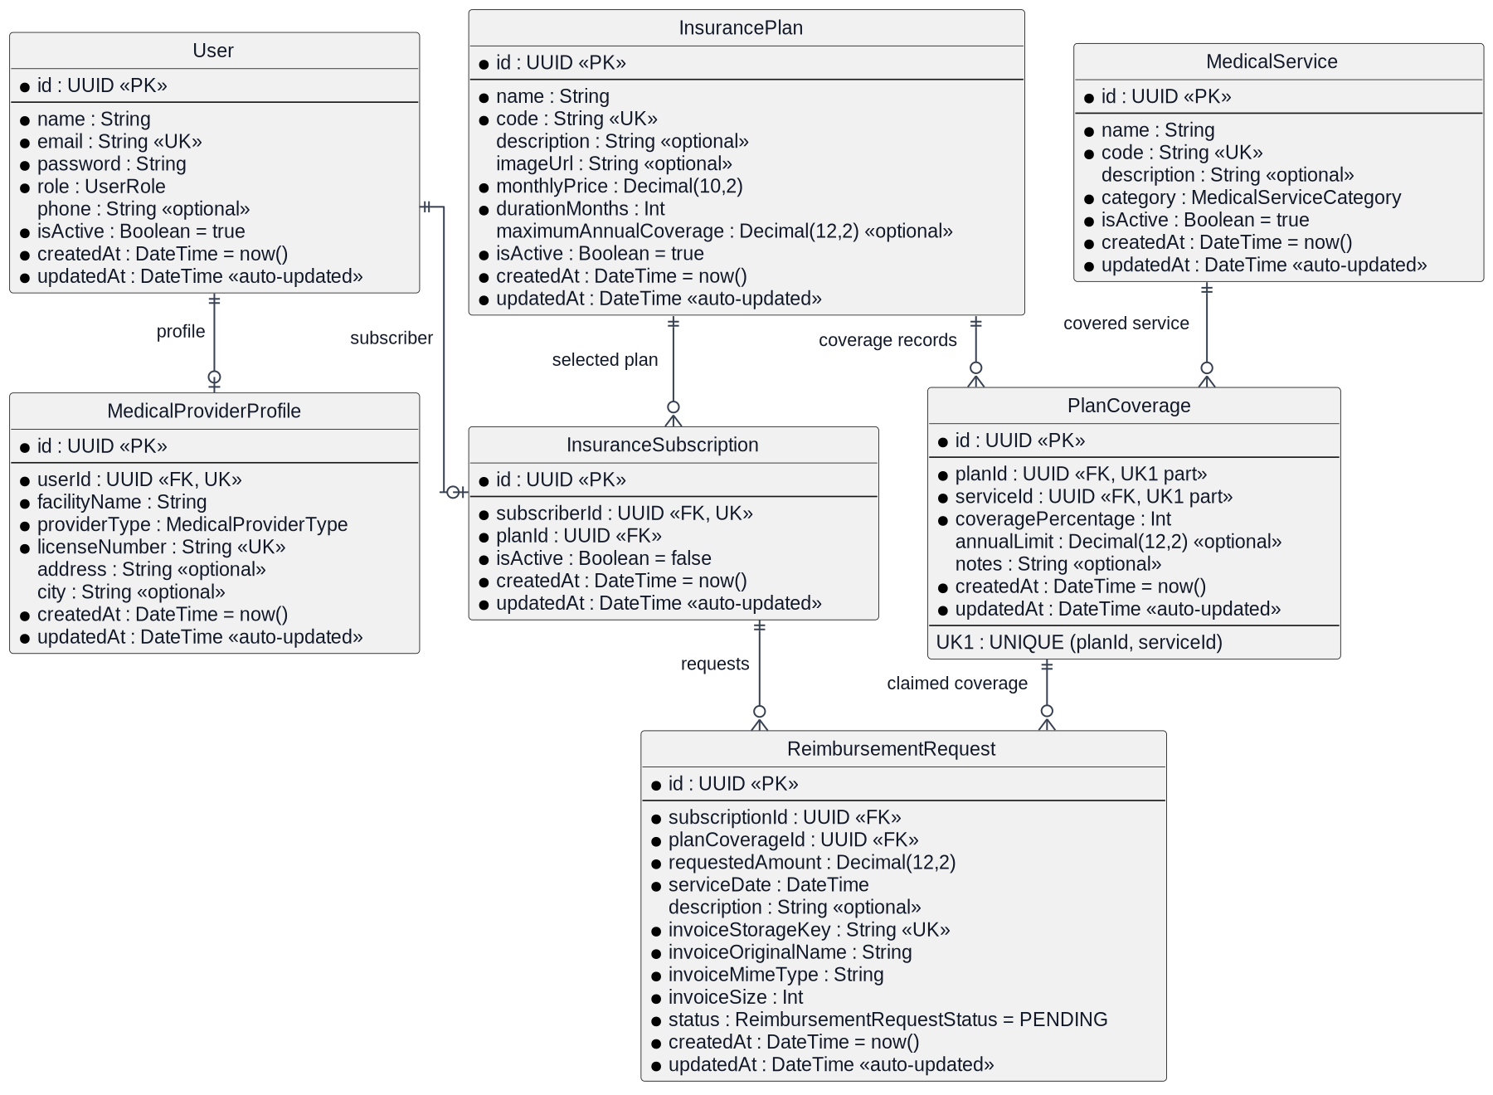
Database Design
Entity–Relationship Diagram
The ERD defines the core entities and relationships supporting the main system functions.
Entity–Relationship Diagram of the Health Insurance Management System.
+
Health Insurance Management System
16

Slide 17
Development Environment & Technology Stack
Implementation
A full-stack web application using modern technologies for interfaces, validation, authorization, and data management.
UI
Frontend
BL
Application Logic
• Next.js App Router
• Server Actions
• TypeScript
• Zod validation
• Tailwind CSS
• Role-based authorization
DB
Data Management
DV
Development Tools
• Prisma ORM
• Visual Studio Code
• PostgreSQL
• Git and GitHub
• Private invoice file storage
• Local development environment
✓
The technology stack supports modular implementation and future maintainability.
+
Health Insurance Management System
17

Slide 18
Six Main Functional Modules
Implementation
Each functional module combines the interface, validation, business logic, and data-access operations for its workflow.
1
Account & Login
2
Plans & Coverage
◎
▤
Subscriber and provider registration with role-based sign-in.
Create insurance plans and define covered services and coverage percentages.
3
Subscription Activation
4
Reimbursement Submission
✓
↑
Link a subscriber to an insurance plan and activate coverage.
Submit requests and upload invoices or medical documents.
5
Review & Decision
6
Eligibility Verification
◈
◇
Review requests and approve or reject them with a reason.
Verify subscriber eligibility and active subscription status.
✓
The modules were implemented and tested incrementally before integration.
+
Health Insurance Management System
18

Slide 19
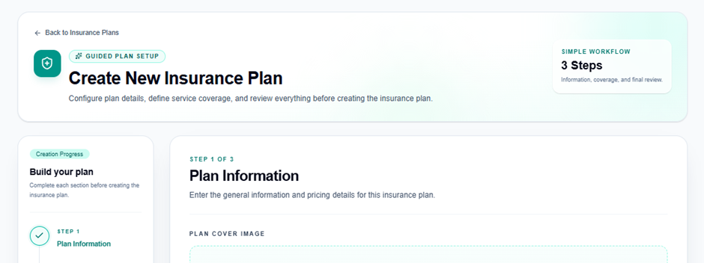
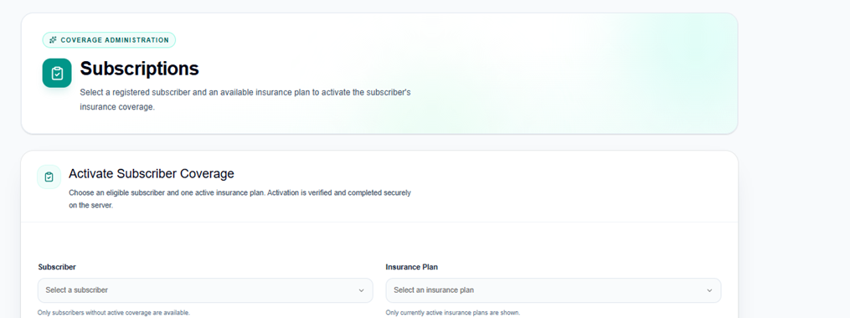
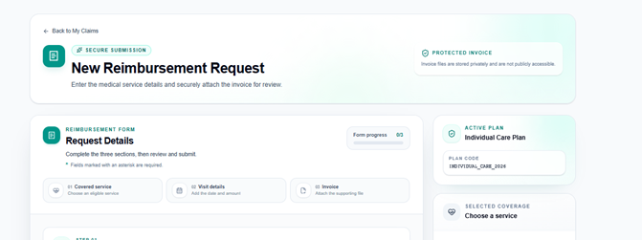
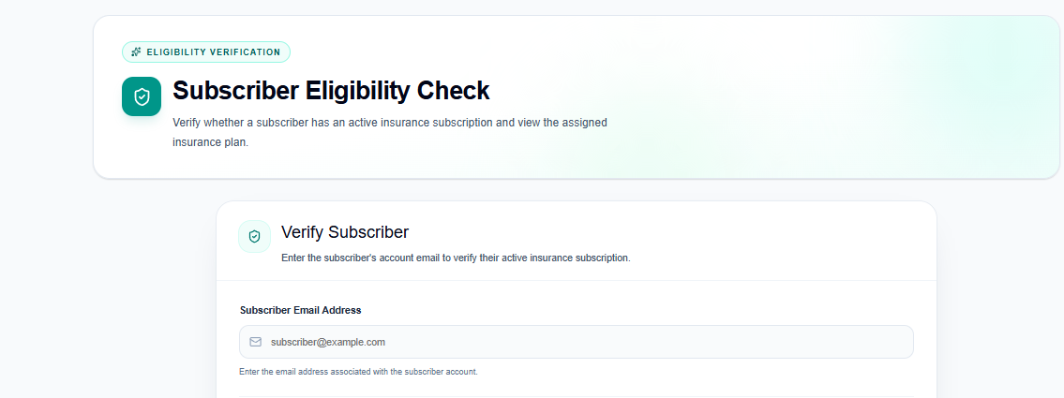
Implemented System Interfaces
Selected interfaces
Screenshots from implemented workflows for the administrator, subscriber, and medical service provider.
Administrator — Create Insurance Plan
Administrator — Activate Subscription
Subscriber — Submit Reimbursement Request
Medical Provider — Verify Eligibility
+
Health Insurance Management System
19

Slide 20
Achieved Results & Comparison
Results
The implemented prototype supports core workflows with controlled access according to user roles.
✓
Main implemented results
↗
Traditional process vs. proposed system
✓
Role-based authentication and access control
Traditional Process
Proposed System
✓
Insurance plans and covered services management
Manual operations
Digital workflows
✓
Subscriber subscription activation
Disconnected records
Centralized data
✓
Reimbursement request submission with documents
Slow eligibility checks
Quick verification
✓
Request review, approval, and rejection
✓
Provider eligibility verification
Limited request tracking
Clear status tracking
✓
Result
Organized role-based digital workflows replace scattered manual processes.
+
Health Insurance Management System
20

Slide 21
Testing Indicators
Results
Workflow, authorization, validation, and data-access checks were carried out during development and integration.
Indicator
Verification focus
Status
Functional workflows
Checked for administrator, subscriber, and provider roles.
Verified
Role authorization
Access restrictions checked for each user role.
Verified
Input validation
Invalid and missing values display validation errors.
Verified
Database operations
Records are created, retrieved, and related correctly.
Verified
File upload handling
Invoice type, size, and access checks were reviewed.
Checked
Performance target
Main-page performance evaluated under local conditions.
Checked
✓
Testing was conducted incrementally and repeated after integration.
+
Health Insurance Management System
21

Slide 22
Conclusion & Recommendations
Wrap-up
✓
Achievements
!
Challenges
↗
Future Work
✓
Digitized core procedures
!
Limited project time
→
Electronic payment processing
✓
Created role-based interfaces
!
Lack of real insurance data
→
Intelligent chatbot support
✓
Integrated administrative workflows
!
Complex business process modeling
→
External integration and fraud detection
✓
Conclusion
The project applies software engineering principles to health insurance management.
+
Health Insurance Management System
22

