Slide 1

Ha11y
Braccia, Braccia, Hubka, Tran

Slide 2
About Ha11y
Ha11y is a Google Chrome Extension that can determine how accessible a website is to a user before they even open it.
Sources: ISEMAG

Slide 3
Problem
There are over a billion people with disabilities and large portions of the web are inaccessible to them.
This has been a growing problem because the internet becomes more integral every day.

Slide 4
98%
Of websites fail to meet the legal standard for accessibility despite the fact that over 1.2 billion (15%) people have a disability
Sources: ISEMAG, CDC.GOV

Slide 5
Our Solution: Ha11y
Ha11y crawls search engine results to determine what websites are accessible for a user before they even open the website.
It utilizes the user’s disabilities to analyze each site saving them both time and frustration.

Slide 6
Our Solution Continued:
Ha11y supports all of the disabilities under disabilities affected within Deque University’s WCAG rule explanations.
Ha11y is named after one of the most famous allied spies from WWII, Victoria Hall, who had a disability herself.

Slide 7
Completeness
Ha11y is pending approval on the Google Chrome Extension Store
Ha11y is screen reader tested for blind users
Let’s See a Demo of Ha11y.

Slide 8
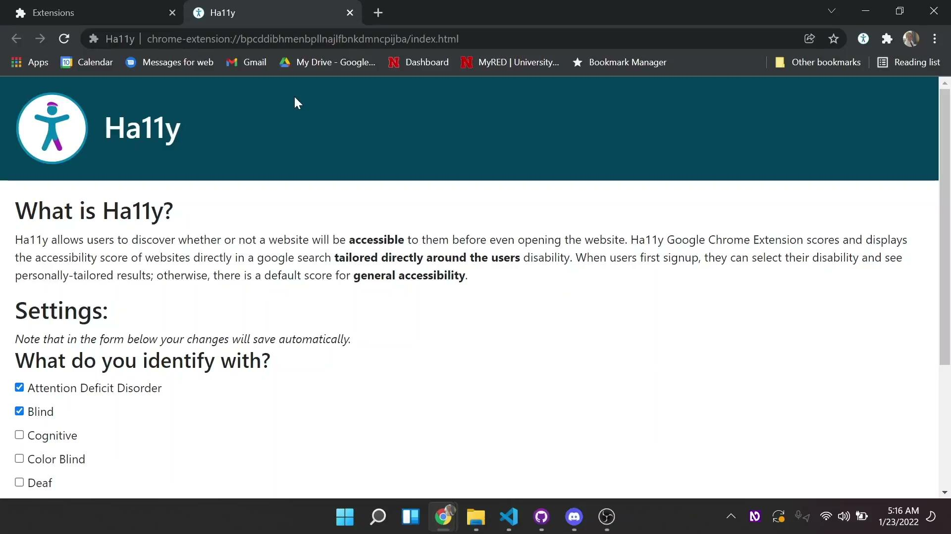

Slide 9
Difficulties Under Time Constraints
Learning to develop a new type of tool
Including Accessibility throughout the Development Lifecycle
Google returns results in a variety of ways
Introducing a newcomer to programming

Slide 10
Software Engineering
Implemented a modified Agile
Documented all code properly
Created and refactored test cases
Utilized GitHub/Git features such as
Branching
Issue log

Slide 11
Stack
Node Express API living on AWS
HTML, CSS, JavaScript with Bootstrap
API scans the site using tooling built on Deque’s Axe Core
Chrome extension is using the most up to date manifest versioning

Slide 12
How Scoring Works
Every website begins with 100, then following Deque’s accessibility classification of the violations the following point amounts are taken off per infraction:
Critical Infraction: Deduct 10 points
Serious Infraction: Deduct 5 points
Moderate Infraction: Deduct 3 points
Minor Infraction: Deduct 1 point

Slide 13
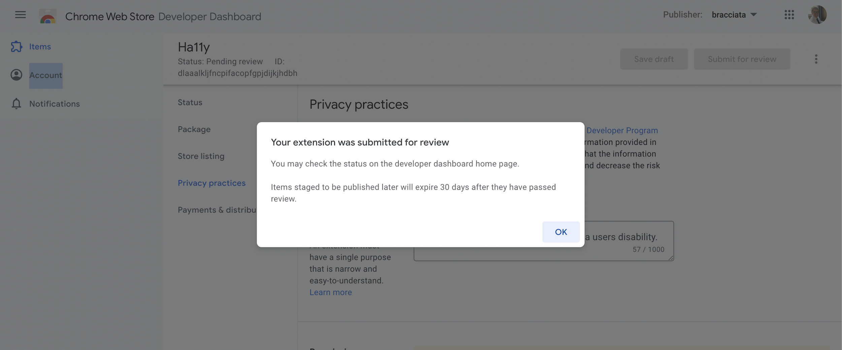
Google Confirmation of Submission to Store

Slide 14
Ha11y
Braccia, Braccia, Hubka, Tran

