Slide 2
😃 😭 😠 🤔 🤣 😶
😑 😰 🤩

Slide 3
THANK YOU | 有り 難う
谢谢 大家 | MUCHOS GRACIAS

Slide 4
Thank you so much for bringing this book, by the way. I enjoyed the chapter you posted above very much. I have always wanted to know more about the history…
Thank you so much for bringing this book to the page by the way I enjoyed the chapter you posted above very much I have always wanted to know…
gratitude
Indirect_btw
you_direct
Direct_start
has_positive
Gratitude
Indirectness
Directness
Hedge
Positive

Slide 5
“I was running my spellchecker and totally didn't realize that this
was a vandalized page. Please accept my apology. I will spellcheck a little slower next time.”
I was running my spellchecker and totally didn't realize that this was a vandalized page. Please accept my apology. I will spellcheck a little slower next time.
Categories
First person
Please
Negative
Promise
Apologetic

Slide 6
“This was potentially the most dangerous stunt I have ever seen someone do. One minor mistake and you die.”
I was running my spellchecker and totally didn't realize that this was a vandalized page. Please accept my apology. I will spellcheck a little slower next time.
Circumplex
↓arousal
↑arousal, ↓valence
↓arousal, ↓valence
↑valence

Slide 7
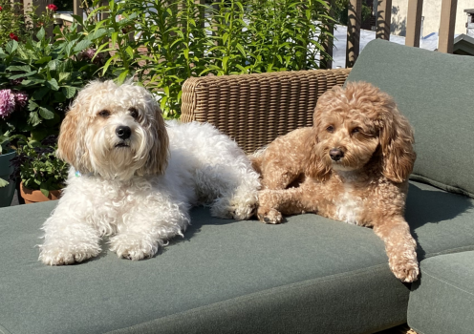
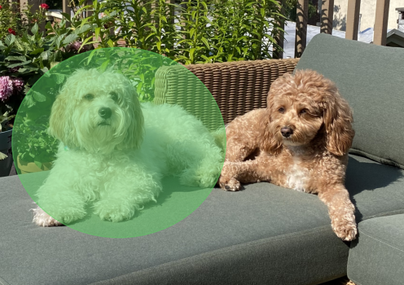
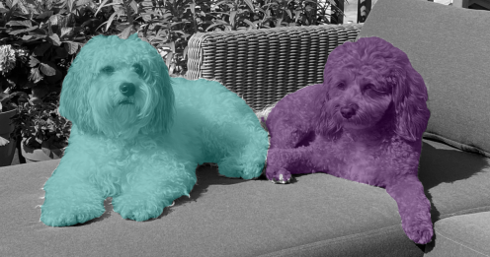

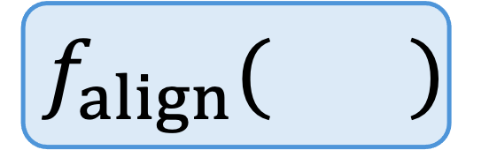
Expert Scoring Function
Input
$$f_{align}( )$$
Predicted Expert Feature
Implicit
Explicit
Expert Annotation
Domain Expert

Slide 8

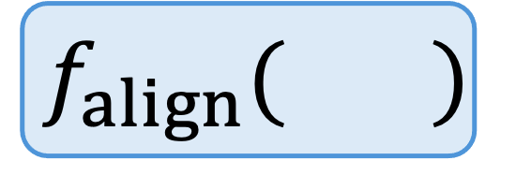
Interpretable Feature Extraction
Expert Scoring Function
$$f_{align}( )$$
Implicit
Explicit
Domain Expert
Expert Annotation

Slide 9
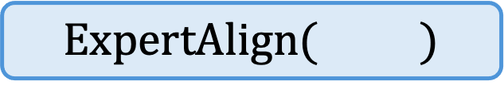
Interpretable Feature Extraction
Implicit Scoring Function
$$ExpertAlign( )$$
Domain Expert
Explicit Expert Annotation

