Slide 1
Correlations between poverty, food environment and diabetes in the United States
Springboard Data Science Capstone Project
Shuangshuang Liu
January 2020

Slide 2
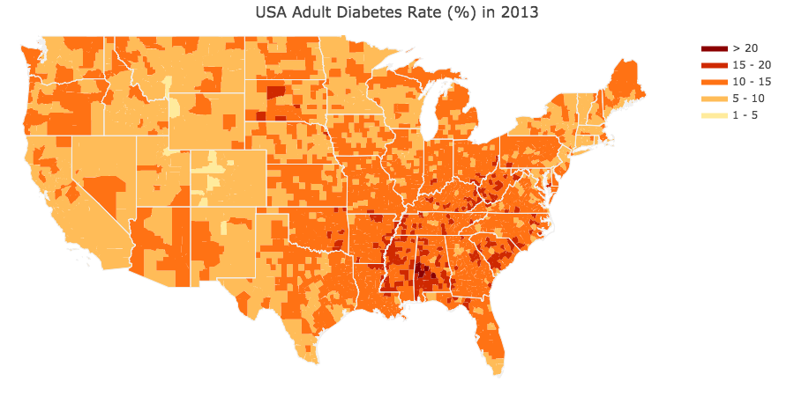
1. Background
Globally, by 2014 there are 422 million people with diabetes, up from 108 million in 1980;
In the United States, more than 30 million people (all ages, 2015) have diabetes;
In the last 20 years the number of adults diagnosed with diabetes has more than doubled as the American population has aged and become more overweight or obese.
(Diabetes quick facts, Centers for Disease Control and Prevention)
Data source: Food Environment Atlas (https://www.ers.usda.gov/data-products/food-environment-atlas/)

Slide 3
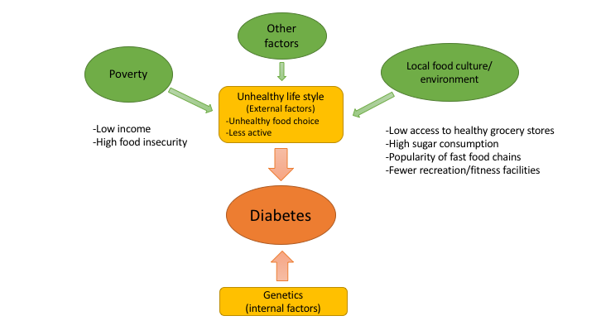
Measures to prevent or delay the onset of type 2 diabetes include healthy diet, regular physical activity, maintaining a normal body weight and avoiding tobacco use (International Diabetes Federation).
We hypothesized that poverty level and local food culture/environment, as measured by factors such as access to grocery stores, among other possible factors, may contribute to unhealthy life style and thus be associated with diabetes prevalence. The hypothesis can be summarized in the following diagram.

Slide 4
Specific questions addressed:
Are there significant differences in adult diabetes rate between metro and non-metro counties (i.e., urbanity, which is related to access to different types of stores), as well as poverty-persistent and non-poverty counties?
2) What are the most important features that may contribute to diabetes
rate? Among those features which ones are more significantly correlated
with diabetes rate, indicators of poverty level or food environment?
3) Are there any patterns of food environment across U.S. counties?

Slide 5
2. Methods
Dataset
The "Food Environment Atlas" database will be used for analysis: (https://www.ers.usda.gov/data-products/food-environment-atlas/)
Statistical Analysis and Modeling
Mean comparisons evaluating the effects of urbanity and poverty
Predicting diabetes with food environment features (supervised learning)
Multiple Linear Regression
Decision Trees
Random Forest
XGBoost
Finding patterns of food-economic environment among counties (unsupervised learning)
Principal component analysis (PCA)
K-means clustering

Slide 6
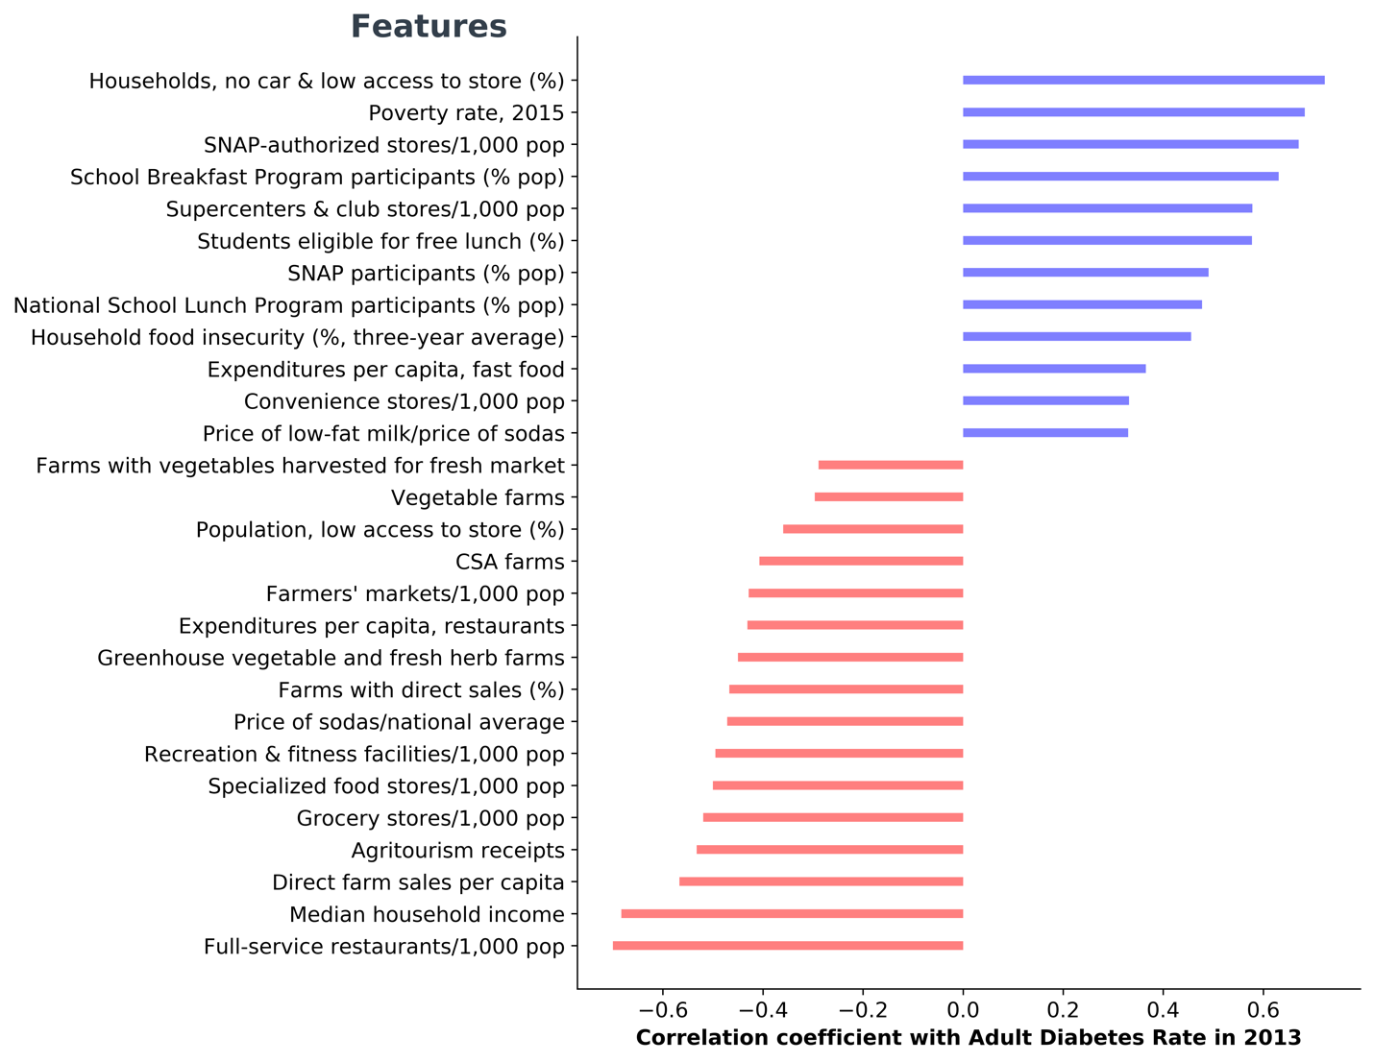
Feature selection: 28 initial features were selected
Simple linear regression correlation coefficients between 28 Selected features against adult diabetes rates in 2013 based on state average values (p< 0.05, unadjusted for multiple testing). When data of a feature for multiple years are available, only the most recent year is considered.

Slide 7
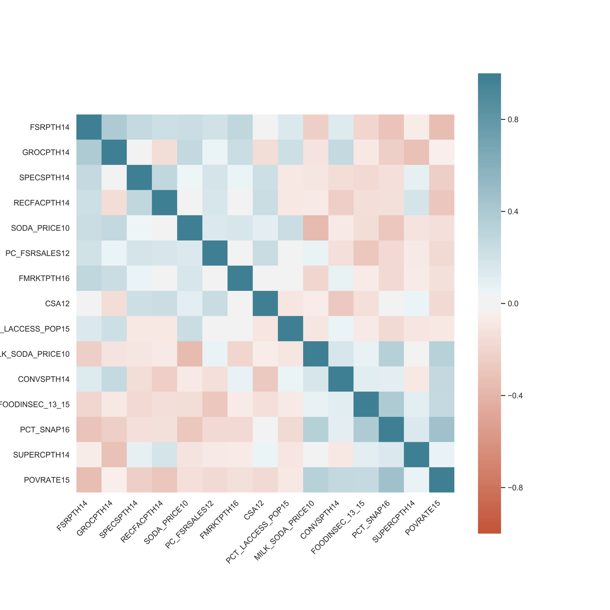
After removing highly correlated features, 15 final features were selected for statistical analysis
Correlation matrix among the 15 selected features from the food environment atlas.

Slide 8
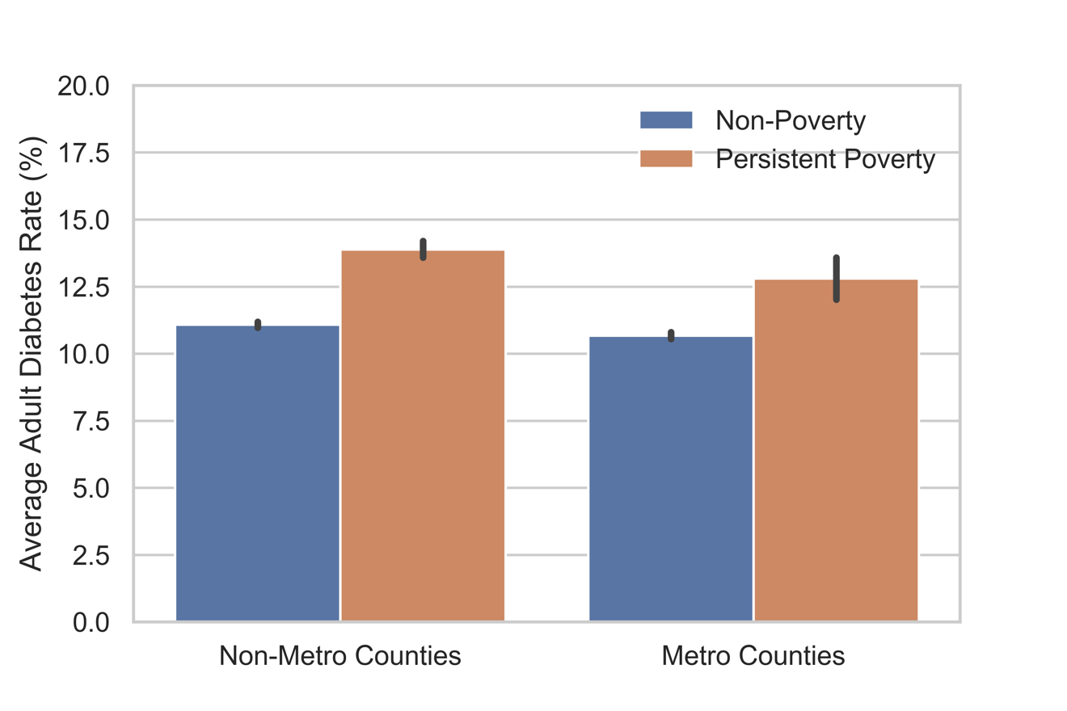
3. Results
3.1 Both urbanity and poverty had significant effects on adult diabetes rates among the counties (p<0.05 for both cases).

Slide 9
3.2 Random forest model is choosing as the final model after comparing several models for predicting diabetes rates.
Model (All counties) | Training dataset R² | Testing dataset R²
Linear regression | 0.51 | 0.56
Decision tree | 0.55 | 0.50
Random forest | 0.68 | 0.63
XGBoost | 0.83 | 0.69

Slide 10
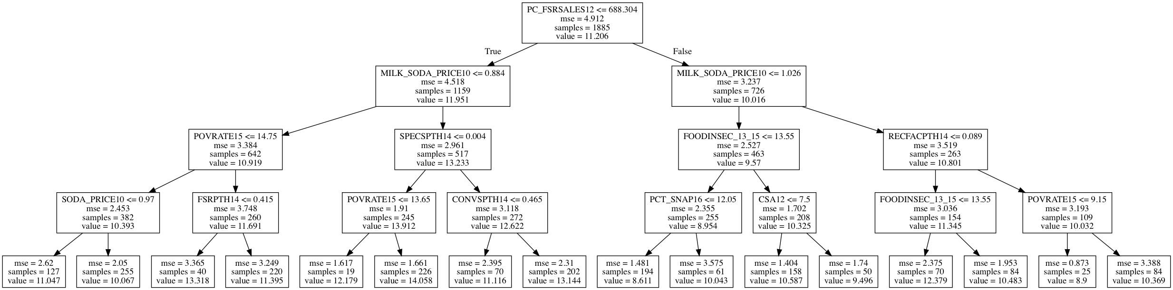
Decision Tree results:
The most important feature (root node) is ‘restaurant expenditures per capita’
(PC_FSRSALES12).
2nd split:
Price of low-fat milk/price of sodas (MILK_SODA_PRICE10)
3rd split:
Poverty rate (POVRATE15)
Specialized food stores/1,000 pop (SPECSPTH)
Food insecurity, three year average (FOODINSEC)
Recreation & fitness facilities/1,000 pop (RECFACPTH14)

Slide 11
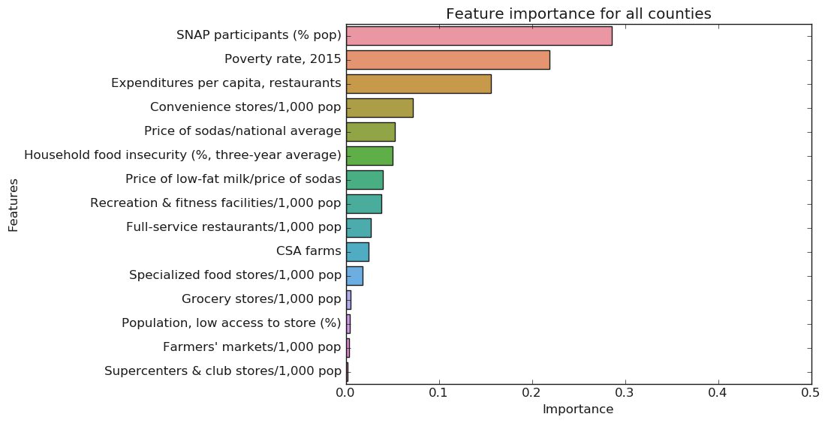
Random forest model results: ranking of feature importance

Slide 12
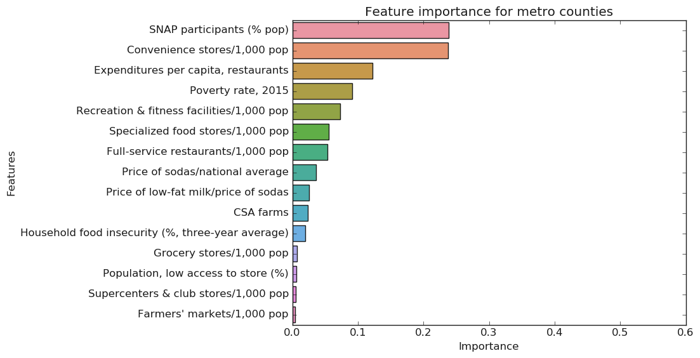
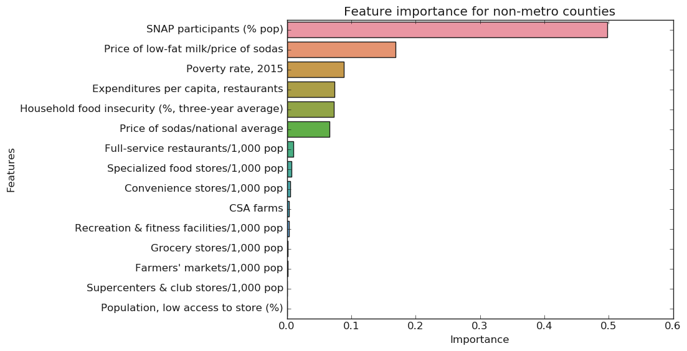

Slide 13
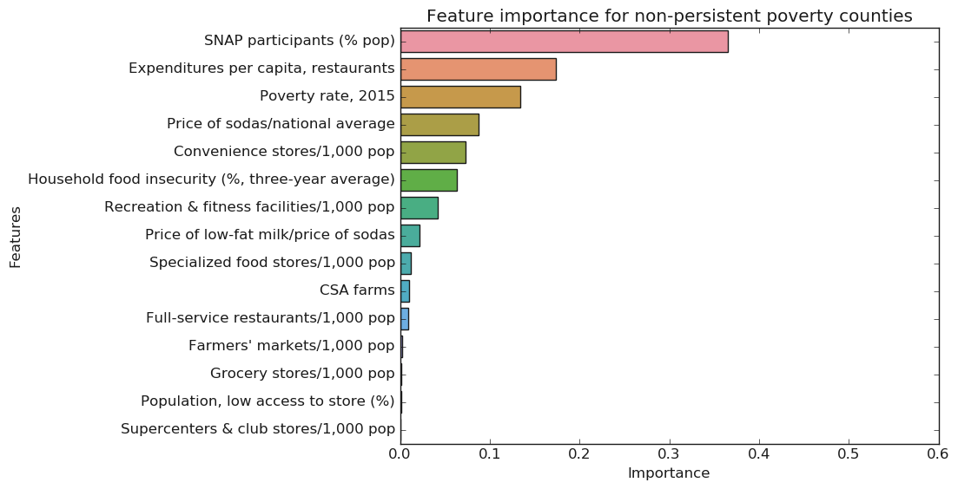
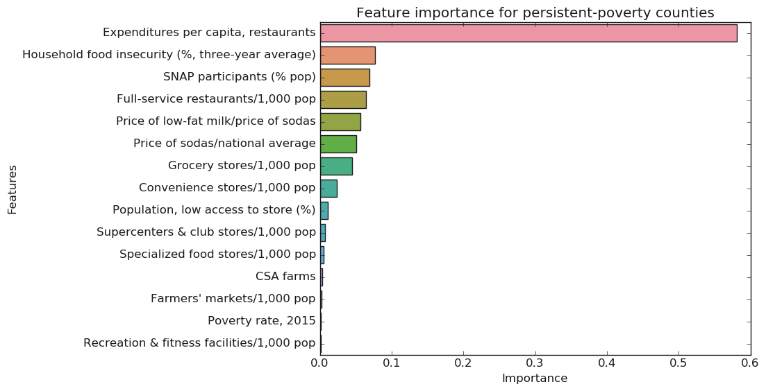

Slide 14
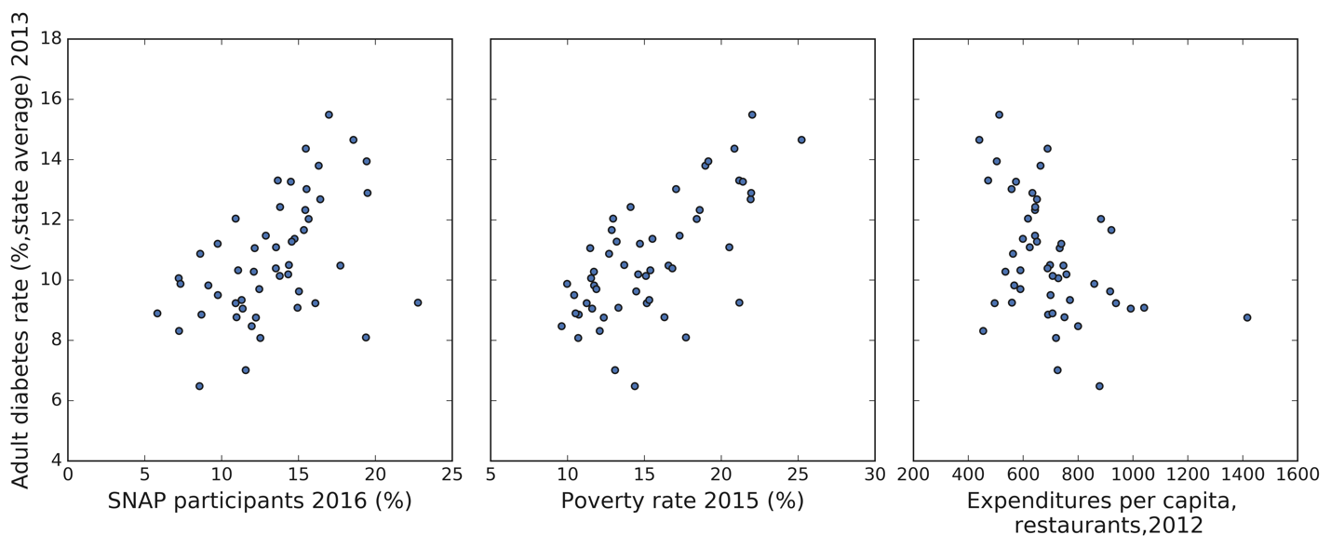
Correlations between the top three features and adult diabetes rate (state averages), based on random forest model.

Slide 15
Rankings of top features by random forest model when considering all counties, urbanity or poverty level.
Feature name | All counties | Metro counties |  | Non-Metro counties | Non-persistent poverty counties | Persistent poverty counties
SNAP participants (% pop) | 1 | 1 | 1 |  | 1 | 3
Poverty rate | 2 | 4 | 3 |  | 3 | 14
Expenditures per capita, restaurants | 3 | 3 | 4 |  | 2 | 1
Convenience stores/1000 pop | 4 | 2 | 9 |  | 5 | 8
Price of low-fat milk/price of sodas | 7 | 9 | 2 |  | 8 | 5
Household food insecurity (%, three-year average) | 6 | 11 | 5 |  | 6 | 2

Slide 16
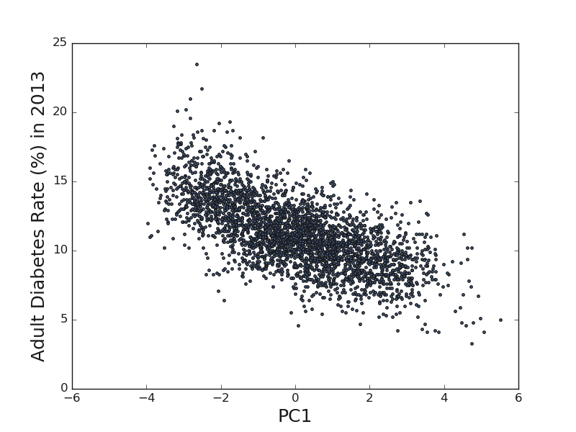
3.3 The landscape of food environment across the United States PCA results For the group of 15 shortlist features, the first four PCs explained 51% of variance. For the ‘Local’ group, first three PCs explained 51% variance; for the ‘Restaurants’ and ‘Stores’ groups, the first two PCs explained 61% and 66% variances, respectively.
Correlations between PC1 of 15 shortlist features and adult diabetes rate.

Slide 17
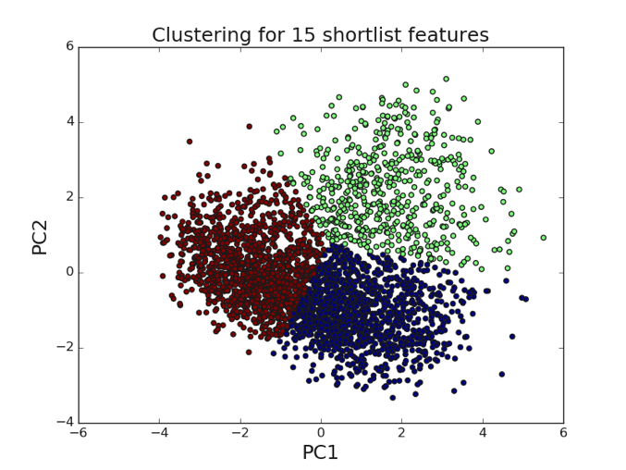
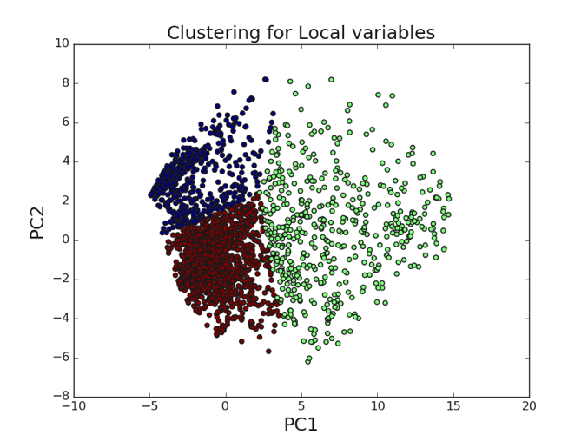
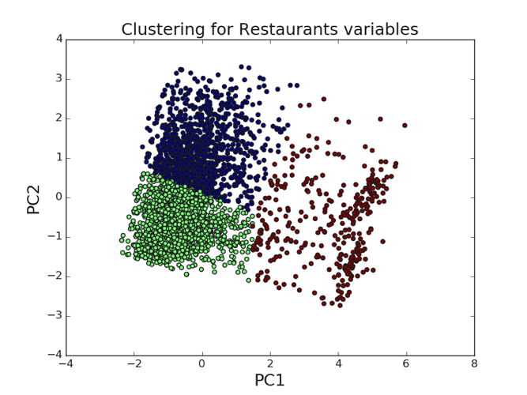
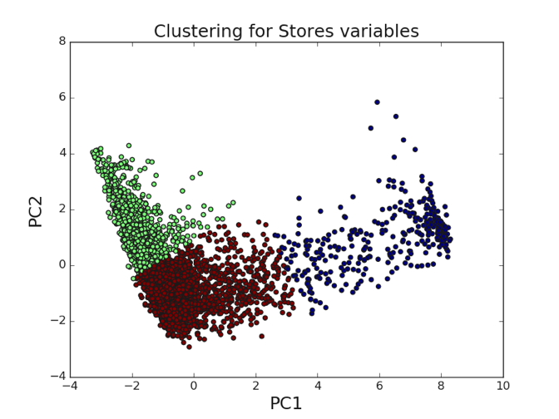
3.3 (Cont.)
K-means clustering results (with k=3, on data of the first two PC components from PCA on the 15 shortlist features, and groups ‘Local’, ‘Restaurants’, and ‘Stores’).

Slide 18
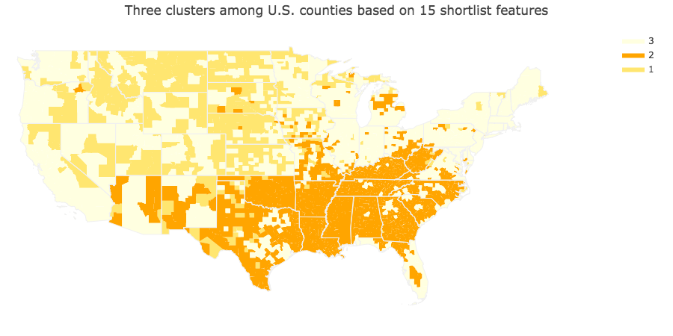
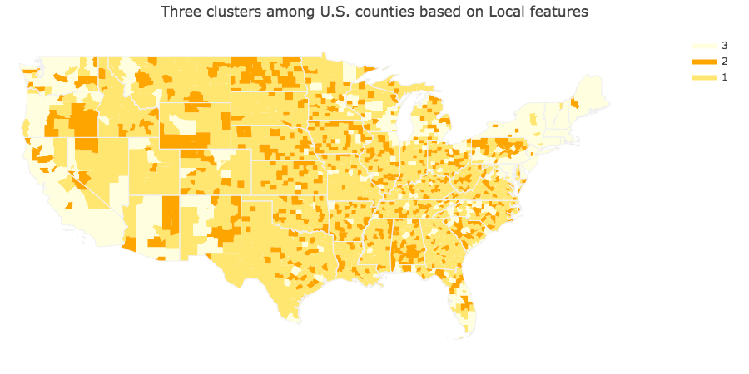
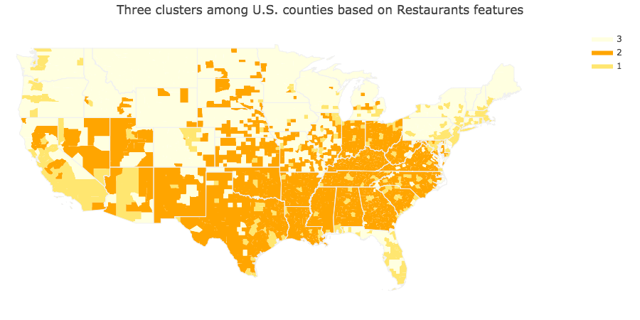
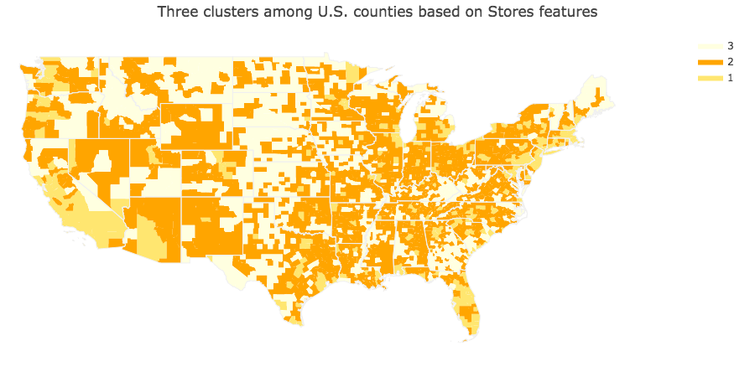

Slide 19
4. Conclusions
Features related to economic status generally played the most important role in predicting diabetes rate. The top ranked features included SNAP participants, poverty rate and expenditures at restaurants.
Among persistent-poverty counties, the expenditures at restaurants became the most predictive feature.
PCA on 15 diabetes-predicting features revealed three major clusters of U.S. counties: the central south and southeast (higher poverty and diabetes rate), west and east coast and the great lakes area (lower poverty rate and diabetes rate), and the rest counties.
Counties at central south and southeast are high-risk areas and should be allocating more resources to improve the prevention and treatment of diabetes.

