Slide 1
Scrum Sprint Planning, 04.05.2017
Henriette Selter
Dana Vladimirova
Mohamed Achref Chiha
Vanya Vucheva
Kaloyan Todorov
Nils Jonalik
House Tyrell

Slide 2
Agenda
Project Overview
(Customer) Software Requirements
Sprint Review
Actual Sprint Planning

Slide 3
Project Overview

Slide 4
Lab Topics
Team Based Software Building
Story Driven Application Testing
Using Cutting Edge Tech Stack
Agile Development

Slide 5
Lab Goals
Simplifying Testing Process
Learning Teamwork with Scrum
Learning Technologies
Learning to work with a Client

Slide 6
(Customer) Software Requirements

Slide 7
General Project Guidelines
Angular or React for Frontend
Dockerize Microservices
Sprint Boot for Backend
Other Technologies as needed

Slide 8
Requirements Frontend
CSV Data Im-/Export
Data Management on Page
Manipulation
Creation/Deletion
Interfacing Backend Functionalities

Slide 9
Requirements Backend
Storing and Retrieving Data from DB
Working with Test Stories
Execution and Resultparsing
Efficient Storing
Search and Analyze Everything Test Related
Generating Test Data

Slide 10
Sprint Review
Requirements Engineering First Sprint

Slide 11
Initializing Project
25.04.2017
Learning about our Project
Finding our House (Team)
27.04.2017
Meeting Customer
Learning about Customer Requirements
01.05.2017
Feature Engineering
Dividing Responsibilities
Next Sprint Planning

Slide 12
Sprint Planning

Slide 13
General Guideline
Always write Documentation
Dockerize your Microservices
Split your Tasks => Jot down as User Stories

Slide 14
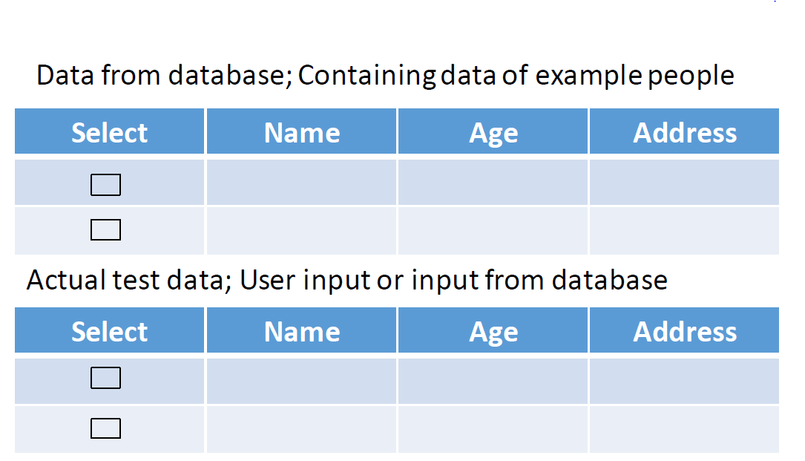
Frontend (Achref, Dana)
ToDo
Technologies
AngularJS
Bootstrap (CSS)
Basic Mockup
Footer, Navbar
Clear Text API Requests
2. Displaying API Replies in a nice Fashion

Slide 15
REST API (Nils)
ToDo
Defining Basic Endpoints
Writing YAML Documentation
Technologies
Flask or Spring Boot (API)
Swagger (Documentation)
Dataflow Im/Export
Frontend
CSV File
API Handler
JSON
Backend

Slide 16
Backend Data Manipulation (Kaloyan)
ToDo
Technologies
Spring Boot
Creating Project Structure Eclipse
Implementing Im/Export
Creating first Datamodel
Interfacing with API Handler

Slide 17
Backend Data Management (Henriette, Vanya)
ToDo
Technologies
MongoDB (DB)
Spring Boot (Interface)
Creating DB Schema for
Test Data
Test Stories
Create first DB Interface
Implementation
Documentation

Slide 18
Deliverable House Tyrell (18.05.2017)
Frontend
Import
Export
Basic Display
API Handler
Import Endpoint
Export Endpoint
Swagger Documentation
CSV File
JSON
Database
Schema Test Data
Scheme Test Story
Backend DB
DB Interfacing
Backend Manipulation
Import Functionality
Export Functionality
API Interfacing
?
?

