Slide 1

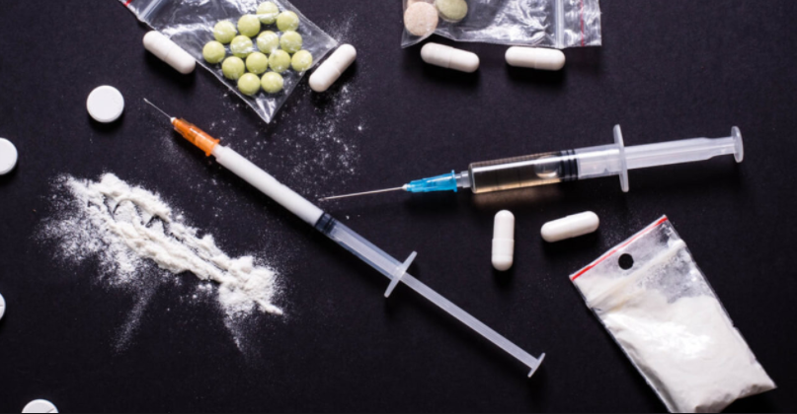
DRUG DELIVERANCE
Brad Barrett
Manny Ramos
Samantha Devlin
Tim Tallent

Slide 2
Functional Proposal
Building on Project Two, DrugDash – where we explored how US unemployment rates impact US drug overdose; Drug Deliverance explores how machine learning can use insights derived from DrugDash to predict US overdoes rates.
Due to Covid-19 unemployment rates across the US have increased drastically. Although portions of the economy have begun to recover we sought to see if historical drug overdose and unemployment data could predict if the US would see a rise in overdoses.
Expanding from DrugDash data which incorporated only year end data; we expanded our data set to monthly data points. These additional data points gave the group more source material to train our machine for better accuracy.

Slide 3
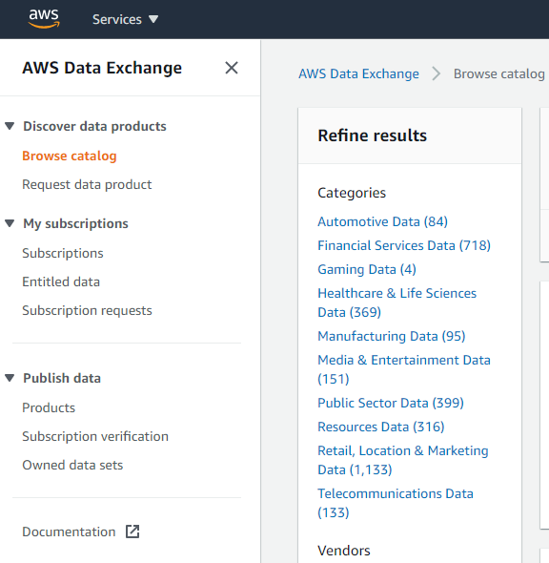
Source Data
Data source from AWS Data Exchange: Original format CSV.
Drug Overdose by type, state and year.
Unemployment rate by state and year.
Drug overdoses compared to % total deaths in the state.

Slide 4




ETL Process:
Loaded CSVs in Jupyter labs using Pandas to transform and combined data.
Using Python we developed three functioning Machine Learning programs to analyze unemployment and overdose data sets with the intent to predict future overdoses based on unemployment rate.
Heroin
Cocaine
Meth
Visualized the results through Tableau and published through Tableau Public.

Slide 5
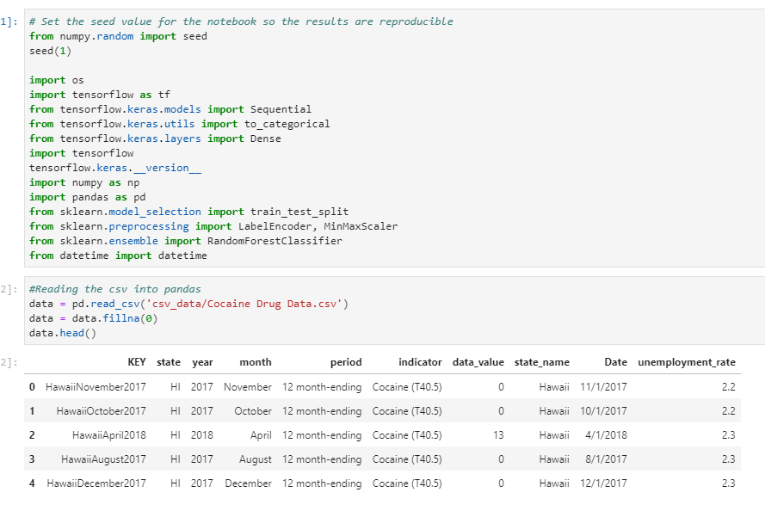
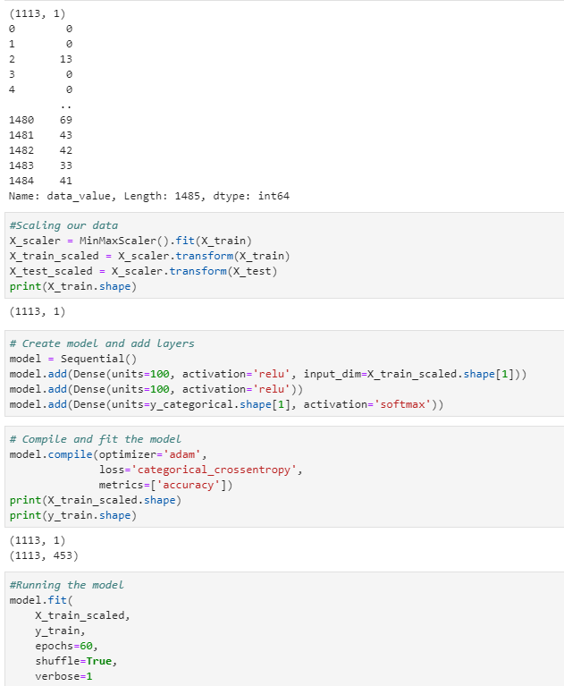
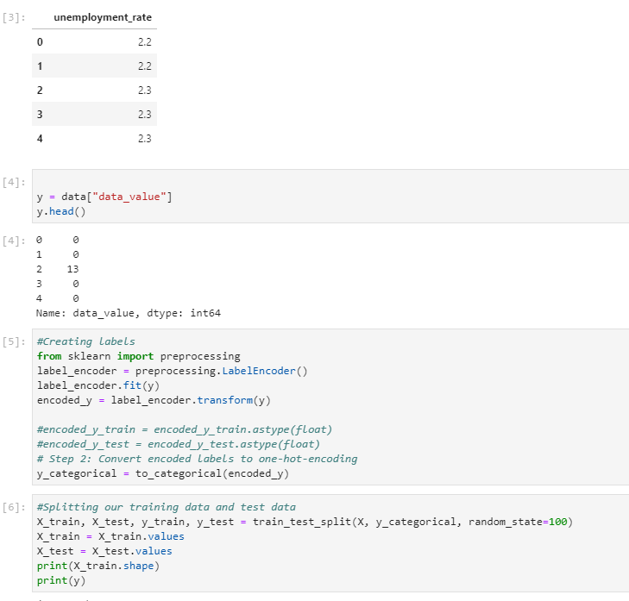
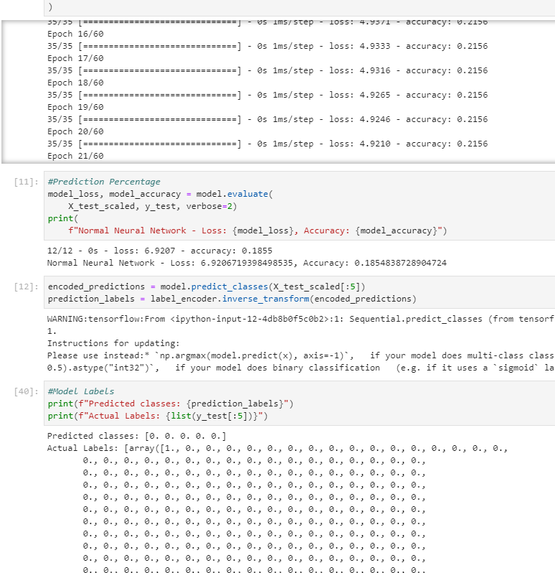
Machine Learning Process
Import and transform CSV Data.
Split training data and testing data.
Scaling Data, creating models and building layers. Compile and fit the model
Optimizer – “adam”
Loss – “categorical corssentropy”
Training Epochs - 60

Slide 6
Machine Learning Process
Results.
Heroin
Loss – 6.03
Accuracy 0.290
Cocaine
Loss – 6.92
Accuracy 0.186
Meth
Loss – 4.14
Accuracy 0.266

Slide 7
Conclusions & Observations
Some States showed declines in OD Rates when Unemployment rates decreased.
Majority of OD occurred were Non-Heroin based Opioids including synthetics.
Majority of States showed decreased in OD Death Rates while some states maintained OD Rates without death. Although we cannot prove this we believe the more wide spread use of products like Narcan may have helped save OD patients in some states.
Majority of people surveyed did not list drugs or drinking as their primary response to stress factors.
Issues:
State data for OD Rates is spotty with some records by states not recording for some or all years.

Slide 8
Visualization Live Share

Slide 9

Questions?

