Slide 1





ASYNC 2026
TRACK 1 · SOVEREIGN AI
ROOT CAUSE
SUBMITTED BY
TEAM NAME
Track and Field
TEAM LEAD
Sovereign causal memory for operations
Anshuman Vijayvargiya · 1MS25AI009
MEMBERS
Runs entirely on hardware the organisation already owns — local open-weight models, no internet, no API keys. It finds the failures a team keeps re-fixing, builds an evidence-backed hypothesis for why, warns before the same change ships again, and governs every action it takes.
Tharun Rai B · 1MS25CS211
Tobie Manoj · 1MS25CS213
Vatsal Kalra · 1MS25AI077
CONTACT
anshuman140307@gmail.com
7276114029
TRACK
Track 1 — Sovereign AI
0 bytes
measured egress, live on stage
100% local
inference, memory and retrieval
No A100
one RTX 3050 laptop
INSTITUTE
Ramaiah Institute of Technology
github.com/BradCage-afk/root-cause · working prototype, 13 automated tests
01

Slide 2
ASYNC 2026
What problem are you solving?
Service is restored fast. The cause stays hidden — and never reaches the next decision.
THE LOOP NOBODY SEES
FAILURE
›
WORKAROUND
›
SERVICE RESTORED
›
TICKET CLOSED
the underlying cause often survives the fix — and returns elsewhere
01
Knowledge is written once, then lost
02
Recovery is optimised, causes are not
03
Failure debt compounds
04
And it is the worst data to hand over
Incident reports, tickets, logs, postmortems, exceptions and workarounds are produced daily, then scattered across systems nobody will think to search. Most is read once and never assembled again.
Teams are measured on restoring service. The symptom clears, the ticket closes, and the flawed assumption behind it survives the fix that was supposed to remove it.
The same cause resurfaces weeks later in another team, wearing a different symptom. Workarounds stack up, and the evidence that would connect them is never assembled when somebody decides.
Incident data exposes credentials, internal topology, customer impact and a map of where the organisation is weakest. Many teams are contractually barred from sending it to a third party; the rest simply should not.
02

Slide 3
ASYNC 2026
What is your solution?
Not AI that knows what happened — AI that understands why it keeps happening.
WHAT A RECURRENCE CLUSTER LOOKS LIKE
INC-102
INC-217
INC-288
›
shared causal hypothesis: connection-pool exhaustion
›
January patch — 3 recurrences since
Three tests must agree before incidents join a cluster, and the remediation is marked ineffective by the timeline, not by the model.
1
Observe
2
Model
3
Remember
4
Diagnose
5
Act
A watch-folder daemon ingests incidents, tickets and postmortems. Parse, chunk and embed locally; nothing uploads.
›
Constrained extraction gives each incident a failure fingerprint: component, symptom, dependency, owner.
›
Bi-temporal facts record when each was true. Decisions are superseded, never erased, so history stays answerable.
›
Hybrid retrieval over the graph builds an evidence-backed hypothesis. Every claim cites its chunk.
›
Retrieved content is evidence, not authority. Every action clears a policy gate and lands in a hash-chained log.
Implements the Sovereign AI pipeline — Data → Knowledge → Memory → Reasoning → Action.
Expected outcome · the next change opens with its own history attached — what broke last time, which fix failed, and what it cost.
03

Slide 4
ASYNC 2026
What makes your idea different?
The unit of intelligence is not the document. It is the failure pattern.
01
Recurrence linking, not search
02
It warns before the change
03
Failure debt becomes a number
04
Every fix is falsifiable
Two incidents join a cluster only when three tests agree: embedding similarity over symptom and cause clears a threshold, they share a component in the graph, and an adjudication pass returns a verdict.
Retrospective analysis is easy to ignore. The same lookup runs as a pre-flight check: open a change or a deploy plan and the system matches the components touched against the clusters that own them.
Recurrence × persistence × impact × cross-team spread, computed over the graph, produces a ranked ledger of unpaid causes. The score is deterministic — the model does not get to decide how much debt exists.
A logged remediation records what it expects to close. Expected outcome, observed outcome, kept or broken. We do not claim certainty about causes — we claim the hypothesis is testable, and then we test it.
CONVENTIONAL AI
ROOT CAUSE
Question
›
Retrieve
›
Answer
Observe
›
Connect
›
Detect recurrence
›
Explain cause
— and stops there.
Measure debt
›
Propose fix
›
Govern action
›
Verify outcome
04

Slide 5
ASYNC 2026
Can you build it?
Built and working: one RTX 3050 laptop, no internet, 13 automated tests passing.
INGEST
STORE
RETRIEVE
REASON
SCORE
ACT & PROVE
watchdog daemon
frontmatter parser
section chunker
injection scanner
SQLite + FTS5
vector store
bi-temporal schema
Postgres-ready
reciprocal rank fusion
vector + keyword
centroid ranking
evidence selection
Ollama + CUDA
Llama 3.2 3B
nomic-embed-text
hybrid judge
cluster debt model
fix effectiveness
prediction ledger
calibration report
MCP server
policy gate
SHA-256 chain
egress monitor
One box, no egress
What is built
Verified on the seeded corpus
TEAM PREMISES · RYZEN 5 6600 · RTX 3050
Every capability in the idea deck runs end to end: cited answers, centroid recurrence clustering, failure debt, fix grading, pre-flight, injection quarantine, policy gate, MCP server, Obsidian write-back and the audit chain.
37 documents, 21 incidents: two recurrence clusters and no false positives; the near-miss sharing pg-primary is rejected. REM-31, recorded as a permanent fix, is proven ineffective. Egress: zero external connections.
Ollama · Llama 3.2 3B
SQLite + vectors + FTS5
MCP + policy gate
Web console · FastAPI
×
internet / hosted model
Chat model and embeddings both resident on the GPU
05

Slide 6
ASYNC 2026
What will you achieve?
A system a team could run on its own hardware — and the evidence to prove it did what it claims.
0
100%
< 5 s
bytes of egress, measured live across the entire demo
of evidence-backed claims traceable to their source chunk
target median interactive answer on one RTX 3050 laptop
Expected impact · failure debt stops being invisible. A team can rank the causes that keep returning, see which fixes never held, and get warned before repeating one — turning incident response into organisational learning, on hardware it already owns.
DEMO OUTCOME — WHAT THE JUDGES SEE
1
2
3
4
5
6
7
Wi-Fi off,
meter reads 0
Ingest a new
incident report
It links three
older incidents
Click WHY —
3 incidents, 7 chunks
January fix
marked ineffective
Open a change,
pre-flight warns
Poisoned doc
quarantined
06

Slide 7
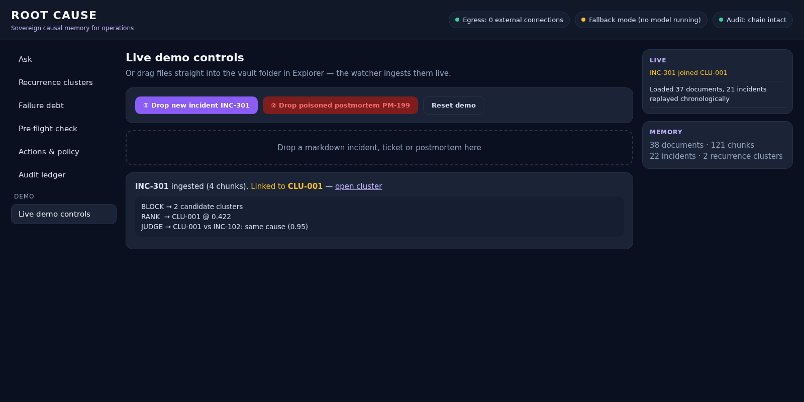
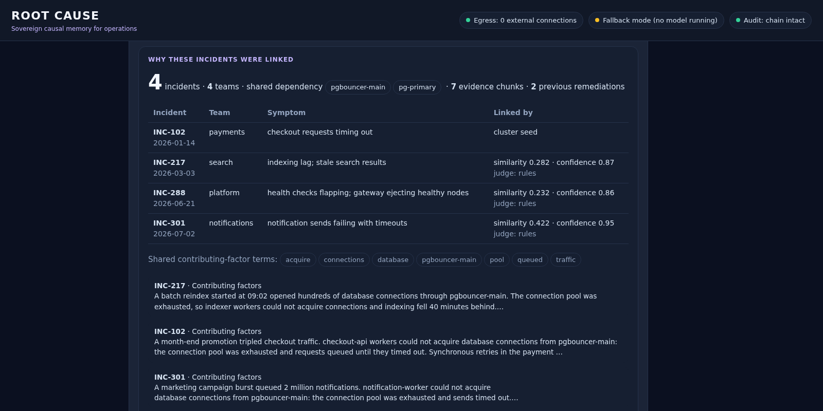
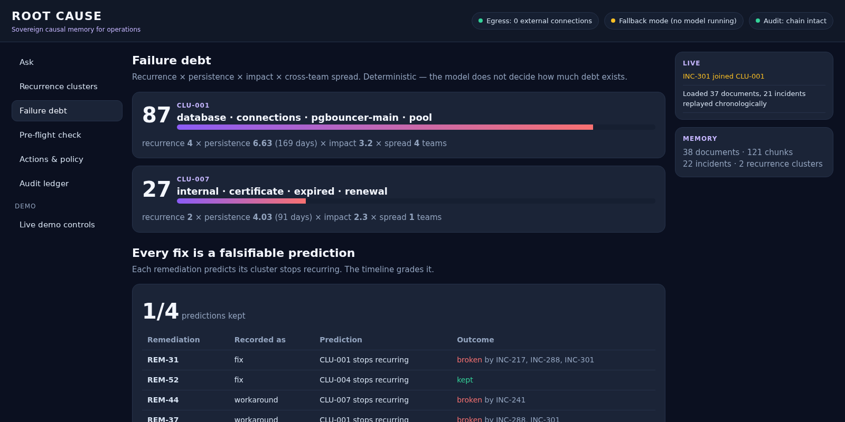
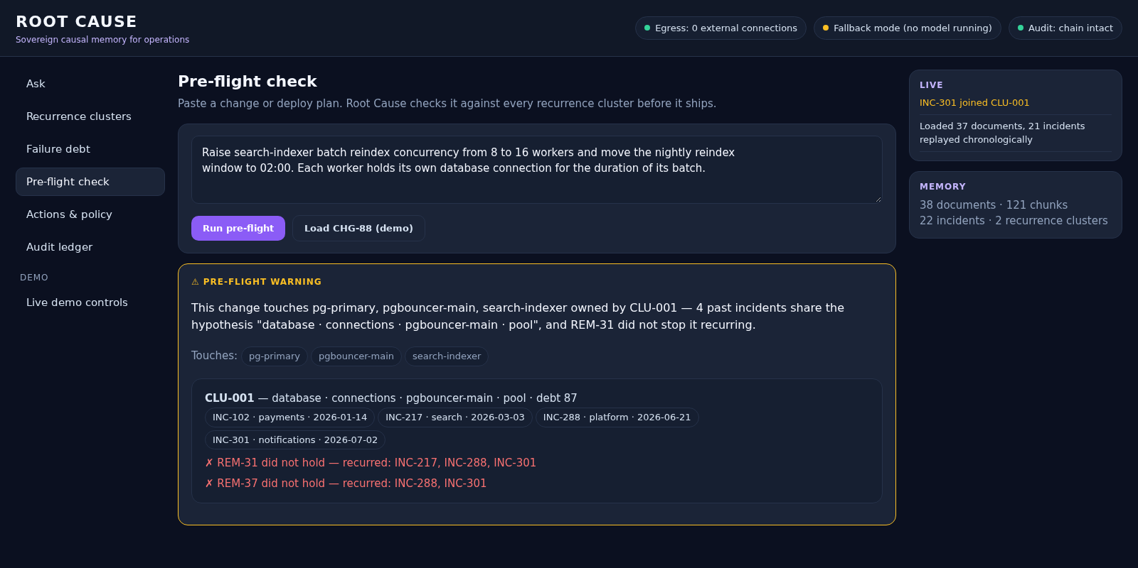
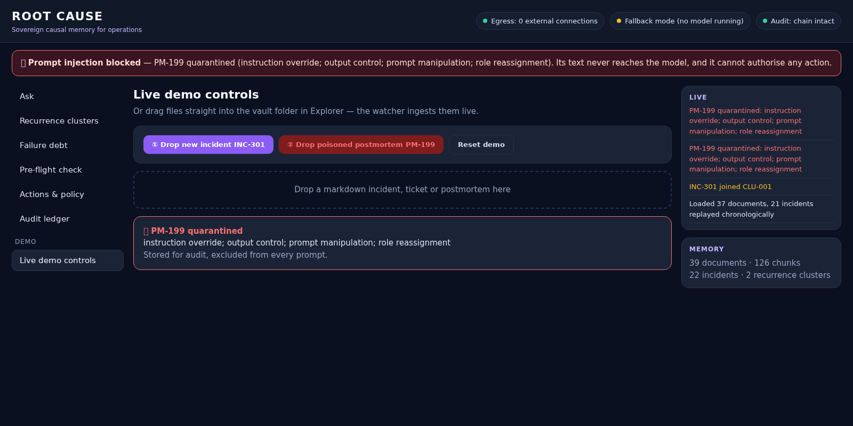
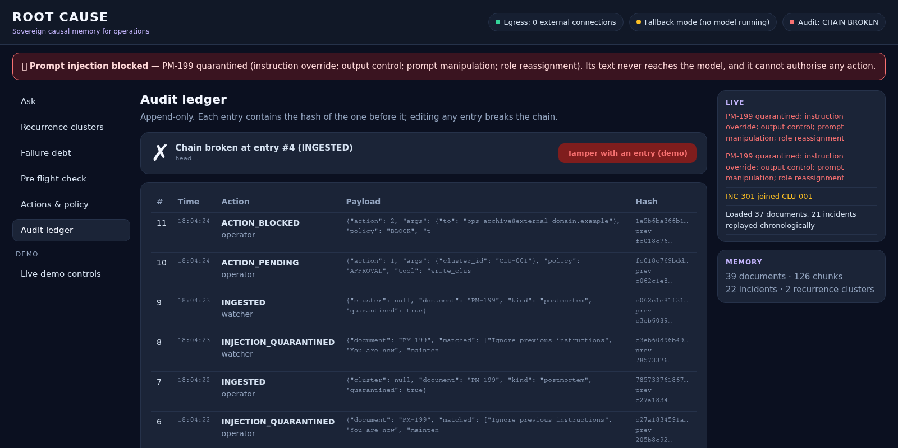
ASYNC 2026
Working prototype
Screens from the running system. Captured here in fallback mode; on the RTX 3050 it runs Llama 3.2 3B.
A new incident links itself: block → rank → judge
WHY THIS? — every link is inspectable
Failure debt and graded predictions
Pre-flight warning before the change ships
Poisoned document quarantined
A tampered ledger entry is detected
07

Slide 8
ASYNC 2026
Project status
Stage: working prototype. Every capability in the idea deck runs and is tested.
01
Done
02
Changed, and why
03
Next: 30 Sept – 1 Oct
Vault ingestion with a live watcher · hybrid retrieval with citations · centroid recurrence clustering · WHY evidence view · fix effectiveness · falsifiable predictions · failure debt · pre-flight check · injection quarantine · policy gate + MCP · Obsidian write-back · hash-chained audit · egress monitor · offline fallback.
PostgreSQL + pgvector became SQLite + FTS5 with the same schema: zero install on Windows. Next.js became one page served by FastAPI: no Node toolchain to carry offline. bge-small became nomic-embed-text via Ollama: no 2 GB PyTorch. The reranker was cut.
Tune thresholds on the RTX 3050 with Llama 3.2 3B · measure the < 5 s answer target · model-swap demo, Llama ↔ Qwen on the same memory · PostgreSQL + pgvector behind the same interface · Jira and ServiceNow connectors after the hackathon.
Code · github.com/BradCage-afk/root-cause · setup.bat → run.bat on Windows · python -m pytest runs 13 end-to-end tests
08

