Slide 1

SMART INDIA HACKATHON 2026
Problem Statement ID - SIH26056
Problem Statement Title - Development of a Real-time Airfare Price Index for India through Automated Web Scraping of Airline and Online Travel Aggregator Portals for Augmentation of the Consumer Price Index (CPI)
Theme - Travel & Tourism
PS Category - Software
Team ID - ‹TEAM ID›
Team Name (Registered on portal) - Fare Enough 101

Slide 2
APIx — AIRFARE PRICE INDEX
Fare Enough 101
PROPOSED SOLUTION
A daily airfare inflation index for the CPI
MoSPI prices air travel by hand, once a month, for one departure date. APIx reads the same public pages every ten minutes and delivers one weighted index number through an API.
BUILT AND RUNNING
53,000+ fares collected · 15 city pairs × 5 lead times · every 10 minutes · ₹0 a month to run
WHAT CHANGES FOR THE CPI
THE INDEX IN ONE LINE
TODAY
WITH APIx
APIxₜ = 100 × exp( Σ wᵢ·ln(Pᵢ,ₜ/Pᵢ,₀) / Σ wᵢ )
Frequency
once a month
every 10 minutes
Weighted Jevons — the elementary-aggregate formula Eurostat and the ONS use for their own price indices.
Coverage
a handful of quotes
75 priced cells
WHAT THE TERMS MEAN
Price basis
one quoted price
minimum logical fare
Basket
15 city pairs × 5 lead times = 75 cells
Price
minimum logical fare, no add-ons
Delivery
typed into a form
authenticated REST API
Weight
route seat share × lead-time share
Base
first observation day = 100
Why it stands out
The standard method
Weighted Jevons on minimum logical fares — the elementary-aggregate method Eurostat and the ONS use for their own price indices.
Weighting is a matrix
Every cell carries route seat share × booking lead time, so Delhi–Mumbai moves the index three times as hard as Delhi–Srinagar.
Admits thin coverage
Below 60% basket coverage the figure ships marked provisional, with the reason. An index that admits thin coverage beats one that never does.
Machine-readable
One authenticated REST call returns the index with its method, coverage and revision history. Nobody retypes a number off a screen.

Slide 3
TECHNICAL APPROACH
Fare Enough 101
How a published fare becomes a published index
1 Collect
every 10 min
robots-gated
2 Extract
13,000 → 3,700
chars per page
3 Validate
38 of 40
flights kept
4 Clean
min 3 obs
per priced cell
5 Index
75 cells
weighted Jevons
6 Publish
2 endpoints
portal + API
What we keep from one results row — and what we drop
ON THE PAGE
WHAT WE STORE
THE RULE
IndiGo · 6E-955 · 20:20 → 22:20
carrier, flight_number, times
the flight's identity
₹6,529
total_fare = 6529
the price a traveller actually pays
₹480 off with CTFKSBIC
dropped
a coupon is not a published fare
no tax or fee breakdown
stored NULL, never derived
a CPI prices the total a household pays
— nothing on the page —
source · scraped_at · model_used
so any index figure traces back
STACK Python · Playwright · LLM extraction with failover · Pydantic v2 · Supabase PostgreSQL · FastAPI · Cloudflare · cron

Slide 4
FEASIBILITY AND VIABILITY
Fare Enough 101
Technical feasibility
Fares are published continuously on public pages and change all day. The data exists; what is missing is a systematic way to read it.
Risks, and what we did about them
USD 18.1 bn
market size, 2026
16 portals surveyed, one is usable
Ten disallow us, four block us, airlines refuse automation entirely.
Operational feasibility
A fixed basket of the 15 busiest city pairs across 148 operational airports tracks the traffic that actually moves the index.
Cloud IPs are blocked too
Verified in CI — so collection runs from a residential host.
164 million
domestic passengers
Models get retired without notice
Three died during this build. Extraction now fails over automatically.
Economic feasibility
Free tiers throughout, about two minutes of compute per cycle. MoSPI visits shops monthly; this observes 144 times a day.
₹0
a month to run
Thin coverage would mislead
Days below 60% basket weight publish as provisional, with the reason.
Regulatory feasibility
Eurostat's HICP guidance names air fares as a scrapeable category and the ONS has published on it since 2014 — precedented, not experimental.
since 2014
ONS precedent
What it costs to run
Collection · Playwright
₹0 · free tier
Extraction · NVIDIA NIM LLM
₹0 · free tier
Storage · Supabase Postgres
₹0 · free tier
Publication · Render + Cloudflare
₹0 · free tier
Total · 144 cycles a day
₹0 a month

Slide 5
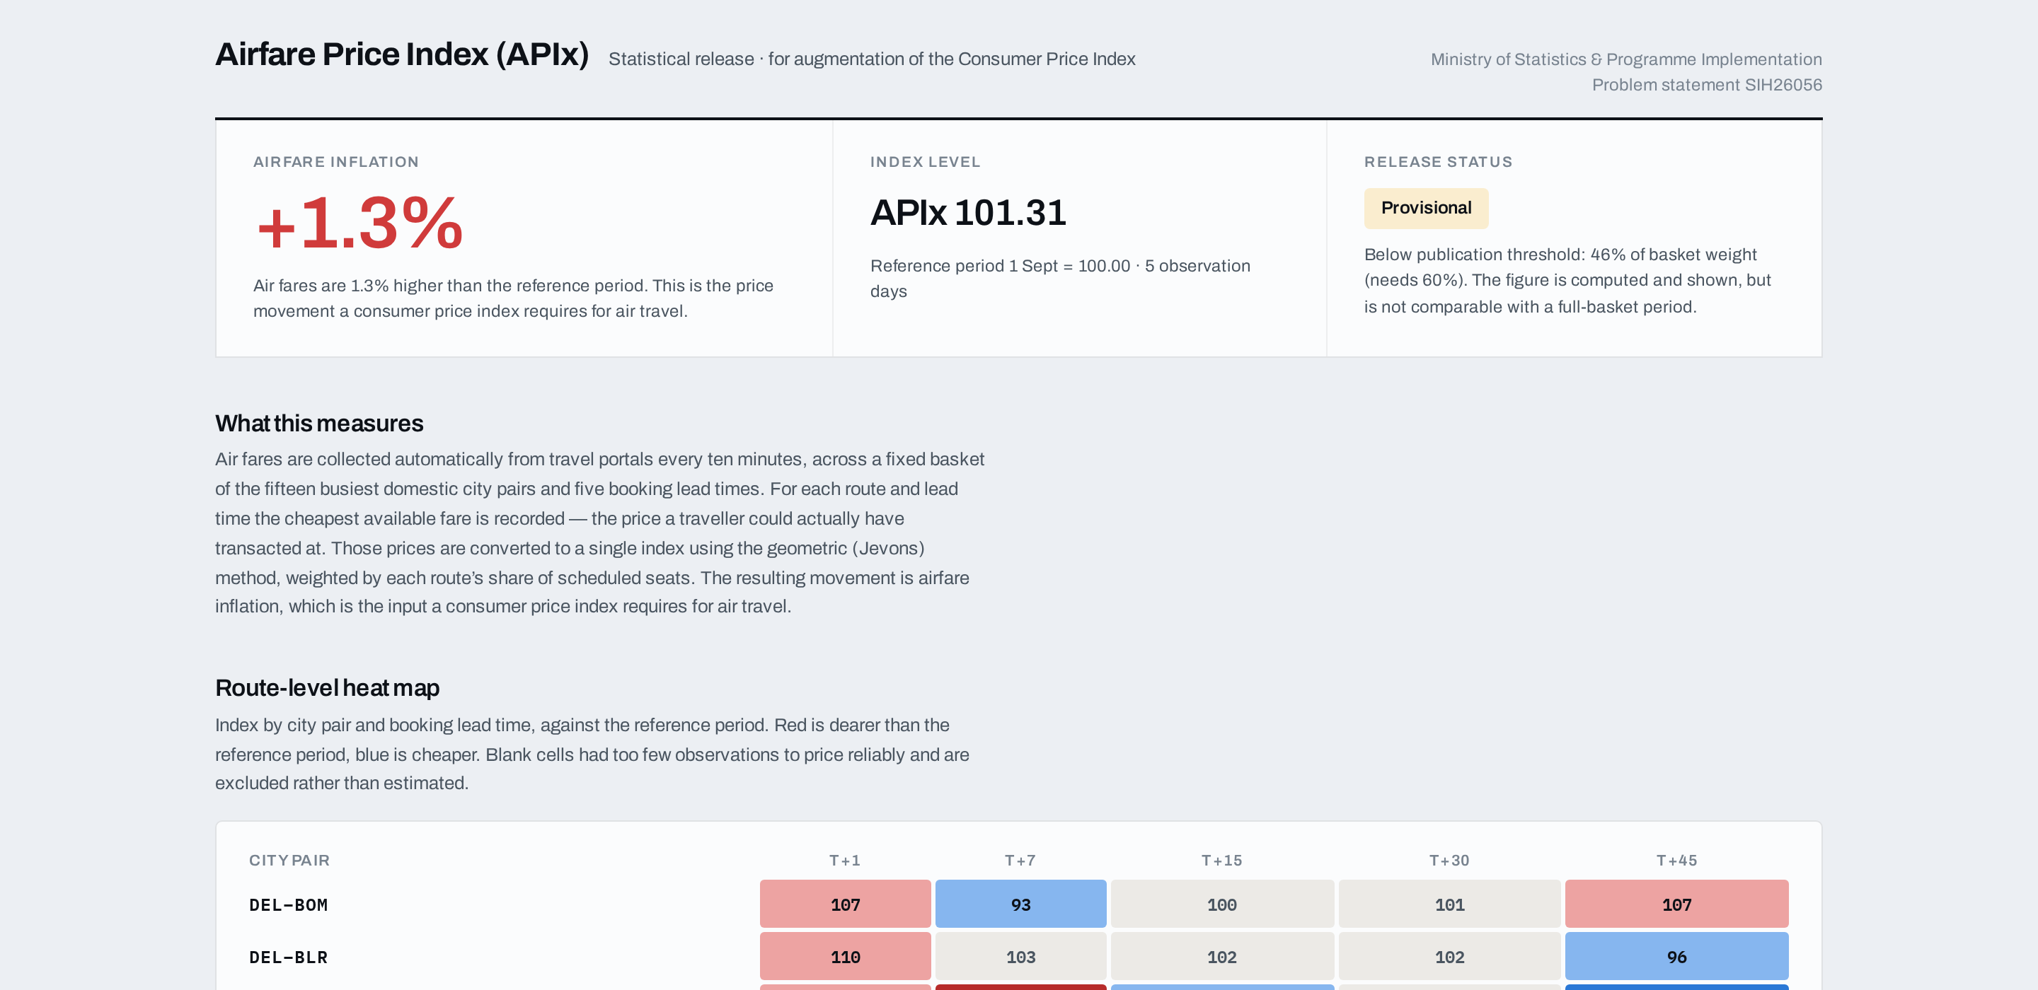
IMPACT AND BENEFITS
Fare Enough 101
From a fare on a screen to a figure in the CPI
1
A fare is published
A portal shows a price for one route, one date
2
We observe it
Read every 10 minutes, robots-checked
3
It becomes a price
Cheapest logical fare per route × lead time
4
It becomes an index
Weighted Jevons across the basket
5
MoSPI ingests it
REST API with method and coverage
6
CPI reflects reality
Transport sub-index from 144 daily reads
Who benefits, and how
MoSPI / NSO
A defensible transport input, recomputable from stored micro-data
DGCA and policy
Route-level fare behaviour nobody currently publishes
Citizens
A public record of what air travel actually costs over time
Researchers
An open, reproducible price series for a market that has none
144 ×
observations a day, not one a month
75
priced cells behind every figure
T+0
same-day index, not a two-week lag
Live: apix-portal.pages.dev
Headline inflation, release status and method on one page.
Our promise — replace one manual price visit a month with 144 automated observations a day, at zero marginal cost.

Slide 6
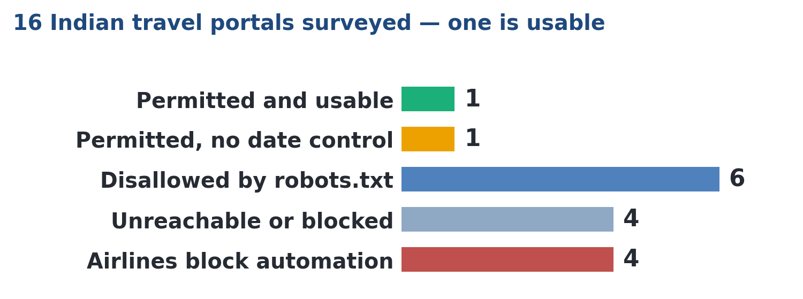
RESEARCH AND REFERENCES
Fare Enough 101
EVERY CARD IS CLICKABLE — THE UNDERLINED LINK OPENS THE SOURCE
Method — why Jevons
Eurostat, Practical guidelines on web scraping for the HICP (2020). Names air fares explicitly as a scraped category.
Precedent — already done
ONS ran a web-scraping programme for consumer prices from 2014, Eurostat-funded from 2015.
The Indian basket
DGCA city-pair statistics: 164 m domestic passengers, IndiGo 64.2%. Our own 1,000-fare sample returned 68.2% — arrived at independently.
Eurostat guidance
ONS study
DGCA statistics
Standards we hold to
RFC 9309, the Robots Exclusion Protocol. We implemented it ourselves after finding Python's standard parser reports disallowed paths as allowed.
CPI methodology
MoSPI moved the CPI to base 2024=100 in February 2026, aligned to COICOP 2018. Air fares are still priced by hand — the process this augments.
Our code and full method
Collector, index engine, export API and portal. The README documents the method and the publication threshold. github.com/BradCage-afk/sih-2026-airfare-index
RFC 9309
The 2024=100 series
Open the repo
Everything above is reproducible.
The index, every chart in this deck and every figure on the portal are regenerated from the database by scripts in the repository. Nothing is transcribed by hand, so no number here can drift from what the system holds.
Everything in this deck is checkable against a live system:
Live API docs
Release portal
README + method
Aviation market

