Slide 1
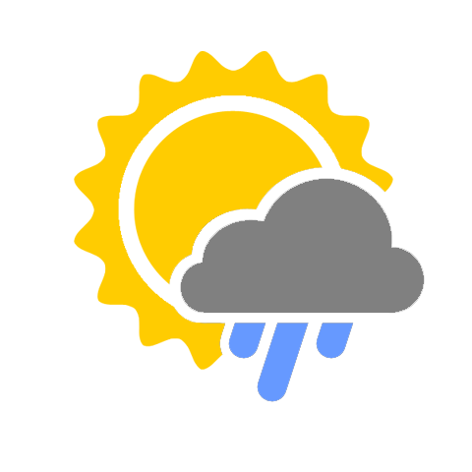
weatherEvent
By: Brad Fabian, Cristian Custodio,
Joseph Evangelista and Natalia Gonzalez

Slide 2
APPLICATION’S CONCEPT
“Weather” you’re new to a city or bored with your current city, this app is intended for finding events or planning your events more efficiently.

Slide 3
MOTIVATION FOR OUR APP’S DEVELOPMENT
Our motivation was to create
a stress-free environment for users
to be able to plan their events for
the location they desire.

Slide 4
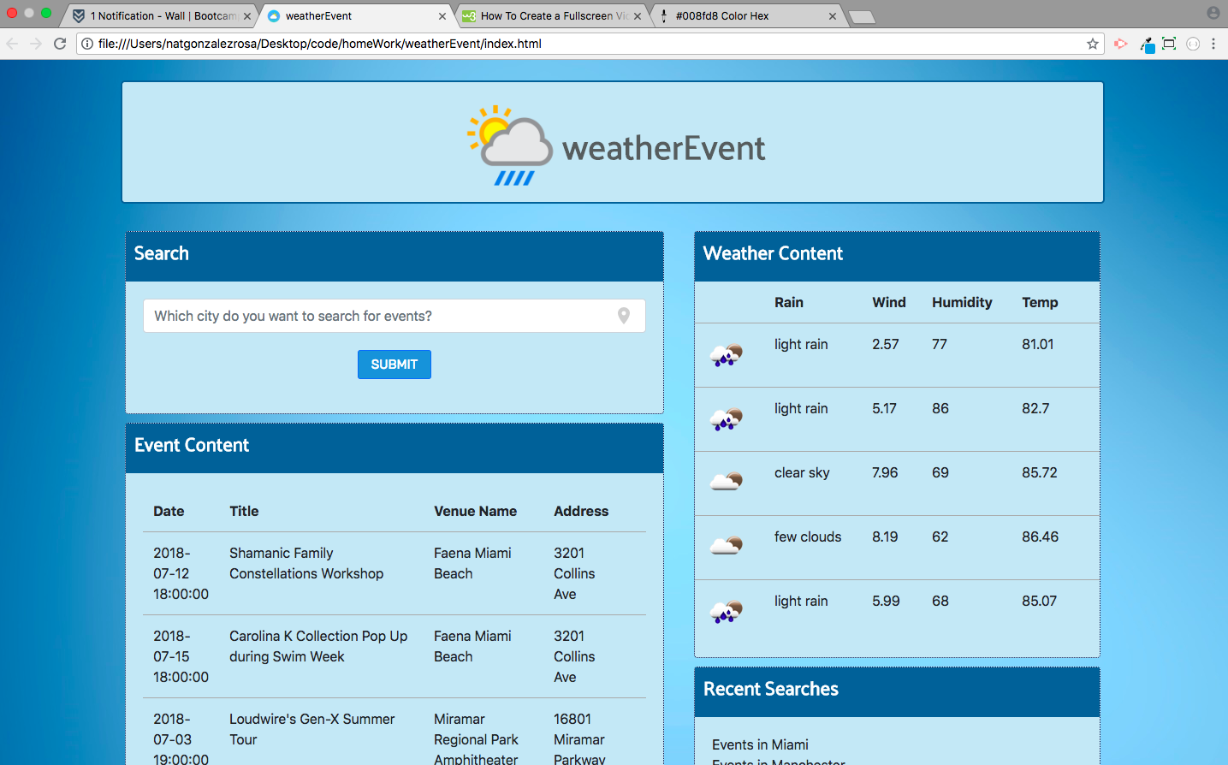
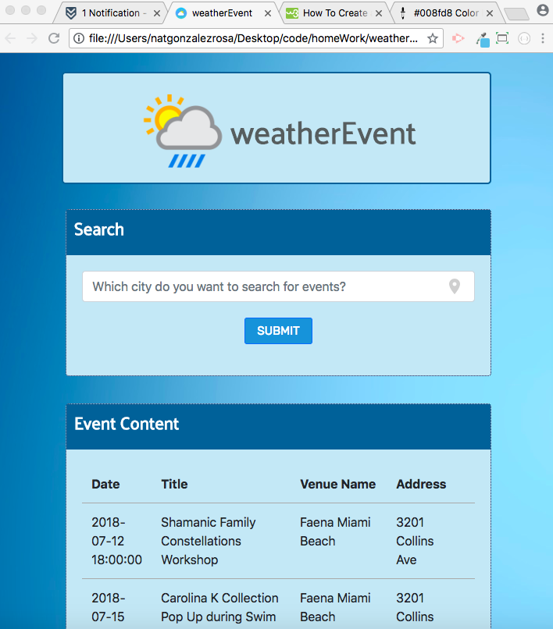
OUR DESIGN PROCESS
DESKTOP
MOBILE

Slide 5
TECHNOLOGIES USED
HTML, Bootstrap and CSS: front-end
jQuery: logic
Firebase: database
Algoria: new technology

Slide 6
FUTURE DEVELOPMENTS
Using parking API to find a parking spot
Integrating the application with Google Maps
Street view so users can scope out the venue
Adding filters to search bar (distance
from the event, type of event, etc.)

