Slide 1
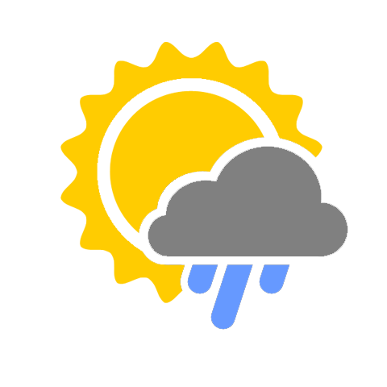
weatherEvent
By: Brad Fabian, Cristian Custodio,
Joseph Evangelista and Natalia Gonzalez

Slide 2
APPLICATION’S CONCEPT
“Weather” you’re new to a city or bored with your current city, this app is intended for finding events or planning your events more efficiently.

Slide 3
MOTIVATION FOR OUR APP’S DEVELOPMENT
Our motivation was to create
a stress-free environment for users
to be able to plan their events for
the location they desire.

Slide 4
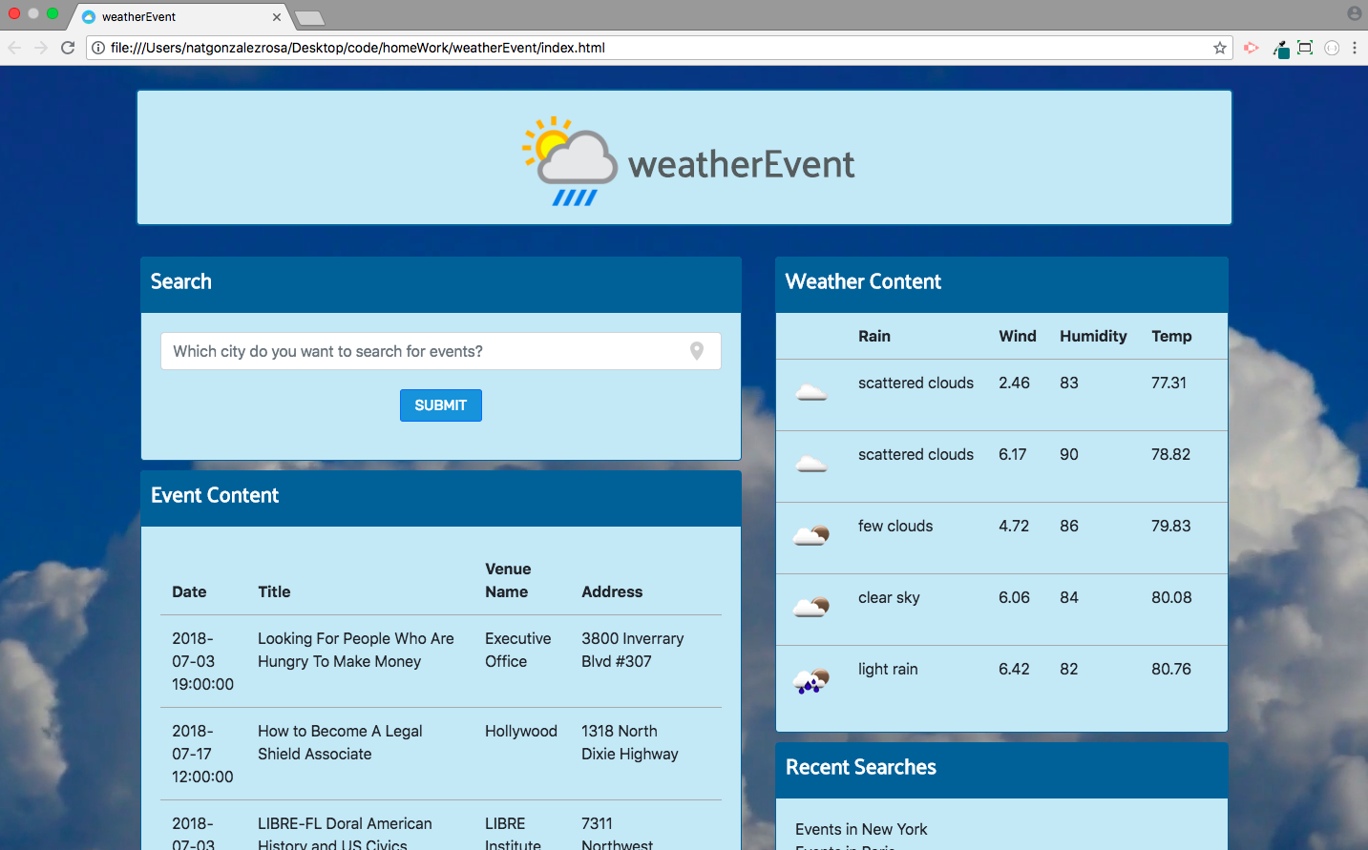
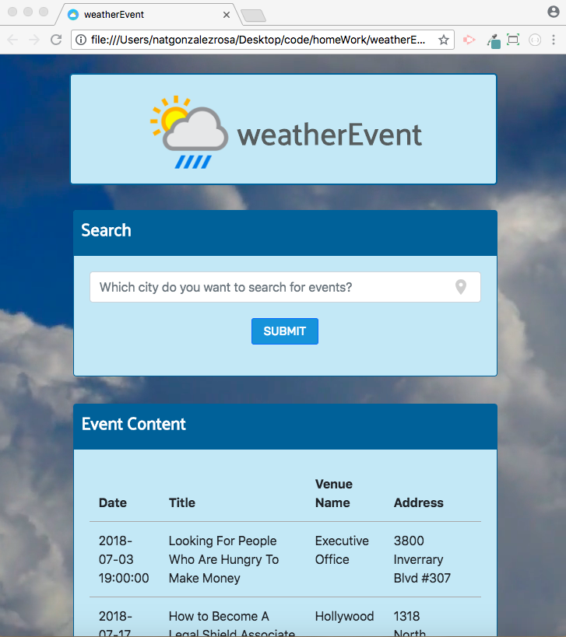
OUR DESIGN PROCESS
DESKTOP
MOBILE

Slide 5
TECHNOLOGIES USED
HTML, Bootstrap and CSS: front-end
jQuery: logic
Firebase: database
Algoria: new technology

Slide 6
FUTURE DEVELOPMENTS
Using parking API to find a parking spot
Integrating the application with Google Maps
Street view so users can scope out the venue
Adding filters to search bar (distance
from the event, type of event, etc.)
Interactive backgrounds (snow, rain, etc.)

