Slide 1

Using Background Processing to Build Scalable Applications with Hangfire
Nick Branstein & David Buckingham
Notes:
TO DOS:
Add Title
Add content
Add images, screenshots to support your points
Make point size big enough to read from 100 ft. away
Respect your audience. If you’re presenting with the slides, use short, punchy & active sentences. If audience can read every word you’re saying, they wouldn’t be listening. The focus should be on what you’re saying, not these slides. Would Martin Luther King Jr. need a PowerPoint in his “I have a Dream” speech?
If you need to read from a script, use this section to hold your notes, speech.

Slide 2


About Us
Nick Branstein
Senior Consultant
KiZAN Technologies
nick.branstein@kizan.com
@nickbranstein
https://brosteins.com
David Buckingham
Senior Consultant
KiZAN Technologies
david.buckingham@kizan.com
@davidbuckingham

Slide 3
About Us
Nick Branstein
Blog about technology at brosteins.com
Writing a book about NativeScript
Video game lover and enthusiast
Cleveland sports fan (Go Cavs!)
David Buckingham
Husband
Cross-Country-Dad, Baseball-Dad, Basketball-Dad, Art-Dad
Runner
Diehard UofL Fan, GO CARDS!
Louisvillian, born-and-raised

Slide 4
Overview

Slide 5
Workshop Goals
Why Hangfire?
LEmming Scheduling System
Introduce Hangfire
Logging
Jobs
Hangfire Internals
Scalability
Hosting
Dashboard Easter Eggs
Logging Deep Dive

Slide 6

Requirements
Hangfire Requirements
.NET Framework 4.5
Persistent Storage
NewtonSoft.Json Library (5.0.1+)
Workshop Requirements
Visual Studio 2015 Community Edition (or greater)

Slide 7
Why?

Slide 8
Why Hangfire?
Why did we choose to present a Hangfire workshop?
Notes:
Talk about last year David and I participated in the Nservice Bus workshop w/Jimmy Bogard
About the same time I was investigating Hangfire as an open source free “alternative”
As developers we have many choices and tools in our toolboxes
David and I talked about it and decided to start with Hangfire to meet the client’s need (we can always adjust later as needed).

Slide 9
LeSS – Lemming Scheduling System

Slide 10
{Demo}

Slide 11
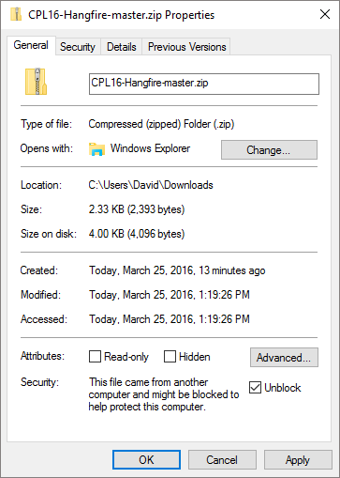
Download Source Code
https://github.com/dbuckingham/CPL16-Hangfire

Slide 12
Download Source Code
Folder | Comments
\doc | Contains all of the exercises for this workshop.
\ppt | PowerPoint presentation
\src | Contains all of the source for the exercises. Note: in addition to the base application solution, snapshots of the solution after each lab are included.

Slide 13
{Lab 1}
Notes:
The purpose of Lab 1 is to get the base application, Lemming Scheduling System, installed and running in your local environment.

Slide 14
Introduction to Hangfire

Slide 15
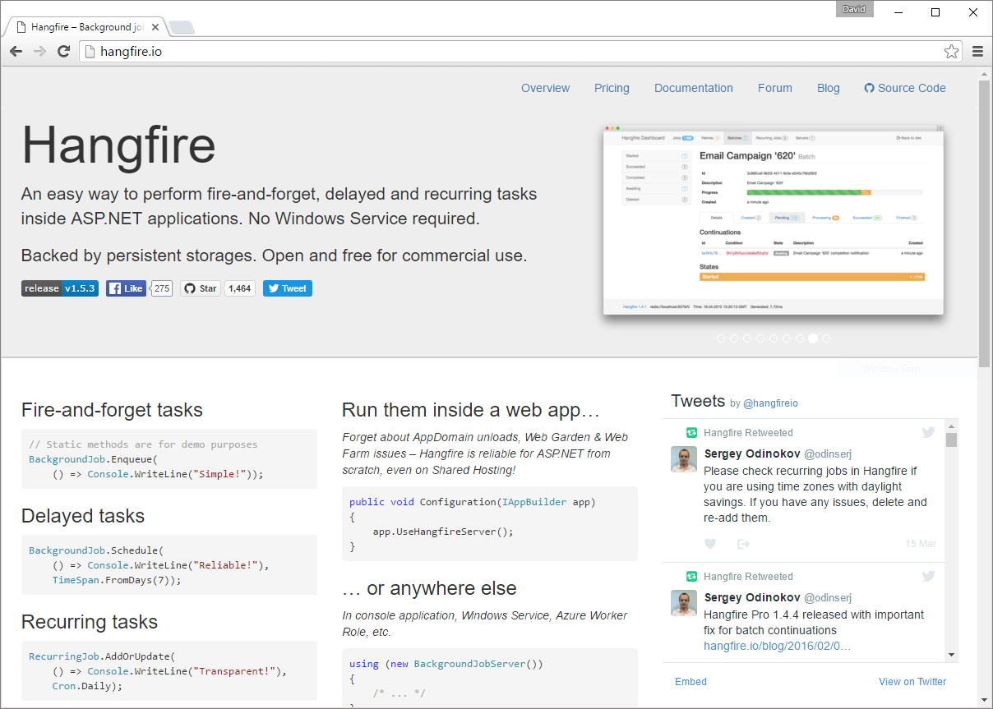
Hangfire
Hangfire
http://hangfire.io

Slide 16
What is Hangfire?
Open source framework
Manage and run asynchronous background jobs
Frees up resources in request processing pipeline
Notes:
Hangfire

Slide 17
Why Hangfire?
Simple to install and configure
Powerful built in monitoring
Scalable
Persistent
Reliable
Extensible
Notes:
Hangfire is installed simply by NuGet packages.
It includes a powerful, full-featured, dashboard that can be integrated in your application to provide monitoring and control.
Hangfire can be configured to run in your application, as a component of your web farm, or even external and on a separate server.
Uses persistent storage to ensure no-job loss between application restarts.
Guarantees that every job/task is executed “at least” once and support automatic retries should an error occurred during execution, or a server shutdown.
Hangfire is extensible and has a community of open-source packages offering a variety of persistent storage providers, logging, dependency injection, etc.

Slide 18
Installation
It’s as easy as…
PM> Install-Package Hangfire
to get: Hangfire, Dashboard, Persistent Storage… and more!

Slide 19
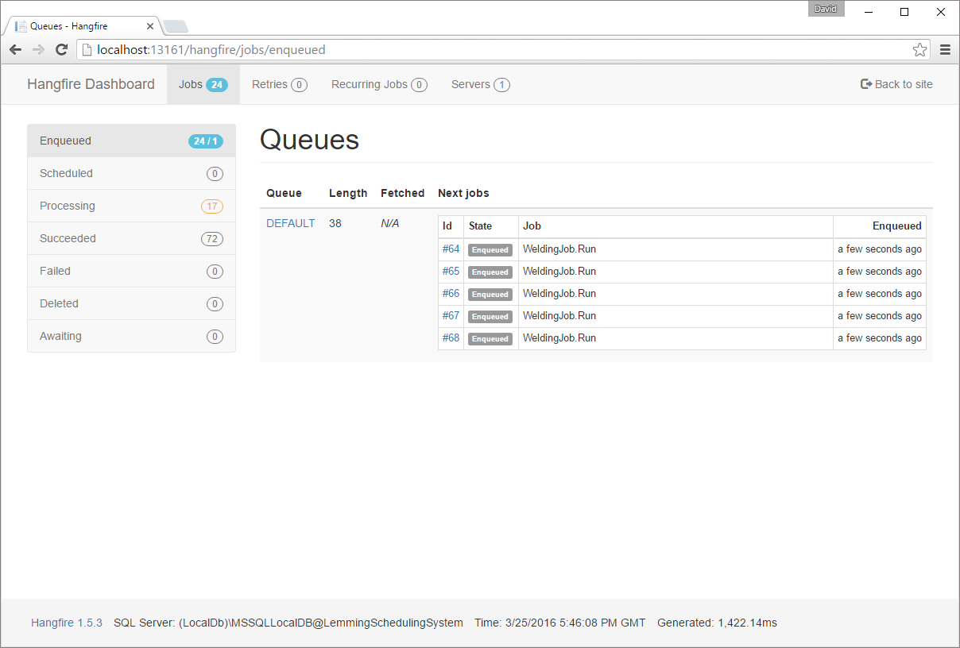
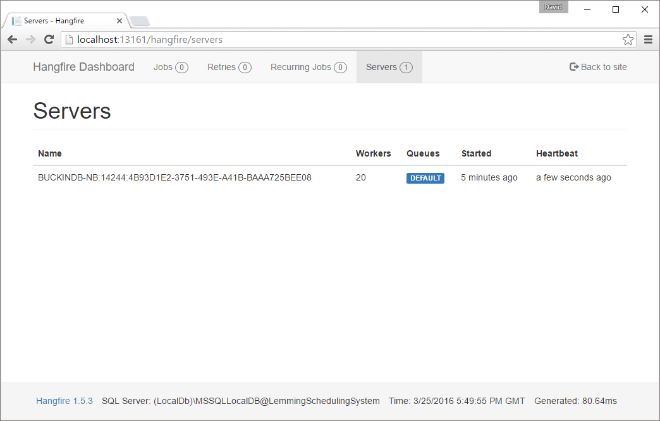
Monitoring
Monitor resources
Attempted retries
View job details and errors
Resubmit failed jobs
Delete failed jobs
Manually trigger recurring jobs
and more…

Slide 20
Scalable
Host Hangfire
in a single web application process
in many, inside of web garden processes
on many servers, across a web farm
a separate service, outside of your application
running on a separate server
keep scaling up and out as needed

Slide 21


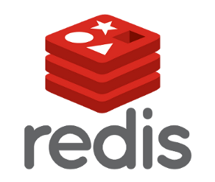

Persistent
Hangfire uses a shared persistent storage mechanism for ensuring data survives application restarts.
Notes:
In addition to the persistent storage providers shown, community extensions exist for:
RavenDB
MySQL
In-Memory Storage

Slide 22
Reliable
Every job is processed “at least” once
Automatic Retries
Unhandled exceptions
Hangfire server shutdown
Unexpected process terminations
Permanent failures are not removed from the queue unless you remove them
Notes:
Every job is guaranteed to be processed “at least” one time. Why “at least” once?
Hangfire supports Automatic Retries, which can be configured for each job.
What causes a job to be retried? Failure.
Unhandled exceptions
Hangfire server shutdown
Unexpected process terminations
Talk about how we’ve had Hangfire running in production for 6+ months now an never had it crash or had to restart the service
250k successful jobs/day and counting

Slide 23
What is a Background Job?
A method!
No message class.
No Request/Response models.
Notes:
This is part of what makes Hangfire simple imo – a job is any method that you want

Slide 24
How can we run jobs?
Fire-and-Forget (One Time)
Recurring
Delayed
Batches (Pro Only)
Notes:
We will only be covering One time and Recurring in this lab but you can use the same techniques you learn today to delay a job
Lab 2 is all about jobs – so time to get started!
We’re going to refactor our code to use Hangfire to run jobs

Slide 25
{Lab 2}

Slide 26
Lab 2 - Review
Getting up and running is quick
Any method in your code can be a job
Dashboard comes out of the box and has a ton of useful information
Think about organizing your code if your jobs are similar in nature

Slide 27
Logging

Slide 28
Why?
Logging is your look into what is happening both inside of Hangfire, as well as from within your jobs themselves.
Even with the Dashboard without Logging it can be difficult to understand what is happening.
What tasks did a job perform before the exception was thrown? Or the server was shutdown?

Slide 29
Supported Libraries
NLog
Serilog
Elmah
Log4Net
EntLib
Loupe
…roll your own
Notes:
Hangfire supports all of the major logging libraries such as Nlog, Serilog, Elmah, Log4net, etc.
What’s does it mean to support a logging library?
Need to support an additional library? Hangfire makes this easy by providing simple interfaces, and the ability to quickly wire up you custom log provider.
We like NLog and will use it during today’s workshop.
NLog is easily configurable via an app.config or web.config file. More importantly it provides an simple configuration API so that our logging implementation can be configured programmatically.

Slide 30
{Lab 3}

Slide 31
Lab 3 - Review
Installed NLog and configured Hangfire
Configured a Database and a Colored Console Target
Logging becomes more important with multiple worker threads

Slide 32
Jobs

Slide 33
Background Jobs
Fire-and-Forget
Delayed Jobs
Recurring Jobs
Notes:
Fire-and-forget are the basic job type: enqueued a single time, and is executed.
Delayed Jobs can be scheduled: send an e-mail to a user 1 day after they register
Recurring Jobs: jobs which are executed according to a schedule that we specify

Slide 34
Fire-and-Forget
BackgroundJob.Enqueue( () =>
Console.WriteLine(“Hello world!”)
);
Notes:
The BackgroundJob Enqueue method simply takes a lamda expression indicating the method to be serialized and enqueued.
Expression<Action<T>>

Slide 35
Delayed Jobs
BackgroundJob.Schedule(() =>
Console.WriteLine(“Hello world!”),
TimeSpan.FromDays(1)
);

Slide 36
Recurring Jobs
RecurringJob.AddOrUpdate(
“my-job-id”, () =>
Console.WriteLine(“Hello world!”),
Cron.Daily
);
Notes:
AddOrUpdate creates a new recurring job in persistent storage.
At 1-minute intervals, a Hangfire thread is responsible for scanning Recurring Jobs which need to execute.
If it finds any, it then enqueues an instance as a Fire-and-Forget job.
The last parameter, Cron.Daily is simply a helper class which provides some common CRON expressions: minutely, hourly, daily, etc.

Slide 37
Cron Expressions
“00 */2 * * *”
00 | Minutes | minutes = 0 (top of the hour)
*/2 | Hours | every 2 hours
* | Day of Month | (unrestricted)
* | Month | (unrestricted)
* | Day of Week | (unrestricted)

Slide 38
Best Practices
Job arguments should be simple
Make jobs reentrant
Notes:
Jobs are serialized method invocations, which means that all parameters to a method are serialized and stored in a database.
Large objects, or arrays, collections, etc. should be persisted in another manner and then looked up inside the job.
Jobs may be interrupted for any number of reasons such as failure, server restart, etc. If this occurs, jobs will be executed again. Care should be taken not to perform duplicate work. For instance, a job sends a batch of e-mails. After each e-mail is sent, it’s state should be updated so that if the job is requeued, e-mail messages will not be resent.

Slide 39
{Lab 4}

Slide 40
Lab 4 - Review
Converted a Background Job to a Recurring Job
Used the Hangfire Dashboard to manage Recurring Jobs

Slide 41
Hangfire Internals

Slide 42
What is happening under the covers?
When a method is queued…
Hangfire serializes the method signature
And any parameters
And stores this using the storage mechanism that was configured
Notes:
Reminder: We are using SQL as our queue

Slide 43
Then…
Hangfire schedules the job to run
Hangfire uses Activator.Instance to instantiate the class your job is in
The method is called with the proper parameters passed to it
Notes:
Reminder: We are using SQL as our queue

Slide 44
Important!
Since Hangfire is serializing your job and activating it later you need to be careful when changing the signature of your method
Why?
If the method (with the exact signature) no longer exists in your code when Hangfire tries to activate it then how can that job run?

Slide 45
What if?
What if you have 1000’s of long running jobs queued and you have to release a bug fix to production?
If you change the method signature the queued jobs will never be run because Hangfire can’t find them.

Slide 46
In Lab 5…
We will see exactly how Hangfire stores the jobs
We will setup a situation where we have to change a method signature
What happens when we do this?
How do we properly fix this?
Notes:
i.e. How do we update our jobs as our solution grows?

Slide 47
{Lab 5}

Slide 48
Lab 5 - Review
Changing method signatures is “bad”
Use a wrapper method with default parameters to transition to newer methods in your code
Only delete the old methods when you’re absolutely sure they are not in a queue

Slide 49
Scalability

Slide 50
Scalability
Hangfire can scale in a number of ways
Multiple queues can be created
Hangfire servers can be configured to have more, or less, worker threads
An application may have multiple Hangfire servers

Slide 51
Queues
Hangfire servers can be configured to have multiple queues
default Queue
Queue names must be lowercase letters, digits, and underscores only
Jobs are assigned to a queue by decorating the method with the QueueAttribute
Notes:
High priority queue
Long running tasks queue
Integration point segregation

Slide 52
Worker Threads
The number of worker threads can be configured per Hangfire server.
Default is Environment.ProcessorCount * 5
Notes:
For small, quick tasks, the more worker threads configured means queues can be serviced quicker.
If queue length continues to grow: it may be necessary to increase the number of worker threads.

Slide 53
Hangfire Servers
Job selection may lead to blocked queues
Execution boundaries
Dedicate threads to queues
Notes:
Worker threads select a job in the first queue (alphabetically) which has a job.
Therefore, if we have multiple queues configured, some queues may not be processed as expected, leading to blocked queues
It may be necessary to run multiple Hangfire servers as a “execution boundary” to prevent blocked queues from occurring.
By running multiple Hangfire servers, we can dedicate threads to queues.
So far our application is configured to run a single Hangfire server, but we can add more.

Slide 54
{Lab 6}

Slide 55
Lab 6 - Review
Hangfire servers can be configured to customize job processing to assist in performance gains
Note: when a worker thread is available, it will select a job from the first queue, alphabetically, which has an item queued.
Notes:
The documentation states:
“The order is important, workers will fetch jobs from the critical queue first, and then from the default queue.”
By order, it means alphabetical order, not necessarily the order in which our queues are configured.

Slide 56
Creating a Hangfire Windows Service

Slide 57
Hosting Options
ASP.NET Web Application
Console Application
Windows Service

Slide 58
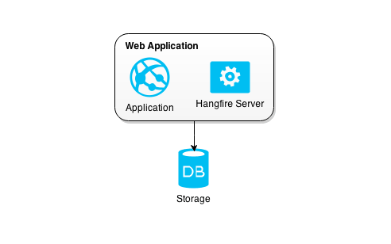
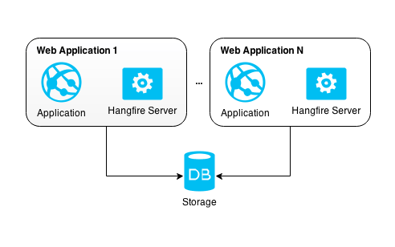
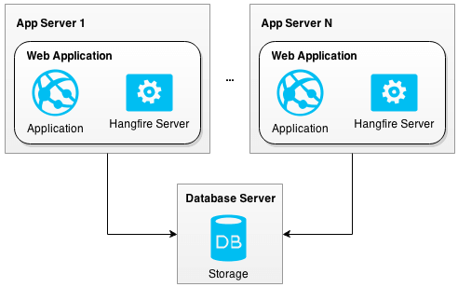
ASP.NET Web Application
Notes:
Single Process
Web Garden
Web Farm

Slide 59
Always Running
Your Hangfire Server should always be running
Windows Service?
Web Application, with additional measures (the site is not started until the first user makes a request)

Slide 60
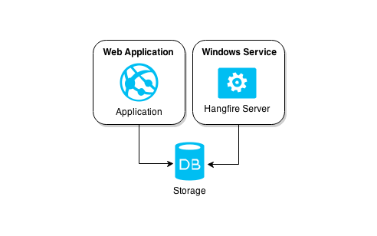
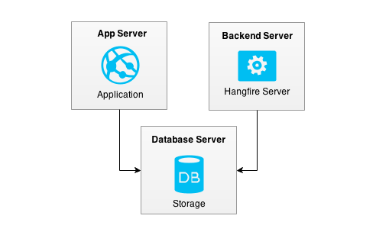
Windows Service
Notes:
Hangfire servers can be configured to run in a Windows Service which can run on the same server as the web application, or a separate server with it’s own resources.

Slide 61
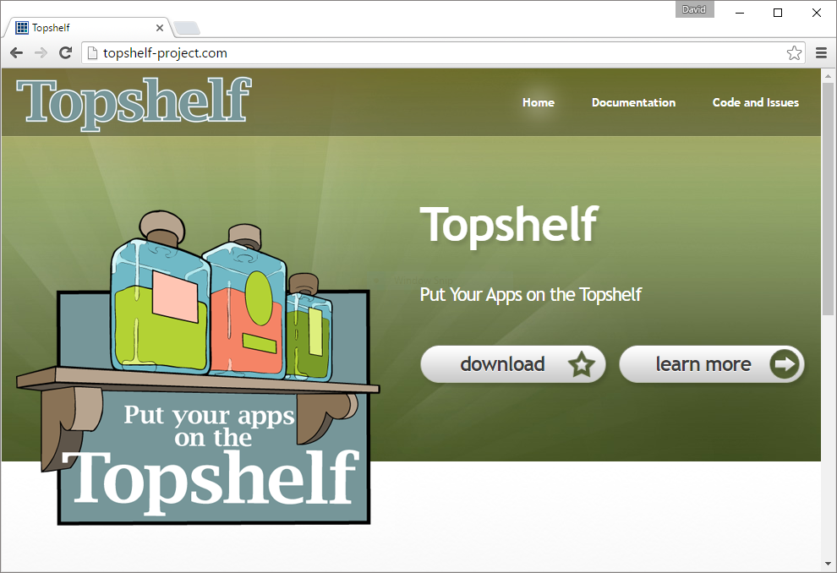
TopShelf
TopShelf
http://topshelf-project.com
Notes:
TopShelf is a framework for hosting Windows services.
Simplifies service creation, installation, and most importantly debugging as a console application.

Slide 62
Cancellation Tokens
What happens if our Hangfire server is shutdown while a long running task is currently executing?
Cancellation tokens “interrupt” a job
Promote prompt and graceful shutdown
cancellationToken.ThrowIfCancellationRequested()

Slide 63
{Lab 7}

Slide 64
Lab 7 - Review
Explored hosting options and the advantages/disadvantages
Illustrated the ease in which a Hangfire Server can be hosted inside a Windows Service, created with TopShelf
Investigated the use of Cancellation Tokens

Slide 65
Dashboard
Easter Eggs

Slide 66
Dashboard Access
Dashboard access is restricted when not running on localhost
We will implement a custom authorization filter
DisplayNameAttribute
What?
Not a well documented feature
Allows customization of the job names on the dashboard
Notes:
Not much more to say really
Hangfire uses the displayname attribute and can pass the parameters of your job to it! Pretty cool!

Slide 67
{Lab 8}

Slide 68
Lab 8 - Review
Implement a authorization filter and register it with the dashboard to allow access in qa/production
In your production application, check ASPNetIdentity Roles or custom permissions in your authorization filter to restrict access
The DisplayName attribute can be useful for customizing your job names

Slide 69
Logging Deep Dive

Slide 70
Let’s talk about logging…
Logging multiple jobs is going to make our logs a mess
Mapped Diagnostics Context
Global Diagnostics Context
Notes:
These are NLog specific but if you have used Log4Net or other logging frameworks there will be something comparable.
Explain the difference
Global Diagnostics is going to be unique per server
MDC is unique per job

Slide 71
Why are these important?
We can use the MDC to quickly find all the events logged for a particular instance of a job
Assists with troubleshooting and debugging
Notes:
These are NLog specific but if you have used Log4Net or other logging frameworks there will be something comparable.
Explain the difference
Global Diagnostics is going to be unique per server (remember we can have multiple servers running per windows service instance)
MDC is unique per job

Slide 72
And now for something more fun!
Slack Integration
Everyone’s new favorite team collaboration tool
A great way to be proactive about logging and reviewing errors/warnings
Notes:
We use this in production for errors and warnings

Slide 73
{Lab 9}
Notes:
Show the slack channel

Slide 74
Lab 9 - Review
Review your favorite logging framework for
Mapped Diagnostics Context (per job instance)
Global Diagnostics Context (per server instance)
Utilizing a tool like Slack can help you be proactive about errors/exceptions in your jobs

Slide 75
While at Code PaLOUsa, be sure to check out these other sessions:
Session | Date/Time | Room
Making Requirements Visual – Visio is Your Friend: Word is Your Crutch - David Bjarnson | Wednesday, 3/30/2016 2:00 PM | Jacob Beam Room
Everything is Awesome… when You’re Using Visual Studio Code - Mike Branstein | Wednesday, 3/30/2016 3:30 PM | John McDowell Ballroom
Iterate Yourself! Using Agile Methodologies to Build a Better You - David Buckingham | Wednesday, 3/30/2016 4:45 PM | Adam Shepherd - A

Slide 76
Questions?

