Slide 1
Hands On with Containers for .NET Core Applications
Daniel Egan - Robert Green
Bret Stateham – Bruno Terkaly
Microsoft
Monday 9am - 4pm

Slide 2
Agenda
Today's workshop
Introduction to containers
Build an ASP.NET Core WebAPI
Put your WebAPI in a Docker Container
Run the container locally
Publish the container to Docker Hub
Publish the container to ACR (Azure Container Registry)
Deploy the container using a web app in azure
Set up Continuous Deployment for your container in a Web App
Run the container in Azure using ACI (Azure Container Service)
Run the container as part of a cluster using AKS ( Azure Kubernetes Service)
We will be pulling together a mixture of hands on labs and presentations

Slide 3
Intro to Containers

Slide 4

What is a container?
Containers are a method of operating system virtualization that allow you to run an application and its dependencies in resource-isolated processes
Slice up the OS to run multiple apps on a single OS
Typically you run one application/service per container
Container and apps share lifecycle
Every container has an isolated view and gets
Own root directory
eth0 network interface
it’s own PID0
Kernel features to accomplish this:
cgroups: limiting what you can use
namespaces: limiting what you can view
Cannot mix operating systems
Notes:
Containers are a method of operating system virtualization that allow you to run an application and its dependencies in resource-isolated processes
Add HyperV slide

Slide 5
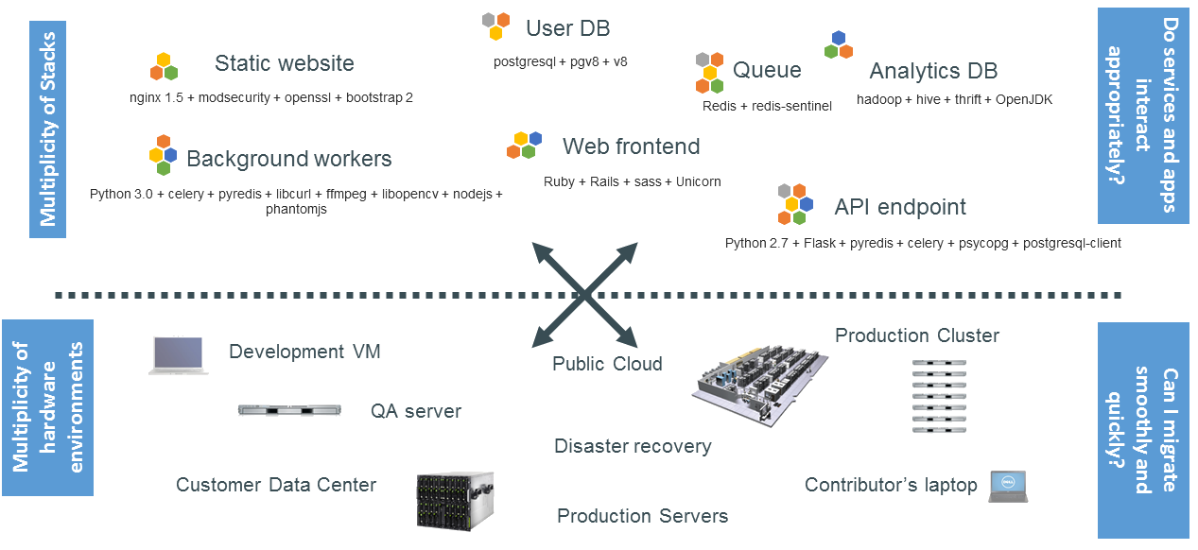
The Challenge

Slide 6
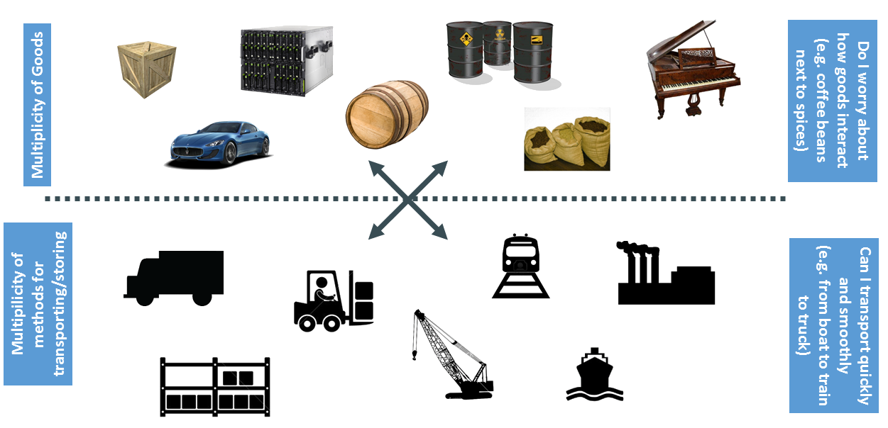
Cargo Transport Pre-1960

Slide 7
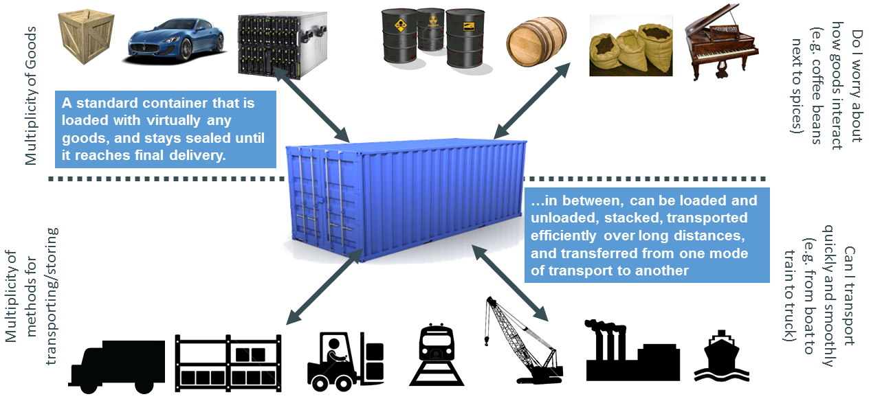
Solution: Intermodal Shipping Container

Slide 8
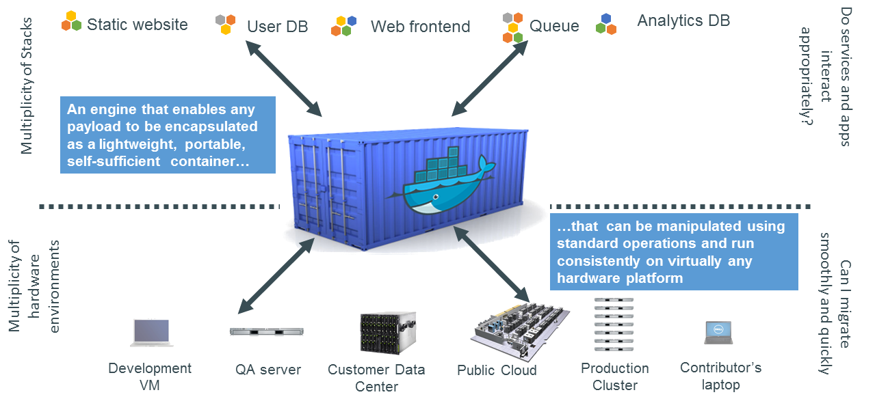
Docker is a Container System for Code

Slide 9
Containers vs. VM’s
Virtual Machines
Each VM has independent, full OS
Full isolation
Separate app frameworks
Support features such as live migration
Containers
Shared Host OS
Near instant start-up
Processes in containers are isolated
Dependent app services and libraries are tied to container (layers)
All containers on a host will share the same guest OS version
App
A
App
A
App
B
App
C
App
Framework
App
Framework
App
Framework
App
Framework
VM
Guest OS
Guest OS
Guest OS
Guest OS
Hypervisor
Physical Server
App
A
App
A
App
B
App
B
App
C
App
C
Container
App
Framework
App
Framework
App
Framework
Guest OS w/ Docker
Hypervisor
Physical Server

Slide 10
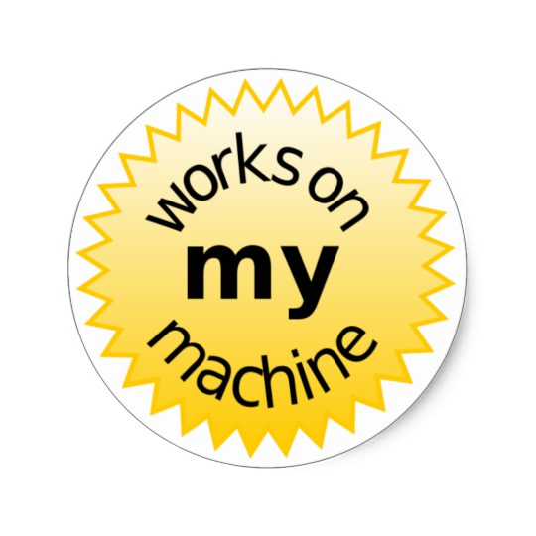
Why Containers?
Repeatable execution
immutable environment
reusable and portable code (“Build, Ship, and Run”)
Consistency across development, test, & production
Fast & agile app deployment; instant startup
Cloud portability
Density, partitioning, scale
Diverse developer framework support
Microservices

Slide 11
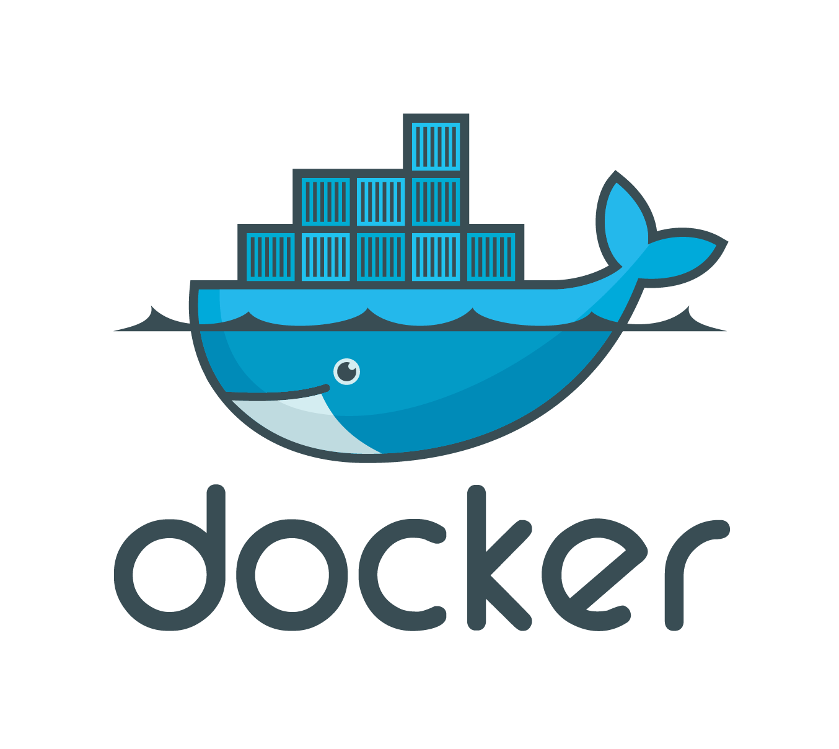
Docker
Containers have been around for many years
Docker Inc. did not invent them
They created open source software to build and manage containers
Docker is a container format and a set of tools
Docker CLI, Docker Engine, Docker Swarm, Docker Compose, Docker Machine and more…
Docker makes containers easy
Even I can create and run them
Some of the biggest names in the industry involved
Open source - Apache License 2.0

Slide 12




Some Docker Vocabulary
Docker Image
The basis of a Docker container. Represents a full application
Docker Container
The standard unit in which the application service resides and executes
Docker Engine
Creates, ships and runs Docker containers deployable on a physical or virtual, host locally, in a datacenter or cloud service provider
Registry Service
Cloud or server based storage and distribution service for your images

Slide 13
Creating an asp.net core WebAPI Running your asp.net core WebAPI in Docker
HOL - Add Docker Support to Asp.net Core App

Slide 14
Container Registries
Where do I put my images?

Slide 15
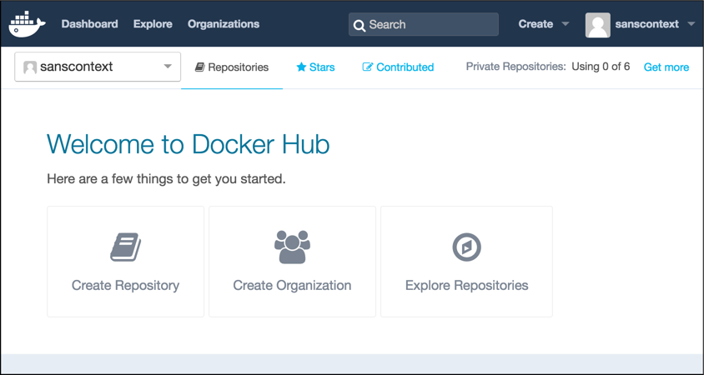
Docker Hub
Image Repositories: Find and pull images from community and official libraries, and manage, push to, and pull from private image libraries to which you have access.
Automated Builds: Automatically create new images when you make changes to a source code repository.
Webhooks: A feature of Automated Builds, Webhooks let you trigger actions after a successful push to a repository.
Organizations: Create work groups to manage access to image repositories.
GitHub and Bitbucket Integration: Add the Hub and your Docker Images to your current workflows.

Slide 16
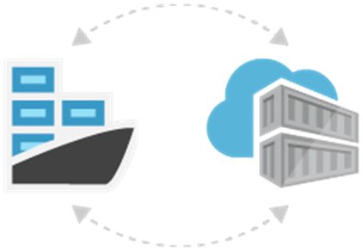
Azure Container Registry
Private Docker Registry on Azure
Authentication with Azure Active Directory
Webhook integration
Trigger events on image push (update) or delete
Charged per day dependant on plan
Geo-replication in preview on premium SKU

Slide 17
Uploading to DockerHub
Uploading your container to ACR (Azure Container Registry)
HOL - Push Container to Registries

Slide 18
Hosting containers
Where do I put my containers

Slide 19
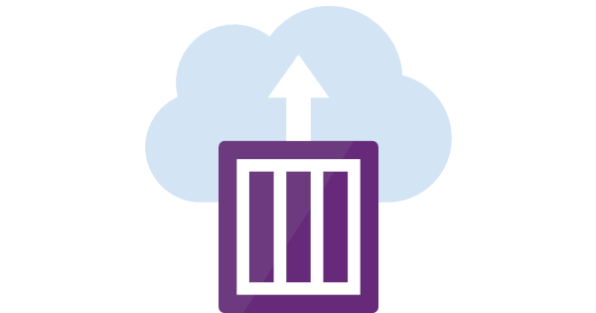
ACI Features
Create and manage easily
CLI, SDK, ARM
Fast Startup times
Per Second Billing
https://azure.microsoft.com/en-us/pricing/calculator/?service=kubernetes-service
Easily Network
Public IP addresses
DNS Names
ports
Easily Mount Volumes – Persistent Storage
Secrets, repositories
File shares
Container Co-Scheduled groups
More that one containers
Share resources (host machine, local storage) to create sidecar logging etc

Slide 20

ACI Use Case
Easy to Experiment try out something new
CI Build agents
Batch Jobs run just a bit at night
Permanently running container anything with state

Slide 21
Deploying your image to ACI (Azure Container Instance)
HOL - ACI (Azure Container Instance)

Slide 22
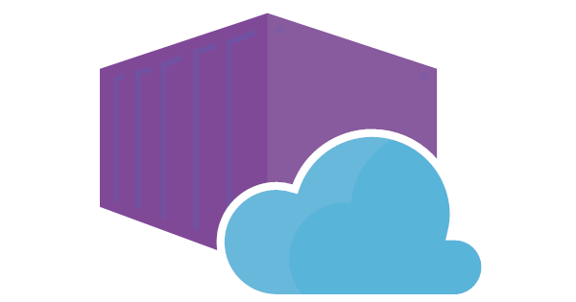
Containers in Web App
Support more frameworks
Control over framework versions
Multi-container support
Sandboxed environment
Trigger deployments form registry

Slide 23
Deploying your image as an Azure Web App
HOL - Run Container in Web App

Slide 24
Setting up Continuous Deployment for your container in a Web App
HOL - Run Container in Web App

Slide 25
Need Bruno Slides

Slide 26
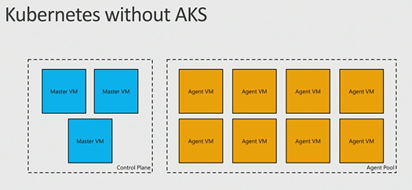
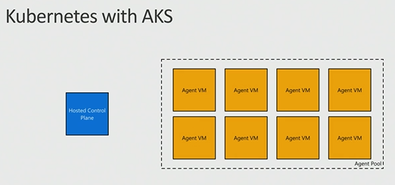
AKS: Managed Kubernetes
Azure-hosted control plane
No master nodes to manage or pay for
Automated upgrades and patching
Easily upgrade control plane and worker nodes to new versions of Kubernetes
Scale agent pool to increase or decrease capacity

Slide 27
Deploying your image in a Kubernetes Cluster
Orchestrators

