Slide 1
ASP.NET Core Security

Slide 2
Authentication Options
WS-Federation
OAuth
Cookies
JWT
OpenID Connect
Facebook &
Twitter

Slide 3
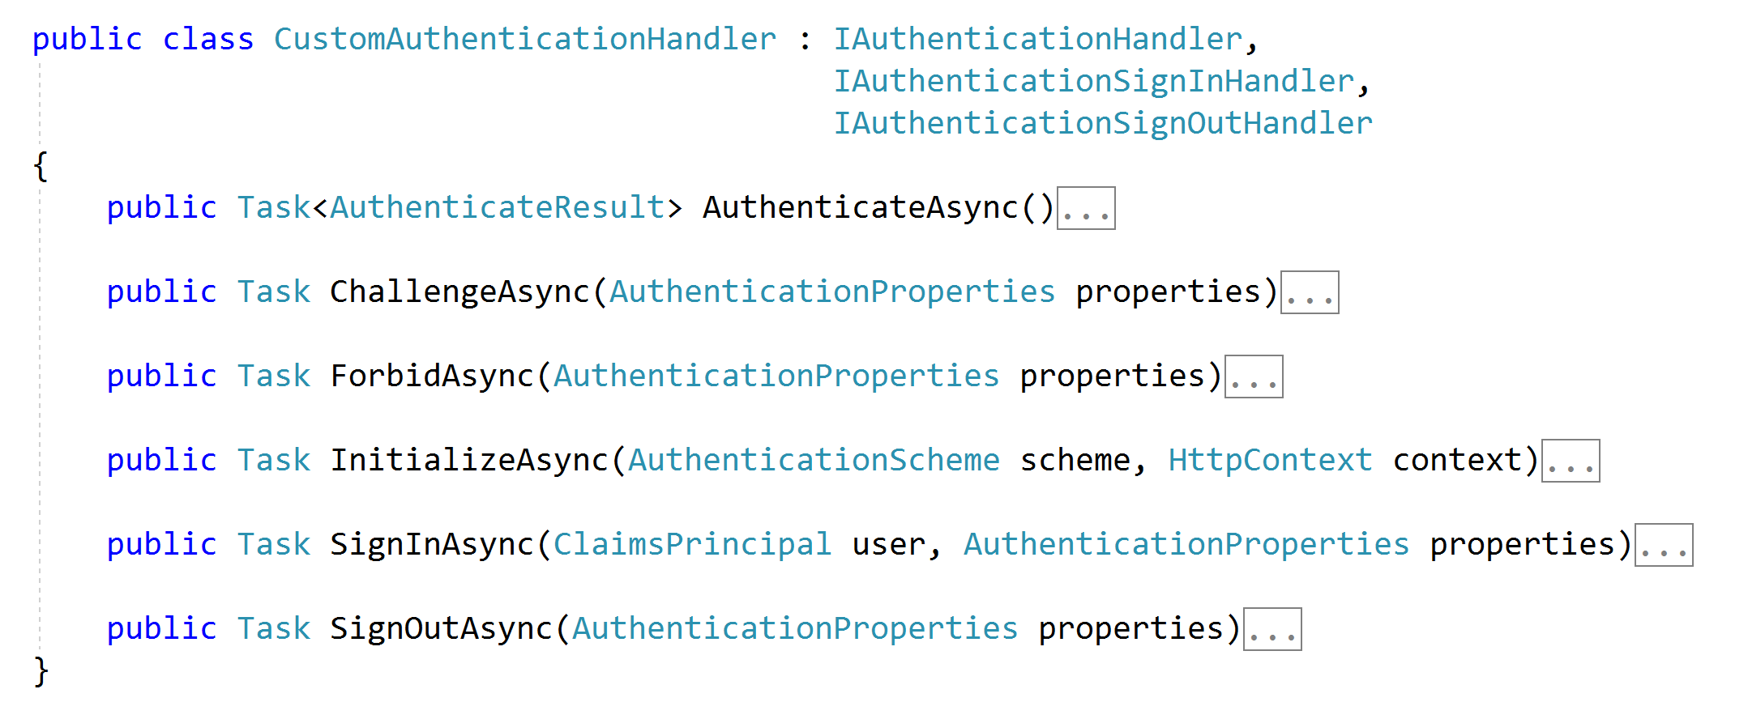
Authentication Handler

Slide 4
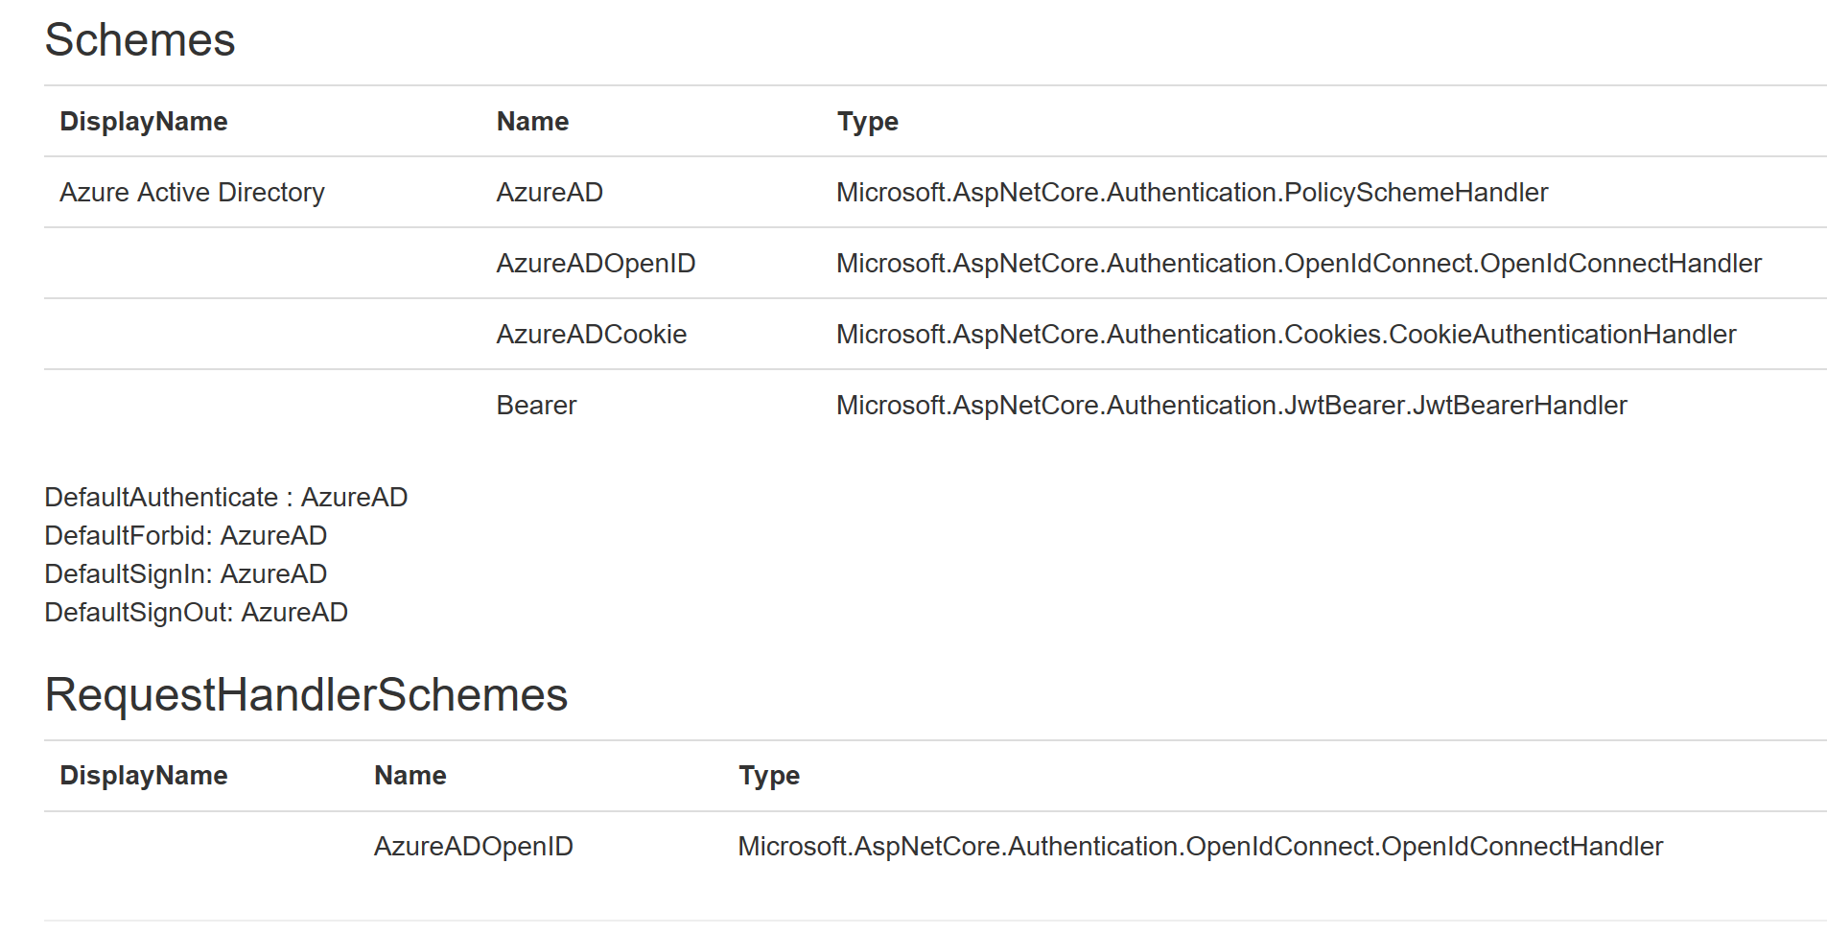
Schemes and Handlers

Slide 5
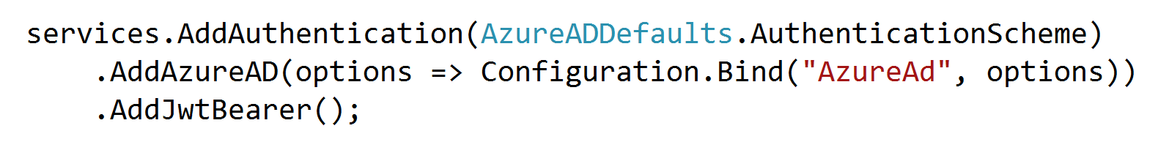
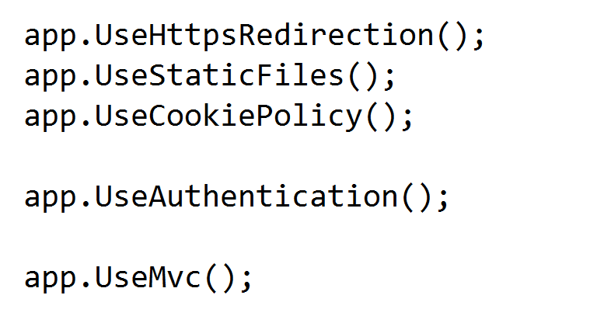
Adding Handlers

Slide 6
It’s All About Claims
Identities are based on claims throughout .NET framework
Claims are simple key-value pairs
“admin” : true
“email” : “scott@OdeToCode.com”
ClaimsIdentity is a collection of claims

Slide 7
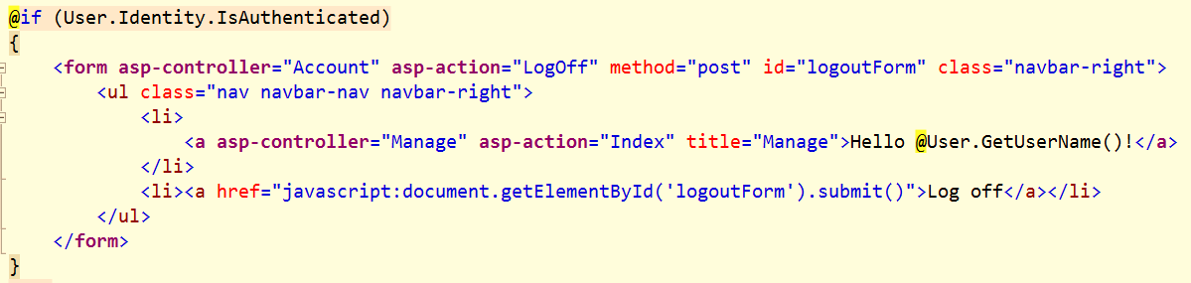
ClaimsPrincipal
A collection of ClaimsIdentity
User property available in controllers, views, pages, and middleware

Slide 8
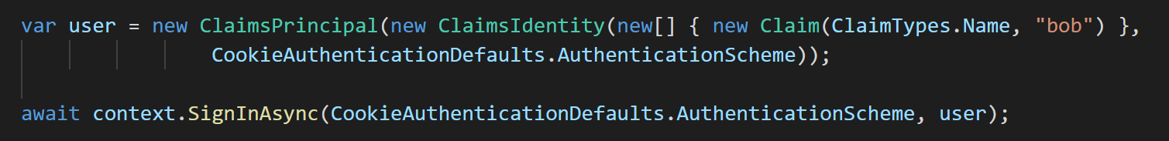
Creating an Identity

Slide 9
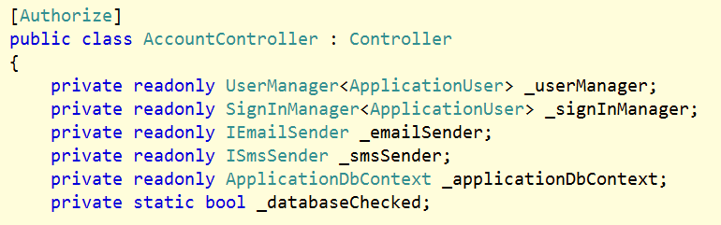
Authorize Attribute
Use to protect controllers, actions
Inverse is [AllowAnonymous]

Slide 10
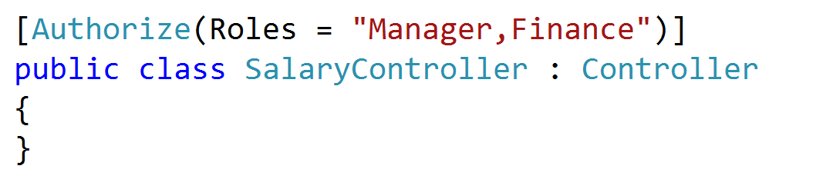
Authorization Roles
Checks IsInRole on ClaimsPrincipal

Slide 11
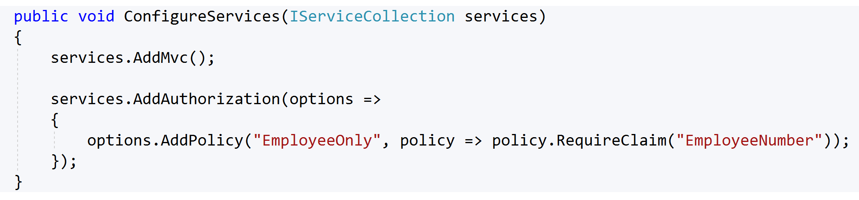
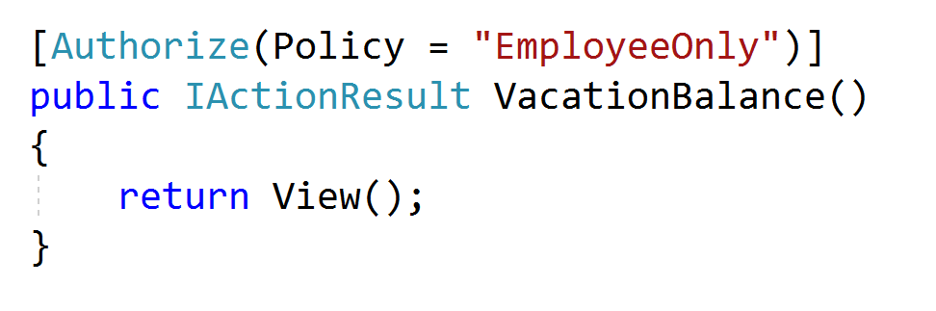
Authorization Claims

Slide 12
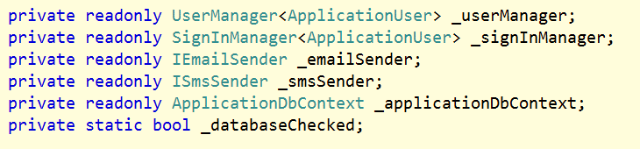
ASP.NET Identity
Supports local user accounts and federated logins
Builds on cookie authentication
Default implementation builds on EF
UI lives in a class library, but can scaffold

Slide 13
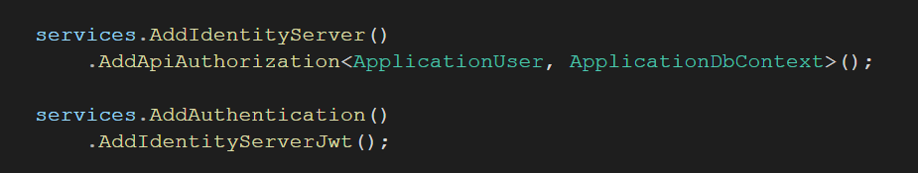
Identity Server

Slide 14
Summary
Three key abstractions
Middleware
ClaimsPrincipal
AuthenticationManager

