Slide 1





Working on the Client

Slide 2
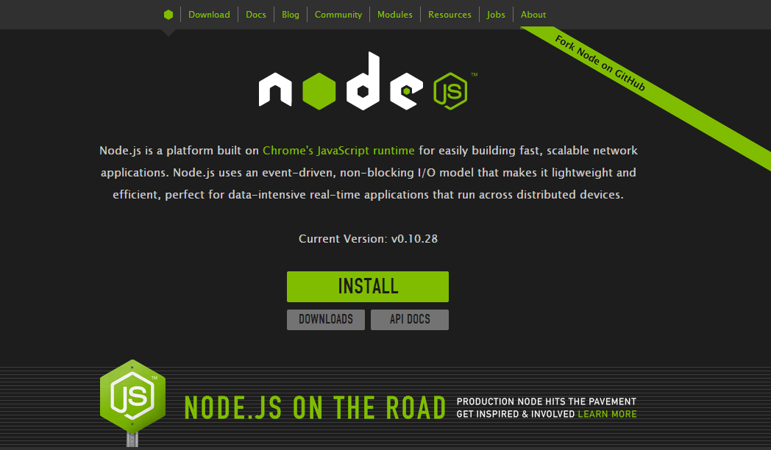

Slide 3
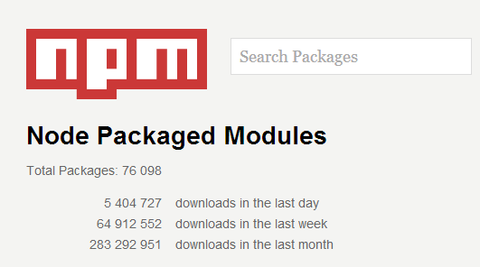
Package Management: npm
npm is the gateway to other tools
yarn is the new npm

Slide 4
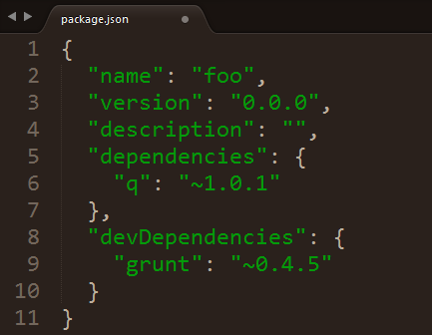
npm help
npm init
npm install <package> --save
npm install <packge> --save-dev
npm install
npm update

Slide 5
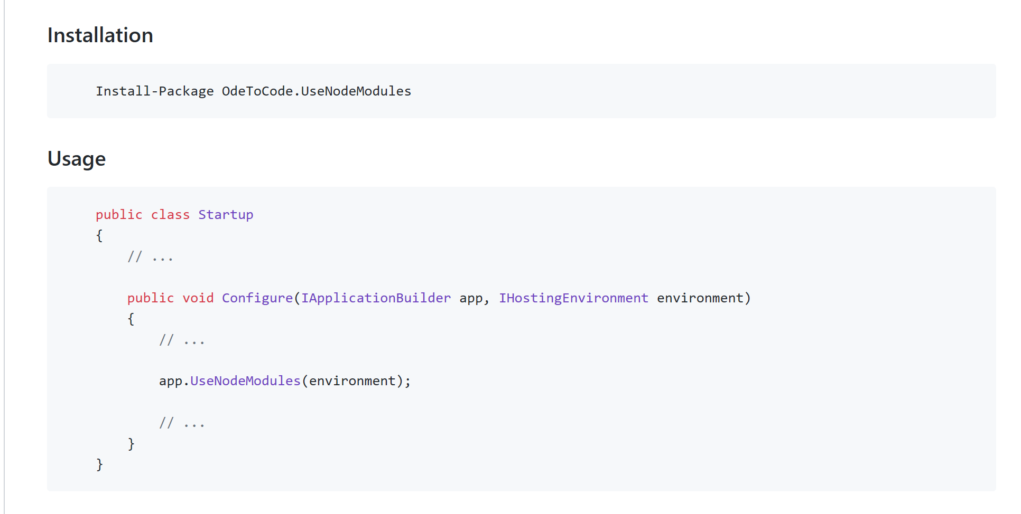
Using Files from node_modules

Slide 6
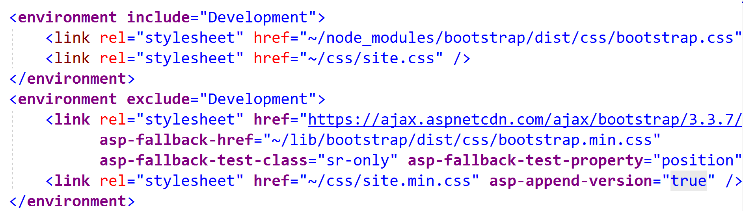
Serving Files

Slide 7
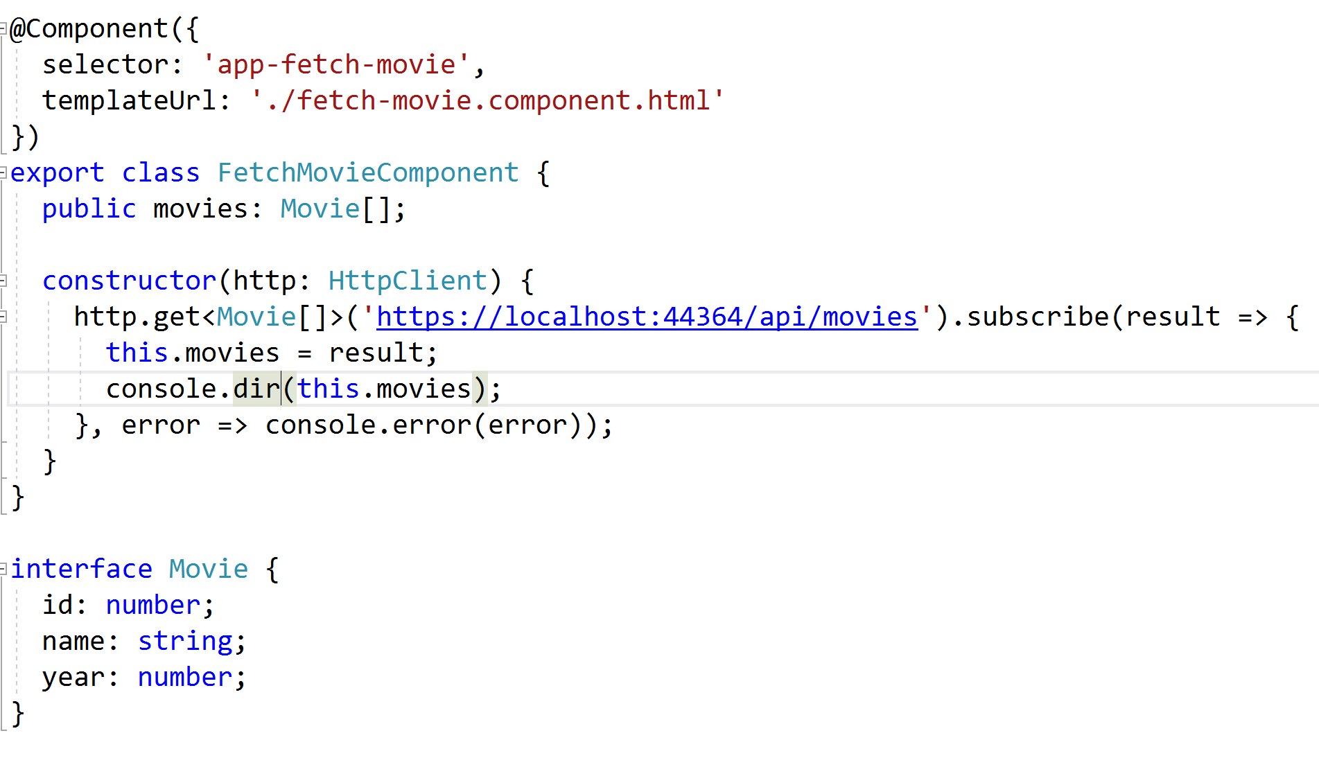
ASP.NET and Angular / Redux / Blazor

Slide 8
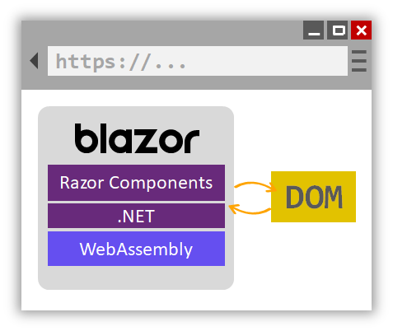
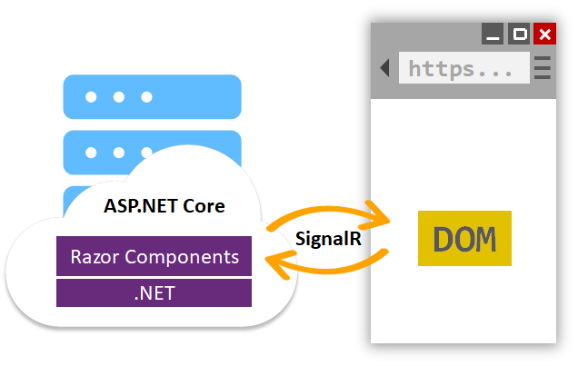
Blazor
Full Stack C# Programming

Slide 9
Summary

