Slide 1
Configuration
App Settings and More

Slide 2
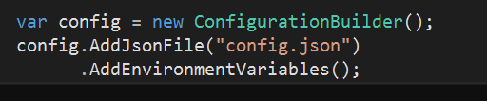
Runtime Configuration
Configuration set before Startup, typically
Many possible sources
JSON files
INI files
Environment variables
Command line parameters
Azure Key Vault
Other providers

Slide 3

Configuration Is Key => Value
Drill into hierarchy using : symbol
Keys are case-insensitive
For arrays, you can use binding (see later)

Slide 4
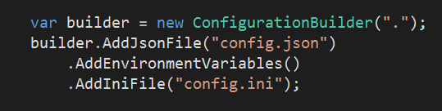
Configuration Override
Last entry wins

Slide 5
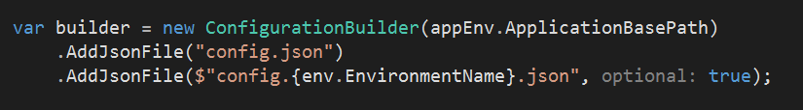
Using the Environment
ASP.NET Core looks for ASPNETCORE_ENVIRONMENT env variable
Default is production
Add files with names corresponding to environment

Slide 6
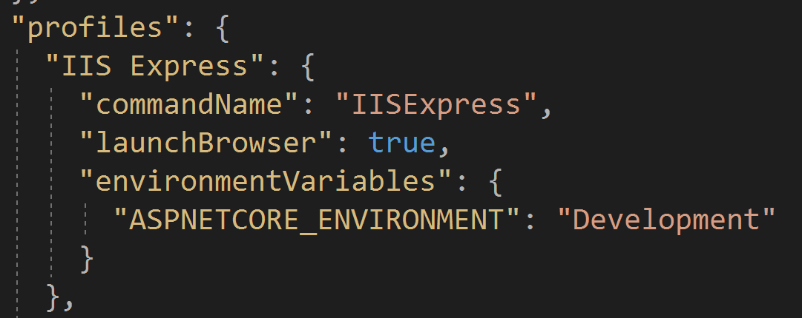
launchsettings.json
Gives tools different profiles to use
Visual Studio
VS Code / dotnet run

Slide 7
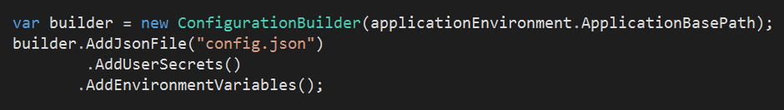
User Secrets
Secrets stored in user home directory
Manage from Visual Studio or user-secrets CLI
Allows protected configuration outside of source control

Slide 8
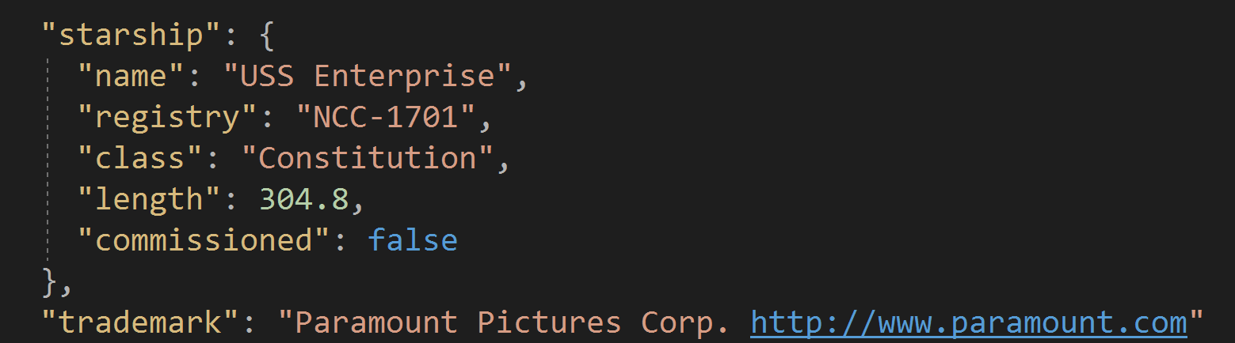
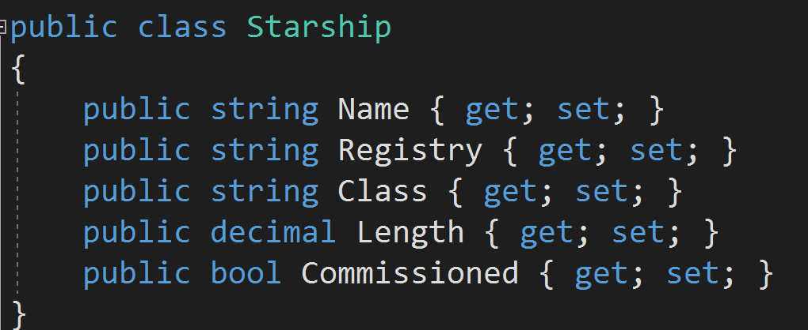
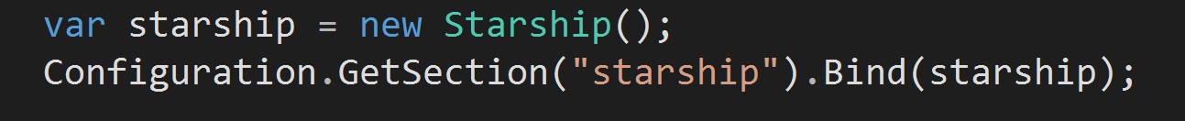
Binding Configuration

Slide 9
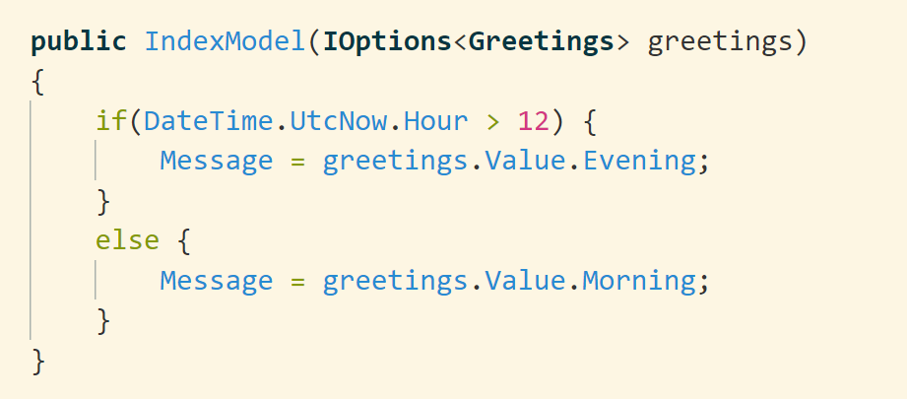
Configuration as a Service

Slide 10
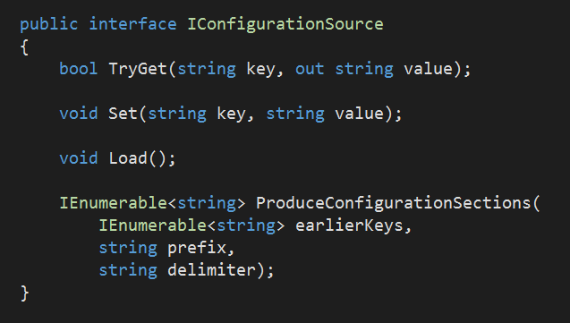
Custom Configuration Providers
Implement IConfigurationSource
Load, Set, TryGet
Or, inherit from ConfigurationSource

Slide 11
Summary
Configuration and Dependency Injection (next) work together
Many options for flexibility and extensibility

