Slide 1
ASP.NET Core Controllers
C is for Controller

Slide 2
MVC – The Pattern
Controller
Model
View
Notes:
Routing has other uses outside of ASP.NET MVC

Slide 3
The Faces of ASP.NET Core
MVC Framework
Controllers
(for APIs)
Razor Pages
(for HTML)
SignalR
(for Realtime)
gRPC
(for APIs)

Slide 4
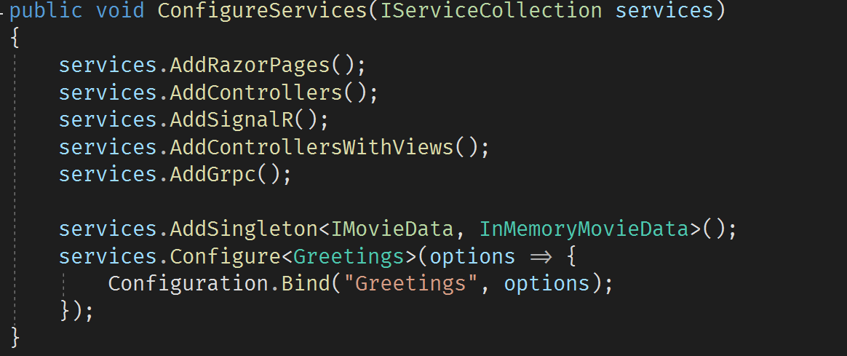
Setup
Most frameworks require services
And then some middleware

Slide 5
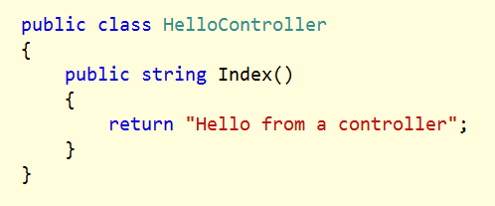
Controllers
Can be POCOs with a Controller name suffix
Or, derive from Controller base class
Public methods are actions

Slide 6
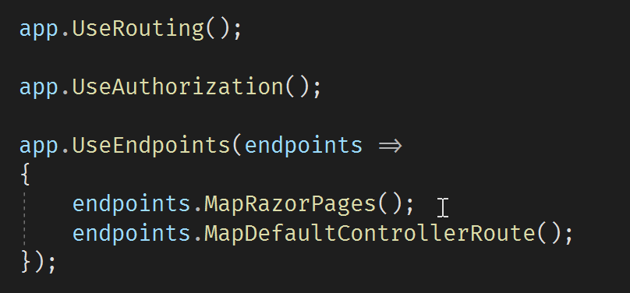
Routing and Endpoints
Routing determines where to go
Endpoints will send the request to destination

Slide 7
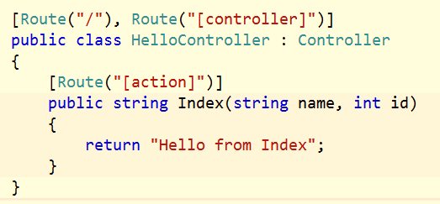
Routing with Attributes
Sets routing rules inline with a controller
Use [controller] and [action] tokens

Slide 8
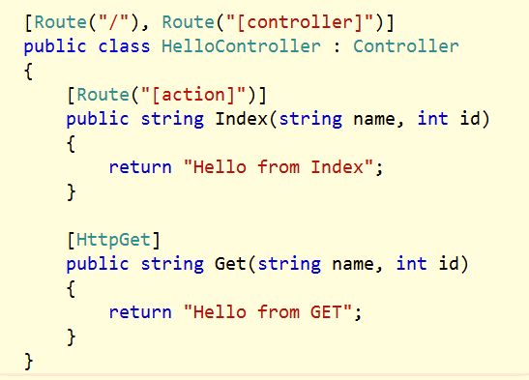
Verb Routing versus Named Actions
Routing works with actions and API style routing

Slide 9
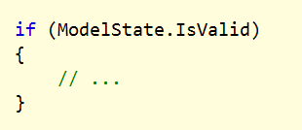
Controller Base Class
Provides access to HTTP context, current user, request, response
Provides IActionResult helpers

Slide 10
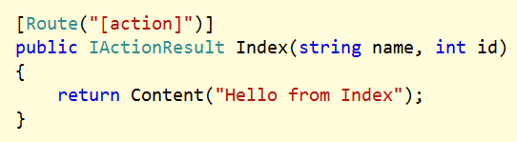
Action Results
IHttpActionResult encapsulates controller decision
Execution of result is later in the MVC pipeline

Slide 11
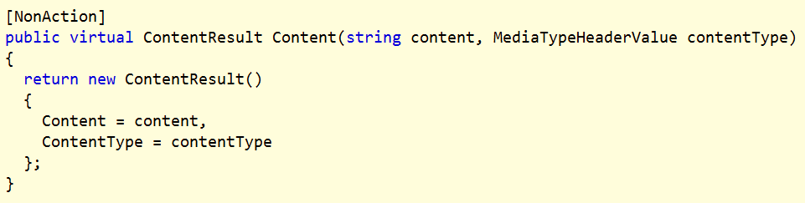
Action Result Helpers
Controller base class provides convenience methods
Created, HttpNotFound, Redirect, and more

Slide 12
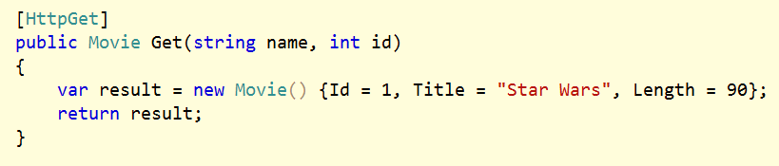
Content Negotiation
Default format is JSON
XML formatter not included by default

Slide 13
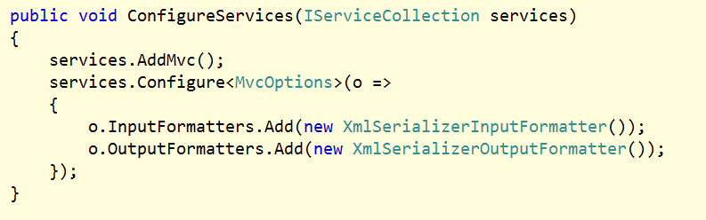
MVC Options
Configure in ConfigureServices

Slide 14
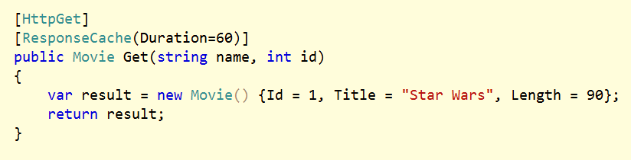
Action Filters
Filters work on actions, controllers, and globally

Slide 15
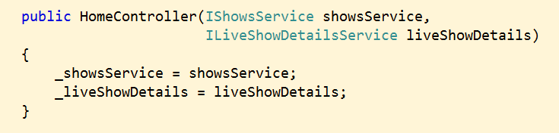
Dependency Injection
Controller and filters can all use constructor injection

Slide 16
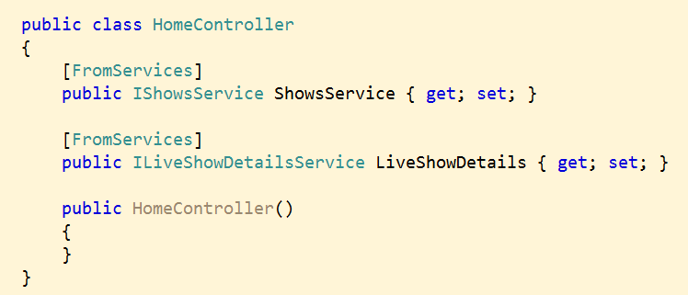
[FromServices]
Attribute allows binding on properties
Even works with model objects

Slide 17
Summary
Controller
Model
View

