Slide 1
ASP.NET Core Deployment
dotnet publish

Slide 2
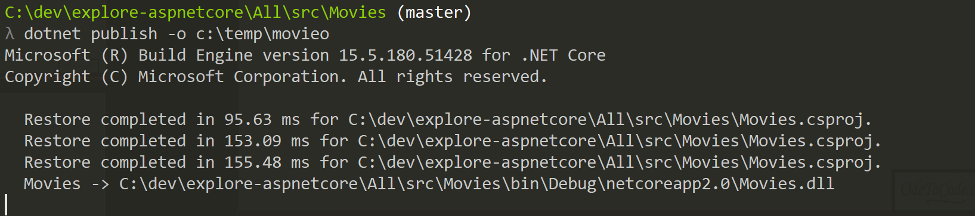
dotnet publish

Slide 3
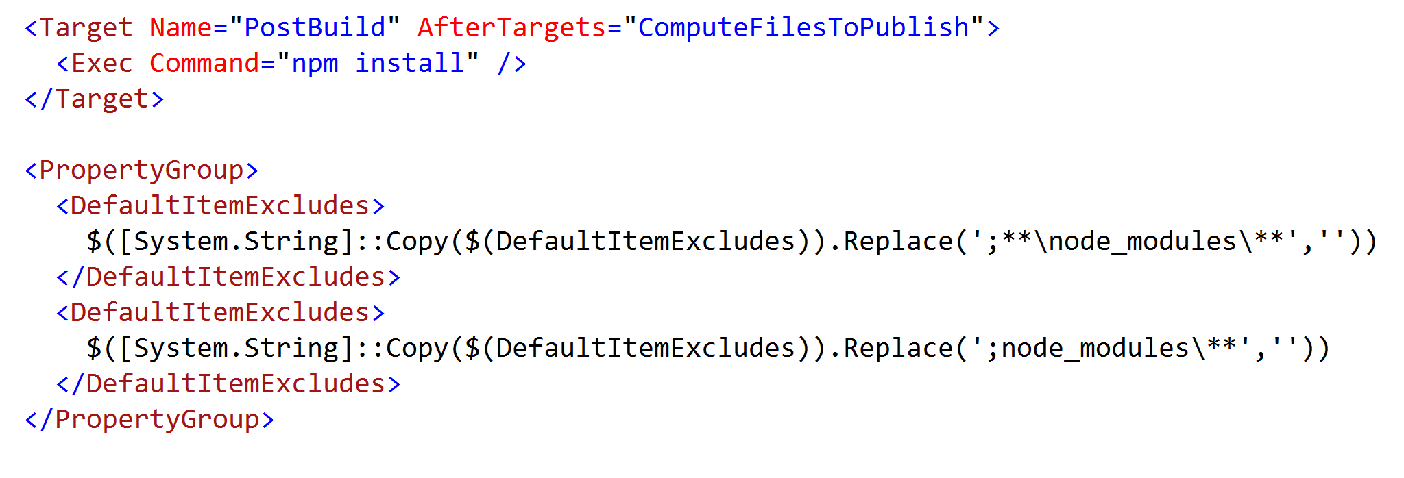
Powered by MSBuild

Slide 4
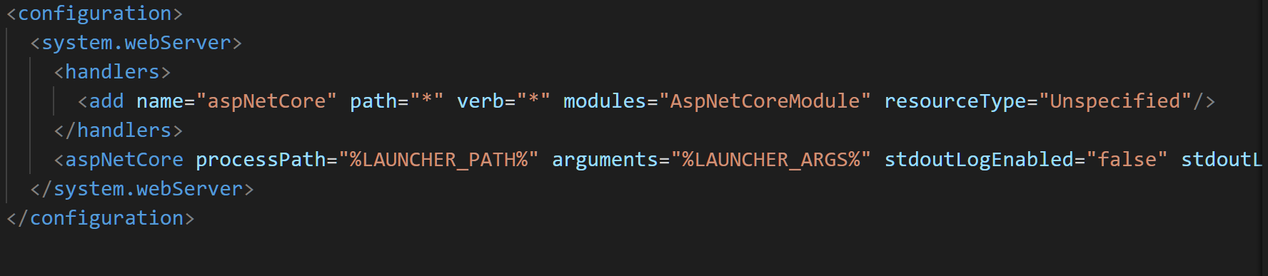
Web.config for IIS

Slide 5
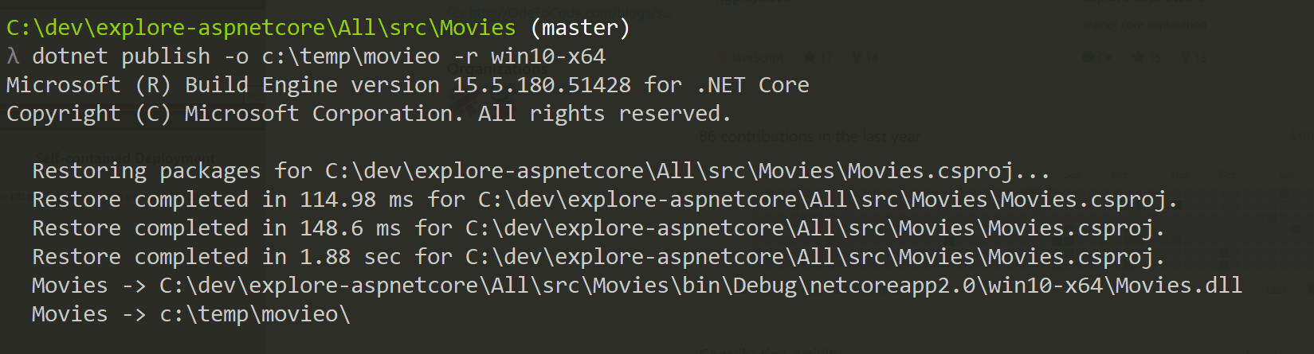
Self-contained Deployment
All the bits needed to run the app are in one directory

Slide 6
Summary

