Slide 1
Configuration
App Settings and More

Slide 2
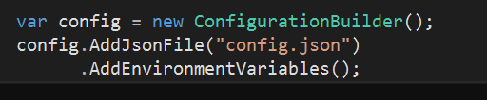
Runtime Configuration
Configuration set before Startup, typically
Many possible sources
JSON files
INI files
Environment variables
Command line parameters
Azure Key Vault
Other providers

Slide 3

Configuration Is Key => Value
Drill into hierarchy using : symbol
Keys are case-insensitive
For arrays, you can use binding (see later)

Slide 4
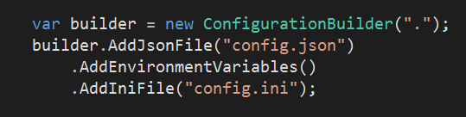
Configuration Override
Last entry wins

Slide 5
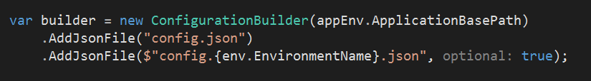
Using the Environment
ASP.NET Core looks for ASPNETCORE_ENVIRONMENT env variable
Default is production
Add files with names corresponding to environment

Slide 6
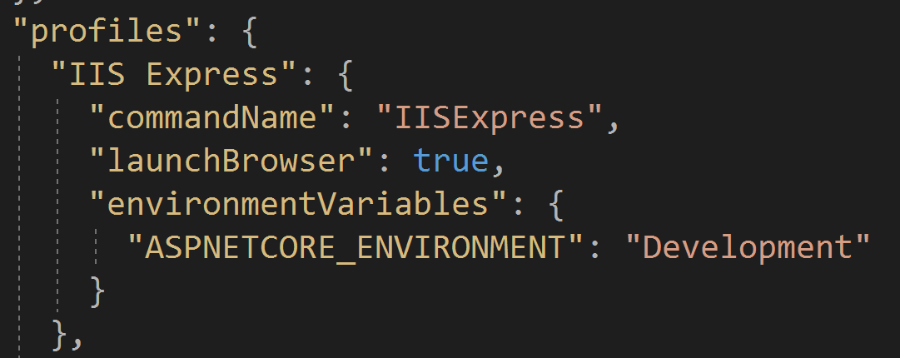
launchsettings.json
Gives tools different profiles to use
Visual Studio
VS Code / dotnet run

Slide 7
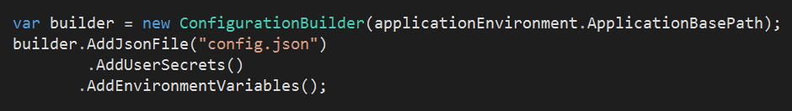
User Secrets
Secrets stored in user home directory
Manage from Visual Studio or user-secrets CLI
Allows protected configuration outside of source control

Slide 8
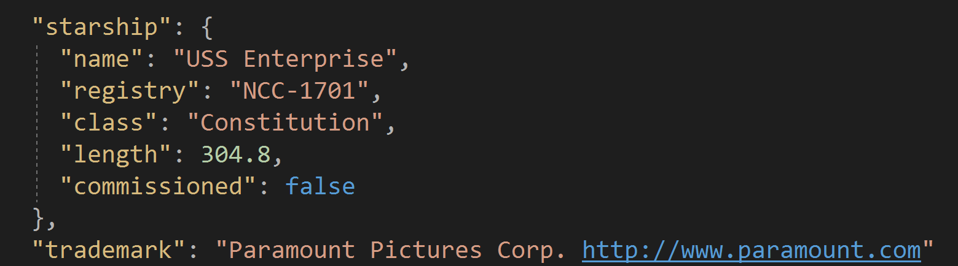
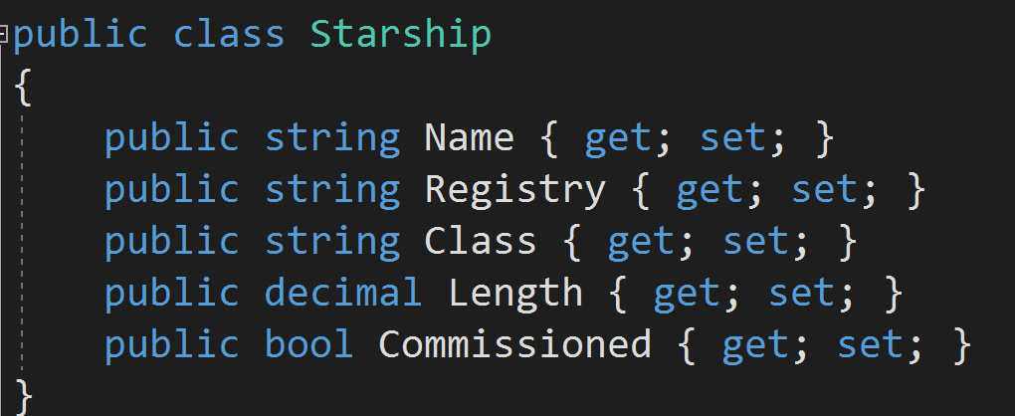
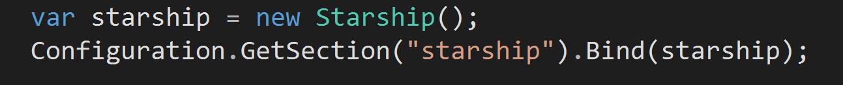
Binding Configuration

Slide 9
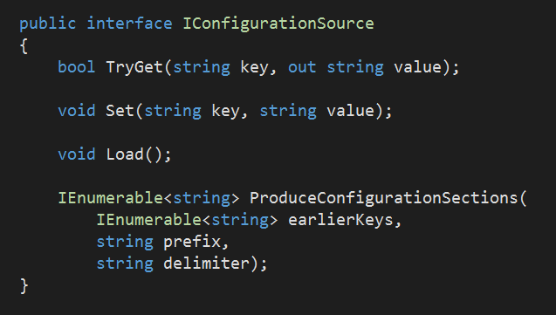
Custom Configuration Providers
Implement IConfigurationSource
Load, Set, TryGet
Or, inherit from ConfigurationSource

Slide 10
Summary
Configuration and Dependency Injection (next) work together
Many options for flexibility and extensibility

