Slide 1
.NET Core
New framework - familiar platform

Slide 2

.NET Reboot

Slide 3
.NET Today
.NET
FRAMEWORK
.NET
CORE
XAMARIN
Windows
Windows
Linux
macOS
x86, x64, ARM
MOBILE
APPS

Slide 4






.NET Core
Fast
Cross-platform
Lightweight
Open Source
Compatible
Tools

Slide 5
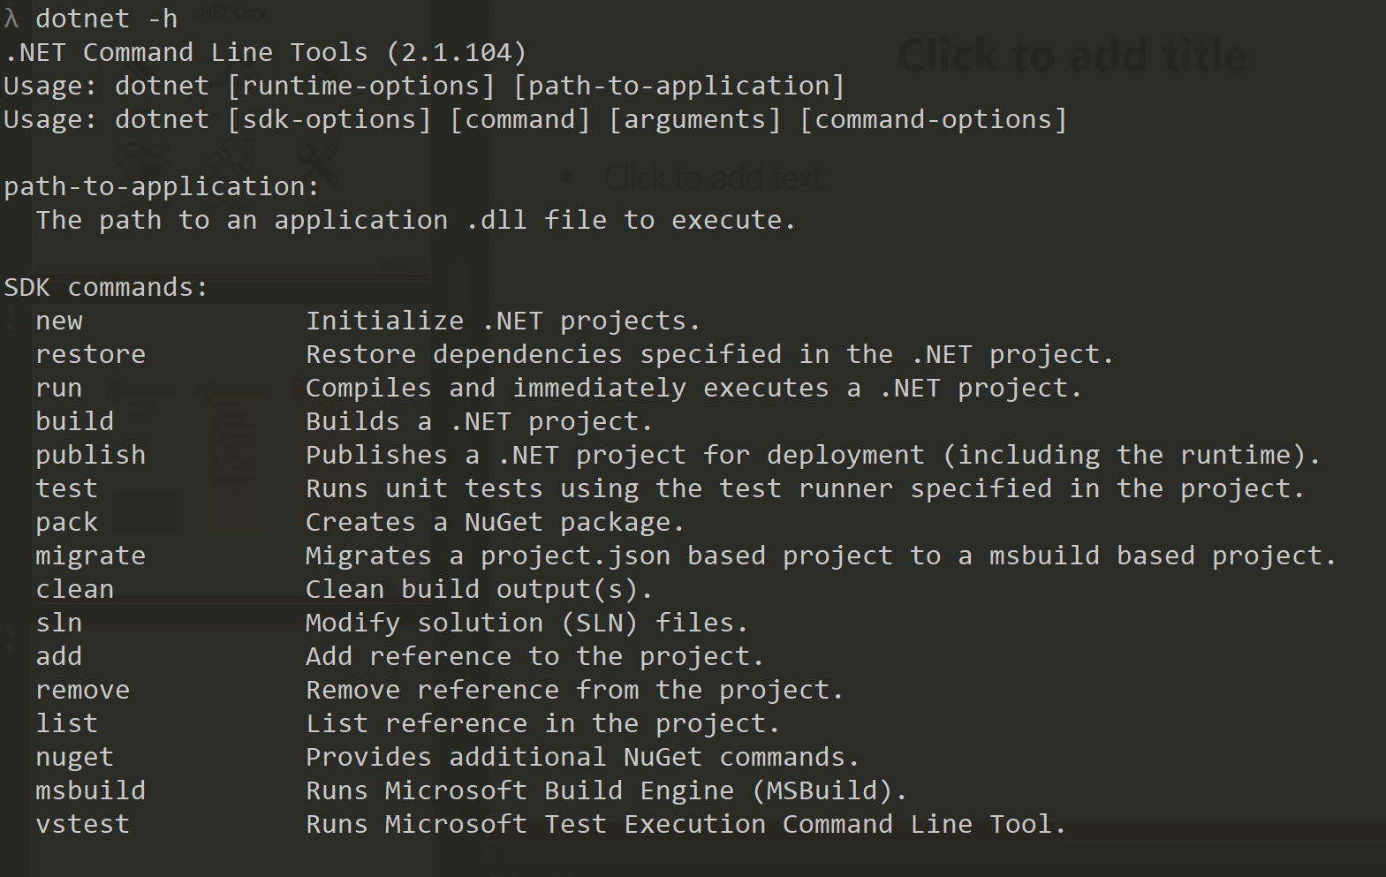
dotnet CLI

Slide 6
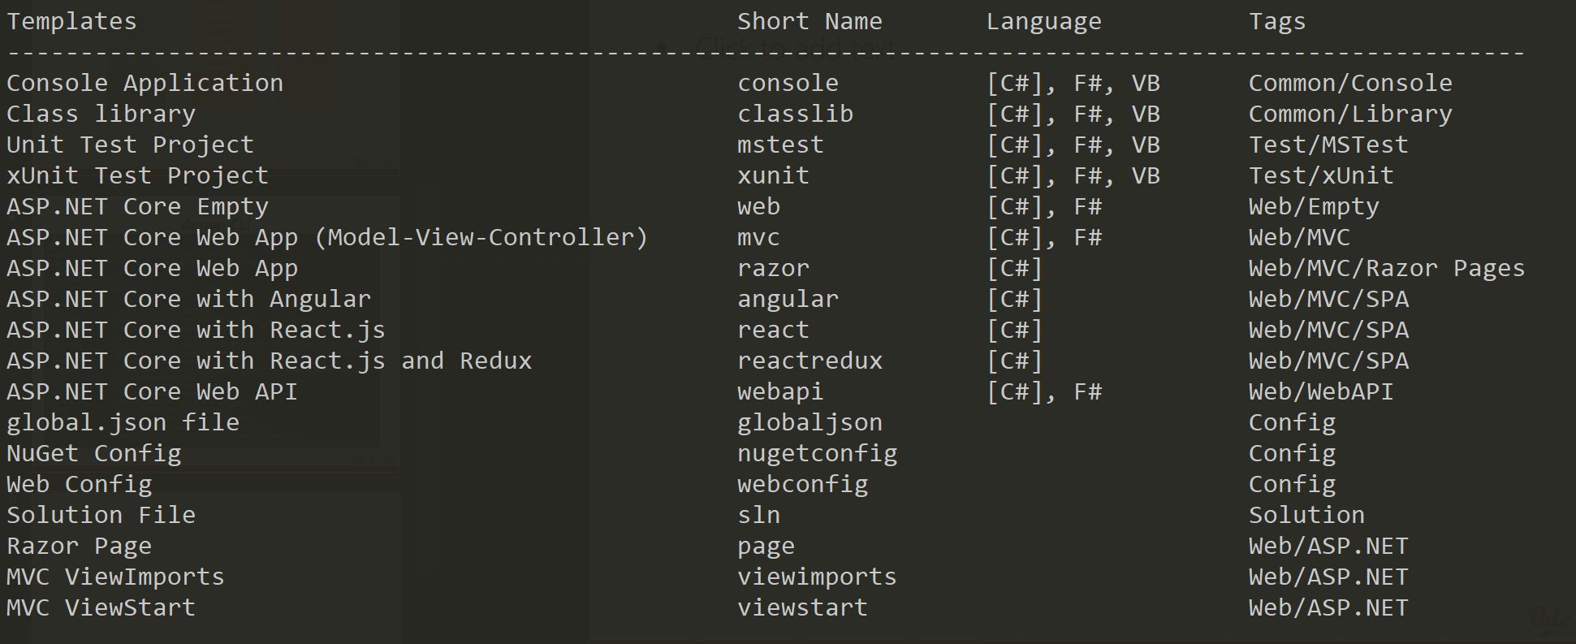
dotnet new

Slide 7
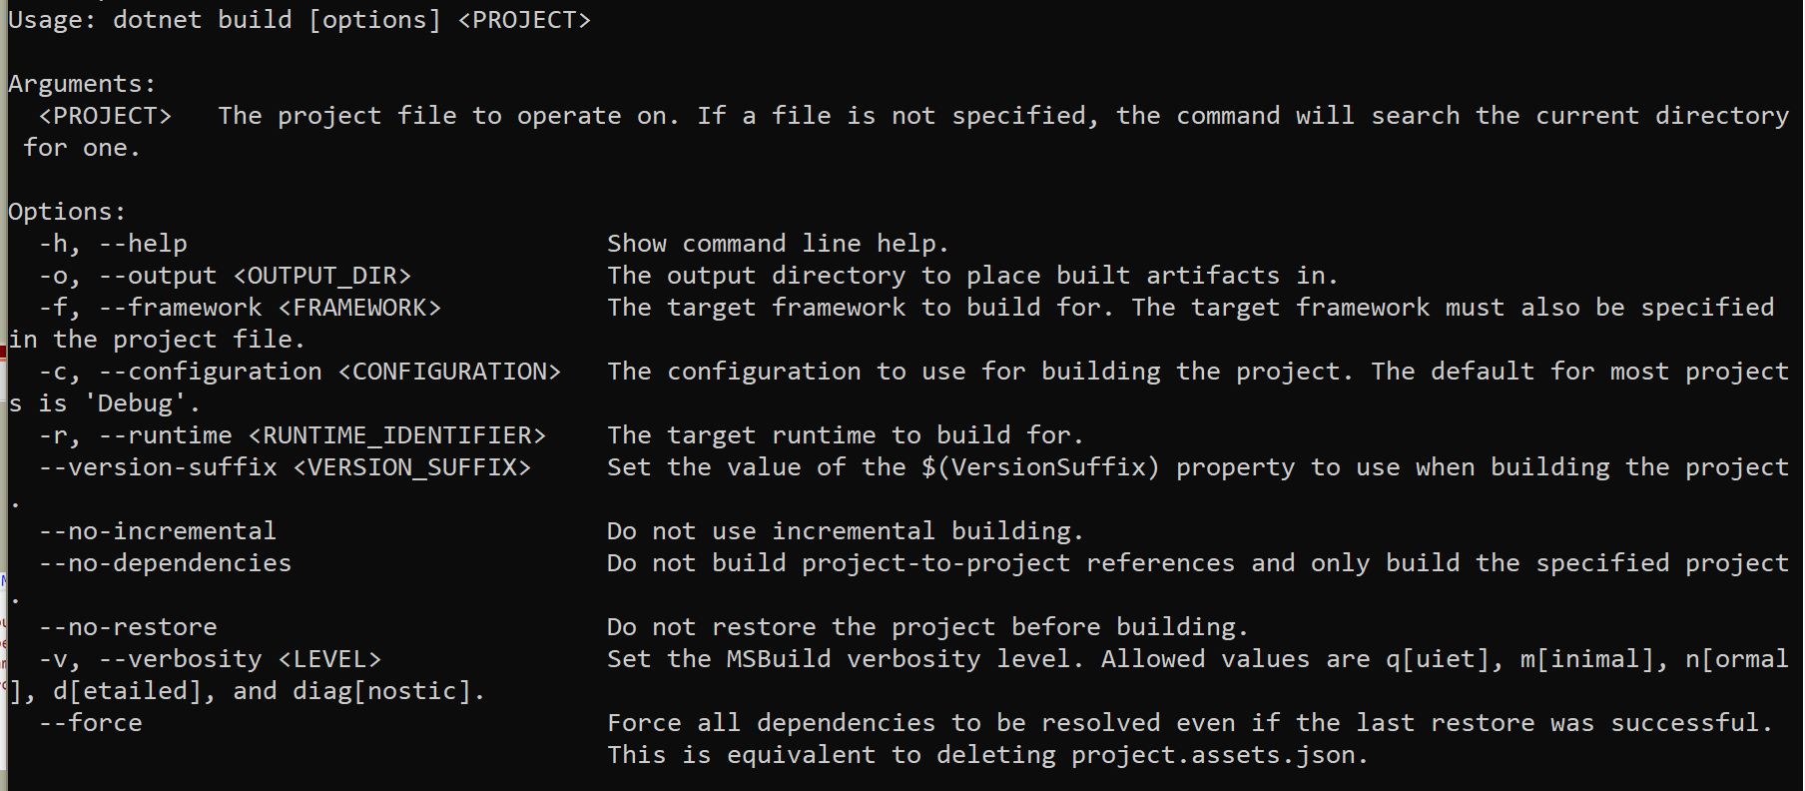
dotnet build

Slide 8
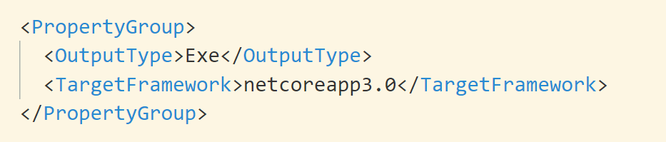
TFM

Slide 9
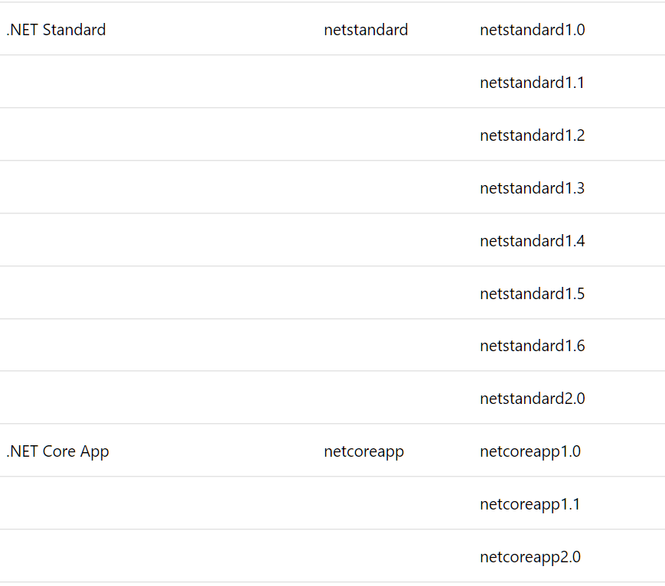
Target Framework Monikers

Slide 10
Compatibility with .NET Standard
.NET
FRAMEWORK
.NET
CORE
XAMARIN
WINDOWS
APPS
X-PLAT
APPS & SERVICES
MOBILE
APPS
.NET STANDARD

Slide 11
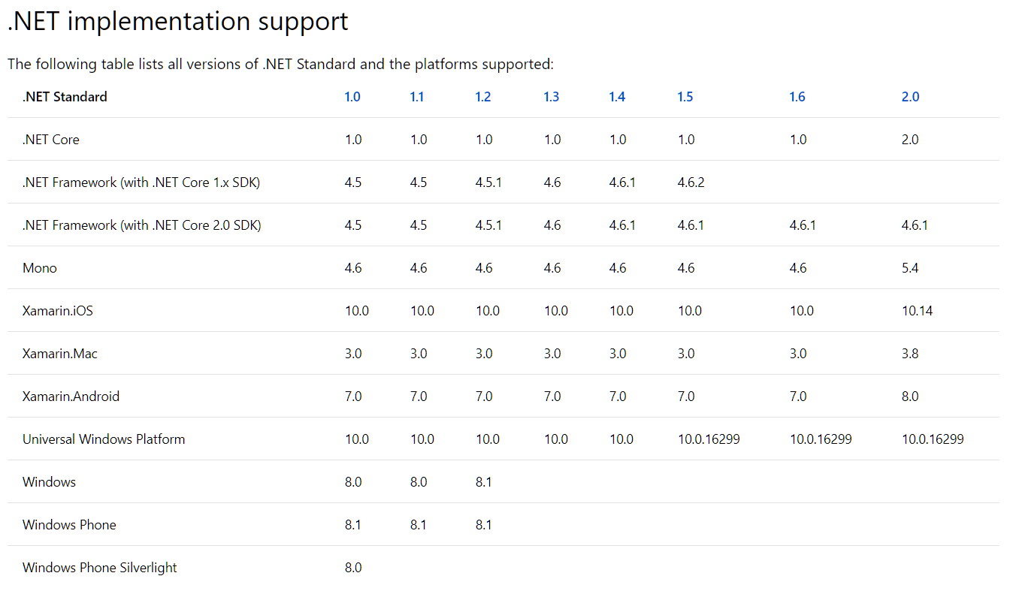
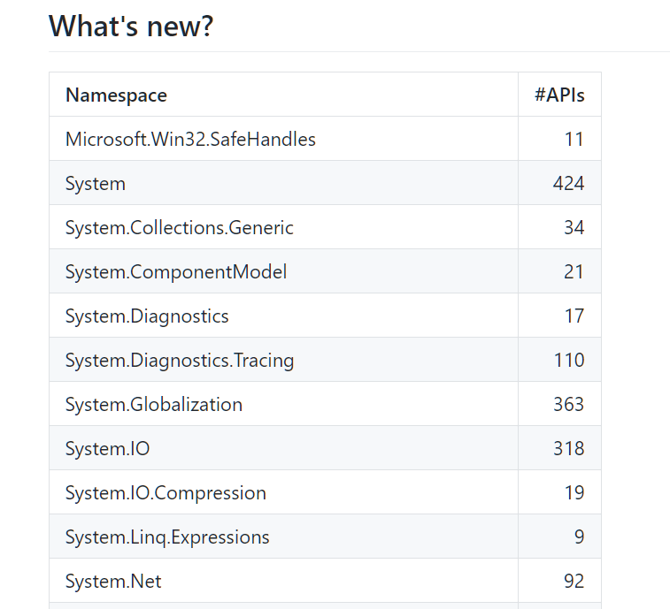

Slide 12
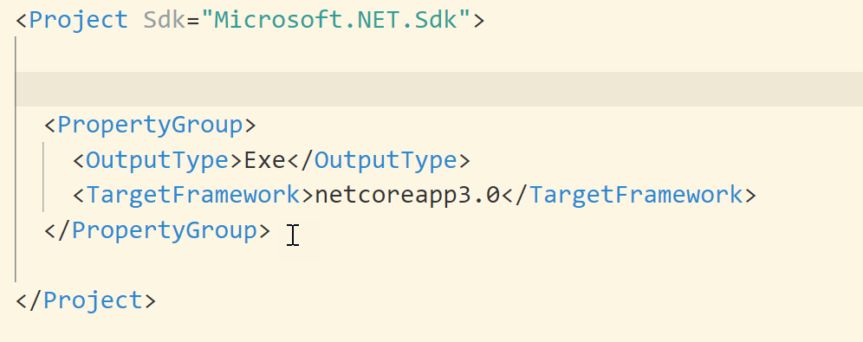
SDKs, Packages, Metapackages

Slide 13
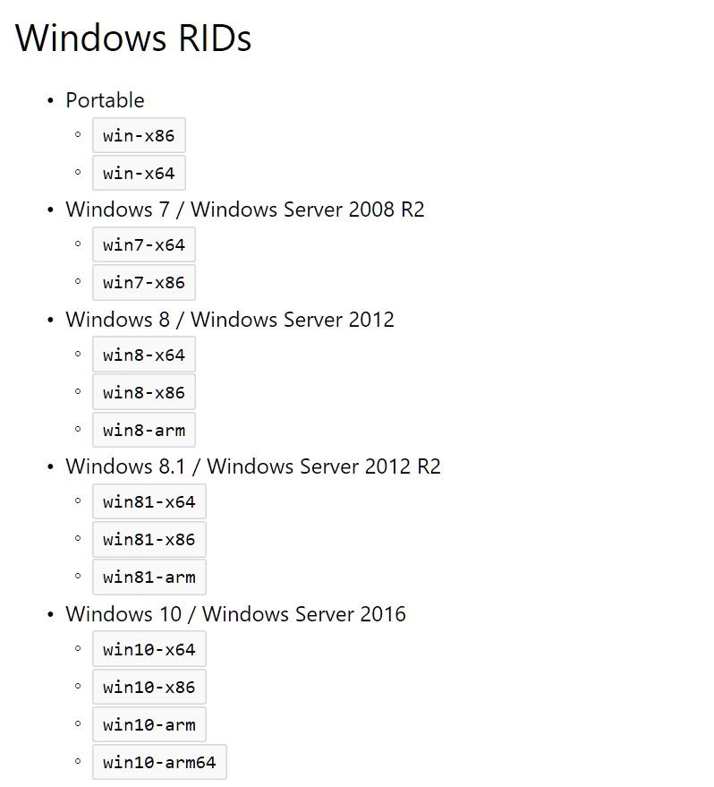
dotnet publish
Can create self-contained app

Slide 14
Summary

