Slide 1
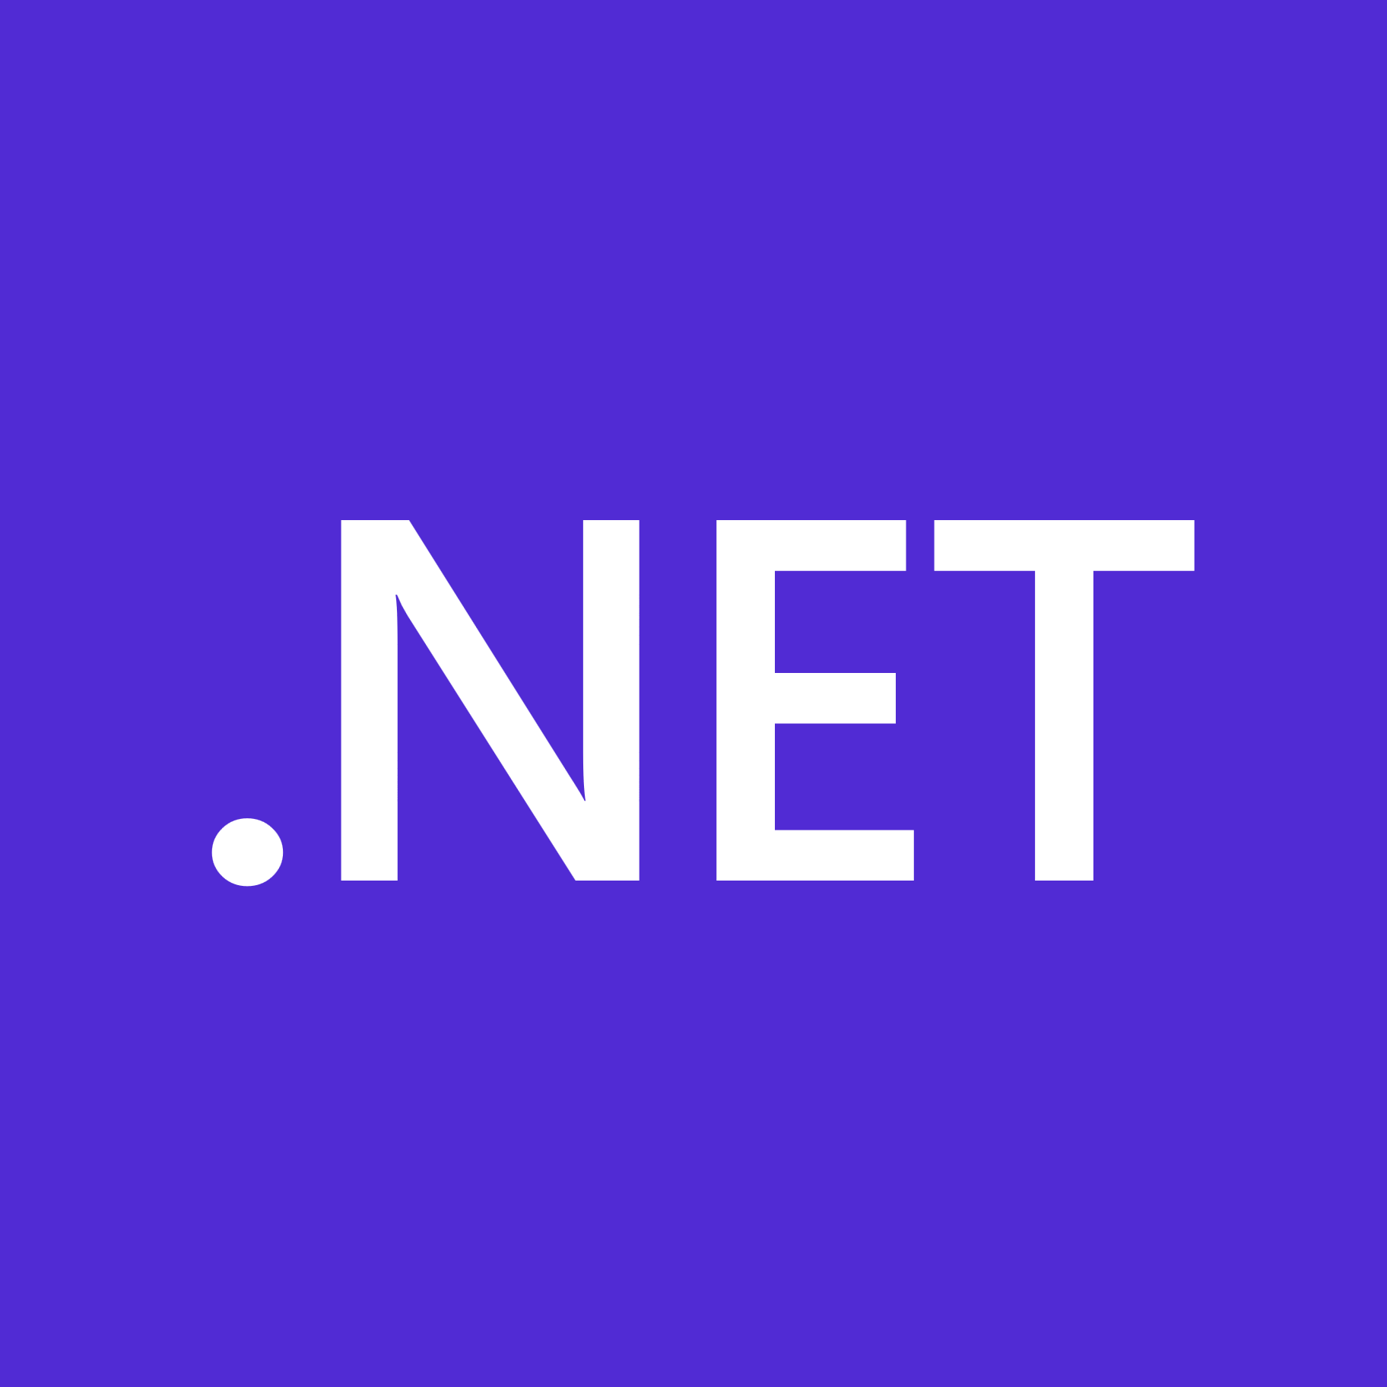
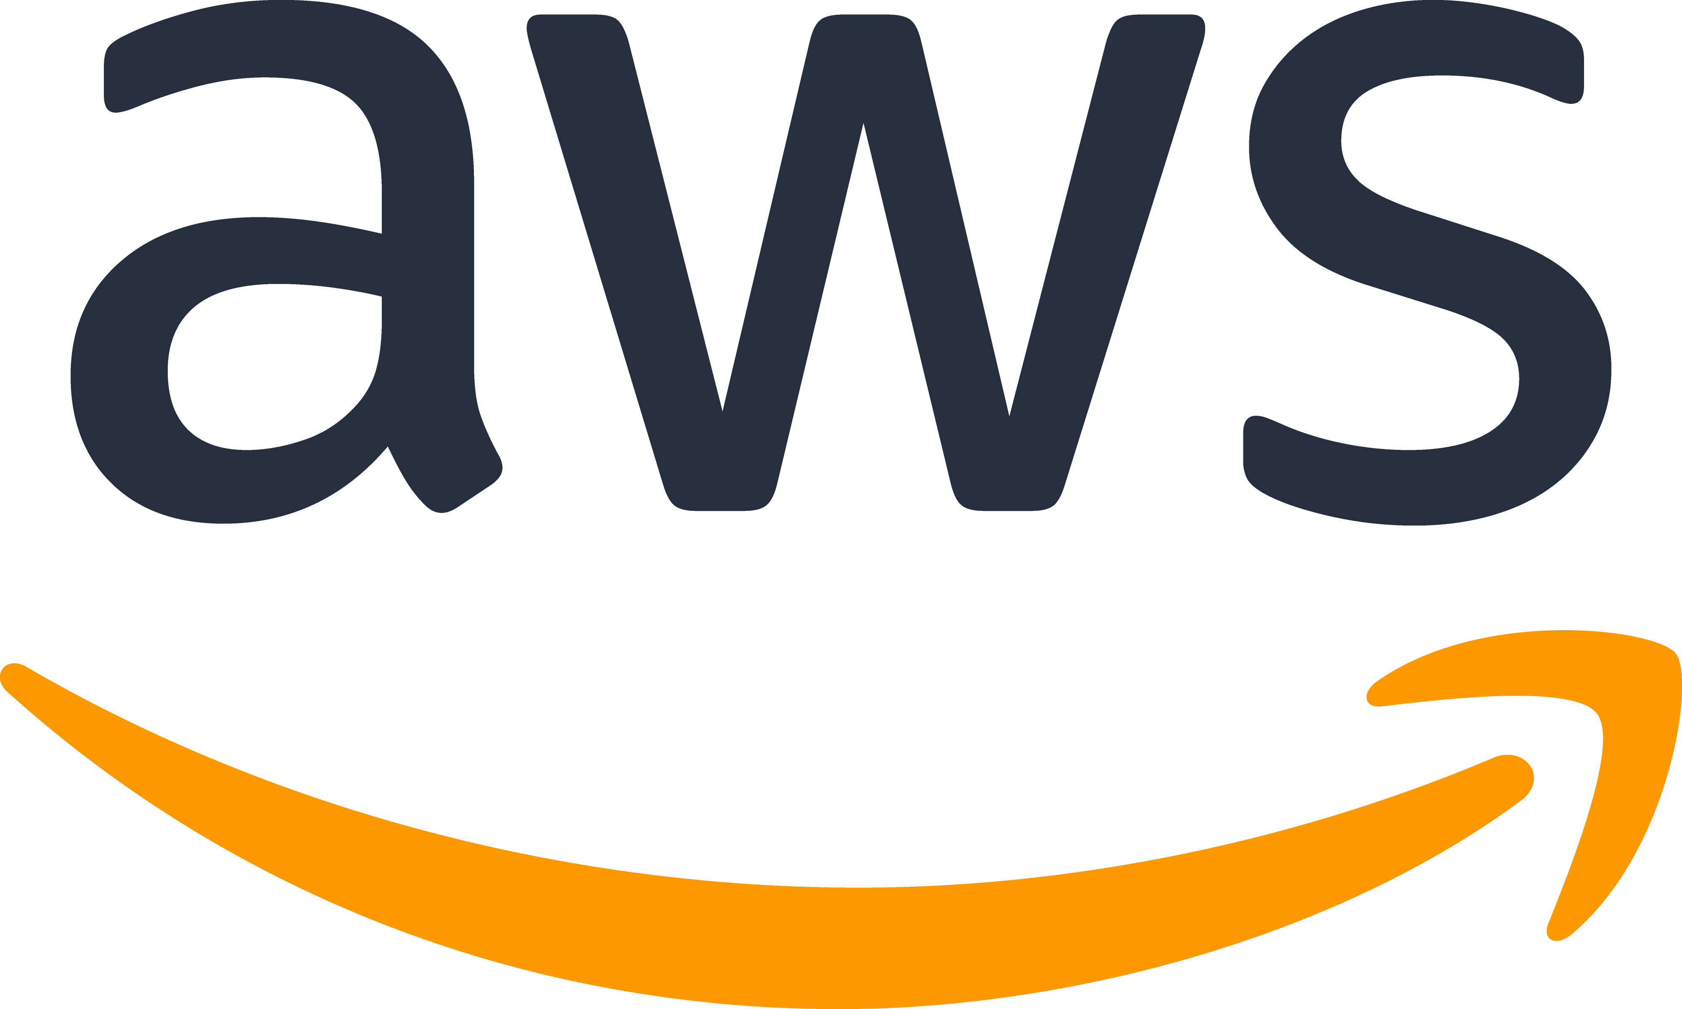
.NET on AWS
Wait you can do that?
Notes:
Good afternoon y’all, welcome to this session titled .NET on AWS, where we’ll answer the question
<CLICK>
Wait, you can do that?
Yes, Virginia, not only is there a Santa Claus, but you also run .NET workloads on AWS. In fact, there are MULTIPLE ways and we’re going to highlight some of them in our time together this afternoon.
[LEAD IN]
Now if you’re anything like I was a few years ago, AWS wouldn’t have been my first choice in cloud providers for .NET. It would probably been this one… Microsoft Azure
<CLICK>

Slide 2
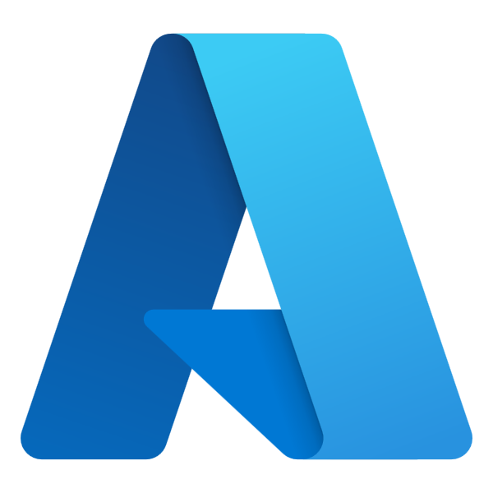
Notes:
What’s interesting, is at the time, I had the same experience with Azure, that I did with AWS…. Zero. So why didn’t I think of AWS first? Simple, brand recognition. If .NET is from Microsoft, then the cloud provider from the same company has to be the best choice, right? It has to be better optimized for .NET, doesn’t it? It just makes sense.
At a previous employer we were making our first foray into the cloud. The higher ups were deciding on which cloud basket to put all of our eggs. The tech folks had our assumptions, and preferences, as to who would be crowned winner.
However, <CLICK> this is what we got instead

Slide 3
Notes:
What are we supposed to do with AWS? We’re a .NET shop, don’t the people above me understand that… and many other such things we uttered.
But there we were, the choice had been made… it was up to us to figure out how to make it work. And make it work we did…
This is the talk I wish I could’ve attended as we started our AWS journey…
My name is Brad Knowles, and while that story was my real experience from a previous employer, I’m currently a Cloud Application Architect with AWS Professional Services where I focus on helping .NET customer use AWS to it’s fullest.
[LEAD IN]
Let’s dive in…

Slide 4
Agenda
Brief History of .NET
Popular AWS Services
Infrastructure as Code
Service Landscap
Notes:
Service Landscap
Brief History of .NET
Popular AWS Services
Infrastructure as Code

Slide 5
AWS Services
Notes:
At the moment, AWS has over 200 services. Now we call everything a service, but not all of the “services” are things that can contain your application code. For example, CloudWatch, Identity and Access Management, Key Management Service, etc. Those are counted in that 200+ number, but it’s not something you can deploy to.

Slide 6


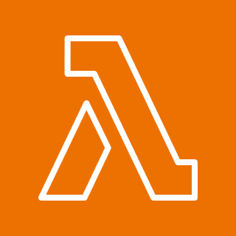







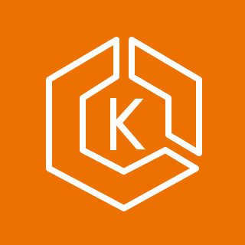
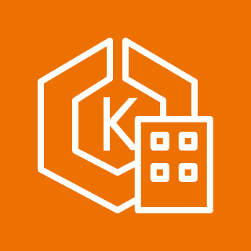
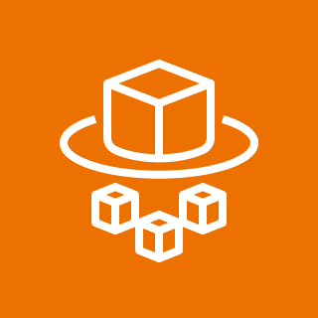




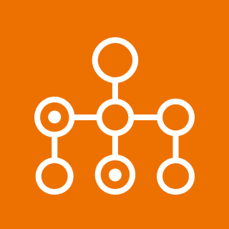


Amazon Elastic Compute Cloud (Amazon EC2)
AWS Elastic Beanstalk
AWS Lambda
Amazon Lightsail
Amazon Lightsail for Research
AWS App Runner
AWS Serverless Application Repository
Amazon Elastic Container Registry (Amazon ECR)
Amazon Elastic Container Service (Amazon ECS)
Amazon ECS Anywhere
Amazon Elastic Kubernetes Service (Amazon EKS)
Amazon EKS Anywhere
AWS Fargate
AWS Outposts family
AWS Outposts rack
AWS Outposts servers
AWS Nitro Enclaves
AWS Batch
Red Hat OpenShift Service on AWS (ROSA)
AWS Local Zones
Notes:
On this slide is 20 of the services in the “compute” category. All of this accept user deployed code. There’s even a few I’ve probably missed, but you get the idea.
You see the usual suspects, Elastic Compute Cloud, which are virtual machines, AWS Lambda, our “serverless” offering. We have container options, actually we have several container options. Amazon Elastic Container Service and Amazon Elastic Kubernetes Service, each with their own serverless node platforms called “Fargate” as well, and a few you’ve probably never heard of, that’s OK.
On the next slide, I’ll show you which of these can run .NET workloads.

Slide 7
Amazon Elastic Compute Cloud (Amazon EC2)
AWS Elastic Beanstalk
AWS Lambda
Amazon Lightsail
Amazon Lightsail for Research
AWS App Runner
AWS Serverless Application Repository
Amazon Elastic Container Registry (Amazon ECR)
Amazon Elastic Container Service (Amazon ECS)
Amazon ECS Anywhere
Amazon Elastic Kubernetes Service (Amazon EKS)
Amazon EKS Anywhere
AWS Fargate
AWS Outposts family
AWS Outposts rack
AWS Outposts servers
AWS Nitro Enclaves
AWS Batch
Red Hat OpenShift Service on AWS (ROSA)
AWS Local Zones

Slide 8


Slide 9
Amazon Elastic Compute Cloud (Amazon EC2)
AWS Elastic Beanstalk
AWS Lambda
Amazon Lightsail
Amazon Lightsail for Research
AWS App Runner
AWS Serverless Application Repository
Amazon Elastic Container Registry (Amazon ECR)
Amazon Elastic Container Service (Amazon ECS)
Amazon ECS Anywhere
Amazon Elastic Kubernetes Service (Amazon EKS)
Amazon EKS Anywhere
AWS Fargate
AWS Outposts family
AWS Outposts rack
AWS Outposts servers
AWS Nitro Enclaves
AWS Batch
Red Hat OpenShift Service on AWS (ROSA)
AWS Local Zones
Notes:
That’s right, all of these services can run .NET workloads… every single one of them. Now you may not be able to run EVERY type of workload on each service, some are tailor-made for certain situations, but they all have the capability of running a .NET based workload.
How is this possible? I would love to say it’s solely from the hard work of AWS engineers. While that’s true, it takes a lot of talented people to build and maintain these services, I believe a large amount of credit belongs to how .NET itself has evolved over the last several years.

Slide 10
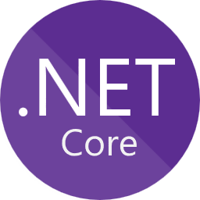
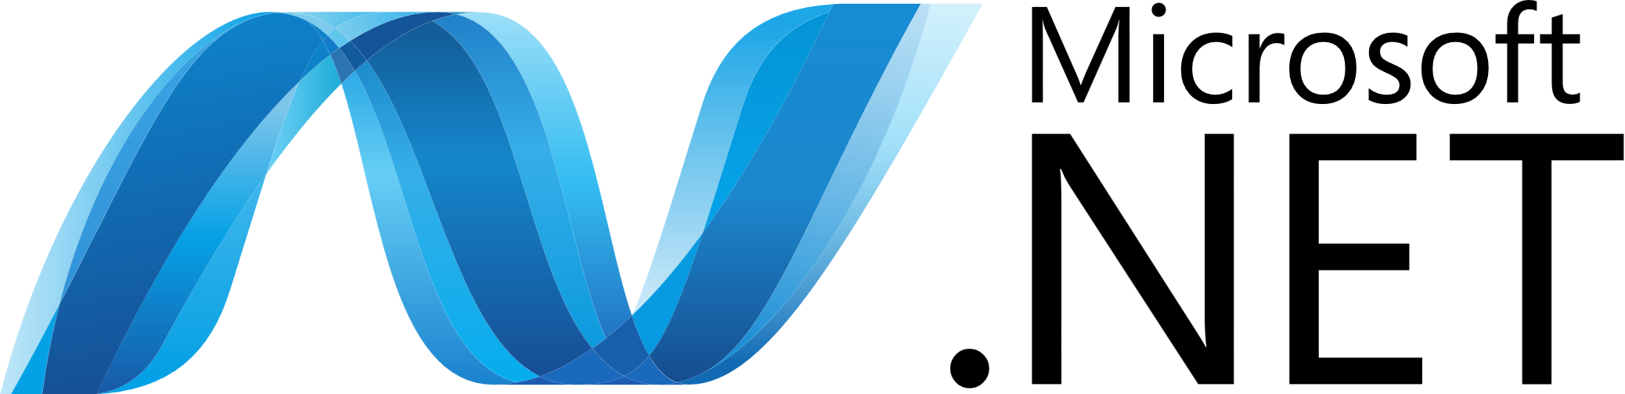
History of .NET
Notes:
So, before we delve into specific AWS services, we must talk about that evolution. I believe without this strategic shift from Microsoft, a lot of what we’ll be talking about wouldn’t be possible. Or at the very least, would be much more difficult.

Slide 11
Notes:
In the beginning, or if you prefer, “A long time ago in a galaxy far, far away…” There was a single .NET Framework, and it was just called Microsoft .NET.

Slide 12
Amazon EC2
Launched in 2002 (22 years ago)
Windows Only
Proprietary
Notes:
It was released January 15, 2002, which means on Monday, .NET will be 22 years old. It only ran on Windows and was closed source. While open source was a thing, this was before git was created, much less, GitHub, so it was not as mainstream then.
There was always a promise “this could be run on multiple platforms” but it never really materialized. The most famous community driven attempt is Mono, and is still in use today. If I’m not mistaken, the game developer platform Unity uses it for their scripting API.
.NET Framework served us well for many years, but technology changes quickly…

Slide 13
Notes:
Enter .NET Core
.NET Core represented a radical shift in Microsoft’s thinking about the future of .NET, for the better.

Slide 14
Amazon EC2
Launched in 2016 (7.5 years ago)
Cross Platform
Open Source
Flexible Deployments
Command-line Tools
Notes:
Launched in 2016 (7.5 years ago)
Cross Platform
It was the first time in history this promised was fulfilled from Microsoft directly
You could now run .NET on Windows, Mac, and Linux, natively…. 100% supported by Microsoft
This, to me, is the key to make everything we talk about today work as well as it does.
Flexible Deployments
Before, the right version had to already be deployed on the Windows machine, there was lots of versions to keep in sync etc. Now, you could bundle the Runtime with your app for self-contained deployments, or even run multiple versions of the runtime side by side without issues.
Command-line Tools
Streamlined CLI tools that make development and deployment easier. Especially with CI/CD pipelines
Open Source
Everything is now out in the open. Normal folks like you or I can contribute to .NET in ways that were not possible before.

Slide 16
Amazon EC2
Continued Updates
Launched Nov 2020 (3 years ago)
Unifies .NET Framework & .NET Core

Slide 17
Notes:
OK, Brad, this is getting confusing… now you’re saying I have 3 flavors of .NET to know about and choose from.
.NET Framework, .NET Core, and just .NET
Thankfully, no. This brings us to where we are today, .NET Framework and what I’m calling “Modern .NET” to differentiate it from the older Framework versions.
.NET Framework versions are anything below 5, and “Modern .NET” is 5 and up.

Slide 18
4.8.1
4.8
4.7.2
4.7.1
4.7
5.x – No Longer Supported
7.x – EOS May 14, 2024
8.x
Infinity and beyond…
6.x – EOS Nov 12, 2024
Notes:
This is the current landscape of .NET. .NET Framework is still around, but is no longer receiving new features, only security updates. If you’ve been in the space for a minute, you’ll notice the versions for Modern .NET are coming out more quickly than for .NET Framework. They also go out of support more quickly as well. We’re not going to dig into all that today, but be aware you’ll need to pay closer attention to release cycles than you did previously.
<CLICK>
These are the versions you should be targeting.
.NET 8 should be your first choice. If you’re already on the .NET stack, anything 5.0 and up, it should be as simple as updating your project file, recompiling, running tests, and deploying.
If you’re still using .NET Framework, look at moving to .NET 8. Not only will more cloud services to within your reach, but you should notice major performance improvements. If you absoluately can not start moving .NET 8, at the very least get to 4.8.1, and any future version that is released as that will contain your security updates.

Slide 19
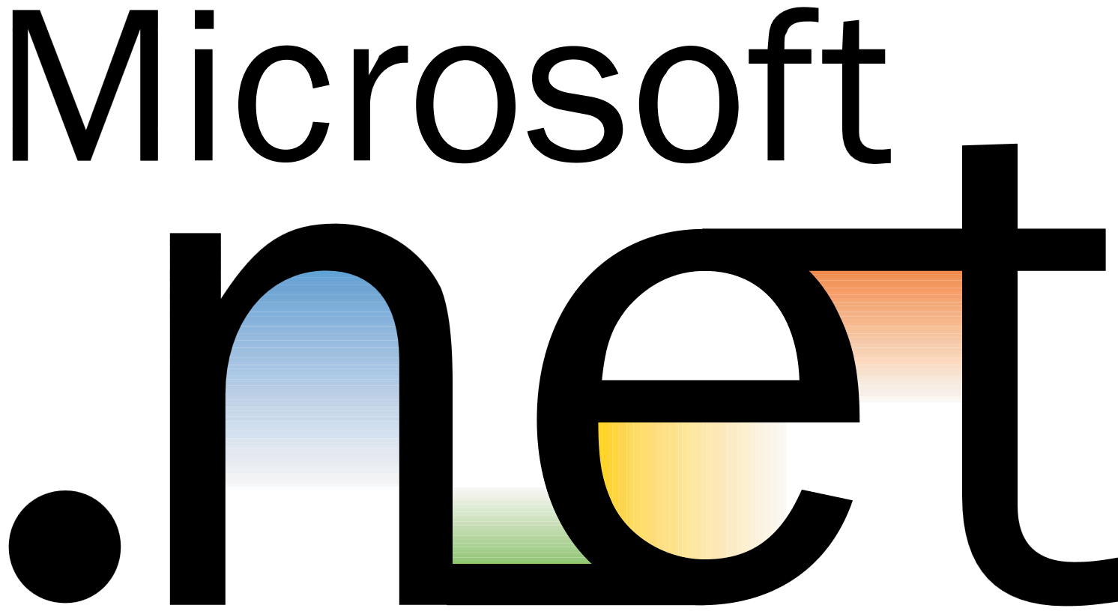
4.8.1
4.8
4.7.2
4.7.1
4.7
4.6.2
4.6.1
4.6
4.5.2
4.5.1
4.5
4
3.5
3.0
2.0
1.1
1.0

Slide 20
4.8.1
4.8
4.7.2
4.7.1
4.7

Slide 21
Amazon EC2
Elastic Compute Cloud
Notes:
First up, Amazon EC2.

Slide 22
Amazon EC2
Most Versatile
Virtual Machines
Workhorse of the Cloud
Boring
Notes:
This service supports .NET Framework and Modern .NET workloads
Virtual Machines
It’s a machine in the cloud, which means anything you can do with a box on-prem, you can do with an EC2 instance.
Most Versatile
Since you get an entire machine in the cloud with do what you want. You have admin access to install whatever you need. If you’re app is hosted in IIS or runs as a Windows service, you can use an EC2 instances for that job
Boring
It isn’t hot, it isn’t new, but it just plain works. Sometimes that’s what you want, just give me something that works. This is the base level of entry to the cloud. There are some neat things you can do, auto-scaling for one. If the CPU’s running hot, spin up another instance, behind a load balancer and distribute the load. So just because it’s boring tech, doesn’t mean you can’t take advantage of some of that cloud goodness.
Workhorse of the Cloud – EC2 makes a lot of other services happen, you just might not know it. For example, that really cool Kubernetes cluster you want to run, uses EC2.

Slide 23
Amazon EC2
Windows Server 2019
Windows Server 2016
Windows Server 2022
SQL Server Variants
Custom
Marketplace Options
Notes:
For Windows you have several options….
Server 2022, 2019 2016, some have SQL server baked in as well.
You can also build your own machine image if you have really unique requirements

Slide 24
Amazon EC2
Amazon Linux 2023
Custom
Red Hat Enterprise Linux
Ubuntu
SUSE
Marketplace Options
Notes:
For Linux,
You have choice of distributions, Amazon Linux 2023, SUSE, RHEL, Ubuntu, images from the Marketplace and also custom images,
[LEAD IN]
With EC2 a lot of that management falls on you or your platform team. Ideally, we want to start worrying less and less about the underlying infrastructure…
<CLICK>

Slide 25
AWS Elastic Beanstalk
Notes:
AWS Elastic Beanstalk is a step in that direction.

Slide 26
Elastic Beanstalk
Managed Web App Hosting
Backed by EC2 Instances
IIS Workloads
Notes:
This service supports .NET Framework and Modern .NET workloads.
Think of this services as the “I have stuff running in IIS but I don’t want to think about scaling or VMS or anything.” This is the service for you.

Slide 27
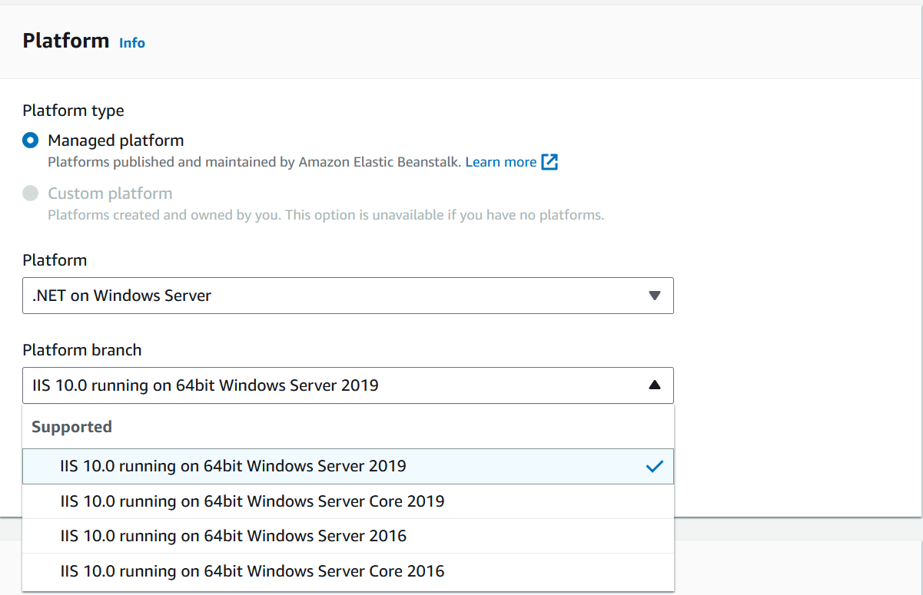
Notes:
You’re a bit more restricted in options here, no server 2022, but

Slide 28
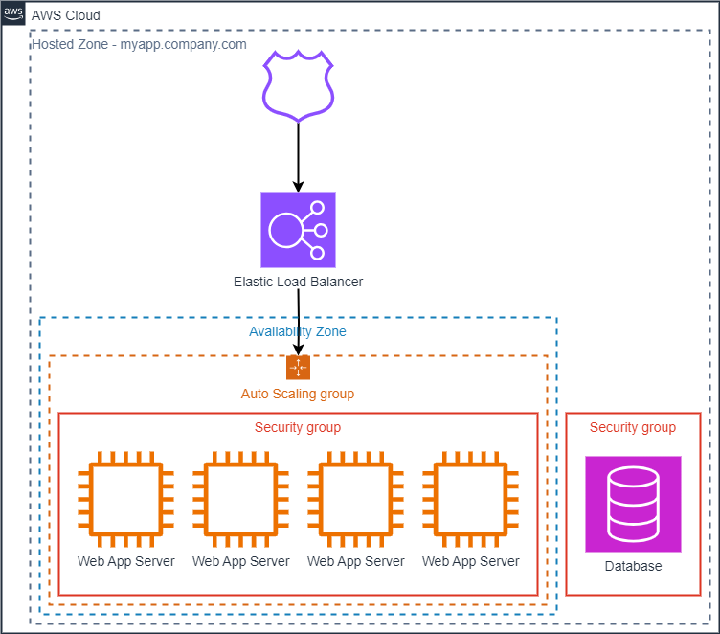
Notes:
When you create an environment, Elastic Beanstalk provisions the resources required to run your application. AWS resources created for an environment include one elastic load balancer (ELB in the diagram), an Auto Scaling group, and one or more Amazon Elastic Compute Cloud (Amazon EC2) instances..
If you are on Modern .NET, you CAN use Beanstalk, but I feel there are better options out there for you.
[LEAD IN]
One such option….
<CLICK>
This is an example of application running in Beanstalk. You get a DNS name, that you can CNAME to myapp.yourdomain.com, an Elastic Load Balancer, an Auto Scaling group, which manages how many EC2 instances are running, and one more of those said EC2 instances. The database doesn’t come with Beanstalk, but you can most certainly connect those applications to one.

Slide 29
AWS Lambda
Notes:
AWS Lambda, our flagship “serverless” computing platform. If you’re familiar with Azure, this would be like Azure Functions.

Slide 30
AWS Lambda
Serverless
Native Service Integrations
Hip / Cool / etc.
Think Differently
Notes:
Serverless
This is what a lot of people envision when they think “cloud.” Code running without having to worry about anything else. I tell you how much memory I need, and cloud provider you do the rest.
Native Service Integrations
Lambda can listen to events from all over the AWS ecosystem. You have API Gateway routes, Simple Queue Service consumers, Simple Object Storage (S3) Events, DynamoDB events, EventBridge events. You can use EventBridge to schedule Lambda invocations, like a Scheduled Task or Cron job. And lots more, those are just the common ones. Very powerful.
Think Differently
NOTICE this only supports Modern .NET. Not only that, but the code for Lambda function looks way different than a typical application.
The execution environment is different
The code you write looks different
Hip / Cool / etc.
If virtual machines are boring, then this is the “hip cool thing to be doing”… unless you’re on the container ship… don’t worry, AWS has you covered there too… more on that shortly.
[LEAD IN]
Let’s breakdown the parts of a small function real quick…
<CLICK>

Slide 31
public class Function
{
private readonly IDatabaseRepository _repo;
public Function()
{
_repo = new DatabaseRepository();
}
public async Task<APIGatewayProxyResponse> Handler(APIGatewayProxyRequest request)
{
var id = request.PathParameters["id"];
var databaseRecord = await _repo.GetById(id);
return new APIGatewayProxyResponse
{
StatusCode = (int)HttpStatusCode.OK,
Body = JsonSerializer.Serialize(databaseRecord)
};
}
}
Notes:
Here we have a function that receives an event from API Gateway, gets something from the database by ID, and returns the result…
This is the whole function. Notice, there’s no main method like in a Console app. There’s no Startup.cs for ASP.NET Core, none of that. Mind you, this is a simple function, and they can get more complex, but the idea is they do a few quick things and do them well… kinda like Microservices, right?

Slide 32
public class Function
{
private readonly IDatabaseRepository _repo;
public Function()
{
_repo = new DatabaseRepository();
}
public async Task<APIGatewayProxyResponse> Handler(APIGatewayProxyRequest request)
{
var id = request.PathParameters["id"];
var databaseRecord = await _repo.GetById(id);
return new APIGatewayProxyResponse
{
StatusCode = (int)HttpStatusCode.OK,
Body = JsonSerializer.Serialize(databaseRecord)
};
}
}
Notes:
Here we establish a connection to our repository. It’s important we do this in the constructor because of the lifecycle of a function so that multiple invocations of the Lambda don’t exhaust your database connections. I’ll have a link to the Execution Environment details in the GitHub repo that goes into more depth of where and why you put some of this code in certain spots.

Slide 33
public class Function
{
private readonly IDatabaseRepository _repo;
public Function()
{
_repo = new DatabaseRepository();
}
public async Task<APIGatewayProxyResponse> Handler(APIGatewayProxyRequest request)
{
var id = request.PathParameters["id"];
var databaseRecord = await _repo.GetById(id);
return new APIGatewayProxyResponse
{
StatusCode = (int)HttpStatusCode.OK,
Body = JsonSerializer.Serialize(databaseRecord)
};
}
}
Notes:
This first parameter lets us know, the Lambda is receiving events from API Gateway

Slide 34
public class Function
{
private readonly IDatabaseRepository _repo;
public Function()
{
_repo = new DatabaseRepository();
}
public async Task<APIGatewayProxyResponse> Handler(APIGatewayProxyRequest request)
{
var id = request.PathParameters["id"];
var databaseRecord = await _repo.GetById(id);
return new APIGatewayProxyResponse
{
StatusCode = (int)HttpStatusCode.OK,
Body = JsonSerializer.Serialize(databaseRecord)
};
}
}
Notes:
We grab the id from the REST URL path, and lookup the record in the database

Slide 35
public class Function
{
private readonly IDatabaseRepository _repo;
public Function()
{
_repo = new DatabaseRepository();
}
public async Task<APIGatewayProxyResponse> Handler(APIGatewayProxyRequest request)
{
var id = request.PathParameters["id"];
var databaseRecord = await _repo.GetById(id);
return new APIGatewayProxyResponse
{
StatusCode = (int)HttpStatusCode.OK,
Body = JsonSerializer.Serialize(databaseRecord)
};
}
}
Notes:
We create a response for API Gateway to process, and serialize the database object to JSON for the API to return to the client.
That’s it. As I mentioned they can, and do, get more complex, but they can also be very targeted and straightforward. It all depends on your architecture.
[LEAD IN]
Let’s wrap Lambda with a few last comments

Slide 36
public class Function
{
private readonly IDatabaseRepository _repo;
public Function()
{
_repo = new DatabaseRepository();
}
public async Task<APIGatewayProxyResponse> Handler(APIGatewayProxyRequest request)
{
var id = request.PathParameters["id"];
var databaseRecord = await _repo.GetById(id);
return new APIGatewayProxyResponse
{
StatusCode = (int)HttpStatusCode.OK,
Body = JsonSerializer.Serialize(databaseRecord)
};
}
}

Slide 37
namespace GetProductHandler;
public class Function
{
private readonly IDatabaseRepository _repo;
public Function()
{
this._repo = new DatabaseRepository();
}
public async Task<APIGatewayProxyResponse> Handler(APIGatewayProxyRequest request)
{
var id = request.PathParameters["id"];
var databaseRecord = await this._repo.GetById(id);
return new APIGatewayProxyResponse
{
StatusCode = (int)HttpStatusCode.OK,
Body = JsonSerializer.Serialize(databaseRecord)
};
}
}
Notes:
Here we have a function that receivies an event from API Gateway, gets’s something from the database by ID, and returns the result…
This is the whole function. Notice, there’s no main method like in a Console app. There’s no Startup.cs for ASP.NET Core, none of that. Mind you, this is a simple function, and they can get more complex, but the idea is they do a few quick things and do them well… kinda like Microservices, right?

Slide 38
AWS Lambda
namespace GetProductHandler;
public class Function
{
private readonly IDatabaseRepository _repo;
public Function()
{
this._repo = new DatabaseRepository();
}
public async Task<APIGatewayProxyResponse> Handler(APIGatewayProxyRequest request)
{
var id = request.PathParameters["id"];
var databaseRecord = await this._repo.GetById(id);
return new APIGatewayProxyResponse
{
StatusCode = (int)HttpStatusCode.OK,
Body = JsonSerializer.Serialize(databaseRecord)
};
}
}
Notes:
Here we have a function that receives an event from API Gateway, gets’s something from the database by ID, and returns the result…
This is the whole function. Notice, there’s no main method like in a Console app. There’s no Startup.cs for ASP.NET Core, none of that. Mind you, this is a simple function, and they can get more complex, but the idea is they do a few quick things and do them well… kinda like Microservices, right?

Slide 39
AWS Lambda
namespace GetProductHandler;
public class Function
{
private readonly IDatabaseRepository _repo;
public Function()
{
this._repo = new DatabaseRepository();
}
public async Task<APIGatewayProxyResponse> Handler(APIGatewayProxyRequest request)
{
var id = request.PathParameters["id"];
var databaseRecord = await this._repo.GetById(id);
return new APIGatewayProxyResponse
{
StatusCode = (int)HttpStatusCode.OK,
Body = JsonSerializer.Serialize(databaseRecord)
};
}
}

Slide 40
AWS Lambda
namespace GetProductHandler;
public class Function
{
private readonly IDatabaseRepository _repo;
public Function()
{
_repo = new DatabaseRepository();
}
public async Task<APIGatewayProxyResponse> Handler(APIGatewayProxyRequest request)
{
var id = request.PathParameters["id"];
var databaseRecord = await this._repo.GetById(id);
return new APIGatewayProxyResponse
{
StatusCode = (int)HttpStatusCode.OK,
Body = JsonSerializer.Serialize(databaseRecord)
};
}
}
Notes:
Here was create a connection to our repository. It’s important we do this in the constructor because of the lifecycle of a function. I’ll have a link to the Execution Environment details in the GitHub repo that goes into more depth of where and why you put some of this code in certain spots.

Slide 41
AWS Lambda
namespace GetProductHandler;
public class Function
{
private readonly IDatabaseRepository _repo;
public Function()
{
_repo = new DatabaseRepository();
}
public async Task<APIGatewayProxyResponse> Handler(APIGatewayProxyRequest request)
{
var id = request.PathParameters["id"];
var databaseRecord = await this._repo.GetById(id);
return new APIGatewayProxyResponse
{
StatusCode = (int)HttpStatusCode.OK,
Body = JsonSerializer.Serialize(databaseRecord)
};
}
}
Notes:
This is the entiretly of the function, minus the error handling and logging to make it fit on a slide, but this is it. Get from the database, return the result.

Slide 42
AWS Lambda
Configurable Timeouts
Max Runtime 15 minutes
128 MB to 10 GB of RAM
CPU / Memory Proportional
6 MB Async Payload Limit
Notes:
At 1,769 MB, a function has the equivalent of one vCPU.

Slide 43
AWS Lambda (RAM / CPU)
MiB | GiB | vCPU
128 | 0.13 | 0.07
1024 | 1 | 0.58
2048 | 2 | 1.16
3072 | 3 | 1.74
4096 | 4 | 2.32
5120 | 5 | 2.89
6144 | 6 | 3.47
7168 | 7 | 4.05
8192 | 8 | 4.63
9216 | 9 | 5.21
10240 | 10 | 5.79

Slide 44
Amazon Elastic Container Service

Slide 45
Amazon ECS
Task & Services
EC2 or Fargate (serverless)
Containers
Orchestration (not K8s or Swarm)
Copilot CLI
Notes:
Containers
This is one of our container solutions,
Tasks and Services
A task definition is a blueprint for your application. It is a text file in JSON format that describes the parameters and one or more containers that form your application. I like to think of it similar to a Docker Compose file in the way you can specify multiple containers, networking, etc.
A service runs a specified number of instances of a task definition simultaneously. If one of your tasks fails or stops, the Amazon ECS service scheduler launches another instance of your task definition to replace it. This helps maintain your desired number of tasks in the service.
Orchestration (not K8s or Swarm)
I like to think of it at Kubernetes-lite. You get orchestration and management, but with a lot more of AWS managed tools.
EC2 or Fargate (serverless)
You can choose to have your container run on EC2 instances… remember, I said EC2 maybe be boring, but it’s still very much the workhorse of the cloud. However, you can also choose our serverless container offering Fargate, which manages all the nodes for you. You just specify how much memory and CPU your task needs, and AWS infrastructure takes care of the rest.
Copilot CLI
Is an open source CLI you can use to build, release, and operate your containers on ECS. Yes, I know, it’s confusing now with GitHub Copilot, but this was started in 2019, so technically they stole our name ☺

Slide 46
Amazon Elastic Kubernetes Service
Notes:
We don’t have time to cover this today, but if Kubernetes is your jam, we have the Amazon Elastic Kubernetes Services that you can use. And yes, it’ll support .NET workloads, ya know, cause containers.
I should point out… you CAN run Windows Containers, which run on Windows Hosts, so TECHNICALLY the container offers do support .NET Framework, the version below 5… but Windows containers in general, aren’t terrible recommended in any environment, AWS or not. So if you’re going to use containers, take advantage of Modern .NET, start at version 8 and enjoy!

Slide 47
Amazon EKS
Pods, Services, Deployments
EC2 or Fargate (serverless)
Containers
eksctl
Notes:
Containers
This is one of our container solutions,
Tasks and Services
A task definition is a blueprint for your application. It is a text file in JSON format that describes the parameters and one or more containers that form your application. I like to think of it similar to a Docker Compose file in the way you can specify multiple containers, networking, etc.
A service runs a specified number of instances of a task definition simultaneously. If one of your tasks fails or stops, the Amazon ECS service scheduler launches another instance of your task definition to replace it. This helps maintain your desired number of tasks in the service.
Orchestration (not K8s or Swarm)
I like to think of it at Kubernetes-lite. You get orchestration and management, but with a lot more of AWS managed tools.
EC2 or Fargate (serverless)
You can choose to have your container run on EC2 instances… remember, I said EC2 maybe be boring, but it’s still very much the workhorse of the cloud. However, you can also choose our serverless container offering Fargate, which manages all the nodes for you. You just specify how much memory and CPU your task needs, and AWS infrastructure takes care of the rest.
Copilot CLI
Is an open source CLI you can use to build, release, and operate your containers on ECS. Yes, I know, it’s confusing now with GitHub Copilot, but this was started in 2019, so technically they stole our name ☺

Slide 48
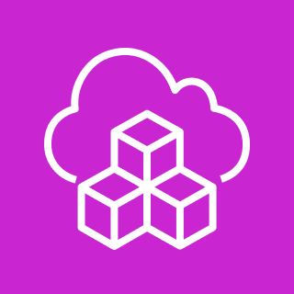
AWS Cloud Development Kit

Slide 49
AWS CDK
Uses CloudFormation Service
Real C# Code
CLI can be used in CI/CD

Slide 50
public class MessagePublisherAppStack : Stack
{
public MessagePublisherAppStack(Construct scope, string id, IRole ec2Role, IStackProps props = null) : base(scope, id, props)
{
var ec2Instance = new Instance_(this, "MessagePublisher", new InstanceProps
{
Vpc = GetDefaultVpc(),
InstanceType = InstanceType.Of(InstanceClass.T2, InstanceSize.MICRO),
MachineImage = MachineImage
.LatestWindows(WindowsVersion.WINDOWS_SERVER_2022_ENGLISH_FULL_BASE),
SecurityGroup = GetSecurityGroup(),
Role = ec2Role,
UserData = GetStartupCode(),
RequireImdsv2 = true
});
ec2Instance.Instance.KeyName = GetKeyPair().KeyPairName;
}

Slide 51
public class MessagePublisherAppStack : Stack
{
public MessagePublisherAppStack(Construct scope, string id, IRole ec2Role, IStackProps props = null) : base(scope, id, props)
{
var ec2Instance = new Instance_(this, "MessagePublisher", new InstanceProps
{
Vpc = GetDefaultVpc(),
InstanceType = InstanceType.Of(InstanceClass.T2, InstanceSize.MICRO),
MachineImage = MachineImage
.LatestWindows(WindowsVersion.WINDOWS_SERVER_2022_ENGLISH_FULL_BASE),
SecurityGroup = GetSecurityGroup(),
Role = ec2Role,
UserData = GetStartupCode(),
RequireImdsv2 = true
});
ec2Instance.Instance.KeyName = GetKeyPair().KeyPairName;
}

Slide 52
public class MessagePublisherAppStack : Stack
{
public MessagePublisherAppStack(Construct scope, string id, IRole ec2Role, IStackProps props = null) : base(scope, id, props)
{
var ec2Instance = new Instance_(this, "MessagePublisher", new InstanceProps
{
Vpc = GetDefaultVpc(),
InstanceType = InstanceType.Of(InstanceClass.T2, InstanceSize.MICRO),
MachineImage = MachineImage
.LatestWindows(WindowsVersion.WINDOWS_SERVER_2022_ENGLISH_FULL_BASE),
SecurityGroup = GetSecurityGroup(),
Role = ec2Role,
UserData = GetStartupCode(),
RequireImdsv2 = true
});
ec2Instance.Instance.KeyName = GetKeyPair().KeyPairName;
}

Slide 53
public class MessagePublisherAppStack : Stack
{
public MessagePublisherAppStack(Construct scope, string id, IRole ec2Role, IStackProps props = null) : base(scope, id, props)
{
var ec2Instance = new Instance_(this, "MessagePublisher", new InstanceProps
{
Vpc = GetDefaultVpc(),
InstanceType = InstanceType.Of(InstanceClass.T2, InstanceSize.MICRO),
MachineImage = MachineImage
.LatestWindows(WindowsVersion.WINDOWS_SERVER_2022_ENGLISH_FULL_BASE),
SecurityGroup = GetSecurityGroup(),
Role = ec2Role,
UserData = GetStartupCode(),
RequireImdsv2 = true
});
ec2Instance.Instance.KeyName = GetKeyPair().KeyPairName;
}

Slide 54
public class MessagePublisherAppStack : Stack
{
public MessagePublisherAppStack(Construct scope, string id, IRole ec2Role, IStackProps props = null) : base(scope, id, props)
{
var ec2Instance = new Instance_(this, "MessagePublisher", new InstanceProps
{
Vpc = GetDefaultVpc(),
InstanceType = InstanceType.Of(InstanceClass.T2, InstanceSize.MICRO),
MachineImage = MachineImage
.LatestWindows(WindowsVersion.WINDOWS_SERVER_2022_ENGLISH_FULL_BASE),
SecurityGroup = GetSecurityGroup(),
Role = ec2Role,
UserData = GetStartupCode(),
RequireImdsv2 = true
});
ec2Instance.Instance.KeyName = GetKeyPair().KeyPairName;
}

Slide 55
public class MessagePublisherAppStack : Stack
{
public MessagePublisherAppStack(Construct scope, string id, IRole ec2Role, IStackProps props = null) : base(scope, id, props)
{
var ec2Instance = new Instance_(this, "MessagePublisher", new InstanceProps
{
Vpc = GetDefaultVpc(),
InstanceType = InstanceType.Of(InstanceClass.T2, InstanceSize.MICRO),
MachineImage = MachineImage
.LatestWindows(WindowsVersion.WINDOWS_SERVER_2022_ENGLISH_FULL_BASE),
SecurityGroup = GetSecurityGroup(),
Role = ec2Role,
UserData = GetStartupCode(),
RequireImdsv2 = true
});
ec2Instance.Instance.KeyName = GetKeyPair().KeyPairName;
}

Slide 56
public class MessagePublisherAppStack : Stack
{
public MessagePublisherAppStack(Construct scope, string id, IRole ec2Role, IStackProps props = null) : base(scope, id, props)
{
var ec2Instance = new Instance_(this, "MessagePublisher", new InstanceProps
{
Vpc = GetDefaultVpc(),
InstanceType = InstanceType.Of(InstanceClass.T2, InstanceSize.MICRO),
MachineImage = MachineImage
.LatestWindows(WindowsVersion.WINDOWS_SERVER_2022_ENGLISH_FULL_BASE),
SecurityGroup = GetSecurityGroup(),
Role = ec2Role,
UserData = GetStartupCode(),
RequireImdsv2 = true
});
ec2Instance.Instance.KeyName = GetKeyPair().KeyPairName;
}

Slide 57
public class MessagePublisherAppStack : Stack
{
public MessagePublisherAppStack(Construct scope, string id, IRole ec2Role, IStackProps props = null) : base(scope, id, props)
{
var ec2Instance = new Instance_(this, "MessagePublisher", new InstanceProps
{
Vpc = GetDefaultVpc(),
InstanceType = InstanceType.Of(InstanceClass.T2, InstanceSize.MICRO),
MachineImage = MachineImage
.LatestWindows(WindowsVersion.WINDOWS_SERVER_2022_ENGLISH_FULL_BASE),
SecurityGroup = GetSecurityGroup(),
Role = ec2Role,
UserData = GetStartupCode(),
RequireImdsv2 = true
});
ec2Instance.Instance.KeyName = GetKeyPair().KeyPairName;
}

Slide 58
public class MessagePublisherAppStack : Stack
{
public MessagePublisherAppStack(Construct scope, string id, IRole ec2Role, IStackProps props = null) : base(scope, id, props)
{
var ec2Instance = new Instance_(this, "MessagePublisher", new InstanceProps
{
Vpc = GetDefaultVpc(),
InstanceType = InstanceType.Of(InstanceClass.T2, InstanceSize.MICRO),
MachineImage = MachineImage
.LatestWindows(WindowsVersion.WINDOWS_SERVER_2022_ENGLISH_FULL_BASE),
SecurityGroup = GetSecurityGroup(),
Role = ec2Role,
UserData = GetStartupCode(),
RequireImdsv2 = true
});
ec2Instance.Instance.KeyName = GetKeyPair().KeyPairName;
}
private IVpc GetDefaultVpc()
{
return Vpc.FromLookup(this, "Default VPC for Region",
new VpcLookupOptions { IsDefault = true });
}

Slide 59
public class MessagePublisherAppStack : Stack
{
public MessagePublisherAppStack(Construct scope, string id, IRole ec2Role, IStackProps props = null) : base(scope, id, props)
{
var ec2Instance = new Instance_(this, "MessagePublisher", new InstanceProps
{
Vpc = GetDefaultVpc(),
InstanceType = InstanceType.Of(InstanceClass.T2, InstanceSize.MICRO),
MachineImage = MachineImage
.LatestWindows(WindowsVersion.WINDOWS_SERVER_2022_ENGLISH_FULL_BASE),
SecurityGroup = GetSecurityGroup(),
Role = ec2Role,
UserData = GetStartupCode(),
RequireImdsv2 = true
});
ec2Instance.Instance.KeyName = GetKeyPair().KeyPairName;
}
private IVpc GetDefaultVpc()
{
return Vpc.FromLookup(this, "Default VPC for Region",
new VpcLookupOptions { IsDefault = true });
}

