Slide 1
EDES 301 Heads-up Display Proposal
9/30/2024
Brad Mahung

Slide 2
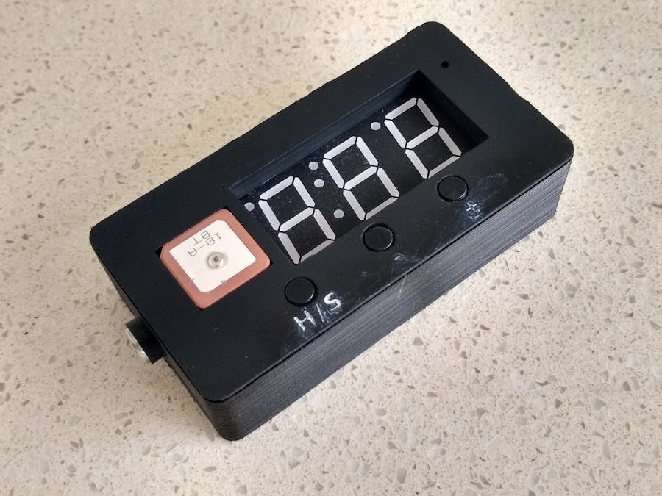

Background Information
The project focuses on creating a device that can accurately display vehicle speed, engine rpm, and timing of acceleration.
Libraries
https://github.com/adafruit/Adafruit_GPS
https://github.com/adafruit/Adafruit_LED_Backpack
https://www.hackster.io/john-bradnam/car-windscreen-hud-e10cbd https://www.hackster.io/marcozonca/car-hud-windscreen-display-for-speed-compass-alt-2d7f36
My project improves upon previous ones by using an updated and more accurate GPS unit, buttons for UI elements (switching between live readout of speed, heading, and timing) and LEDs for additional system feedback. Rather than depending on the buttons alone, a rotary switch poteniometer (knob) will aid the user in navigating various menus within the system.

Slide 3
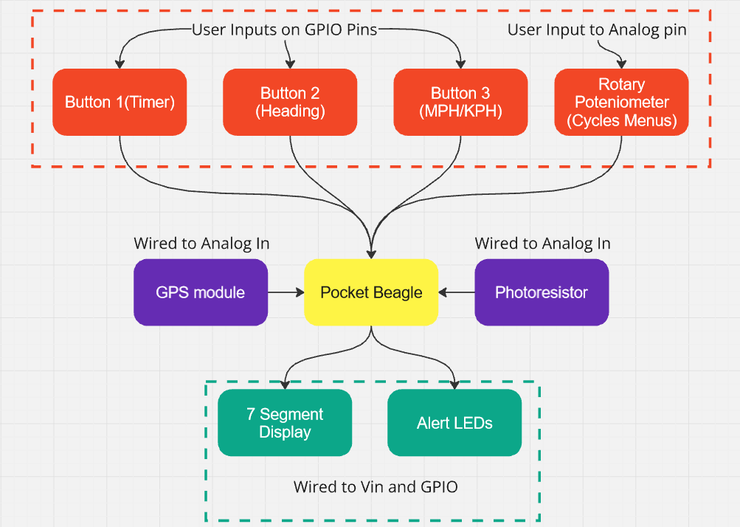
System Block Diagram

Slide 4
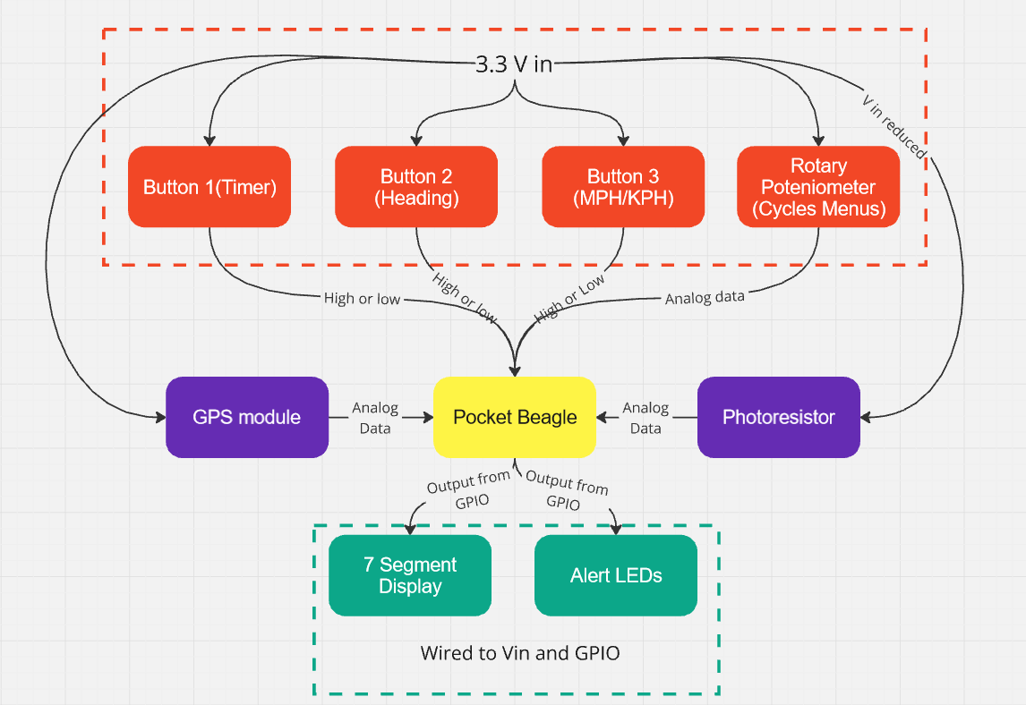
Power Block Diagram

Slide 5
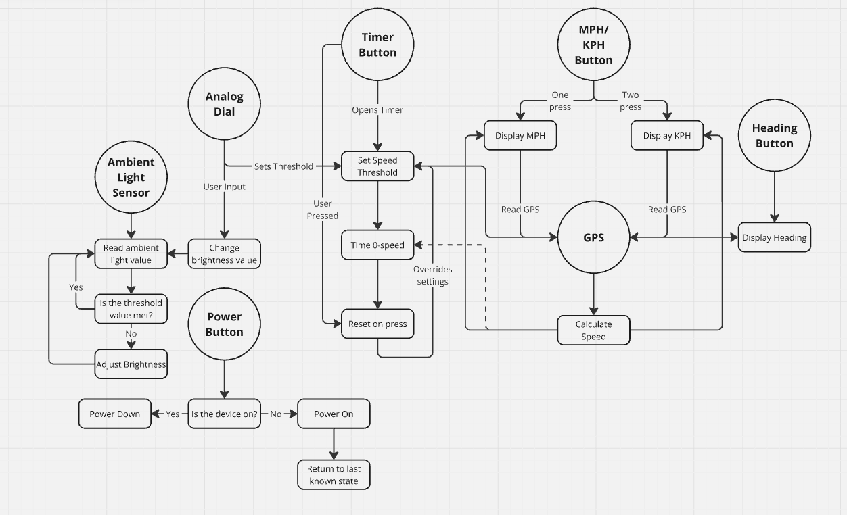
Software Diagram

Slide 6
Components / Budget
Component | EDES301 to Buy? | Cost
Adafruit 0.56" 4-Digit 7-Segment Display w/I2C Backpack - White https://www.adafruit.com/product/1002 | Yes | $10.95
Arduino GPS https://www.amazon.com/Navigation-Positioning-Microcontroller-Compatible-Sensitivity/dp/B0B31NRSD2 | Yes | ~$18 for two units
Buttons in the OEDK | No | Free
LEDs in the OEDK | No | Free
Photoresistor | No | Free
Rotary Switch Potentiometer | No | Free
See Next Slide for Instructions

Slide 7
Component Selection (Remove slide for submission)
All components must be from either: Amazon, Adafruit, Sparkfun, Digi-Key, or Mouser
Select no more than two (2) components that are not on approved component spreadsheet
See Canvas → Files → assignments → EDES301_project_01_parts_list.xlsx
If there is a cheaper part that you would like to use, we can discuss in the project meeting
All components needed for the project should be listed on Slide 5
All components should have links to the website where they can be purchased
Please trim URLs for links to Amazon
EDES301 will supplement $25 to $35 dollars for components
Please indicate what components need to be purchased by EDES301
If you have a special request, we can discuss in the project meeting

