Slide 1

Douglas Engelbart's HyperScope:
Taking Web Collaboration to the Next Level Using Ajax and Dojo
Brad Neuberg
bkn3@columbia.edu
EuroOSCON, September, 2006

Slide 2
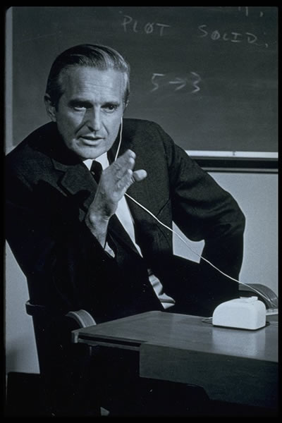
Douglas Engelbart
Notes:
What do you know about Douglas Engelbart?

Slide 3
Invented
Computer Mouse
Hypertext
Collaborative groupware
Email
Windowing
And more
Notes:
Where did these come from?
How did they invent all of these?
I got to ask them all... he said one word....

Slide 4
Augmentation
Notes:
Not what I expected them to say

Slide 5
Augmenting Human Intellect
(1962)

Slide 6
Importance of Engelbart's Paper
PC
Apple
Xerox PARC
Augmentation Research Center
(ARC)
Engelbart
"Augmenting Human Intellect"
(1962)
Notes:
Founding document, like the Magna Carta
No one knows about it
Goose that laid the golden egg
Can it deliver new innovation?

Slide 7
What is Augmentation?

Slide 8
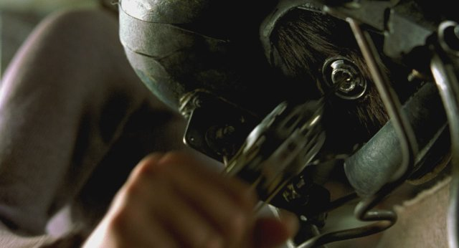
"Matrix" Augmentation
Notes:
Neo from Matrix jacking into the matrix computer
Usual image that comes into people's minds for 'Augmentation'

Slide 9
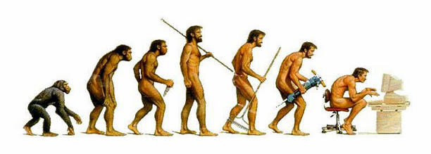
Accelerated Evolution

Slide 10
Improving Human Abilities
Increasing intellectual ability
Speeding up process of improvement
  evolution

Slide 11
Why Accelerate Intellectual Evolution?
"Man's population and gross product are increasing at a considerable rate, but the complexity of his problems grows still faster, and the urgency with which solutions must be found becomes steadily greater..."
"Augmenting Human Intellect,"
Engelbart, 1962

Slide 12
Tools for Thinking
Language (40,000 years?)
Writing (3,500 - 6,000 years?)
Computers (~1950s)
Notes:
All help us figure out, think about, and deal with urgent and complicated problems
Questions so far?

Slide 13
Two Big Ideas in Engelbart's Paper
Look at humans and their tools holistically
Capabilities

Slide 14
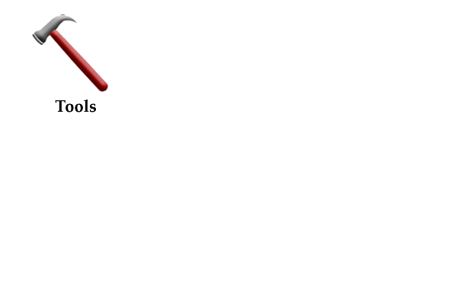
Systems Thinking
Notes:
The tool
Most software people just see this
Could be computer, cell phone, car, etc.
(Image copyright Mad Lantern, free to use)

Slide 15
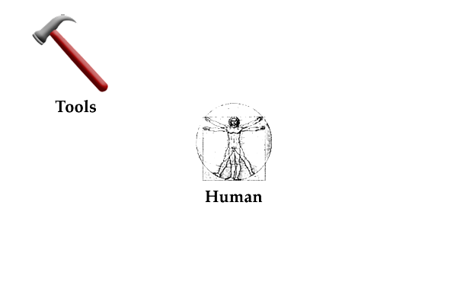
Systems Thinking
Notes:
Now we put the human into the loop
Vitruvian Man from Leonardo da Vinci
This is why many call Engelbart father of HCI, because he put people back into equation
This is where many stop - Engelbart goes on
There is more in the system

Slide 16
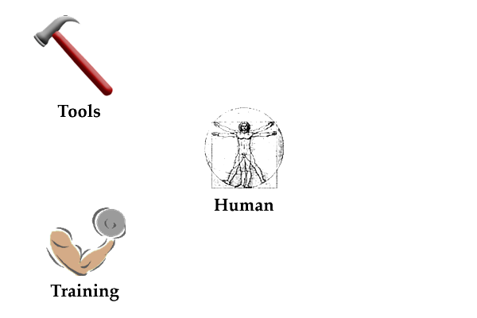
Systems Thinking
Notes:
Training
Training is either based on knowledge already known, absorbed from your culture, or is based on new knowledge.
The only intuitive interface is the nipple, from Bruce Ediger (perhaps)
Standard usability says you should need no new training - use implicit knowledge
Training though can accelerate evolution because you can try truly new ideas

Slide 17
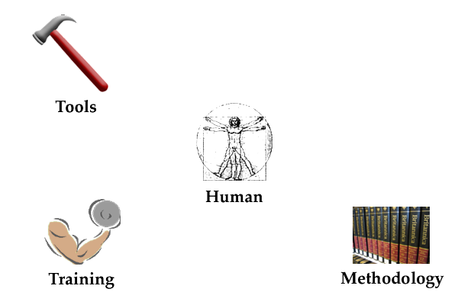
Systems Thinking
Notes:
Methodology
Encyclopedias use the same standard book technology, but use a different methodology to arrange things
Methodologies are patterns, or memes, that get discovered and then reused.
Examples:
table of contents
book index
encyclopedias
Endless innovations are possible just at the methodology level, keeping everything else the same in the system

Slide 18
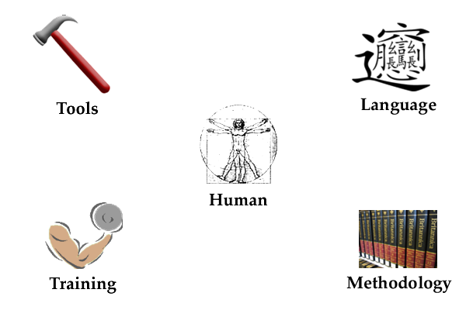
Systems Thinking
Notes:
Language
Chinese character for Biang Biang noodles, most complicated Chinese character in current use
One of "ten strange wonders" of Shaanxi province
By language I mean more than spoken language:
your ability to form thoughts and then to turn them into symbols,
whether these are aural symbols (language) or
written symbols (writing)
and to manipulate these symbols
(Image taken from Wikipedia and in public domain)
So here is the human/tool system, holistically.
What do you think?
Are there questions on what this is?

Slide 19
Capabilities
The ability or skill to do something
Examples:
  Talking on the cell phone
  Riding a bike
  Forming thoughts in your mind
  Giving a presentation

Slide 20
Capabilities
All 5 parts of system can have capabilities

Slide 21
Major Aspects of Capabilities
Can be broken down
Work together
Some are more core than others
Notes:
1) Can be broken down into simpler abilities
- the ability to move my finger
- the capability of my eye to sense light
2) They work together
- Giving a presentation involves many things:
- figuring out what to say
- communication
- using presentation software
3) Some are more core
- hierarchical thinking
- associative thinking
- decision making

Slide 22
Key Insight
Target core capabilities
Make them better
Payoff will ripple all over
  Leverage

Slide 23
Leverage
"Give me a place to stand on, and I can move the earth."
Archimedes, 287 BC - 212 BC

Slide 24
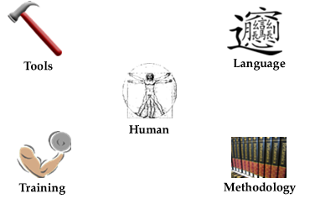
Formula to Accelerate Evolution
Identify capabilities in all areas of our human system

Slide 25
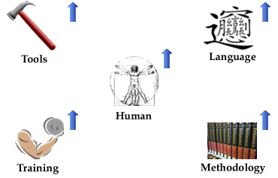
Formula to Accelerate Evolution
Target core capabilities and make them more powerful

Slide 26
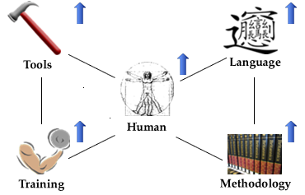
Formula to Accelerate Evolution
Have everything start feeding together
Notes:
Train in these new abilities
invent new methodologies
which will cause new tools to appear
which can open new kinds of thinking and language
which opens new kinds of methodologies

Slide 27
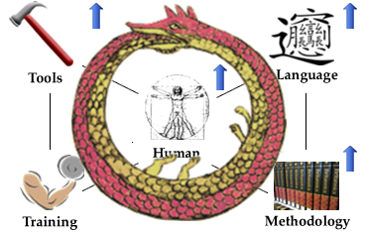
Formula to Accelerate Evolution
Critical mass happens - repeat over and over - "bootstrapping"
Notes:
Engelbart calls "bootstrapping"
Used Ouroboros image to connote bootstrapping and reaching higher and higher levels
Image of Ouroboros, ancient image, date of creation unknown, Plato mentions it
might have been inspired by Milky Way in sky
some ancient texts refer to a serpent of light residing in the heavens
commonly used in ancient alchemy texts
Particular image from 1478 by Theodoros Pelecanos in an alchemical tract entitled Synosius

Slide 28
Summary of Paper
"Augmenting Human Intellect" key paper
Two big ideas:
  Look at Humans and Tools holistically
  Capabilities
Identify key capabilities and make more powerful
Self-perpetuating bootstrapping will occur

Slide 29
Augmentation Research Center
1960s and 1970s
Engelbart and team applied framework to themselves
Bootstrapped over and over, using all 5 human/tool areas

Slide 30
Demo of NLS/Augment
One copy still running in world
Hosted at Logitech
Running Debian Linux on Solaris
Emulating PDP-10 and TOPS-20
Still thinks it's second node on Internet
Notes:
(throughout show how features tie into Augmentation philosophy/framework)
Overview of UI
Command bar and giving commands (verb/noun)
Show hyperlinks
Jump to Link
Show Outline
Different Jump Types
Granular addresses
Viewspecs

Slide 31
Demo of NLS/Augment
Probably less than 100 people in world have directly used
Mother of All Demos

Slide 32
Smalltalk Augment
Built in early 90s by Engelbart and team
Tim Berners Lee saw it in early 90s
Implemented some extra GUI elements
  Quick buttons
  Jump Window
  Viewspec Window

Slide 33
Demo of Smalltalk Augment
Notes:
Show quick buttons
Jump Overlay
Viewspec Overlay
Browser-like features

Slide 34
HyperScope
Goal:
  Bring Augment to contemporary web
  Translate, don't innovate

Slide 35
HyperScope
Uses modern technology:
  Ajax, DHTML, OPML, Dojo, Web
Implements following Augment features:
  Jumping
  Addressing
  Viewing
  Command Bar

Slide 36
HyperScope
New feature:
  transformers to allow all document formats to do advanced addressing

Slide 37
HyperScope
Open source (GPL)
NSF funded Phase I
Phase 1 finished

Slide 38
Demo of HyperScope
Demo Link - Design Document
Demo Link - Example Addressing
Demo Link - OPML 1.0 Document
Notes:
Start with design document
show modes (browser and turbo mode)
show hyperlinks
show different programmed views in arch document in Overview
show how it's all an outline
show node addressing
show quick buttons
show some viewspecs
show content filters
show cut/paste link
Example document that has different kinds of cool hyperlinks into design document (transclusions, indirect links, etc)
Do a view source to show how it's all OPML
Show OPML 1.0 example

Slide 39
Transformers
Transforms other document types into HyperScope OPML
Created by community

Slide 40
Transformers
Currently have:
  RSS -> OPML
  Microsoft Word -> OPML
  Microsoft Powerpoint -> OPML
  XOXO -> OPML
  Augment -> OPML

Slide 41
Demo of Transformers
XOXO:
  Before
  After
RSS
  Before
  After

Slide 42
Architecture
Everything is client-side
  Except for small, optional PHP gateway for cross-host transcludes
OPML is file format

Slide 43
Architecture
Client applies XPath to resolve addressing
Uses XSLT to render viewspecs and final document
HTML is produced and pushed to screen

Slide 44
Architecture
Has JavaScript classes that represent domain:
  hs.address.Address
    A HyperScope address that can be resolved and manipulated
  hs.model.Document
    An outline document that can be rendered and jumped through
  hs.model.Node
    A node in an hs.model.Document

Slide 45
Architecture
Divided into two major pieces, both on client-side:
  "Front-End"
    UI that knows how to interact with user, mouse, screen, etc
  "Back-End"
    Resolves documents, does addressing, etc. Independent of browser environment

Slide 46
Architecture
Front-End turns all user operations into an hs.address.Address
We then resolve this address
Back-End does hard work of figuring out how to do this
We then render results in Front-End

Slide 47
Architecture
We use Dojo:
  Dojo Events
  Dojo IO
  Dojo Widgets
Sarissa for cross-browser XPath and XSLT
Massive unit testing done with JSUnit
  Clone of Java JUnit

Slide 48
Final Thoughts
HyperScope brings Augment to contemporary audience
Lets do what ARC did in 60s and 70s:
  Keep applying the Augmentation framework
  Bootstrap ourselves in all 5 areas (human, language, tools, methodologies, training)
  See what innovations come out

Slide 49
Final Thoughts
Next step:
  Start innovating
  Bring in editing
  More transformers
  Engage community

Slide 50
Final Thoughts
Play with HyperScope and learn more at http://hyperscope.org/

Slide 51
Douglas Engelbart's HyperScope:
Taking Web Collaboration to the Next Level Using Ajax and Dojo
Brad Neuberg
bkn3@columbia.edu
EuroOSCON, September, 2006

