Slide 1

Installing S/W on V709/Leafcard
Everything you wanted to know about the Leaf card. And a little bit of U-Boot.
Paneve - Brad Walker, 7-8-13

Slide 2


Misc. H/W Details
The V709 card uses a Xilinx Virtex-7 - p/n XC7VX690T
Leafcard will use Virtex-7 w/ much higher density of LUTS - p/n XC7VX1140T
  1,139,200 Logic cells compared to 693,120 on VC709
  4 Super Logic Regions (SLR) on XC7VX1140T
  - consult the manual for details
      GTX transceivers
      ~ 290,000 logic cells
      block ram
Means to test out features that we use (i.e. Compiler, Platform H/W, etc.)

Slide 3
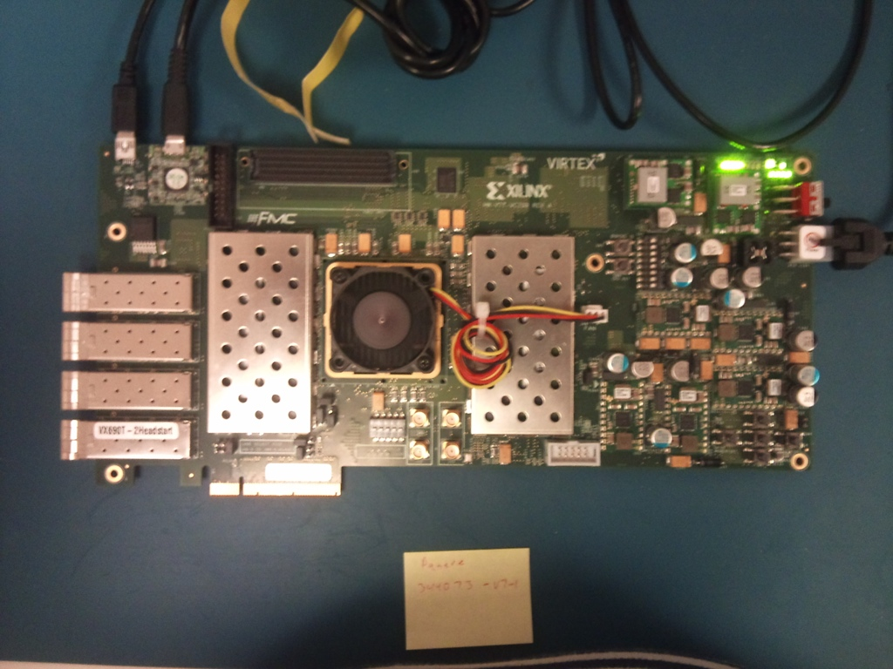
Misc. H/W Details - cont.
JTAG/Serial
MotherShip
E-Net
DDR memory

Slide 4
Overall Process
Build ELF image using your favorite compiler suite
Transform ELF image into MCS (Intel format)
Program Image on board (V709/Leafcard)
Boot image

Slide 5
Build Image
U-Boot
  pull from Git repo
  configure & build
[bwalker@compute6 u-boot]$ make clean; make leaf_config
Configuring for leaf board...
[bwalker@compute6 u-boot]$ make -f Makefile.mcs
make -C sep_boot_files u-boot
make[1]: Entering directory `/home/bwalker/src/leaf/u-boot/sep_boot_files'
make[1]: Nothing to be done for `u-boot'.
make[1]: Leaving directory `/home/bwalker/src/leaf/u-boot/sep_boot_files'
make leaf_config
make[1]: Entering directory `/home/bwalker/src/leaf/u-boot'
Generating include/autoconf.mk
...

Slide 6
Build Image - cont.
Linux
  pull from Git repo
    configure & build
make ARCH=sep CROSS_COMPILE=SEP-elf- V=1 &> ~/tmp/linux-build-output.txt
make -f scripts/Makefile.build obj=arch/sep/kernel include/generated/nr-irqs.h
make[1]: `include/generated/nr-irqs.h' is up to date.
rm -f include/config/kernel.release
echo "3.8.0$(/bin/sh /home/bwalker/src/leaf/linux-stable/scripts/setlocalversion /home/bwalker/src/leaf/linux-stable)" > include/config/kernel.release
make -f /home/bwalker/src/leaf/linux-stable/scripts/Makefile.asm-generic \
src=asm obj=arch/sep/include/generated/asm
make -f /home/bwalker/src/leaf/linux-stable/scripts/Makefile.asm-generic \
src=uapi/asm obj=arch/sep/include/generated/uapi/asm

Slide 7
Transform ELF image
Need to know what the memory map looks like
+-----------------------------------+
| |
| thread_jmp_vector_tbl |
| |
0x1ffff00 +-----------------------------------+
| |
| boot |
| |
0x1fff700 +-----------------------------------+
| |
| peek_poke |
| |
0x1e00000 +-----------------------------------+
| |
| U-Boot |
| |
0x1d00000 +-----------------------------------+
| |
| |
| |
| |
| |
| |
| Unused |
| |
| |
| |
| |
| |
| |
| |
0x0 +-----------------------------------+ Beginning of MCS image

Slide 8
Transform ELF image - cont.
Need to know what the memory map looks like
L2e Memory Layout
+----------------------------+
| |
| |
| Flash Memory is |
| mapped here |
| |
| |
| |
+----------------------------+ 0x10000000
| |
| |
| |
| |
| |
| |
| |
| |
| |
| L2e/DDR Memory |
| |
| |
| |
| |
| |
| |
| |
| |
+----------------------------+ 0x0

Slide 9
Transform ELF image - cont.
done using the makeMCS utility
/home/bwalker/Work/sep_ef/bin/makeMCS -f u-boot_w_cmd 0x1D00000 -f ./sep_boot_files/peek_poke_ui.elf 0x1E00000 -f ./sep_boot_files/boot.x 0x01FFF700 -f ./sep_boot_files/thread_jmp_vector_tbl.x 0x1FFFF00 -o flash_memory_init_u-boot.mcs
sometimes I put the Linux kernel in the unused space
[regressFPGA@lab-mega]$ srec_cat /tmp/vmlinux.clang -binary -offset 0x400000 -o /tmp/vmlinux.clang.mcs -intel
[regressFPGA@lab-mega]$ cp /tmp/flash_memory_init_u-boot.mcs /tmp/vmlinux.mcs
[regressFPGA@lab-mega]$ cat /tmp/vmlinux.clang.mcs >> /tmp/vmlinux.mcs
[regressFPGA@lab-mega]$ ./program_and_debug.sh -mcs /tmp/vmlinux.mcs

Slide 10
Program Image on Board
use program_and_debug.sh
[regressFPGA@lab-mega configure_scripts]$ ./program_and_debug.sh -help
Usage: ./program_and_debug.sh [-help] [-bit <INPUTFILE>] [-mcs <INPUTFILE>] [-proj <INPUTFILE>] [-keep_logs] [-config] [-debug]
-help: Produce this output
-bit <INPUTFILE>: Configure V7 device with INPUTFILE, INPUTFILE needs to be V7 bit file
-mcs <INPUTFILE>: Name of input file to program flash device, if not inputted, flash will not be programmed
-proj <INPUTFILE>: Use input file as ChipScope project file
-keep_logs: Be default all configuration logs are deleted, set this flag to keep them, logs can be overwritten on the next run of this script
-config: Configure V7 with last used configuration file
-debug: Launch ChipScope Analyzer for debugging

Slide 11
Program Image on Board - cont.
or use download.sh (serial port using kermit)
takes about 15 minutes for a Clang built kernel
[regressFPGA@lab-mega configure_scripts]$ download.sh -help
USAGE: ../cdp/bin/src/file_download/download.sh -f <FILENAME> [-start <HEX_ADDRESS>] [-dev <SERIAL_DEVICE>] [-baud <BAUDRATE>] [-exec <HEX_ADDRESS>] [-log <FILENAME>] [-timeout <SECONDS>]
-f <FILENAME> - path to file to be written into flash.
-start <HEX_ADDRESS> - start address that data should be written to, default 0
-dev <SERIAL_DEVICE> - serial device, default /dev/ttyUSB2
-baud <BAUDRATE> - serial device baudrate, default 115200
-exec <HEX_ADDRESS> - execution address, if not entered, execution does not occur
-log <FILENAME> - if -exec is passed, create log of FILENAME and log until u-boot prompt returns
-timeout <SECONDS> - if -log is set, set timeout for prompt to return, default is 15 seconds

Slide 12
Program Image on Board - cont.
[regressFPGA@lab-mega configure_scripts]$ ./program_and_debug.sh -mcs /tmp/vmlinux.mcs
CRelease 14.4 - iMPACT P.49d (lin64)
Copyright (c) 1995-2012 Xilinx, Inc. All rights reserved.
Preference Table
Name Setting
StartupClock Auto_Correction
MessageLevel Detailed
svfUseTime false
SpiByteSwap Auto_Correction
AutoInfer false
SvfPlayDisplayComments false
INFO:iMPACT - Digilent Plugin: Plugin Version: 2.4.4
INFO:iMPACT - Digilent Plugin: Opening device : "SN:210203344073".
INFO:iMPACT - Digilent Plugin: User Name: JtagSmt1
INFO:iMPACT - Digilent Plugin: Product Name: Digilent JTAG-SMT1
INFO:iMPACT - Digilent Plugin: Serial Number: 210203344073
INFO:iMPACT - Digilent Plugin: Product ID: 30800151
INFO:iMPACT - Digilent Plugin: Firmware Version: 0105
INFO:iMPACT - Digilent Plugin: JTAG Port Number: 0
INFO:iMPACT - Digilent Plugin: JTAG Clock Frequency: 10000000 Hz
...

Slide 13
Boot Image on Board
Determine the boot location
[regressFPGA@lab-mega configure_scripts]$ readelf -S /tmp/vmlinux.clang | head
There are 44 section headers, starting at offset 0x6fe9e0:
Section Headers:
[Nr] Name Type Addr Off Size ES Flg Lk Inf Al
[ 0] NULL 00000000 000000 000000 00 0 0 0
[ 1] .shstrtab STRTAB 00000000 000174 001601 00 0 0 1
[ 2] .text PROGBITS 00000000 001780 535d50 00 AX 0 0 16
[ 3] .symtab SYMTAB 00000000 5374d0 100000 10 4 65535 4
[regressFPGA@lab-mega configure_scripts]$ nm /tmp/vmlinux.clang | grep sep_
001147a0 T _sep_start_kernel
[regressFPGA@lab-mega configure_scripts]$
Use U-Boot to jump to starting point
Paneve U-Boot# go 0x515f20 (* this location is 0x1780 + 0x400000 + 0x1147a0 *)
## Starting application at 0x00515F20 ...
Booting from Linux...

Slide 14
Boot Image on Board

