Slide 1
Self driving agent reinforcement learning
General assembly data science immersive
Braden Anderson

Slide 2
Project Overview
Reinforcement Learning Process
Challenges with RL models used in real life
Simulations
Rewards
Exploration vs exploitation
Soft Actor Critic
Next steps
References

Slide 3

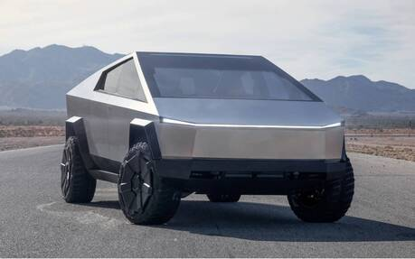
Reinforcement Learning
State changes, rewards
Observations
Actions
Steering wheel, gas pedal.
The agents goal is to learn a policy that will maximize its total expected reward.

Slide 4

Challenges with RL IRL
In real life, negative outcomes can have severe consequences.
Simulation allows the agent to learn from bad experiences without the consequences.
Simulation also lets us speed up time. Years of training can be accomplished in days.
We need simulators that represent the real word as much as possible to make knowledge transferrable!
There is active research going into creating “photo realistic” self driving simulators.
MIT plans to open source one they created soon!
VISTA: http://www.mit.edu/~amini/vista/

Slide 5
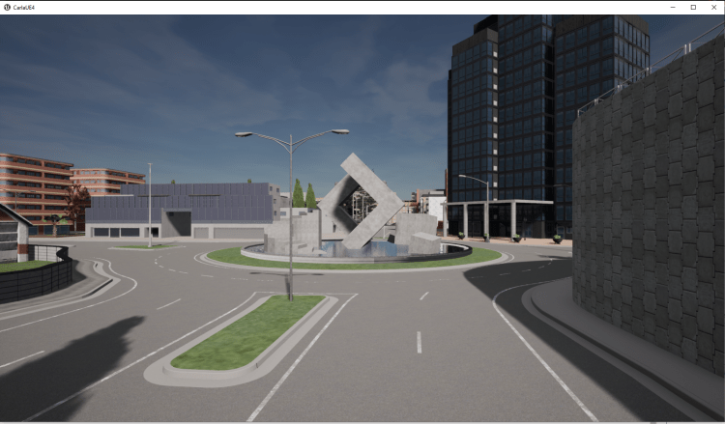
CARLA – Open source simulator
Powered by the UNREAL game engine.
Includes a wide range of sensors (Several different camera types, LIDAR, etc.)
Interfaces easily with python.
Write code that will receive real time sensor data and send vehicle commands.
https://carla.org/

Slide 6
Reinforcement Learning terminology
Policy (π): A system for determining what action to take based on observations of the environment, learned by the agent.
Reward: A signal sent from the environment to the agent. The agents objective is to take actions that maximize its total reward.
State value: The total (discounted) expected reward after being in a particular state.
State-action value Q(s,a): The total (discounted) expected reward after taking a particular action in a particular state.

Slide 7
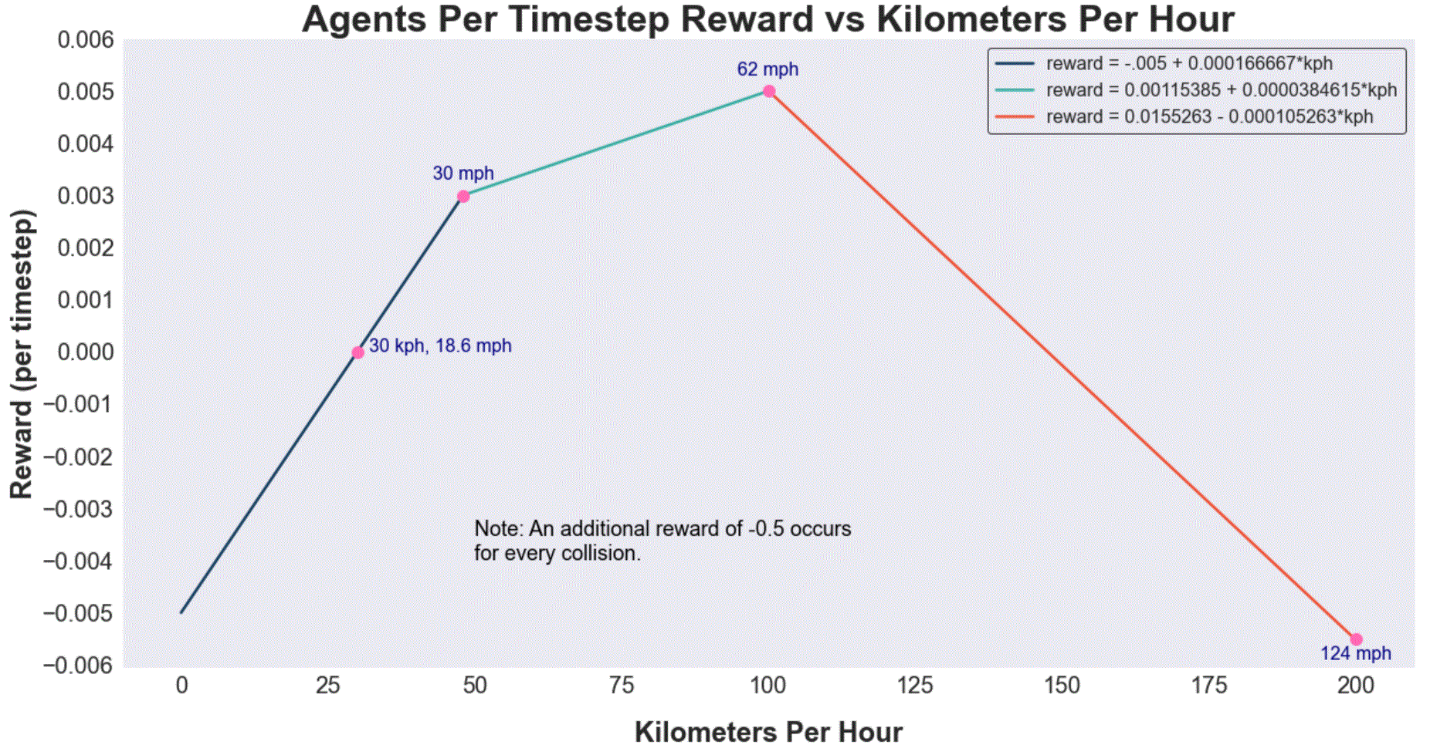
Reward design
We need to balance punishing unsafe behavior and collisions, while still incentivizing movement (don’t let the agent give up and stay still)!

Slide 8
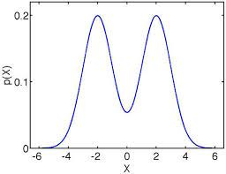
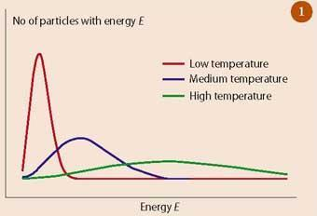
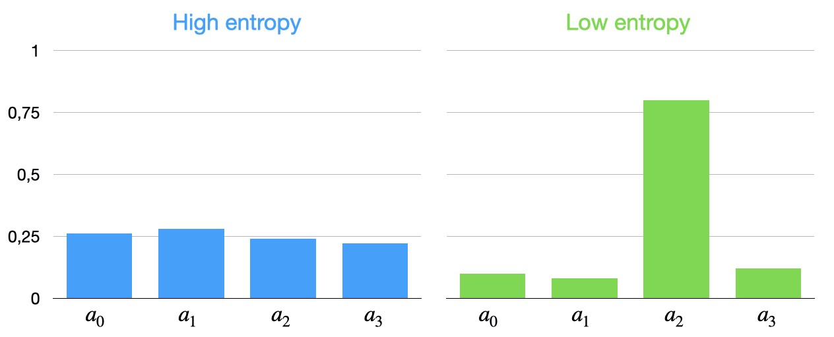
Entropy and exploration vs exploitation
We use “entropy” to refer to how unpredictable the agents behavior is. High entropy will result in better exploration of the environment.

Slide 9
Soft actor critic facts
SAC trains a stochastic policy which encourages exploration. However stochastic policies by themselves will eventually converge towards determinism. This is why SAC uses other exploration methods as well.
The word “soft” comes from fact that the algorithm uses entropy regularization.
Goal is to maximize reward while being as unpredictable as possible. This helps facilitate exploration. (This is different than the standard RL objective).
SAC is an off policy algorithm (utilizing a replay buffer) which helps make it sample efficient.
The algorithm concurrently learns a policy, and two Q-functions.

Slide 10





Soft Actor-Critic
Critic2
(state-action) values
$$state action$$
$$values$$
Actions
Shared convolutional
backbone
Actor (Policy)
π
$µ_{t, }$ $µ_{b, }$ $µ_{s}$
State
(images)
Actions
$$σ_{t}, σ_{b} σ_{s}$$
Critic1
(state-action) values
$$state action$$
$$values$$
Actions
$$Updated with polyak \left(exponential\right) averaging$$
$$\left(not gradient descent\right)!$$
Replay Buffer
(state, action, reward, next_state, done)
Target Critic 1
Target Critic 2

Slide 11
Next steps
Get more compute power, which will allow me to:
1. Perform more reasonable length tests. (10k + episodes).
2. Scale image size up and use multiple stacked images as the state representation at each timestep (show motion)
3. Add automatic temperature adjustment (creating a network and loss for the entropy parameter, alpha).
4. Consider increasing complexity by using additional inputs with more diverse sensor types (e.g. LIDAR).

Slide 12
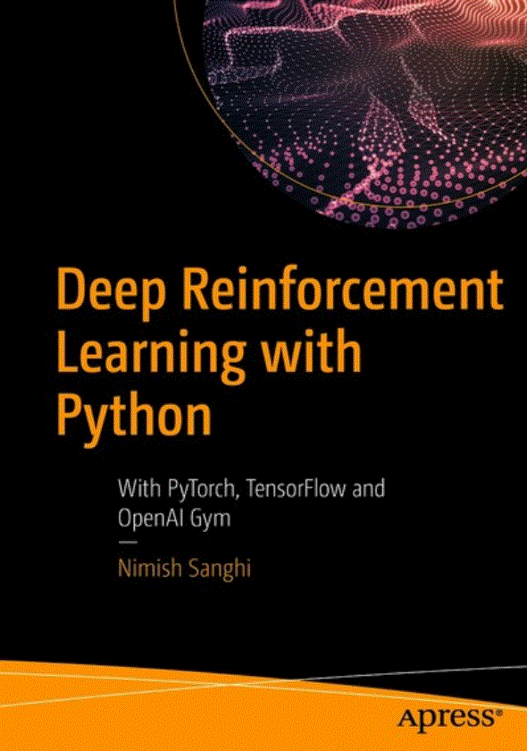
References
OpenAI Spinning up library: https://spinningup.openai.com/en/latest/algorithms/sac.html#soft-actor-critic
This book! (Possibly free with library: https://learning-oreilly-com.ezproxy.spl.org/home/ )
Pythonprogramming.net (Great intro the CARLA, not the best for RL).
Supervised learning wants to work, reinforcement learning must be forced to work… even if its all tuned well you’ll get a bad policy 30% of the time just because.
-Andre Karpathy

Slide 13
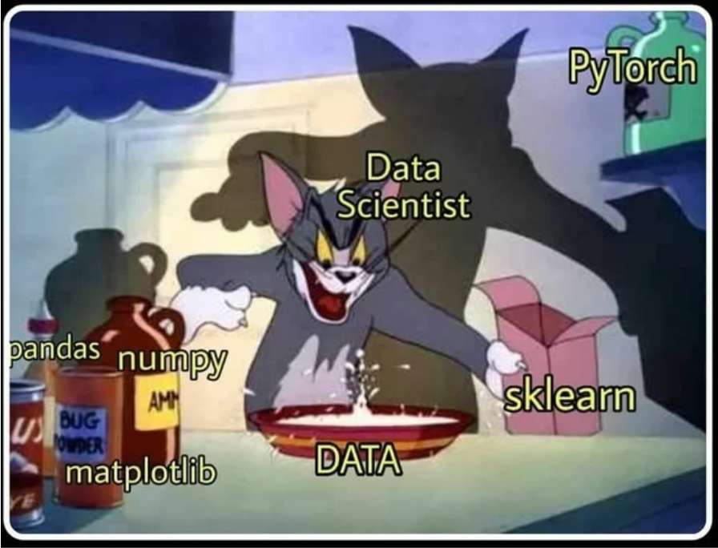
Thanks for listening, I hope you enjoyed the project!

Slide 14


SAC objective
Standard RL Objective
Soft Actor Critic Objective

Slide 15
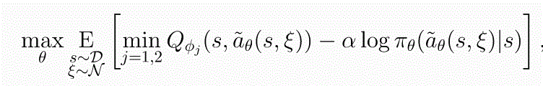
Actor (Policy) loss
Recall Soft Actor Critic Objective
Expected value over the samples taken from the buffer
Our current estimate of the state-action value, where the state is from the buffer
The weights of the actor network that maximize…
Action sampled fresh from the policy
Also maximize the expected entropy.
Expectation over samples from the parameterized policy has been reparametrized to an expectation over normally distributed random noise.
We don’t want the expectation to depend on the same variable we need to take the gradient w.r.t.
min to mitigate overestimation bias

Slide 16
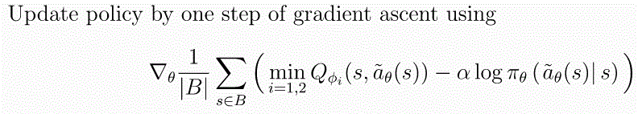
Actor (Policy) loss part 2

Slide 17
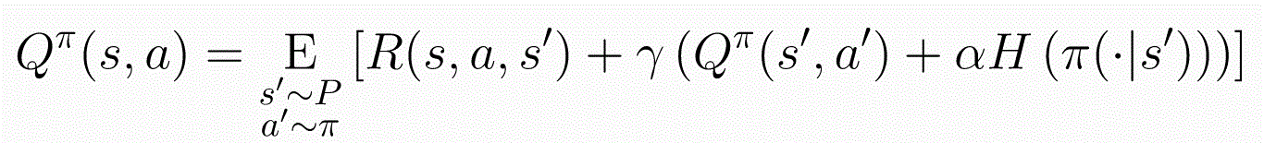
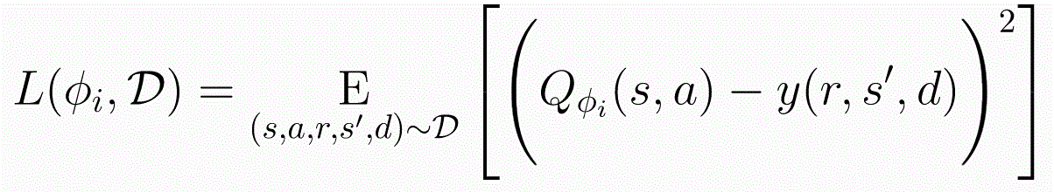
Critic loss
Bellman equation for entropy regularized RL
Rewriting the expectation and entropy term
Q-Loss

Slide 18
Additional terminology
Model based: Methods that require a model of the environment. i.e. we need to know the transition probabilities associated with each action we can take.
Model free: Methods to use when we do not know the environment transition dynamics, or we know the dynamics, but it is much more practical to sample than to calculate transition dynamics at each time step.
Bootstrapping: Using future values of a quantity when calculating its current value.
Off policy: The policy being used to generate samples (behavior policy) is different than the one being optimized (target policy). The important point here is that off policy algorithms can use replay buffers, and therefore can be more efficient.

Slide 19

Dynamic programming and bellman expectation
1
The actions our policy could have us take in that state.
3
The immediate reward and the (discounted) value of the next state.
The value of state S when following policy π, depends on…
2
The next states the environment might send us to as a result of those actions.
Dynamic programming lets us express the value of a state recursively!
BUT… we need to know the transition dynamics!

Slide 20
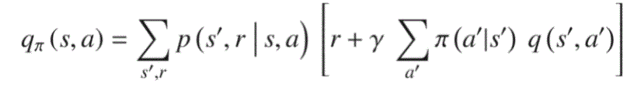
Dynamic programming and bellman expectation
1
2
The environment transition dynamics
The immediate reward received
The value of state action pair (s, a) when following policy π, depends on…
3
The value of all subsequent states our policy could take us to
We can express the value of a state, action pair in terms of future state action pairs!
BUT… we need to know the transition dynamics!

Slide 21
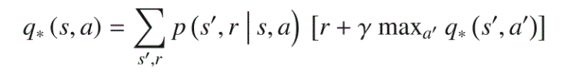
Bellman optimality

Slide 22
Value iteration algorithm

Slide 23
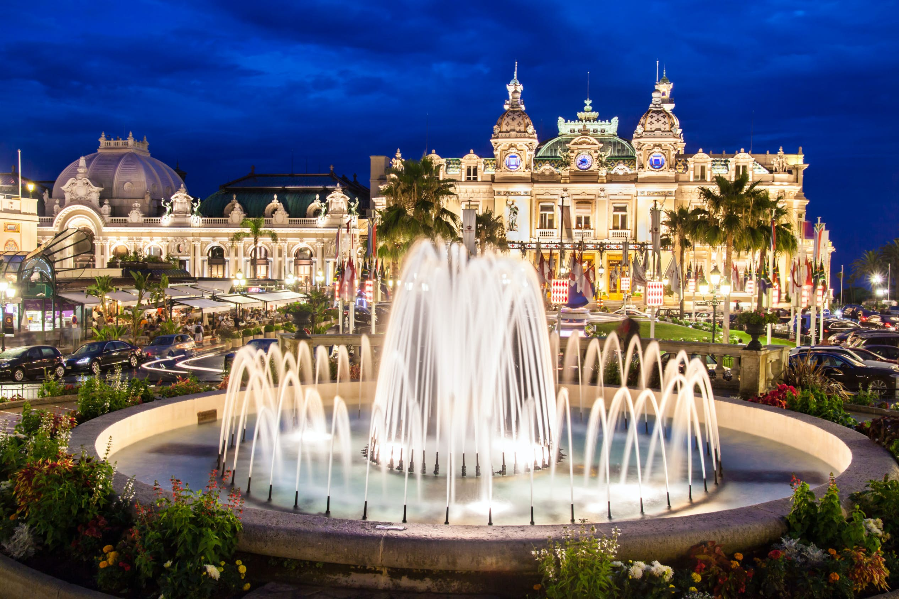
What if we don’t know transition dynamics?
Monte Carlo Estimation!
Estimation through sampling trajectories.
Can only update estimates at the end of episodes.
Does not work for non-episodic tasks.
Can require lots of samples, and as a result be slow.

Slide 24
Temporal difference learning

Slide 25
Safety
https://www.rand.org/pubs/research_reports/RR1478.html
Need to get cars on the road to ever get enough testing to show safety level.
Can take a safety approach like Aerospace. Don’t compete on safety, international cooperation.
LOOK AT THE TROLLY PROBLEM!
Each human starts off as a terrible driver and gets better. In 20 years time we may be able to get into a driverless car that has the benefit of the experience of all the driverless cars that have come before it. Human will never have that benefit.
Supervised learning wants to work, reinforcement learning must be forced to work
-Andre Karpathy

